Slide 1
Various Studies at the CBETA
4-Turn FFA ERL
Including halo, quad centering, TOF correction, degaussing

Slide 2
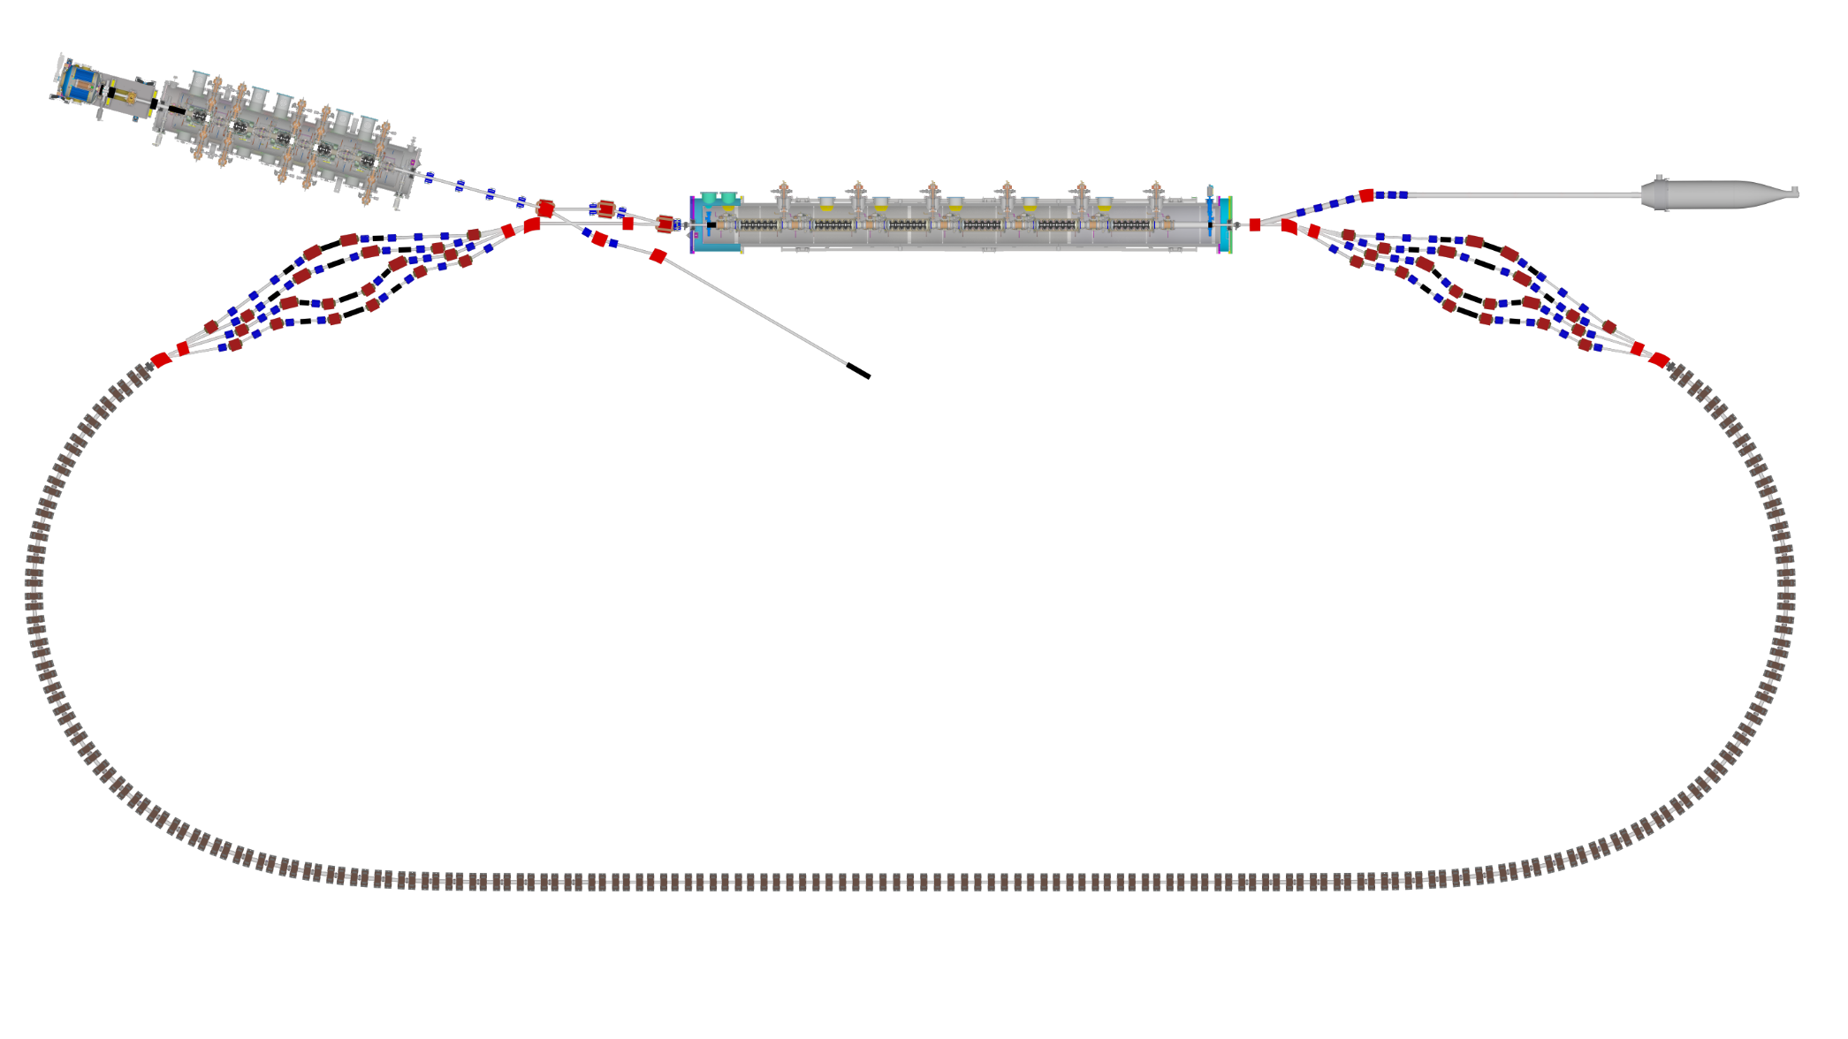

Layout & Parameters
Main linac is a 1.3GHz SCRF module with six 5-cell cavities
Source
±36MeV
Beam stop
Main linac cryomodule
Injector cryomodule
6MeV
6MeV
Diagnostic line
Splitter B
Splitter A
42,78,114,150MeV
Arc A
Arc B
42-150MeV
Transition B
Straight
Transition A

Slide 3
Fixed-Field Return Loop Optics
Beams with 4x rigidity range transmitted through same overall radius of curvature in arcs
Adiabatically merged to zero curvature, separation in straights
Beam cell tune decreases as a function of energy

Slide 4
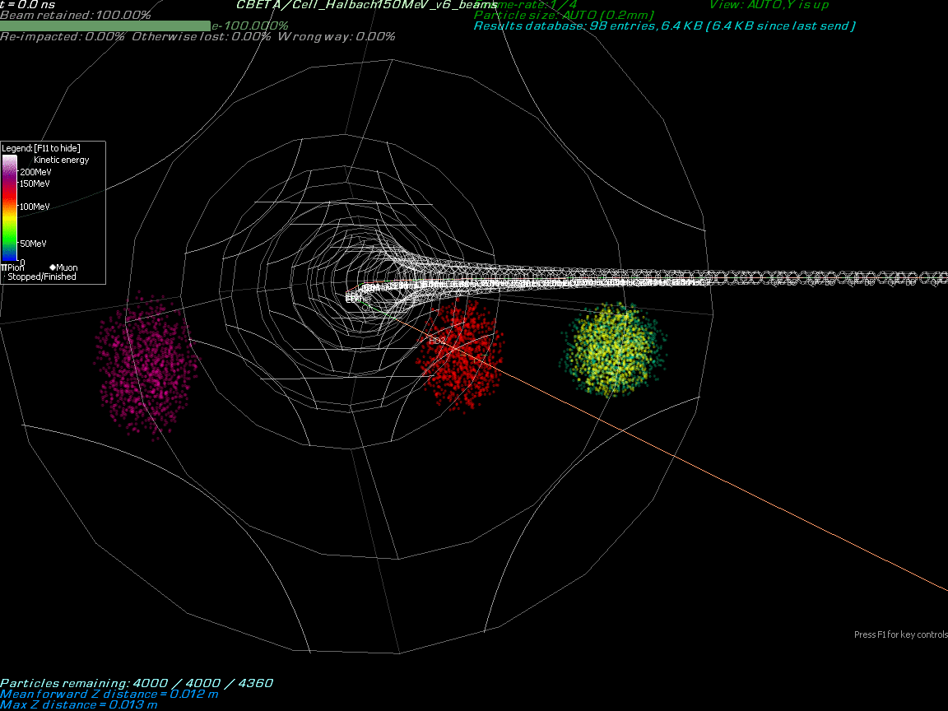

Slide 5
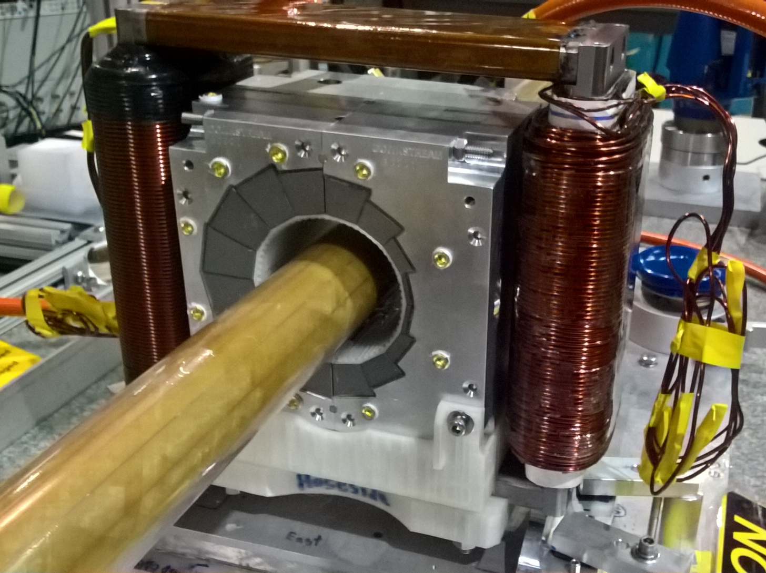
Permanent Magnet Design
Halbach design made of NdFeB material
This is a combined dipole+quad
Being measured on rotating coil at BNL
3D printed multipole corrector pack inside
Windowframe corrector coil outside
Temperature stabilised by water (orange hoses)

Slide 6
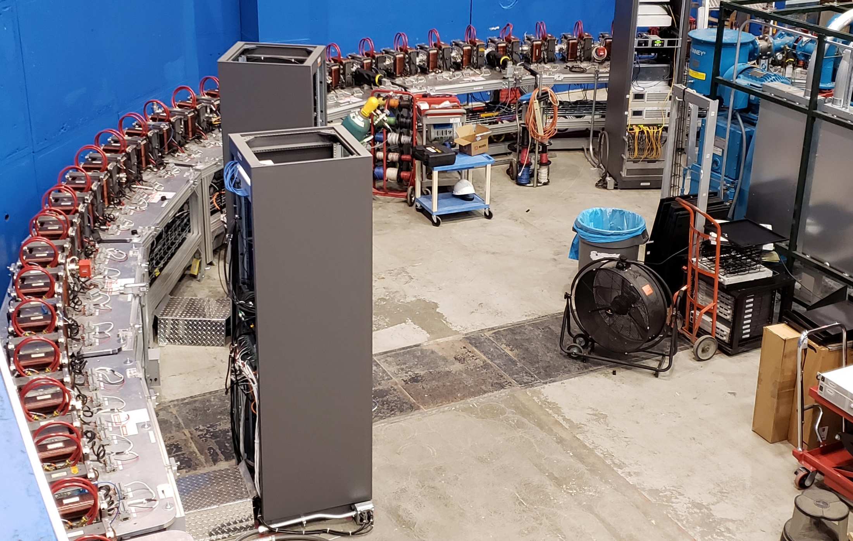
Fixed-Field Return Arc

Slide 7
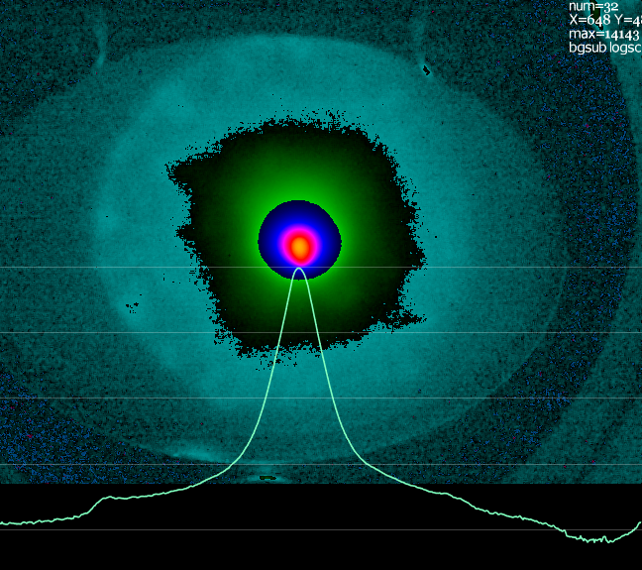
Possible Halo after Injector
3×10⁻⁴ relative intensity
~100x beam core area
About 3% of total charge
Probably from photocathode
(April 17, 2019)
Selectively-activated photocathode has been used before at Cornell to suppress this sort of thing
Collimators in the injector are possible but harder due to high beam powers

Slide 8
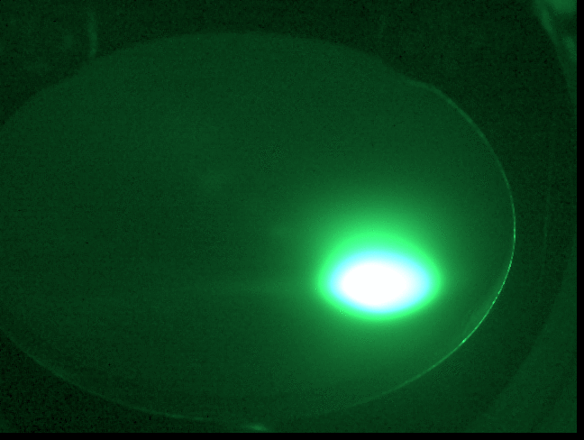
Halo reacts to quadrupole being varied, so is charged particles not camera lens flare!

Slide 9
Quadrupole Centering
If the beam is not centered in a quadrupole, changing the quadrupole strength will move the beam position on a downstream BPM
This movement will change linearly as the beam position in the quad is altered using an upstream dipole
Wrote a script taking a (dipole, quad, BPM) triple and using it to put beam in quad centre

Slide 10
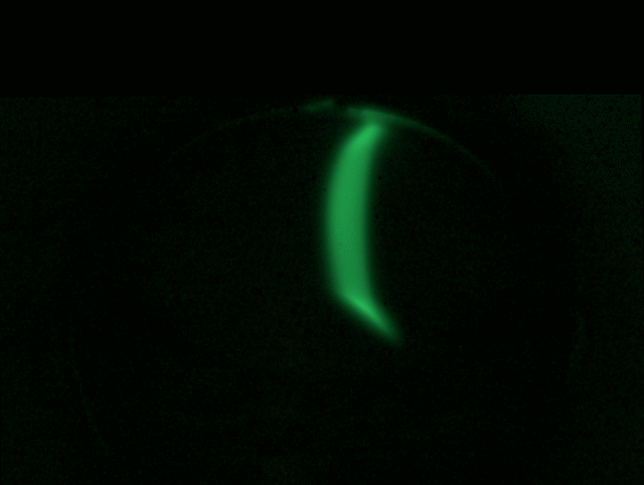
IS1SCR02-MS1QUA03_centered
Centered quad was swung through whole range, beam centre does not move no matter how far downstream the screen is

Slide 11
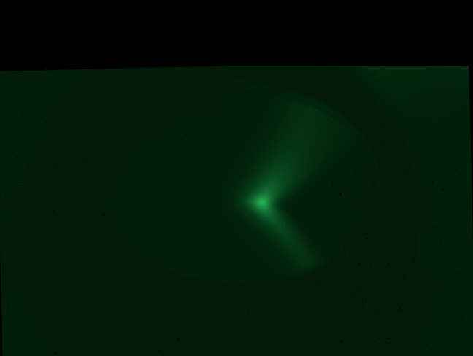
IR1SCR02-MS1QUA03_centered
Centered quad was swung through whole range, beam centre does not move no matter how far downstream the screen is

Slide 12
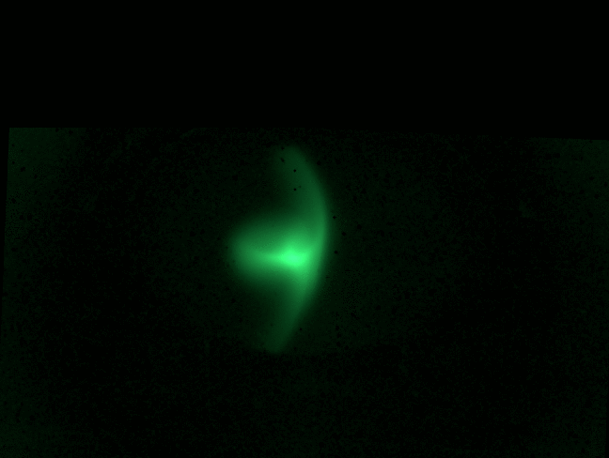
IR1SCR01-MS1QUA03_centered
Centered quad was swung through whole range, beam centre does not move no matter how far downstream the screen is

Slide 13
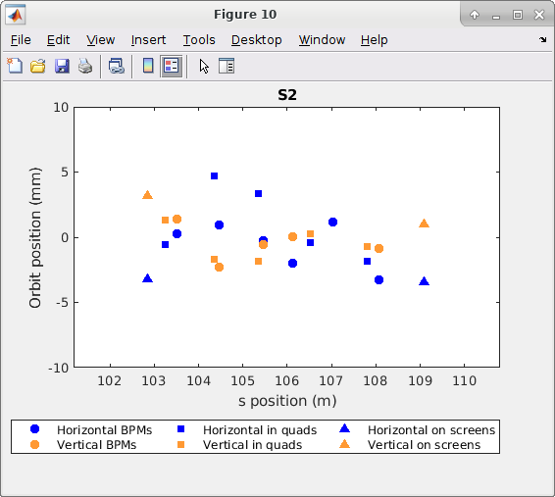
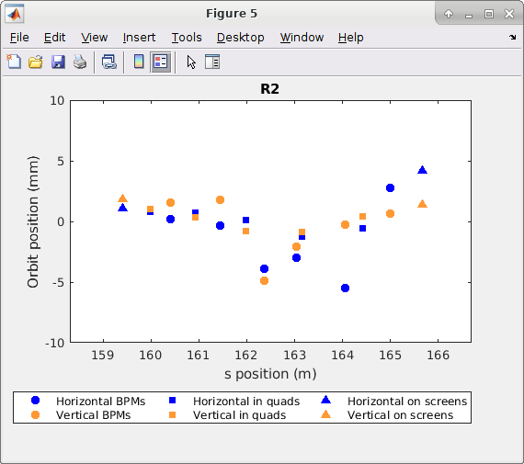
Quads as BPMs Tool
The movement of beam due to quad variation can be used to estimate the beam position in the quad, provided that there are no elements between that quad and the next BPM

Slide 14
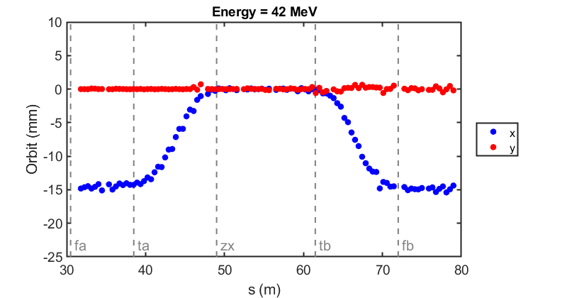
Commissioning results: orbit correction in fixed-field loop
The very first beam through the fixed-field loop on May 7, 2019
Corrected beam using section-by-section local SVD (did not converge for whole FFA)
(June 12, 2019)

Slide 15
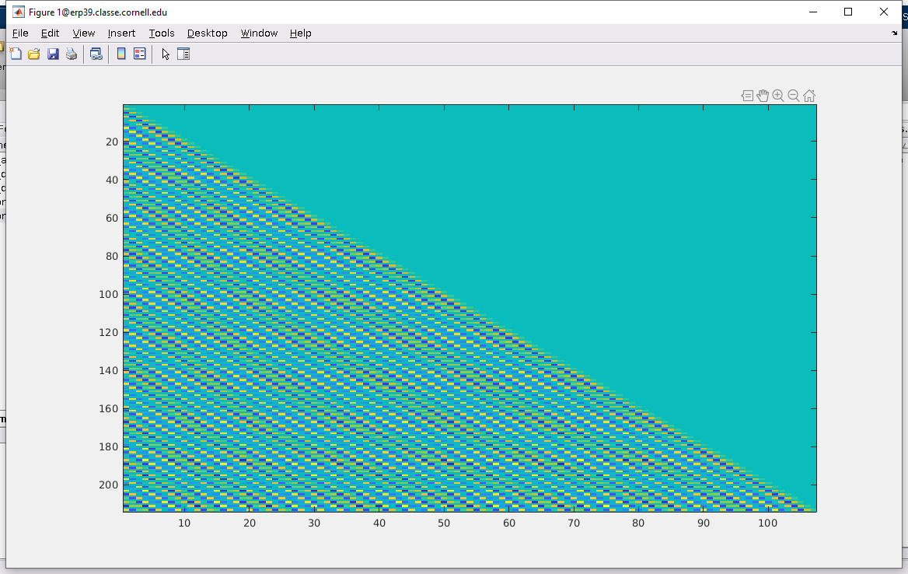
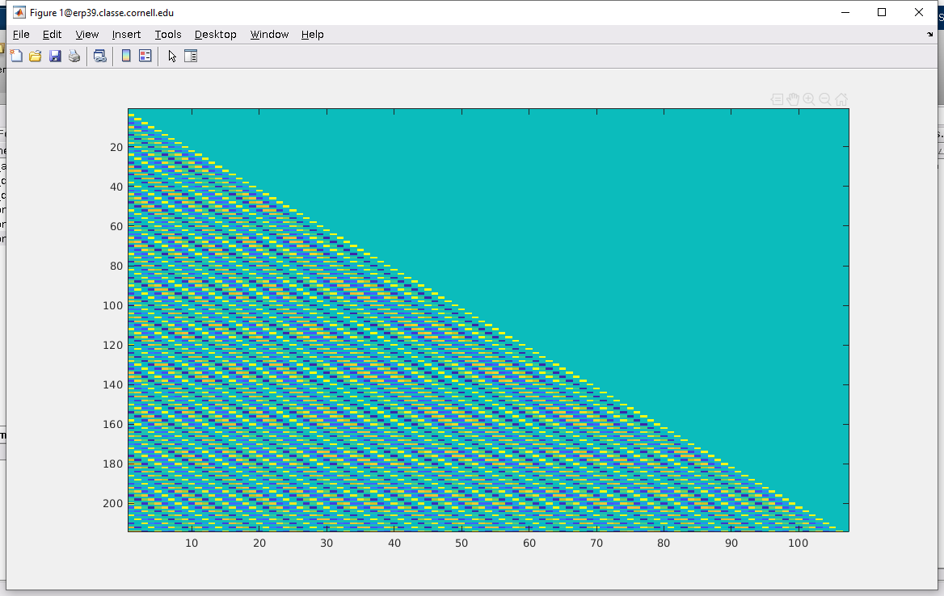
Full Response Matrices from CBETA-V
FFA correctors → FFA BPMs
One baseline setting and then one-sided differences (1+107=108 settings total)
Horizontal correctors
Vertical correctors

Slide 16
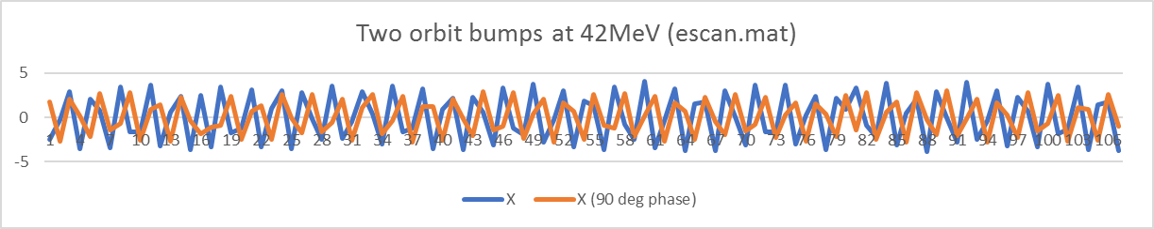
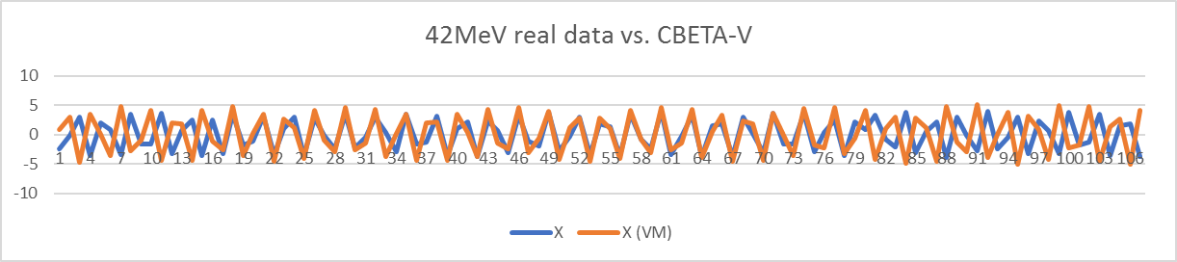
Compare to Real Data (escan.mat)
Below: CBETA-V goes in and out of phase with reality so no wonder we can’t correct globally

Slide 17
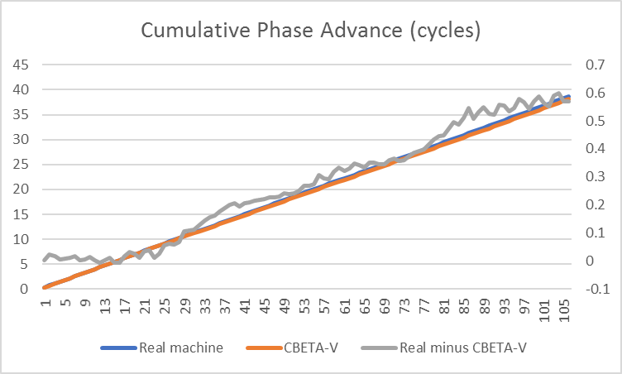
Cumulative Phase Advances
I replaced obviously bad data points by the average of their neighbours
(RHS)

Slide 18
Semi-Empirical Response Matrix
Take the oval shape from the CBETA-V response matrix
Take the phase advances from the real data
Matrix[a→b] = make_oval(sin(θ),-cos(θ))
  where θ = phase[b] - phase[a] + 0.1696 radians
    where 0.1696 radians is a fudge that I fit to get the a→a diagonal entries right, in other words the phase advance from the corrector to the same cell BPM
  make_oval is just the inverse of unoval
In this case the escan.mat used bumps made from dipoles in the splitter, whereas we want to get the response to FFA correctors like was done in the virtual machine response matrix

Slide 19
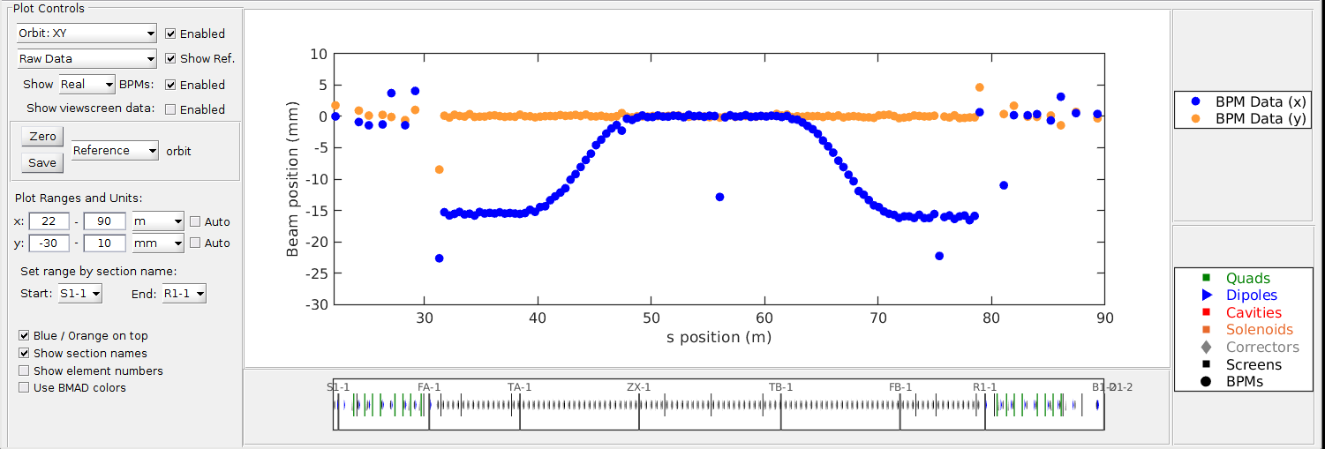
One-turn Whole-FFA SVD Correction
This used an FFA response matrix generated semi-empirically from the phase advances of the first two corrector orbit bumps in each plane
(October 24, 2019)

Slide 20
Get the 107x107 real matrices?
Scott says this takes too long
Turns out it’s OK if we only do it occasionally
  Kirsten did it in 1-2 hours
Why did we want to do this? (once)
  This will show any swapped, disconnected or backwards BPMs as “wrong-looking” rows
  Any swapped, disconnected or backwards correctors as “wrong-looking” columns

Slide 21
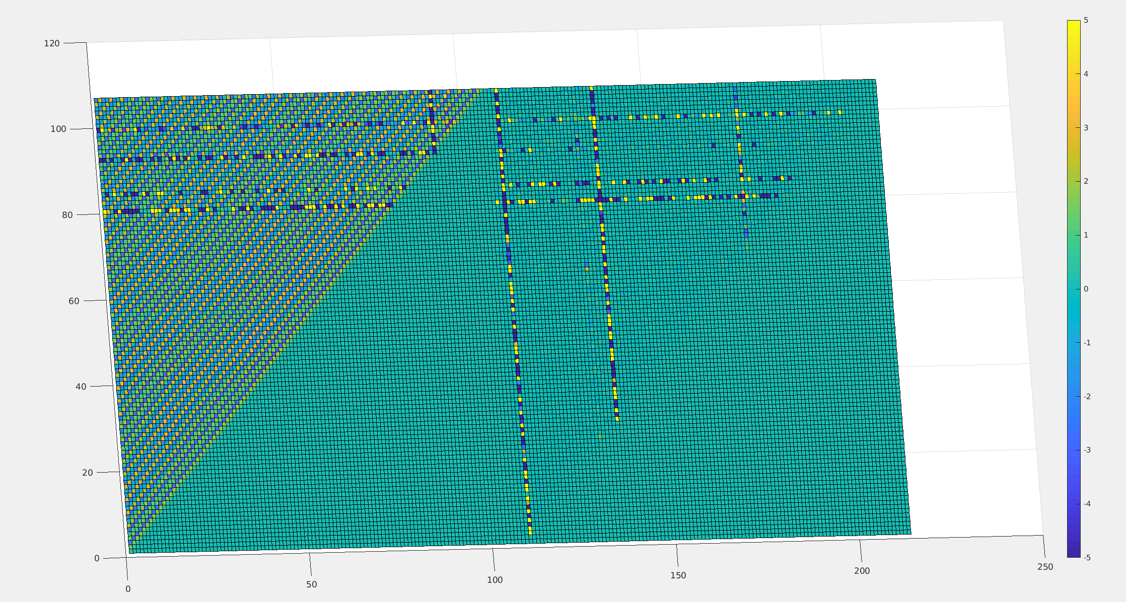
Real Machine Response Matrix
(October 25, 2019)

Slide 22
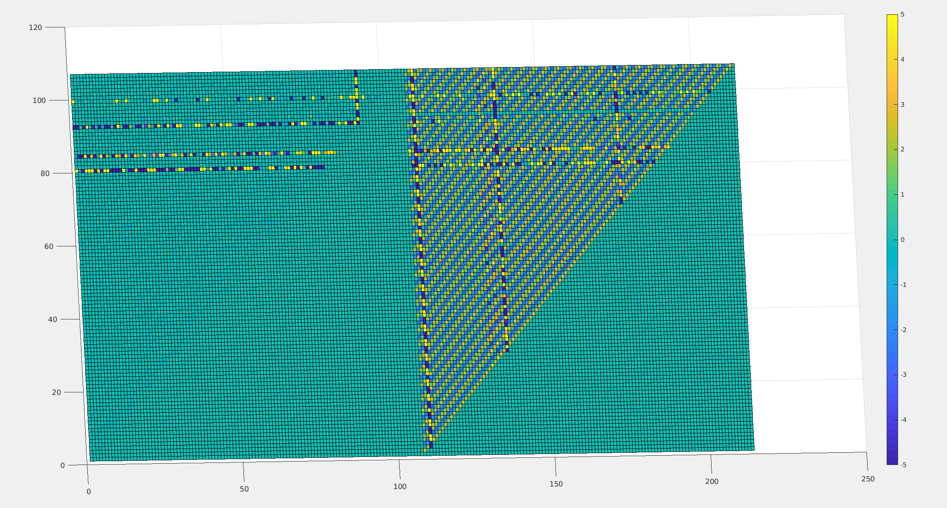
and the Y BPM Plane
(October 25, 2019)

Slide 23
Source of Tune Variation
Around Nov-07 I noticed the main source of tune variation was day-to-day variations in tunes (maybe from beam energy changes from the RF) and not section-to-section variations through the FFA line
  Wrote a program to generate artificial response matrices using just flat tunes, or flat tunes per FFA section

Slide 24
get_all_tunes
Script produces orbit bumps
  Puts in beam screens as necessary
Derives tune from the Fourier transform of the bumps
(November 7, 2019)

Slide 25
Multi-turn Response Matrix
FFA BPMs
42MeV 78MeV 114MeV 150MeV
S1
S2
S3
S4
FFA correctors
make_oval
Two S1 corrector bumps should in theory give a set of phase advances through all turns at once, including turn-to-turn advances, plus phase space oval for each turn

Slide 26
Multi-turn Response Matrix with Correction in RX Combiners
FFA BPMs
42MeV 78MeV 114MeV 150MeV
S1
S2
S3
S4
FFA correctors
make_oval
R
R
R
R
R
R
The RX lines are set to steer the beam correctly back into the MLC. Enforced this using SVD with large weights targeting the beam to its previous position in RX.

Slide 27
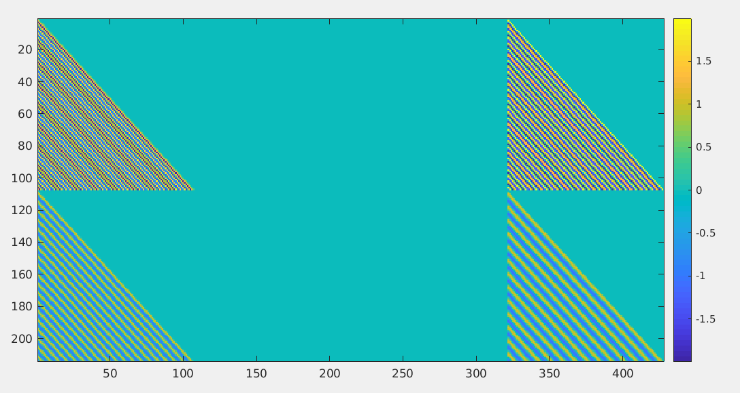
2-Turn Generated Response Matrix
x → x
Uses constant tunes
y → y
Turn 1 BPMs
Turn 2 BPMs

Slide 28
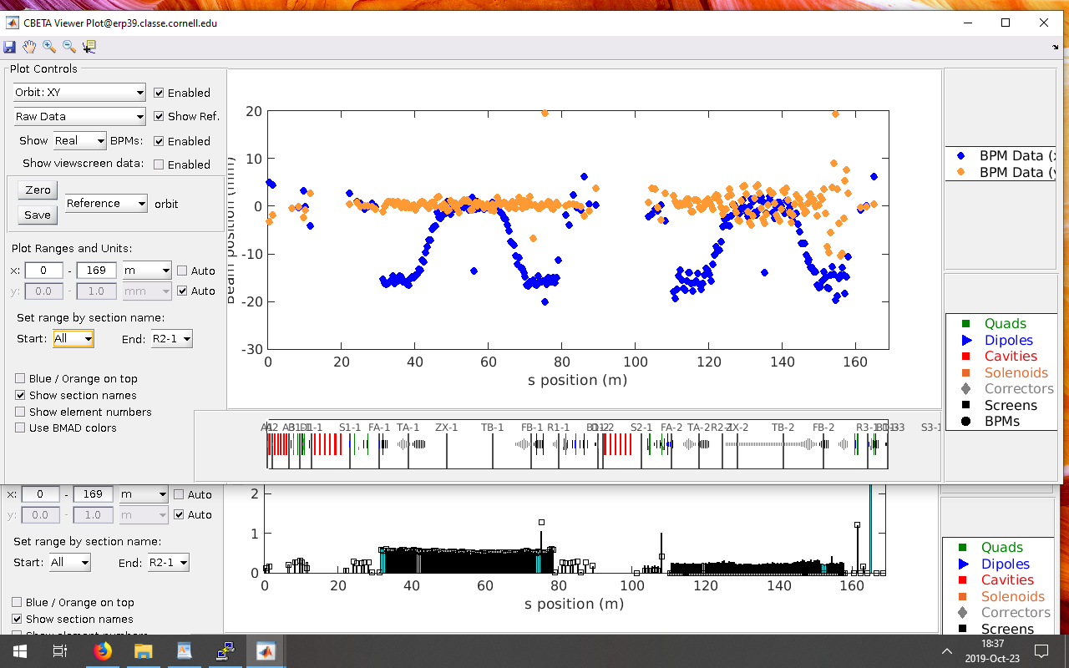
Two Turns Uncorrected
(October 23, 2019)

Slide 29
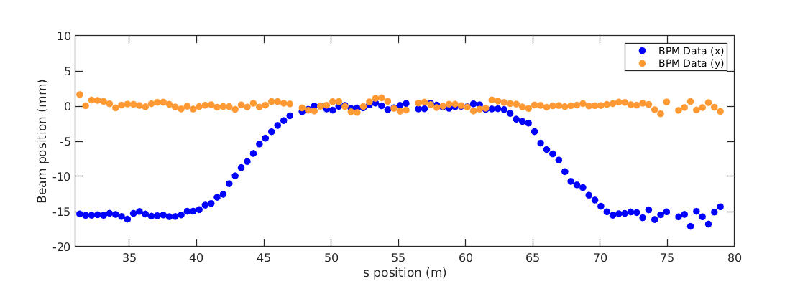
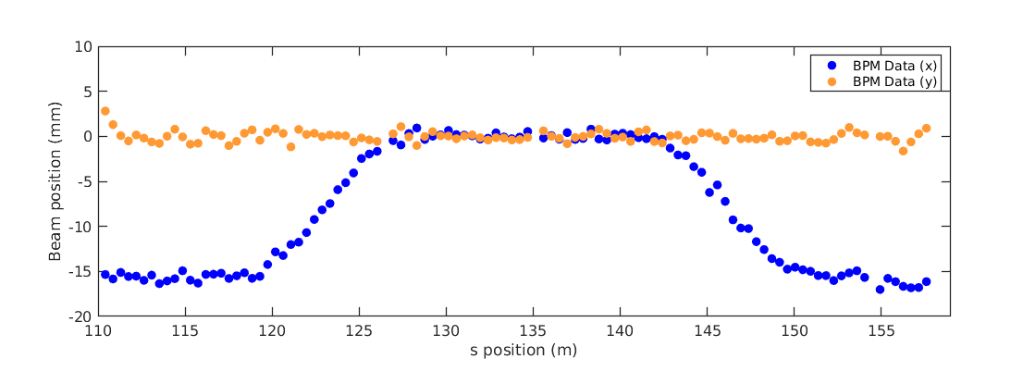
Two Turns Corrected with SVD
(November 8, 2019)

Slide 30
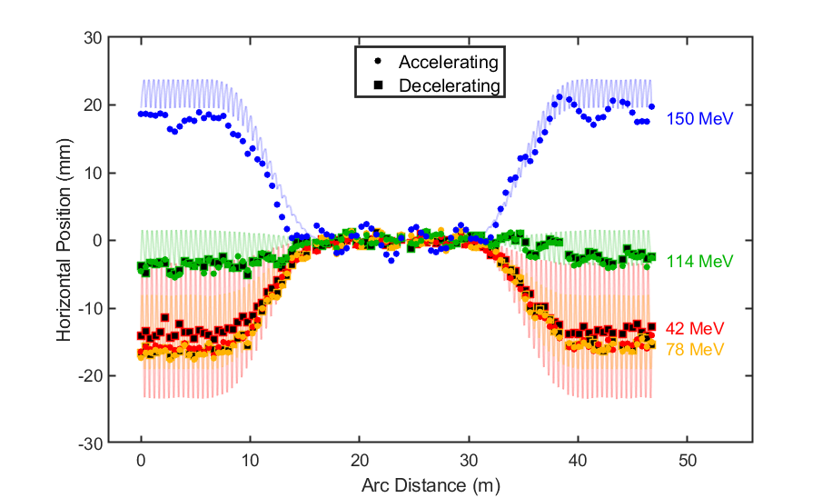
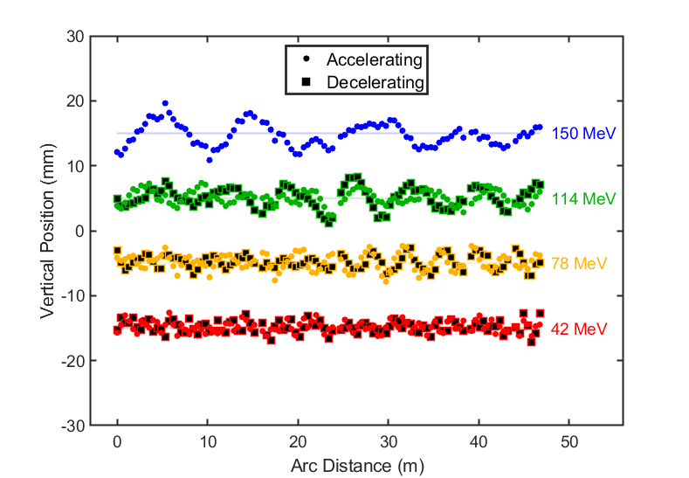
Eventually got 7-turn ERL operation with turns 1,2,3 SVD corrected

Slide 31
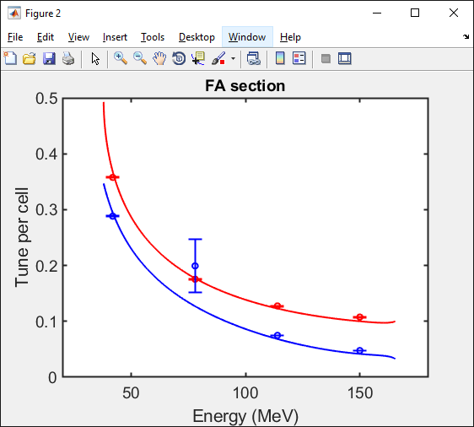
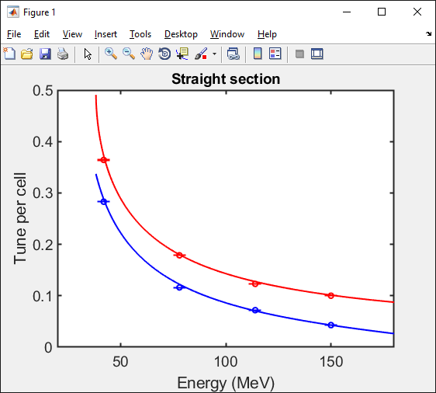
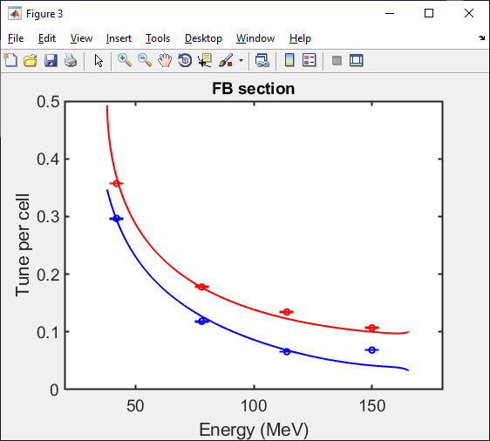
All Four Tunes Compared to Model

Slide 32
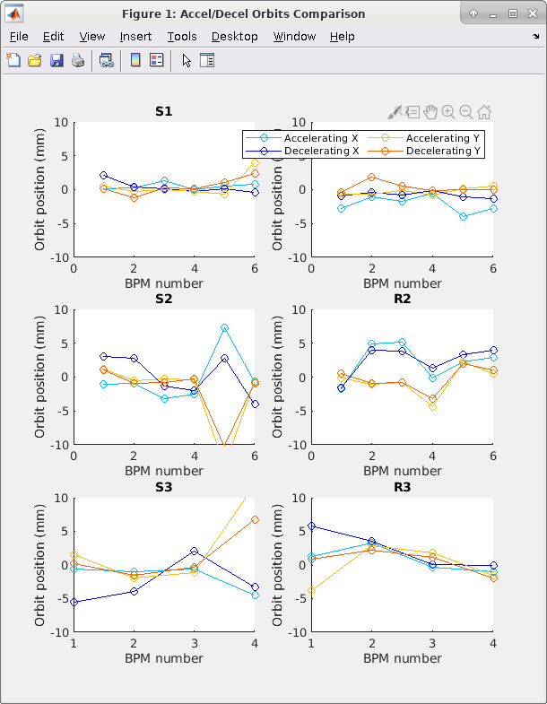
Accelerating vs. Decelerating Orbit Tool for Splitter Lines 1,2,3

Slide 33
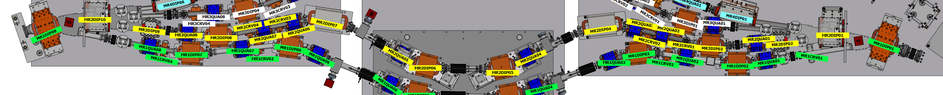
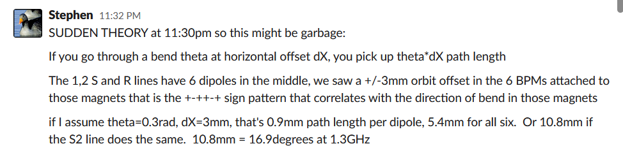
TOF Adjustment with Splitter Orbit
Had problem with beam losses in the 3rd turn
  Phase after 2nd turn appeared to be wrong

Slide 34
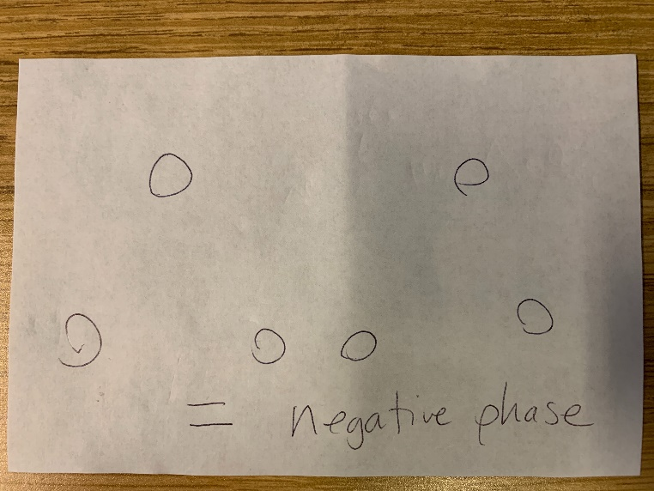
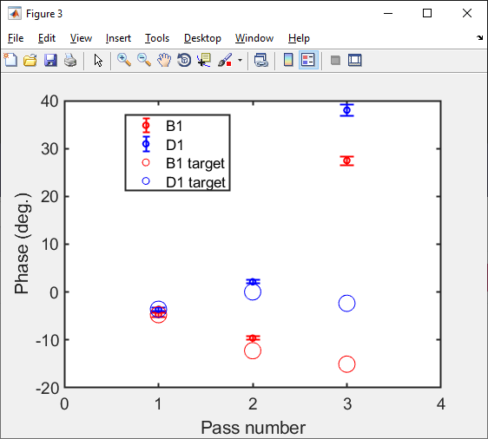
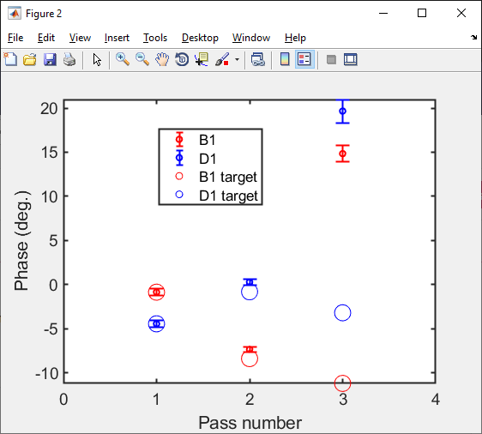
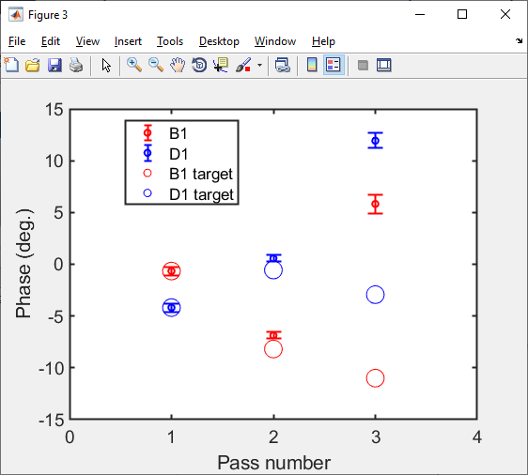
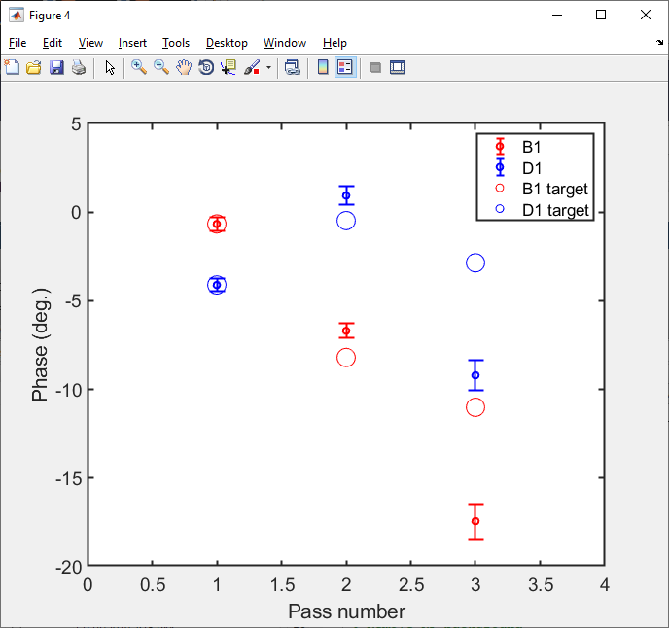
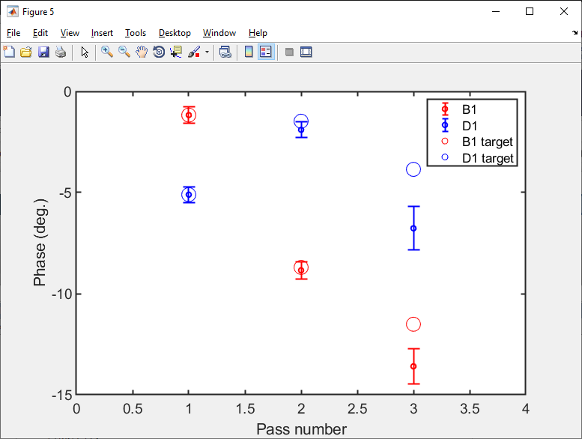
48° phase = 3cm path length added
Horizontal BPM pattern
Initial linac phases
Phases changing as orbit in S2 is steered

Slide 35
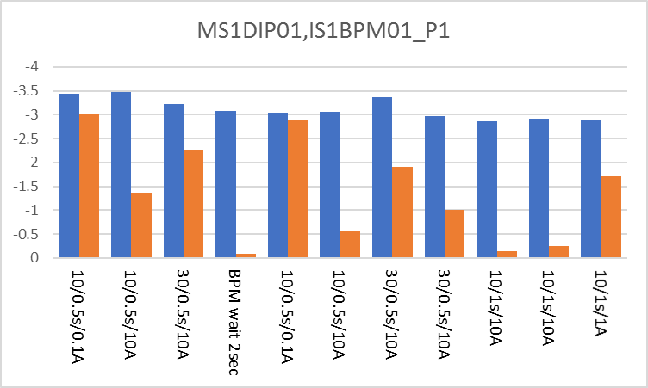
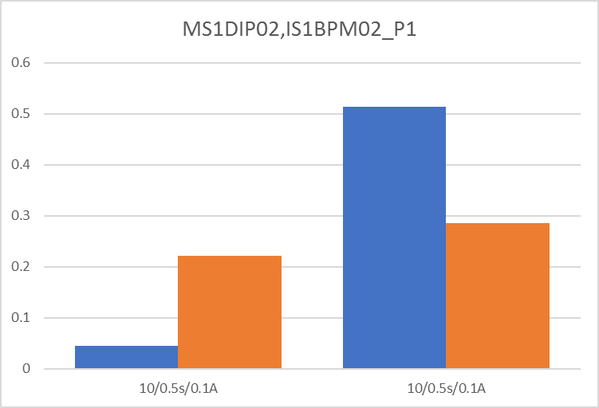
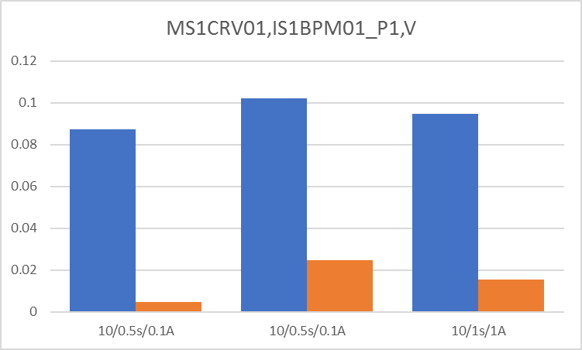
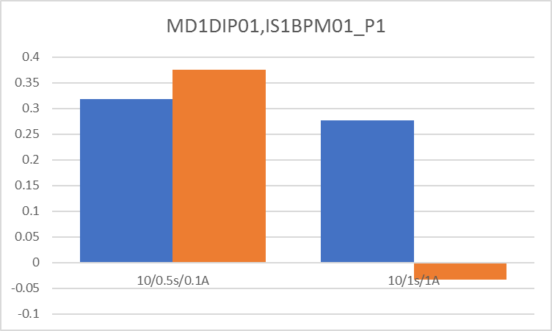
Degaussing Test of Iron Magnets
(November 5, 2019)
Tested beam screen position differences from previous dipole set from + and – directions.
Blue = without degaussing
Orange = with degaussing (various settings)

Slide 36
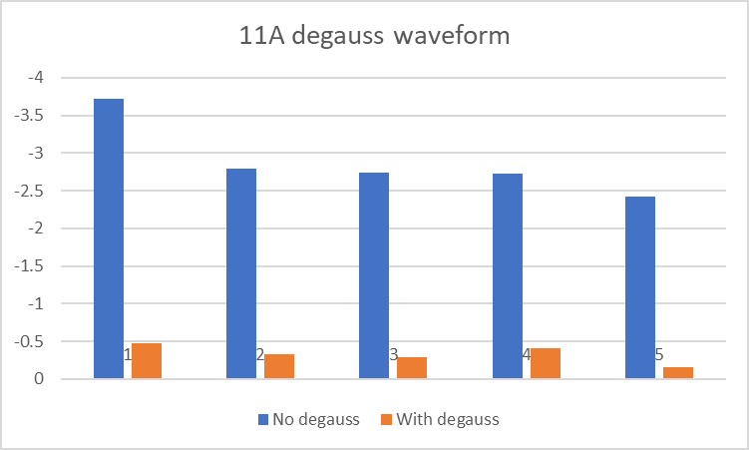
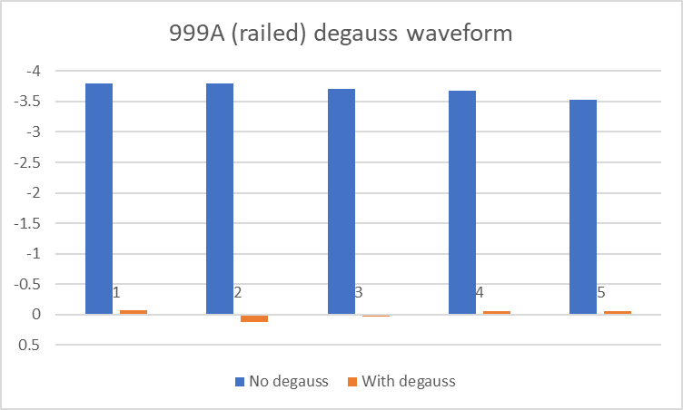
Full-Range Degauss
Had another go on Dec 4 and found using maximum power supply range works better
  However, still not good enough to restore orbit through MLC (pinhole) on machine start each day

Slide 37
Closed Orbit Bumps
(November 6, 2019)

Slide 38
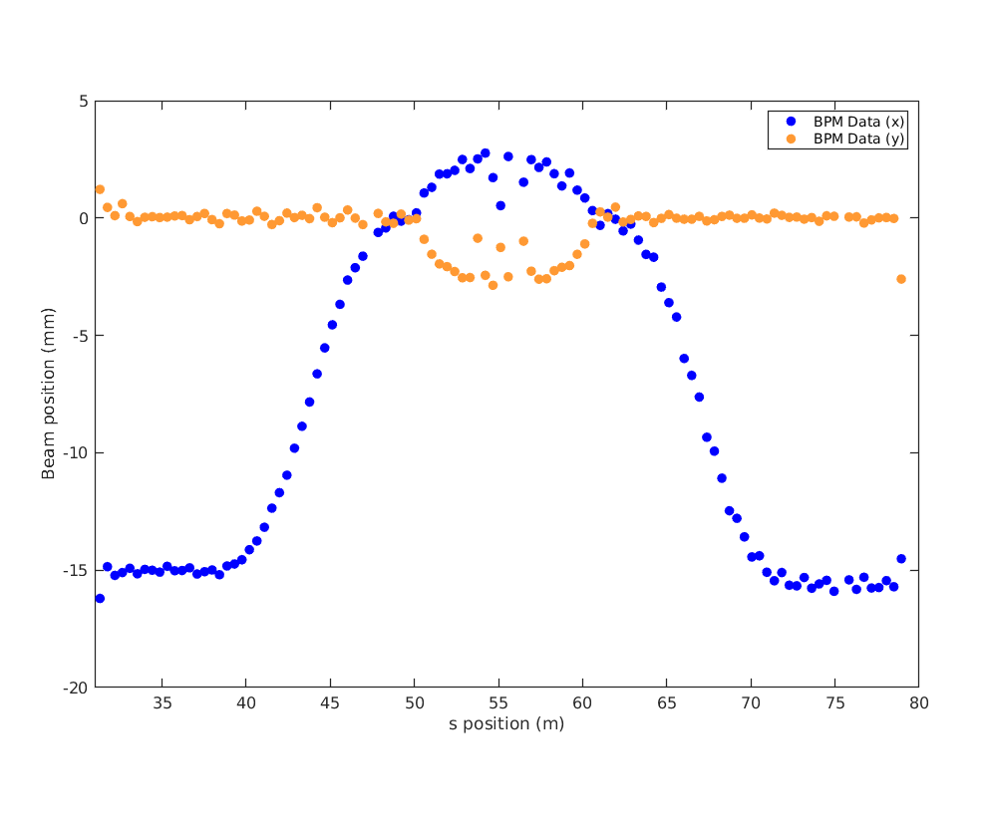
Closed Orbit Bumps (1-turn)
(November 6, 2019)

Slide 39
Operational Improvement Areas
RF trips and drifts (somewhat standard)
Machine settings not repeatable/reloadable
  Hysteresis in the iron-poled magnets
    Mainly in splitter
Machine multi-turn splitter tuning difficult
  Cross-talk between splitter lines
    Stray field from vertical corrector, open magnets
    Tuning a line affects its own “past”
    This changes the initial condition for line being tuned ☹

Slide 40
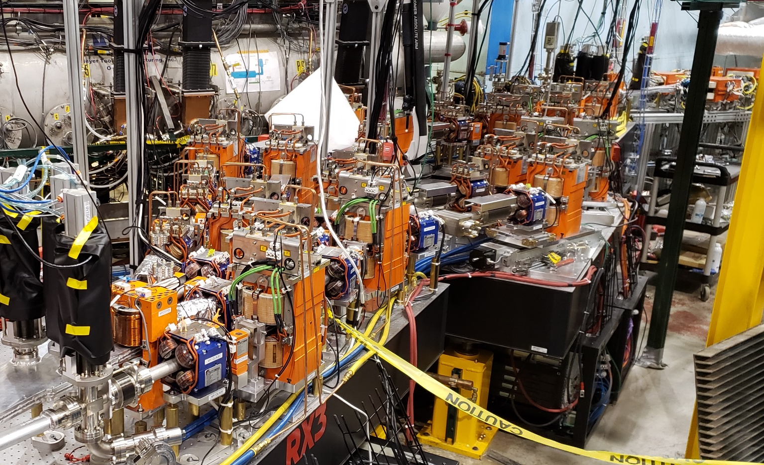
The Splitter (while under construction)

Slide 41
Remedies
Dejan: replace entire splitter by single line
  TOF correction, tuning very difficult in this scheme
Replace iron-poled magnets by mechanically-rotatable pairs of permanent magnets
  No hysteresis, only mechanical backlash
  Halbach have smaller fringe field → less cross-talk
  Expensive ~$1M+
Install Hall probes to use as field feedback
  Probably best solution in the near term
  Helps with repeatability and maybe cross-talk too

Slide 42
BACKUP

Slide 43
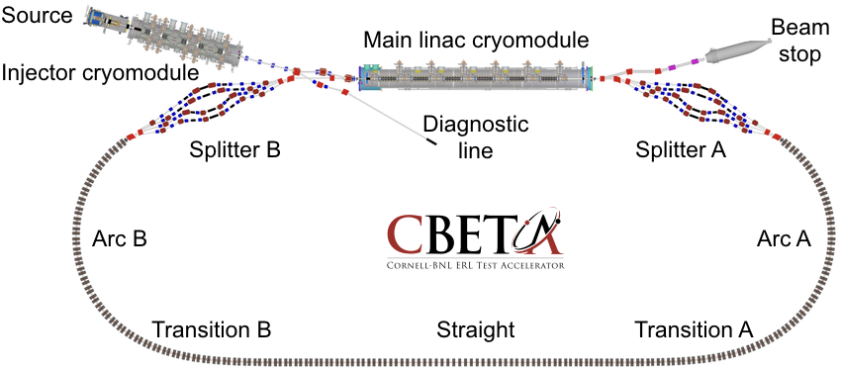
Future: CBETA Facility?
Vertical double chicane
ERL experiment
ERL experiment
RLA experiment
User experiments platform
Single-turn mode with reduced CSR and increased current 40+mA, 55MeV
High energy mode with 3 turns in fixed-field arc, 1-10mA, 200MeV

Slide 44
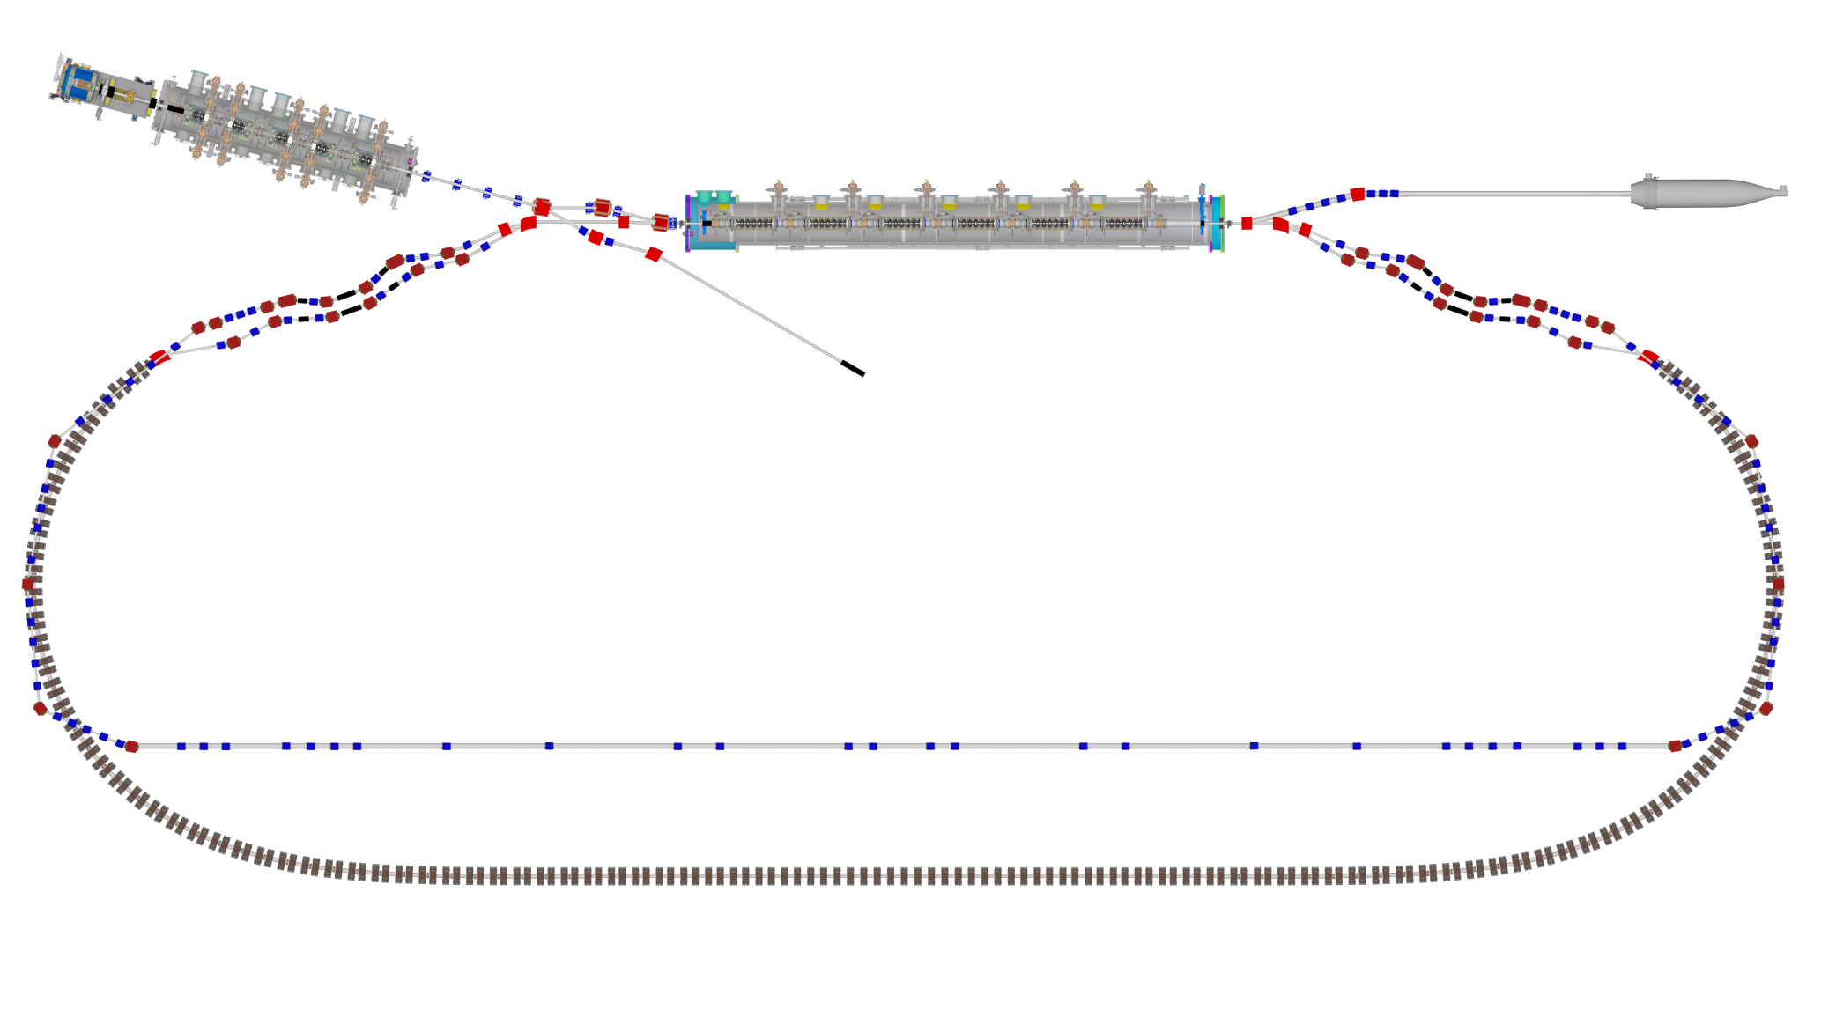
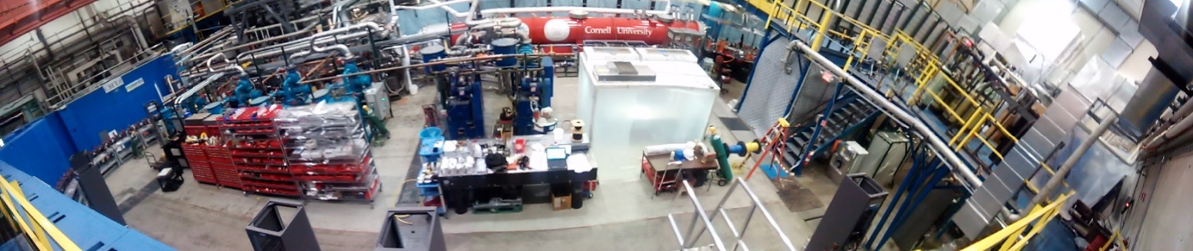
Bypass Design (Kirsten Deitrick)
Single-turn mode with reduced CSR and increased current 40+mA, 55MeV
High energy mode with 3 turns in fixed-field arc, 1-10mA, 200MeV
One possible route is for the bypass to follow above the FFA arcs

Slide 45
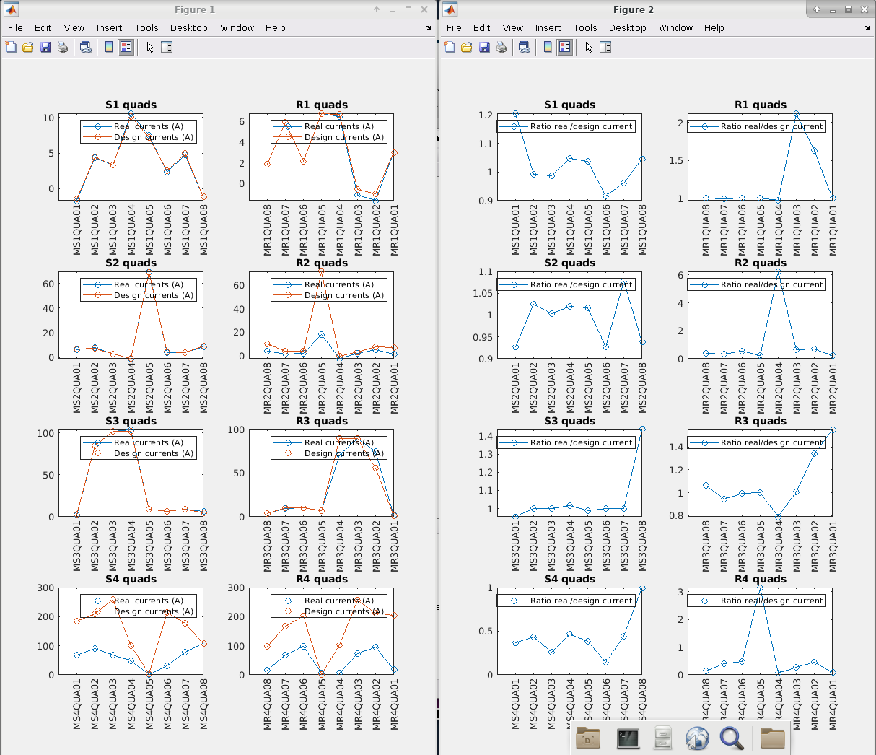
Splitter Quads vs. Design

Slide 46
Ghost Focussing in R2 Line
We could get the magnets to near design settings in most splitter lines apart from R2
Fixed:
  power supply ripple with capacitors
  a backwards-wired dipole coil
Still disagrees with model response matrix!
Tried switching quads off and swinging a dipole at start of line
  should be ~drift but got focusing in R2!
NB: no cross-talk compensation used, results could be invalid

Slide 47

1D Aperture Scan in S2 (normal)
Slope agrees with model, at least in the “good” BPM aperture near x=0

Slide 48


1D Aperture Scan in R2 (bizarre)
Response actually shrinks as you go downstream! Maybe going through the transverse field falloff of a dipole, which gives horizontal focussing.

