Slide 1
Enhanced Field Quality Halbach Magnets for Particle Accelerators
As produced for the return arc of the CBETA four-turn energy-recovery linac at Cornell University

Slide 2
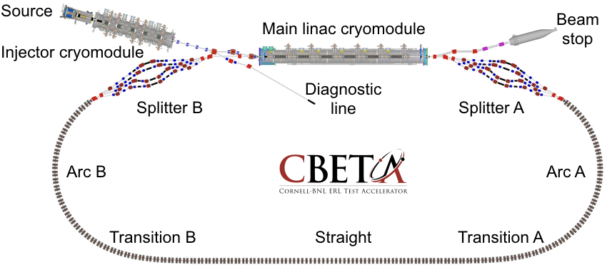
What is CBETA?
It’s a 4-turn energy-recovery linac (ERL)
  CW operation with superconducting RF
The return loop uses FFA (fixed-field accelerator) technology with permanent magnets
  Returns energies of 42-150MeV in same pipe
  “Non-scaling FFA” (linear field) focussing
    Small dispersion (few cm), short cell length (~45cm)

Slide 3
CBETA Energy Saving Technologies
Permanent magnets
Superconducting RF
Energy recovery (6 → 150 → 6MeV)
Recirculation: 4x beamline reuse, 4x energy
Funded by NYSERDA from Nov’16 to Apr’20
  (NY State Energy R&D Authority)
  $25M grant
  Cornell already had the injector & cryomodule

Slide 4
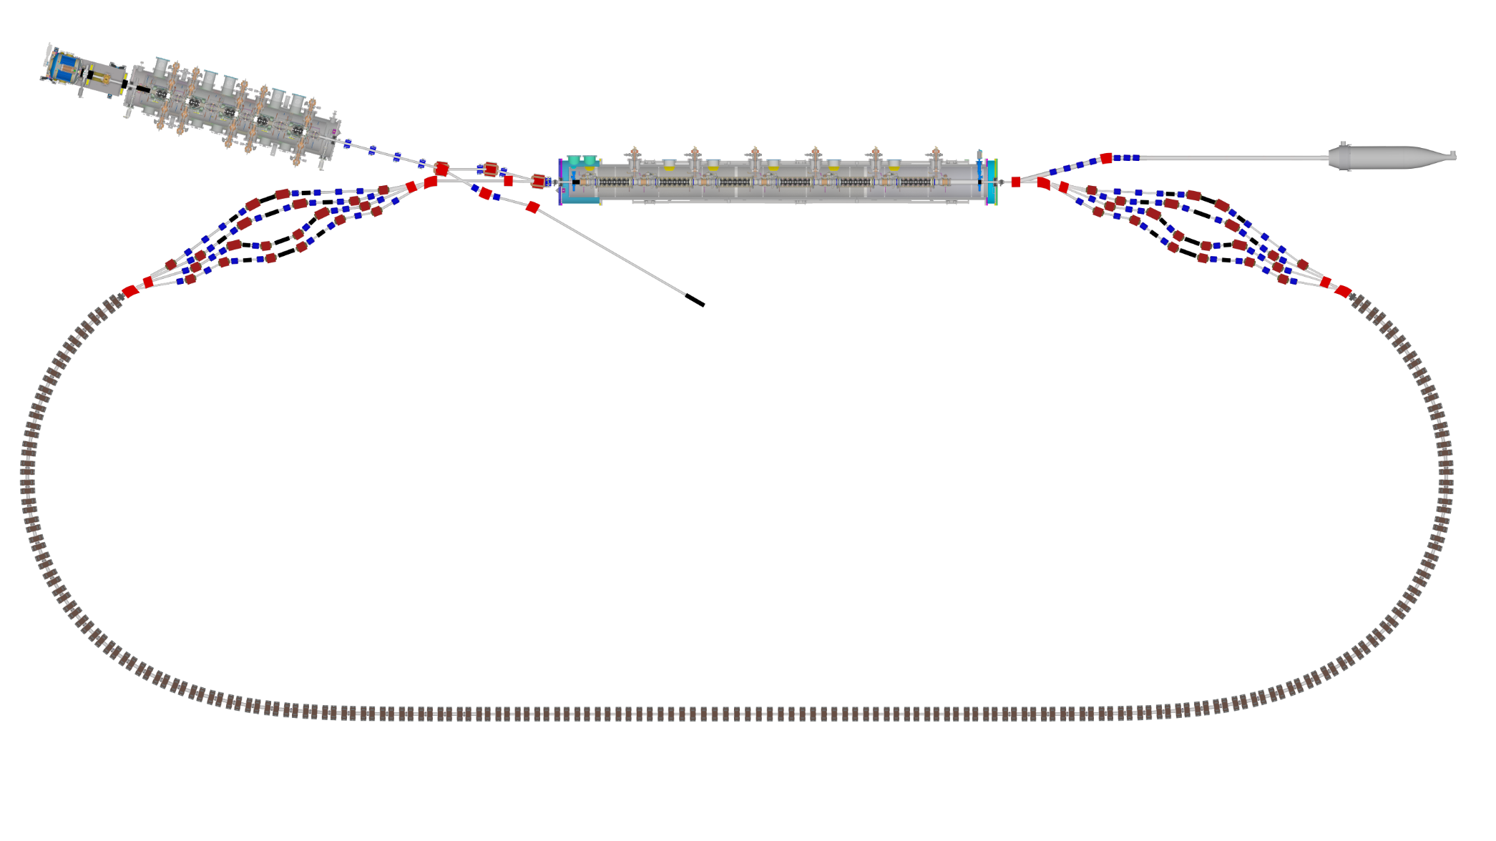

Layout & Parameters
Main linac is a 1.3GHz SCRF module with six 5-cell cavities
Source
±36MeV
Beam stop
Main linac cryomodule
Injector cryomodule
6MeV
6MeV
Diagnostic line
Splitter B
Splitter A
42,78,114,150MeV
Arc A
Arc B
42-150MeV
Transition B
Straight
Transition A

Slide 5
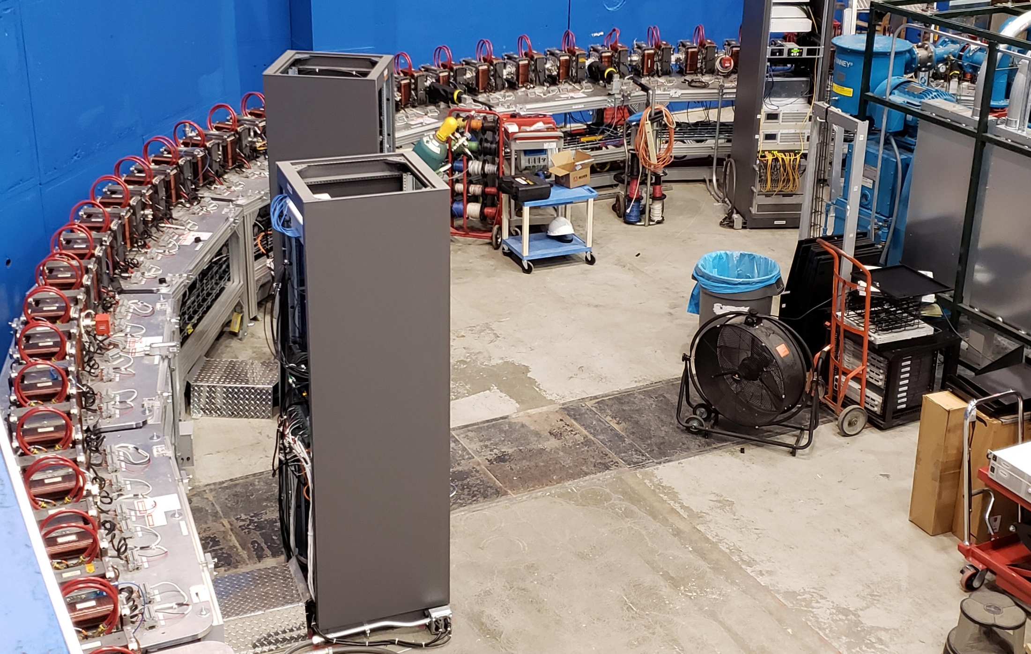
Fixed-Field Return Arc

Slide 6
Fixed-Field Return Loop Optics
Beams with 4x rigidity range transmitted through same overall radius of curvature in arcs
Adiabatically merged to zero curvature, separation in straights
Beam cell tune decreases as a function of energy

Slide 7
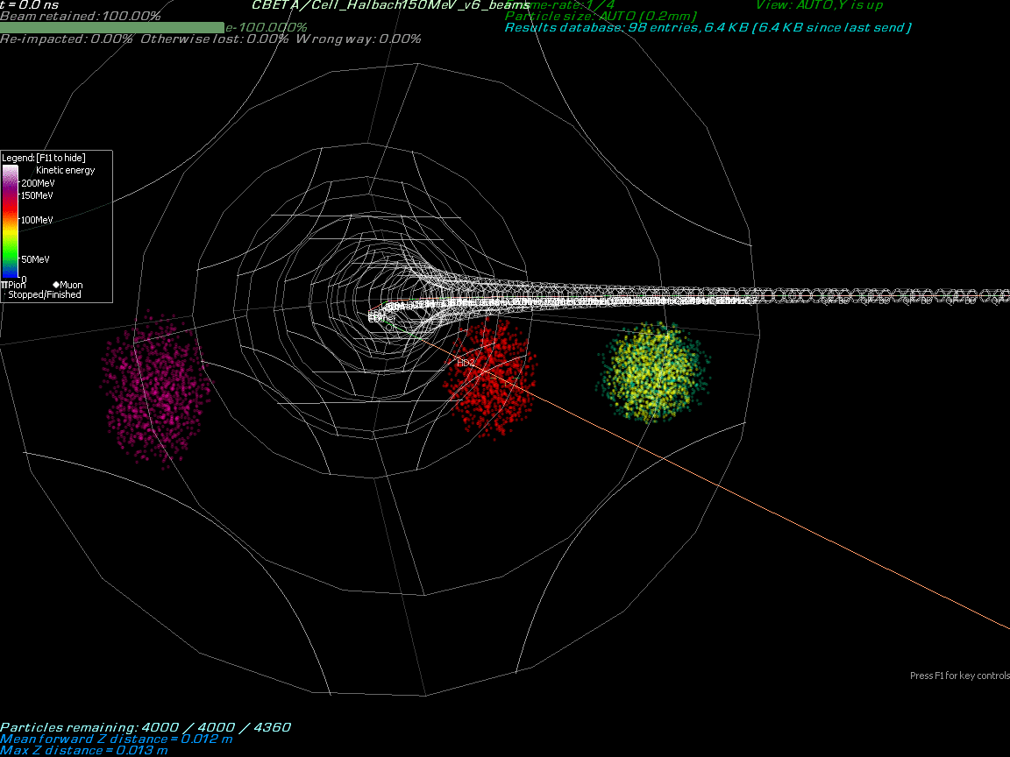

Slide 8
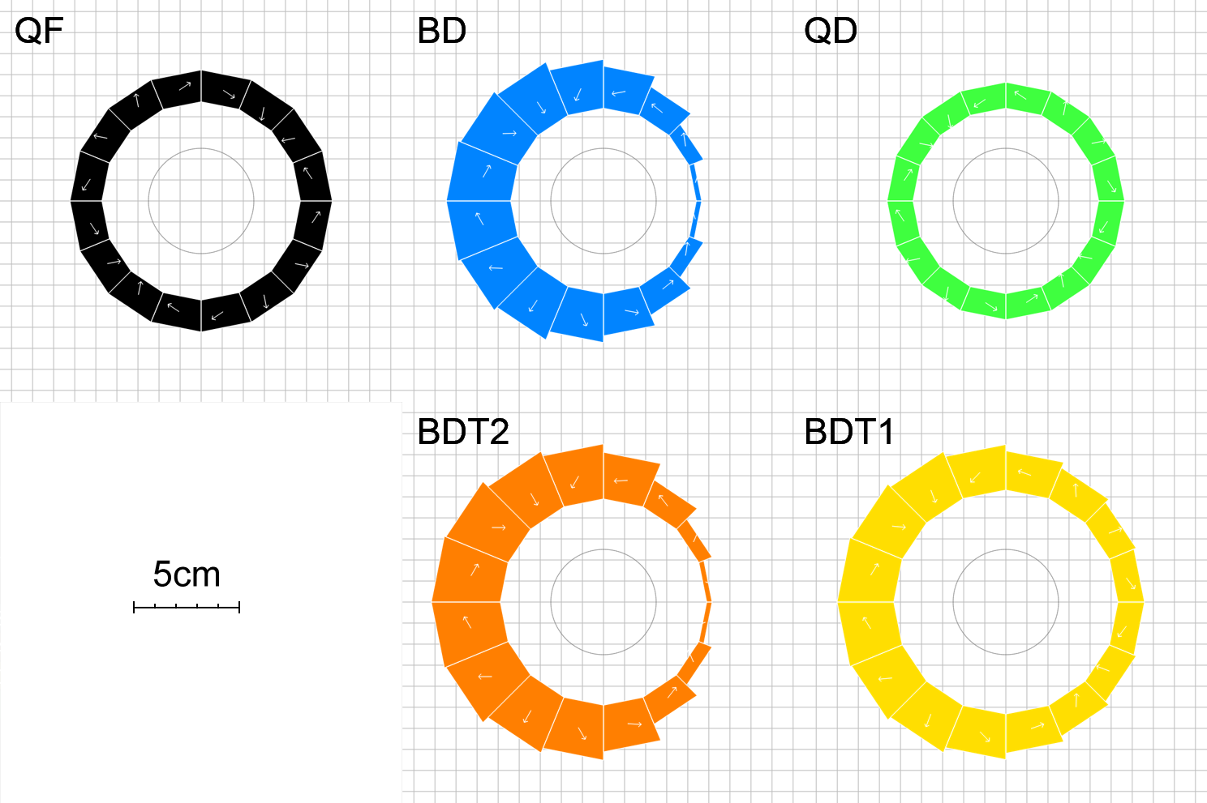
Magnet Types and Parameters
Magnet | Dipole (T) | Quad (T/m) | Good field radius (mm) | Aperture radius (mm) | Max field (T) (good region) | Max field (T) (aperture)
QF | 0 | -11.5624 | 25 | 43.1 | 0.2891 | 0.4983
BD | -0.3081 | 11.1475 | 25 | 40.1 | 0.5868 | 0.7551
BDT2 | -0.2543 | 11.1475 | 25 | 44.938 | 0.5330 | 0.7552
BDT1 | -0.1002 | 11.1475 | 25 | 49.085 | 0.3789 | 0.6474
QD | 0 | 11.1434 | 25 | 40.1 | 0.2786 | 0.4469

Slide 9
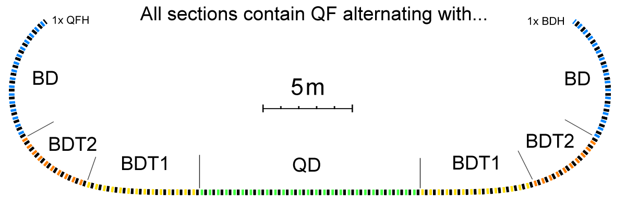
Layout and Magnet Counts
Permanent magnet total: 216
QF: 107
BD: 32
BDT2: 20
BDT1: 28
QD: 27
QFH: 1 (half length)
BDH: 1

Slide 10
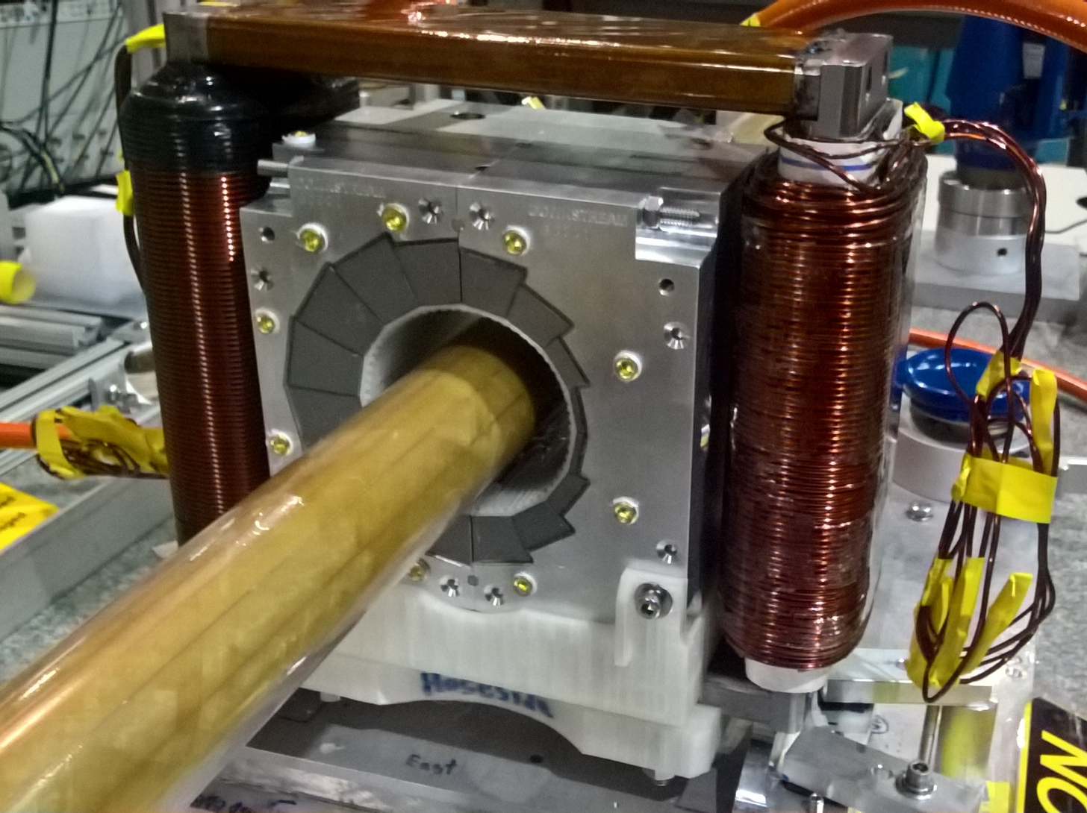
Permanent Magnet Design
Halbach design made of NdFeB material
This is a combined dipole+quad
Being measured on rotating coil at BNL
3D printed multipole corrector pack inside
Windowframe corrector coil outside
Temperature stabilised by water (orange hoses)
Stephen Brooks et al., "Permanent magnets for the return loop of the Cornell-Brookhaven energy recovery linac test accelerator", Phys. Rev. Accel. Beams 23, 112401 (2020); doi:10.1103/PhysRevAccelBeams.23.112401

Slide 11
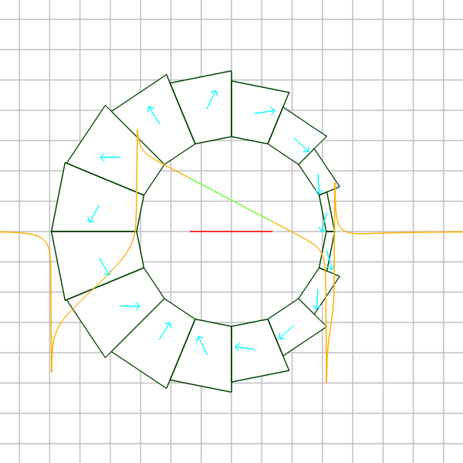
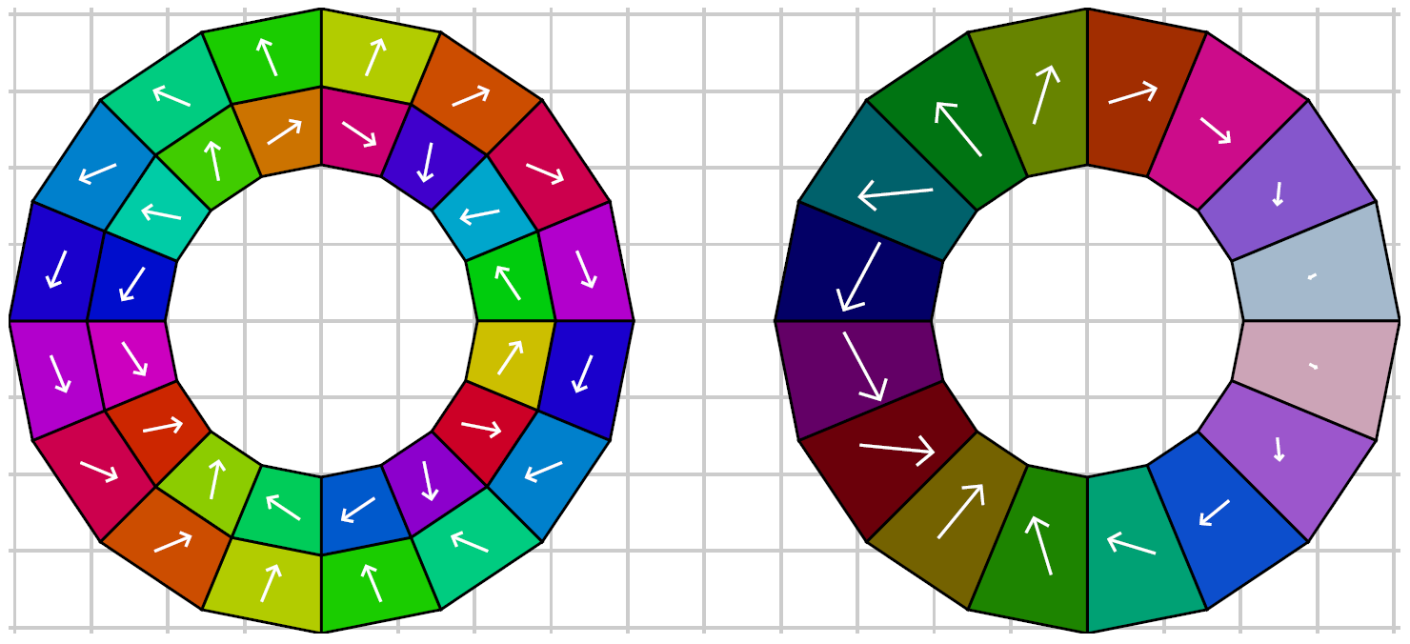
Combined-Function Magnet
Improvement over nested Halbach dipole and quadrupole (shown below) can be made by taking vector sum* of the two layers and implementing as a layer with constant magnetisation magnitude but variable wedge thickness.
* Not exactly a vector sum, needs numerical optimiser for accurate design

Slide 12
Error Sources (~10⁻² level)
Wedge magnetisation vector
  1-2° angle variation
  ~1% strength variation
  Comes from wedge manufacturing process
Wedge position
  0.1-0.2mm XY displacement
  Angle errors (probably fraction of a degree)
  Comes from magnet assembly

Slide 13
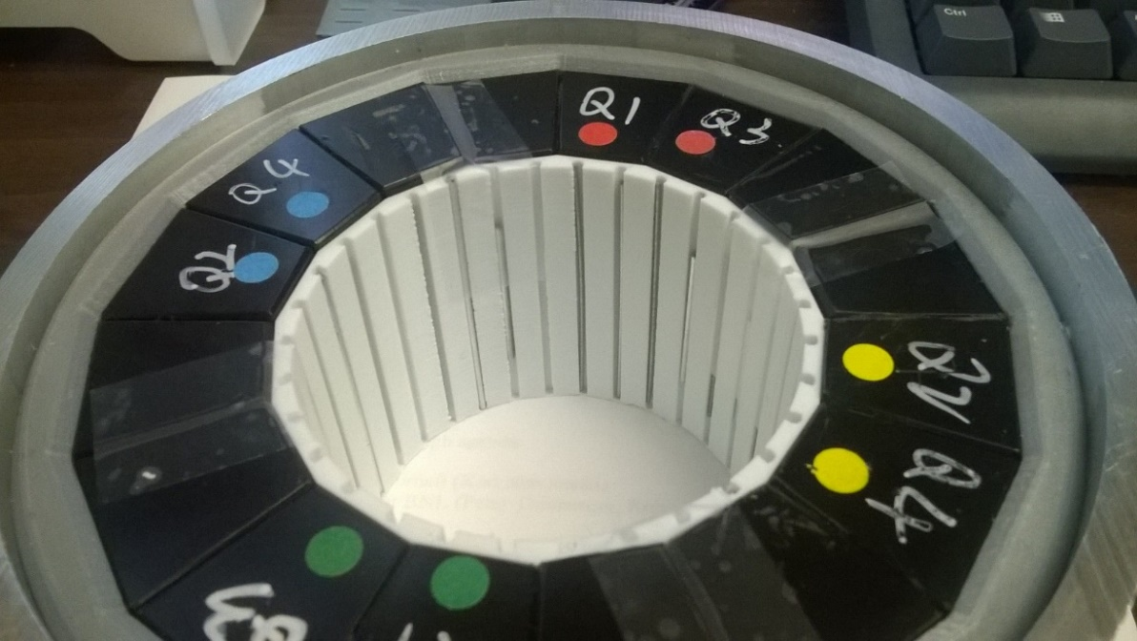
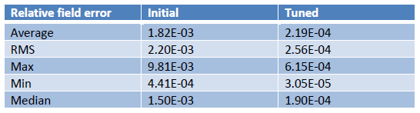
Iron Rod Correction Method
Measure bare magnet harmonics, then calculate lengths of iron rods to be inserted around the aperture
8x reduction in field errors
R&D prototype magnet
3D printed slot insert

Slide 14
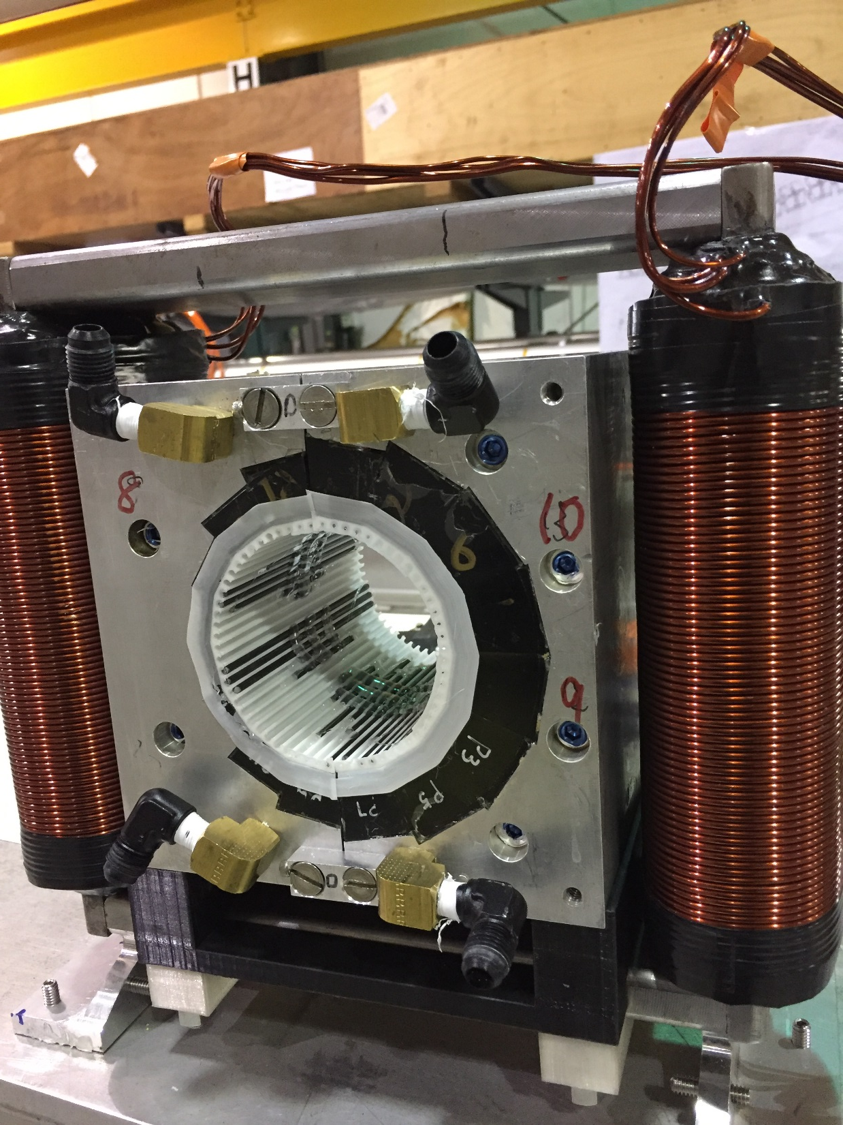
CBETA permanent magnet containing tuning rod insert
Electromagnetic corrector coil outside

Slide 15
CBETA permanent magnet containing tuning rod insert

Slide 16


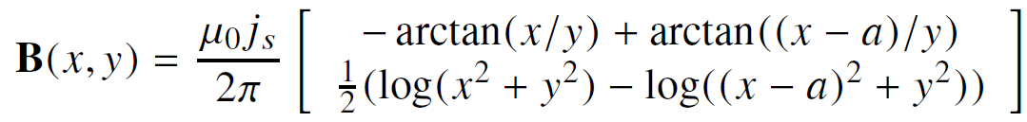
Field Calculation of Magnet Blocks
Magnetostatics:
Areas of constant magnetisation are equivalent to sheet currents around surfaces:
Field of 2D sheet current j_{s} from (0,0) to (a,0):
Rotate, add together for each side of polygon

Slide 17
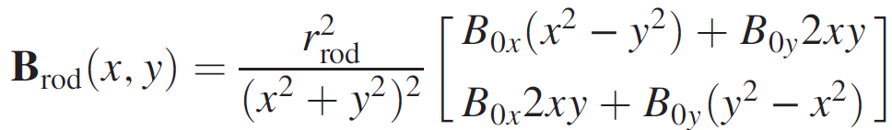
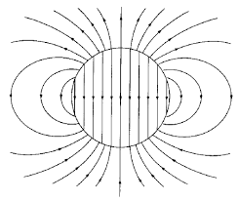
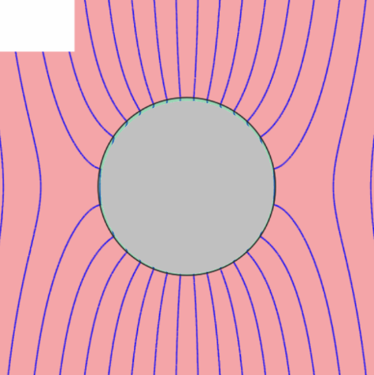
Field Calculation of Iron Rods
Field of 2D perfect μ=∞ iron rod of circular cross-section, centre (0,0), in ambient field B₀:
Rod is magnetised with M=2B₀
B_{rod}
B₀+B_{rod}

Slide 18
Overall Philosophy
Direct approach:
Incorporating correction:
Optimiser
Build
Measure
Simulation
Optimiser
Optimiser
Build
Measure
Correction simulation
Correct
Measure
Simulation

Slide 19

Correction Makes Precision Easier
At ~10⁻⁴ accuracy
Optimiser
Build
Measure
Simulation
$$$$
At ~10⁻² of error
At ~10⁻² accuracy
Optimiser
Optimiser
Build
Measure
Correction simulation
Correct
Measure
Simulation
$
$
Measurement steps still have to be ≤10⁻⁴

Slide 20
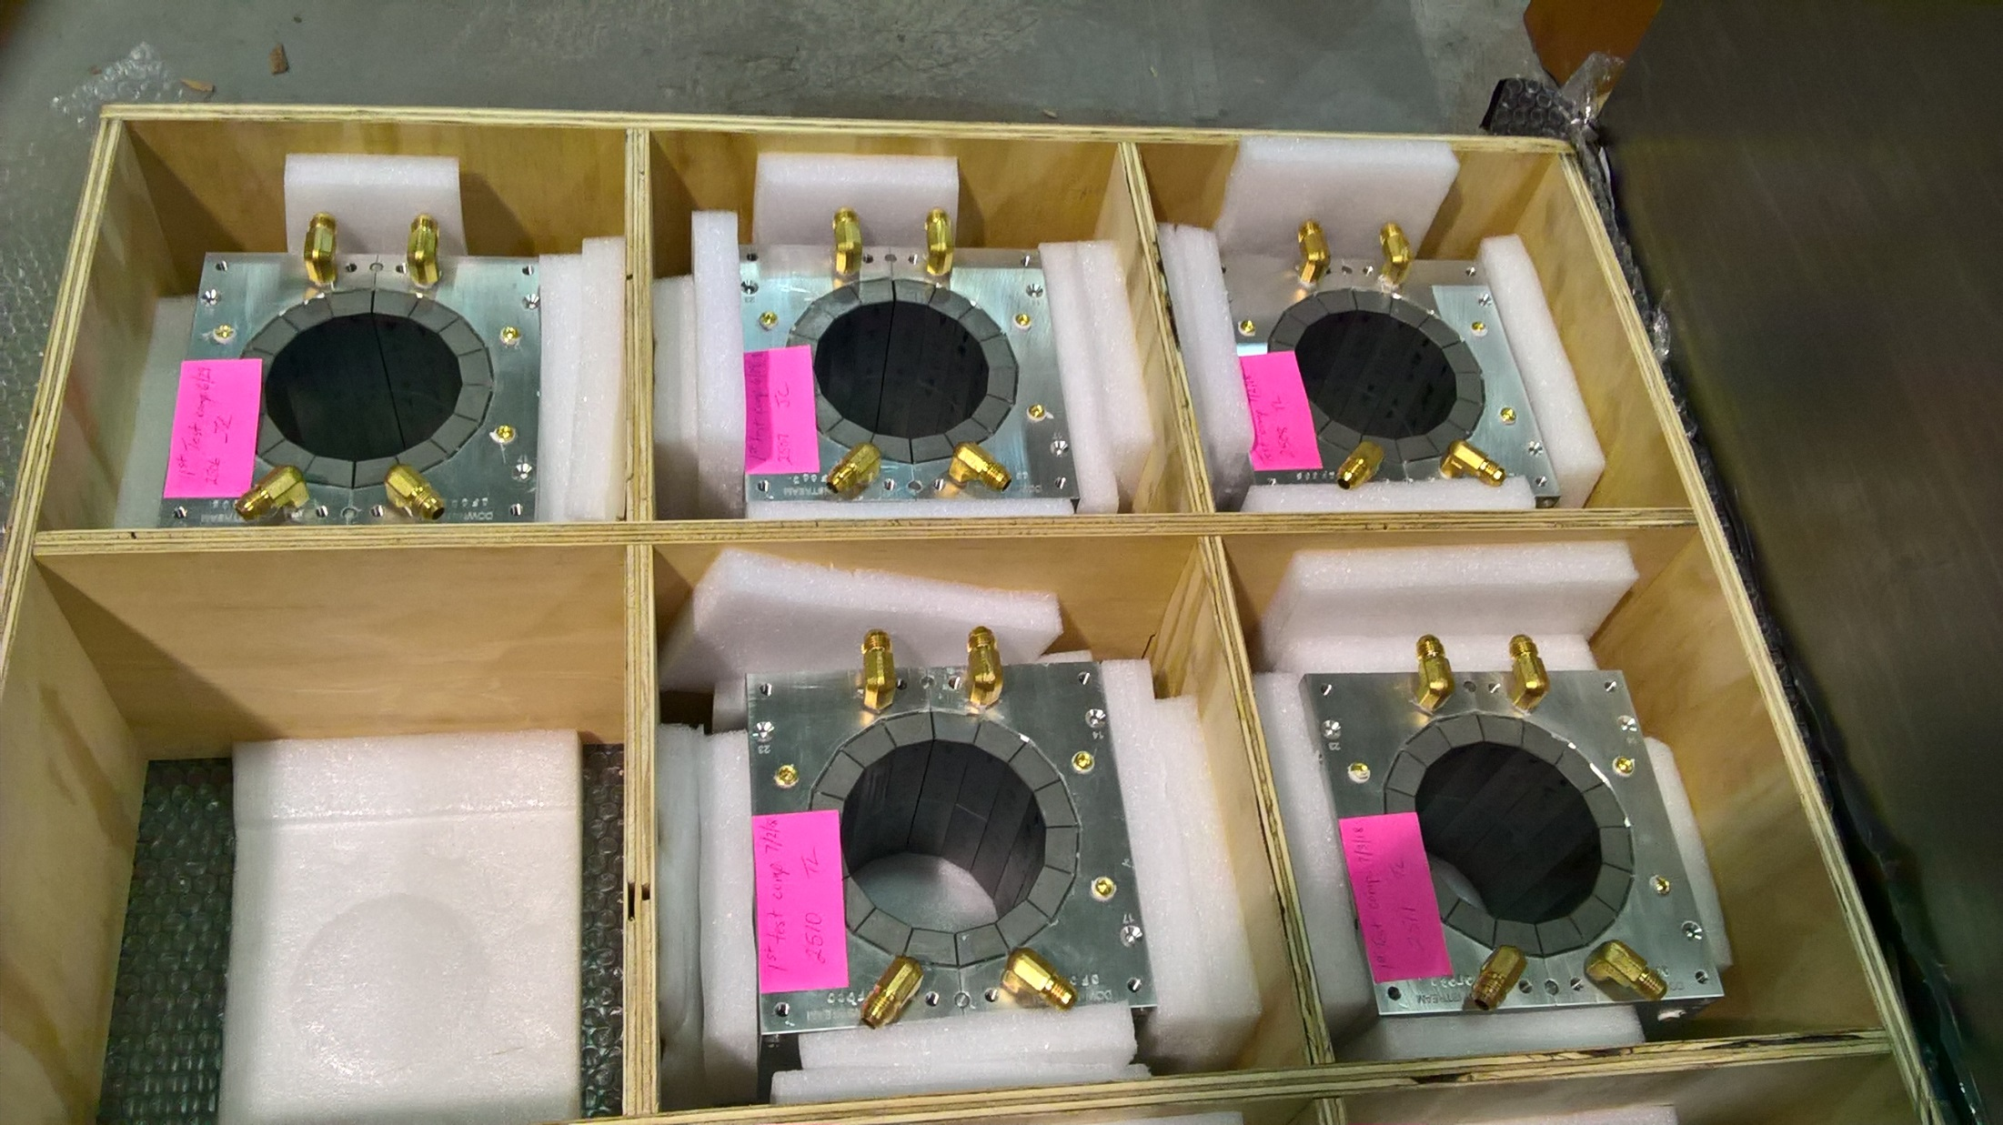
Permanent magnets shipped from KYMA

Slide 21
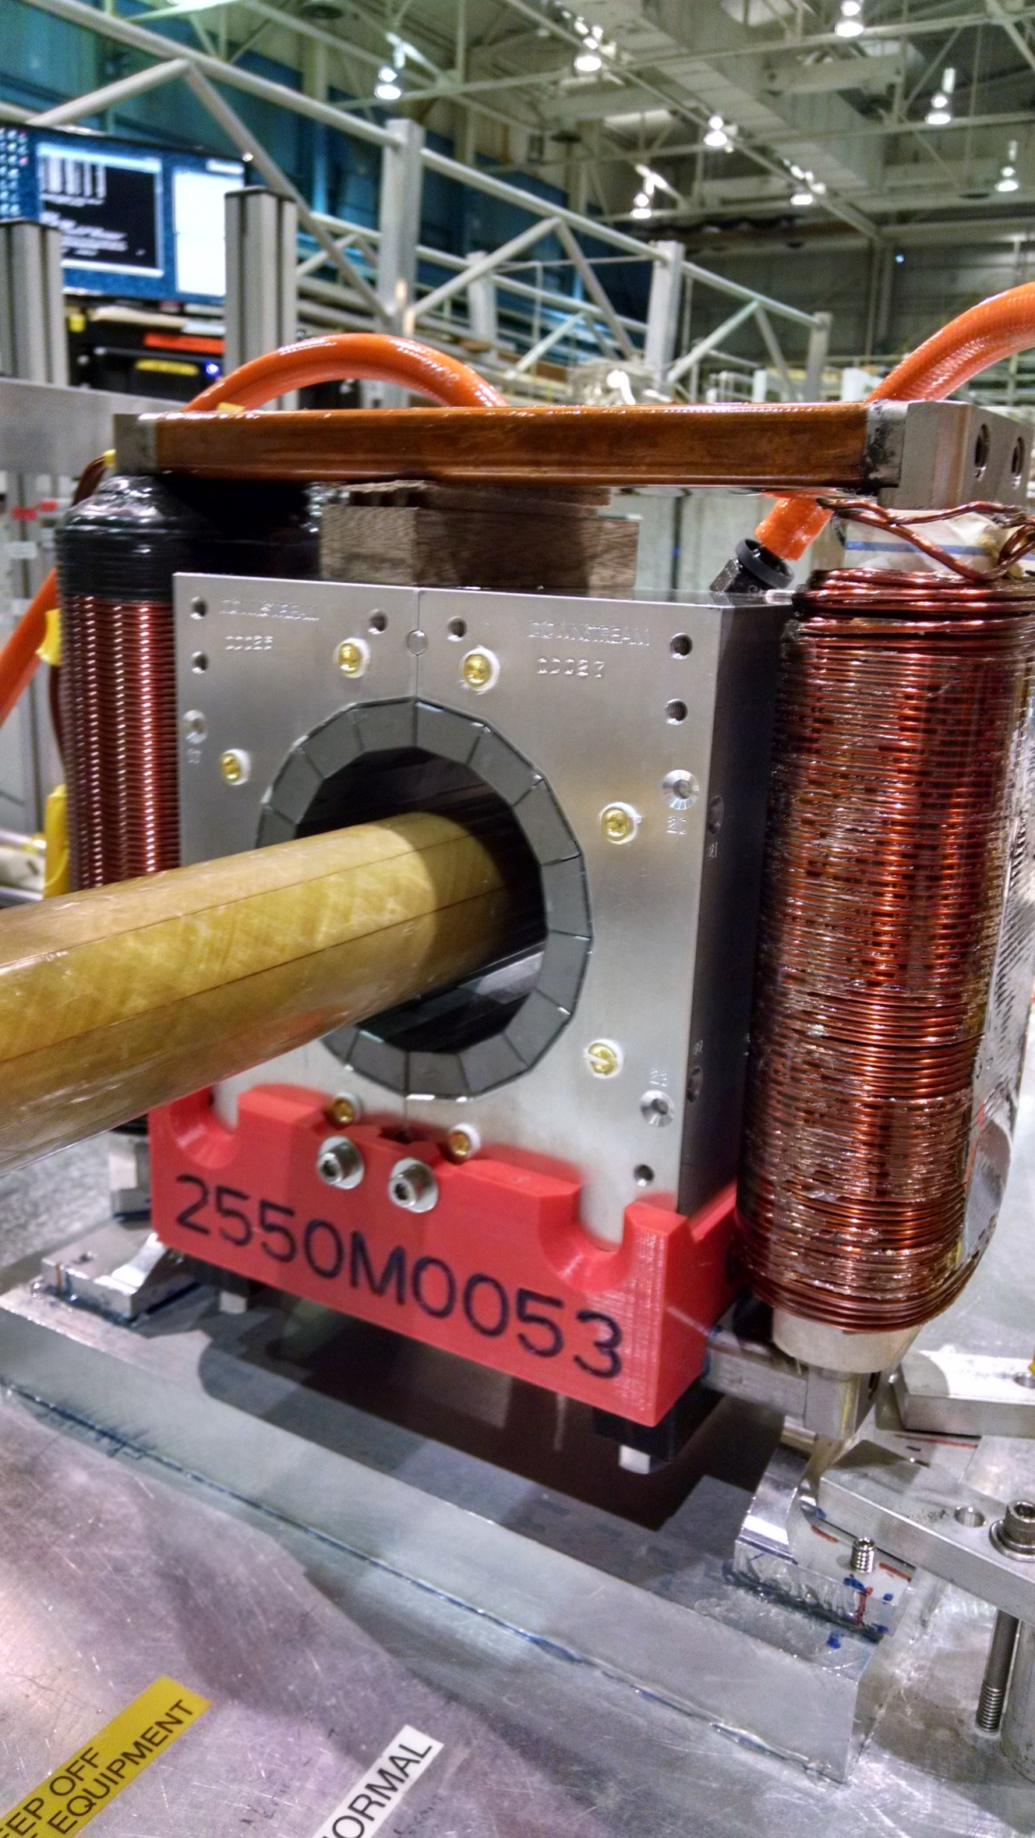
Rotating coil magnet measurement at BNL

Slide 22
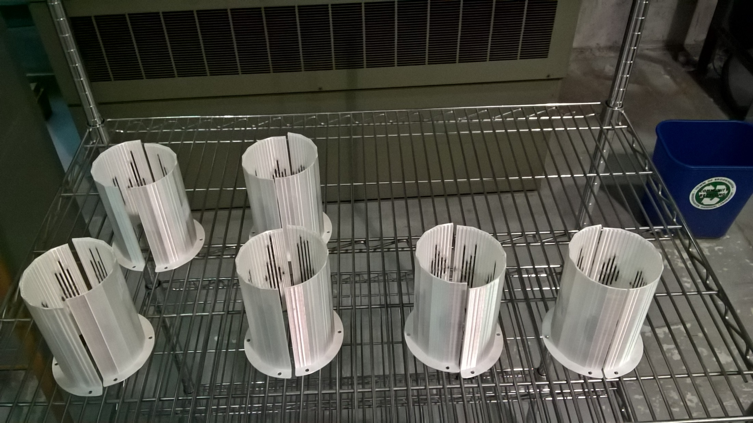
Rod tuning packs for CBETA magnets
Iron rod optimisation program was packaged so that technicians could run it: rotating coil data → rod lengths

Slide 23
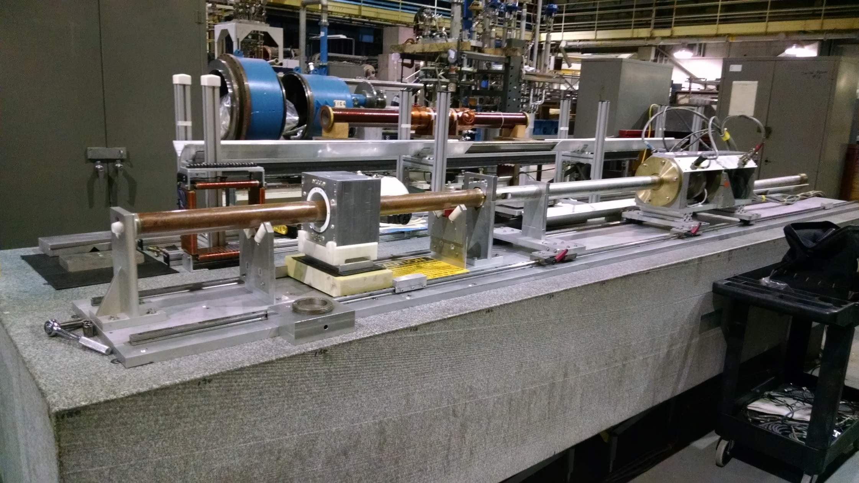
Rotating coil magnet measurement at BNL

Slide 24
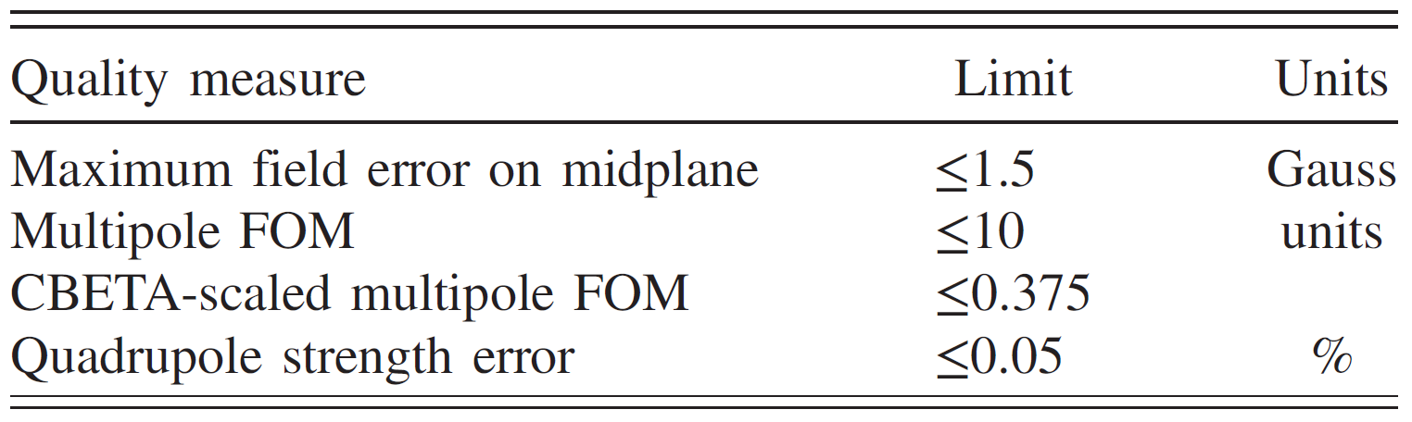
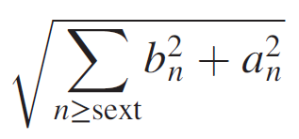
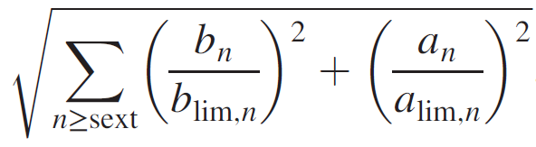
Tuned Field Quality Criteria
Unit = 10⁻⁴ of main pole
FOM is sqrt(sum of all (multipoles in units)²)
  CBETA FOM is weighted version based on tracking
Midplane error generally hardest to achieve
  May go in and out of spec slightly (~0.5G) due to chiller cycle

Slide 25
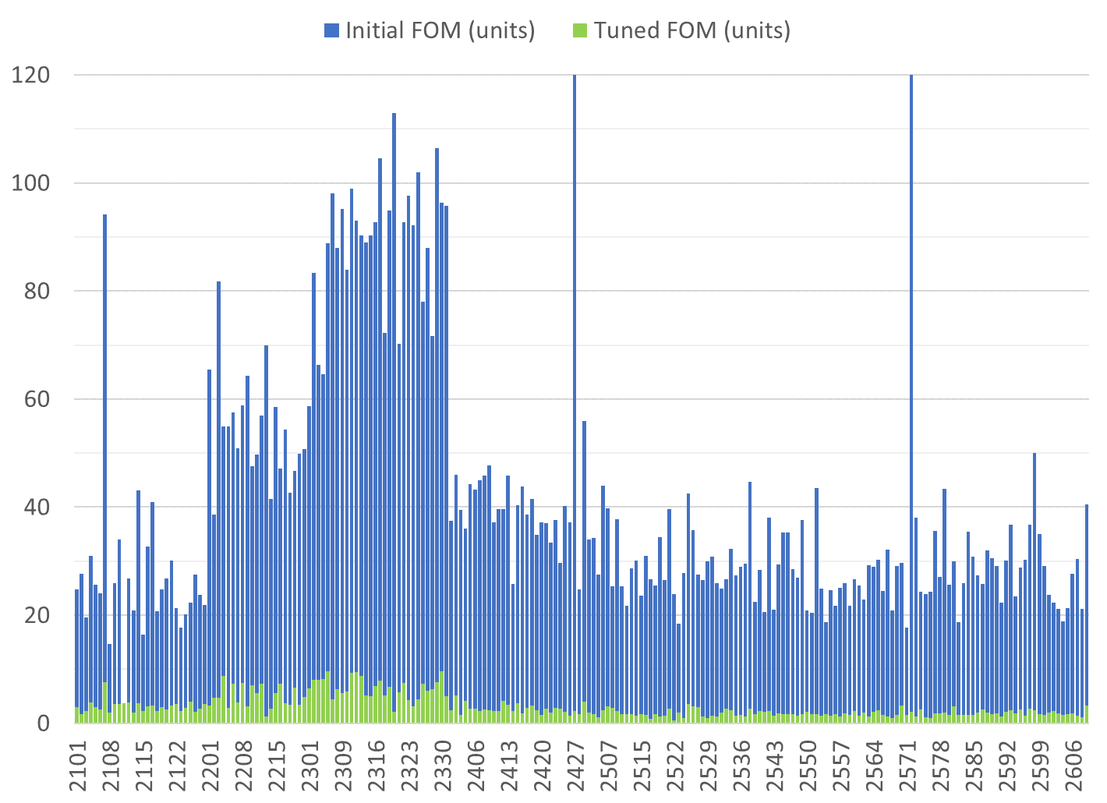
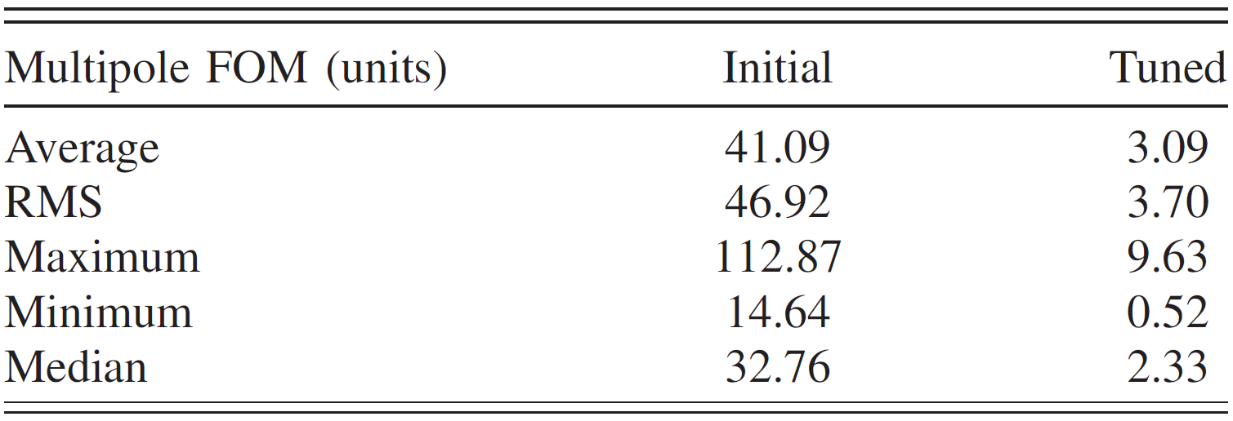
Only tuned magnets shown (2 “rejects” removed)
BDT1
BDT2
BD
QD
QF
Reject matched with good half
Reject matched with good half
80 shims
Tuned with 96 shims
QFH

Slide 26
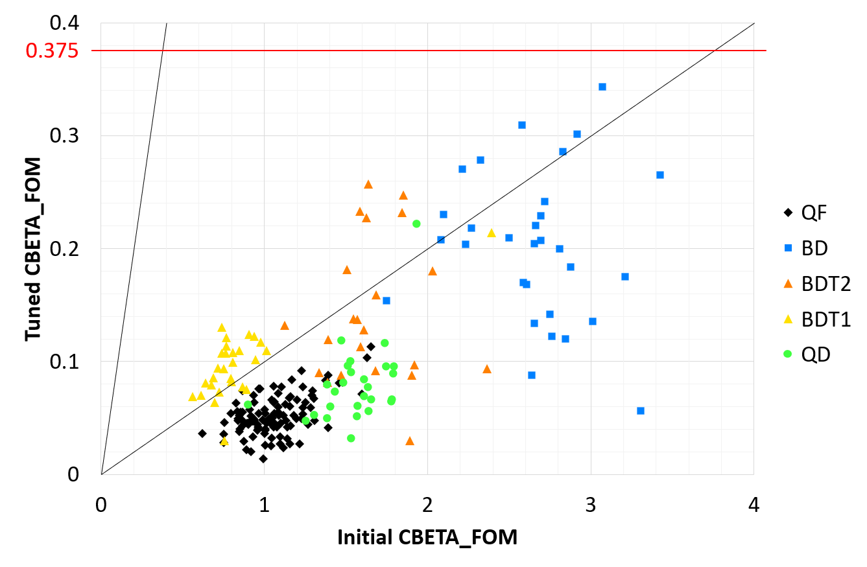
Effect of Tuning (CBETA FOM)
10× improvement

Slide 27
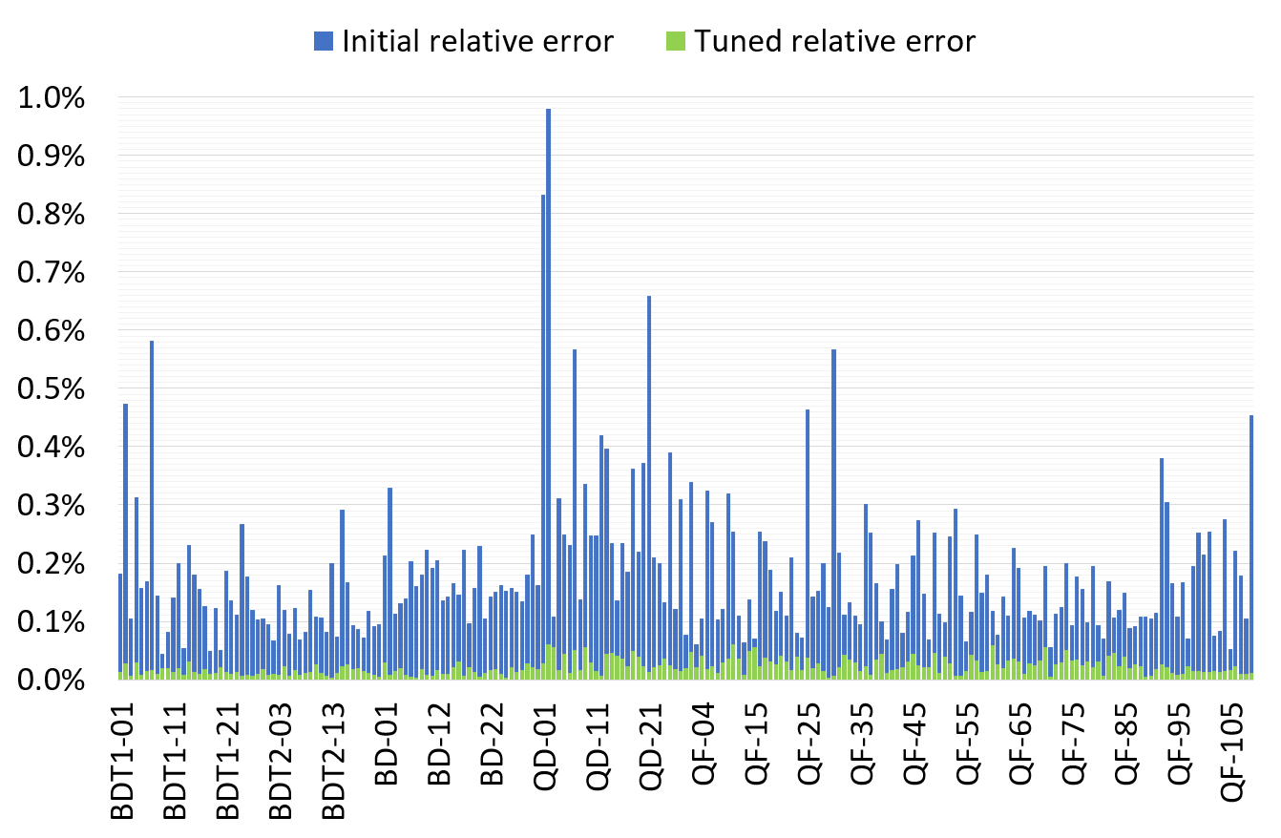
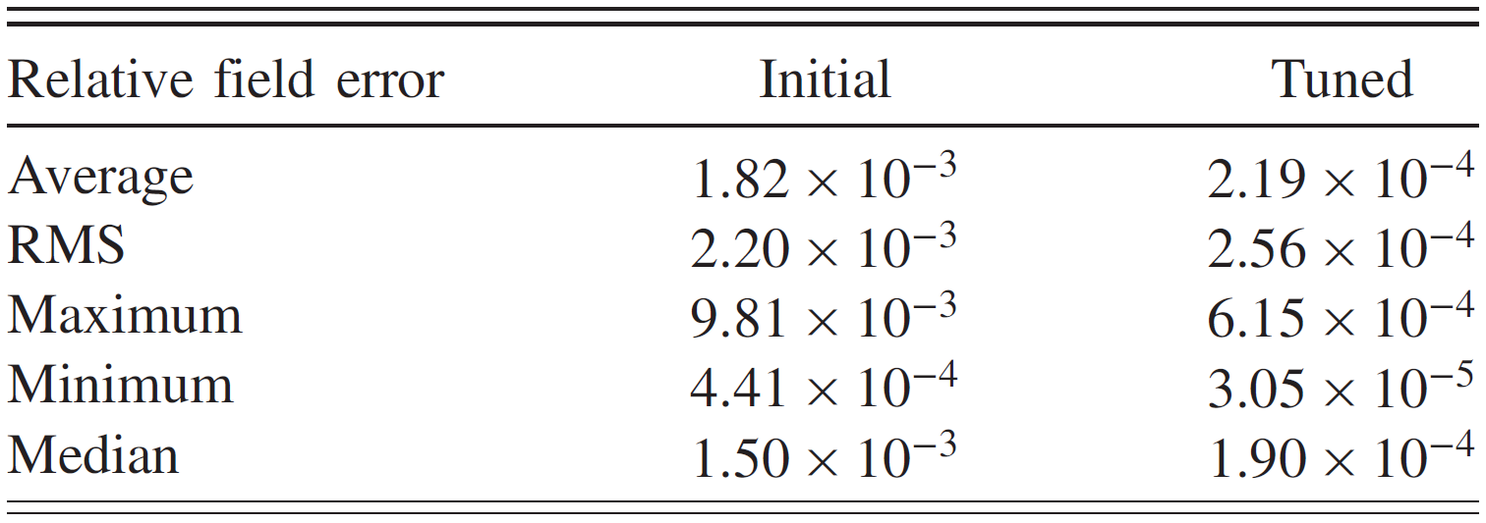
Only tuned magnets shown (2 “rejects” removed)

Slide 28
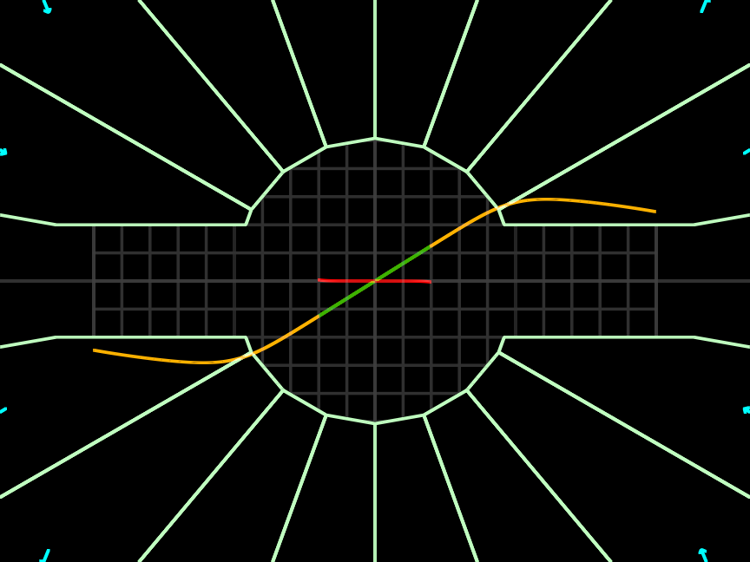
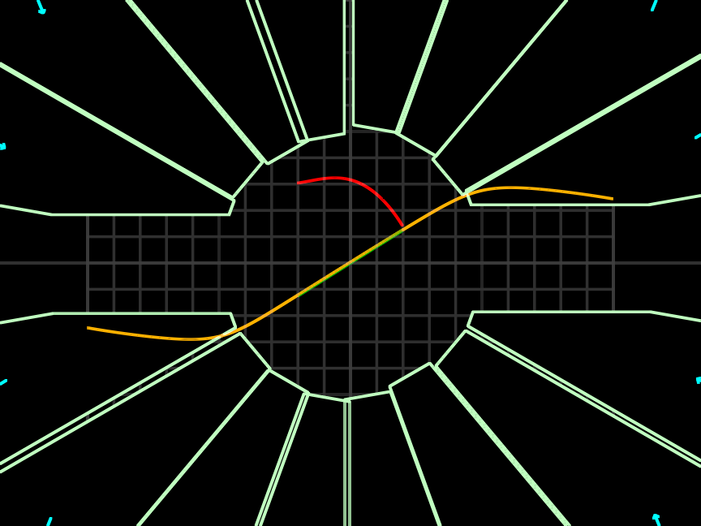
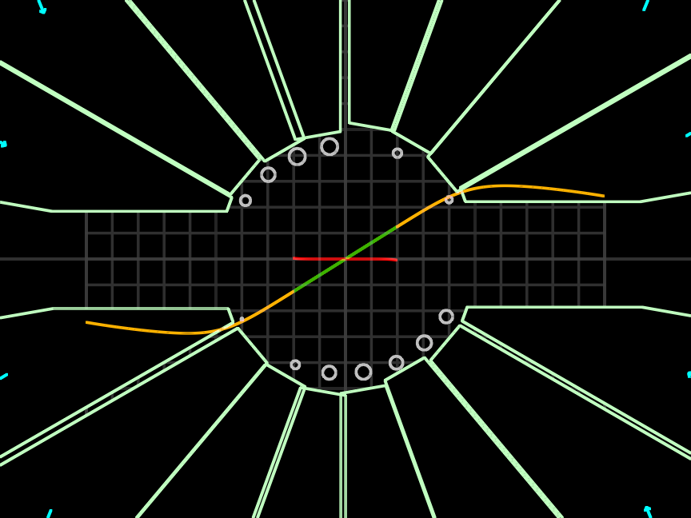
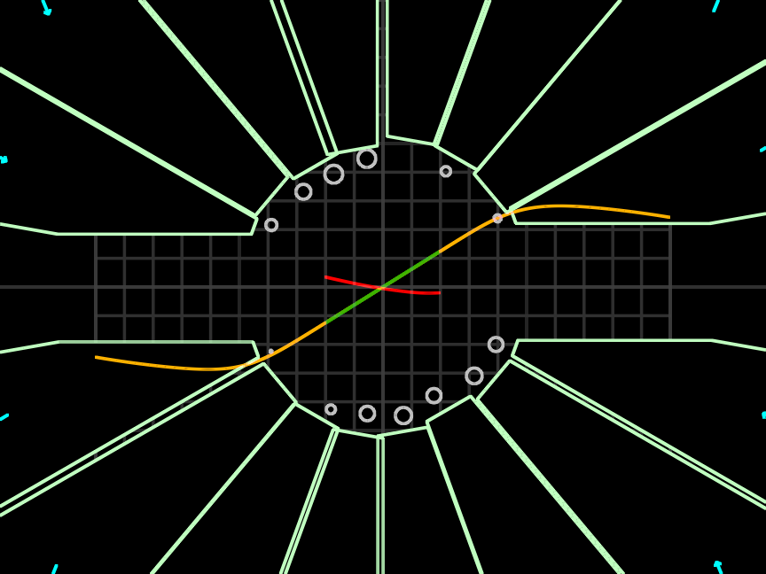
250T/m Tiny Quad Design Example
Perfect magnet (mm grid)
1.98 units error
±0.25mm position errors
96.59 units error
Corrected with 16 iron rods
2.51 units error
±0.25mm position errors on rods
31.05 units error
Errors, correction, errors in correction
New size regime → sensitivities are different

Slide 29
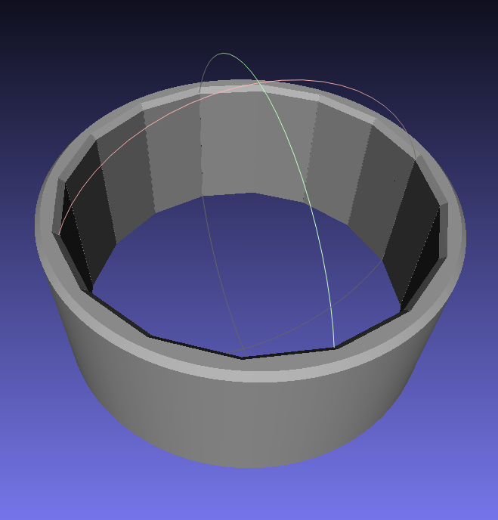
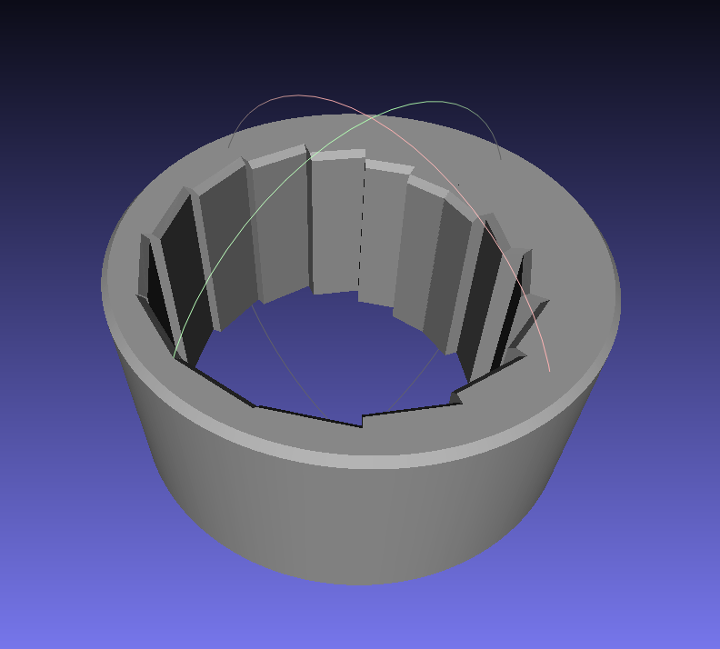
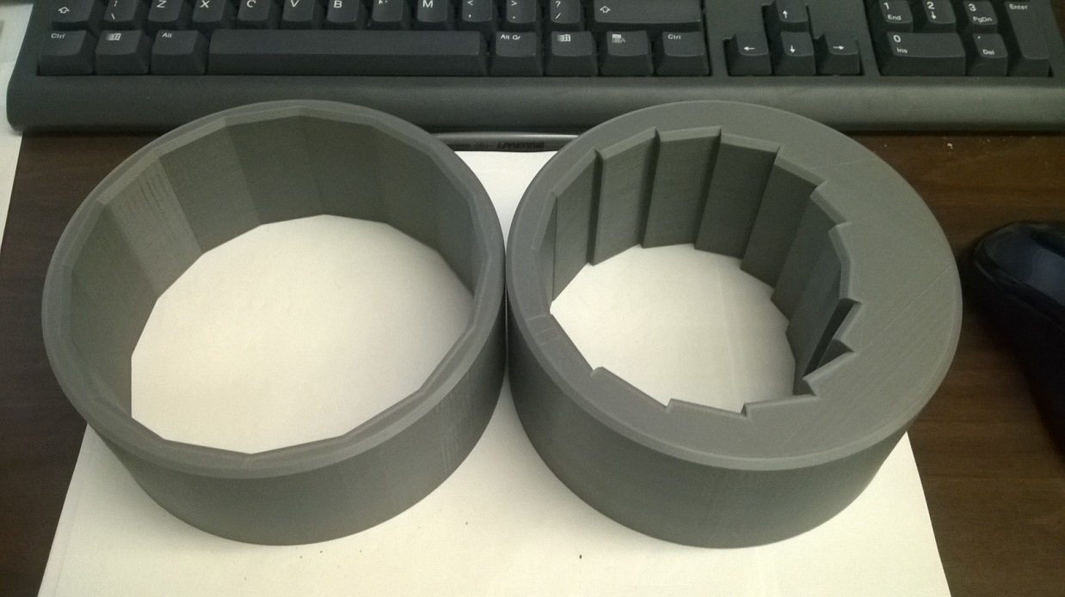
Use of 3D Printing in Prototypes
Field optimiser
→ Magnet wedge dimensions
3D print file (.stl mesh)
and block spec. for manufacturer

Slide 30
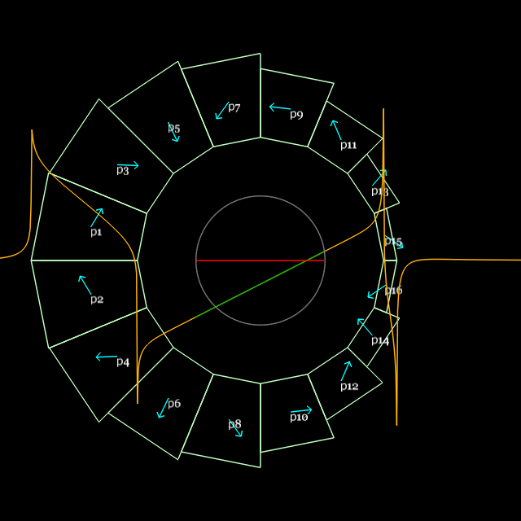
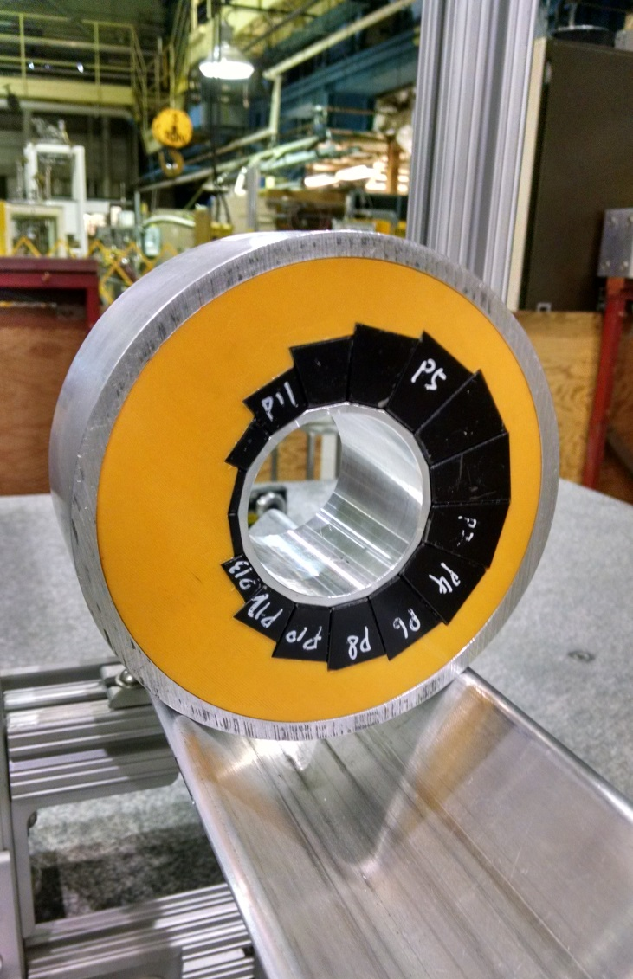
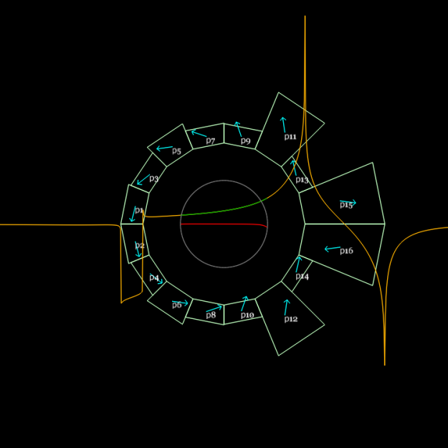
Custom and Cheap – is it possible?
Combined function dipole+quad
Magnet design program generates mesh
Design for B_{y} = B₀r^{k}
3D printed
Material cost: $800

Slide 31
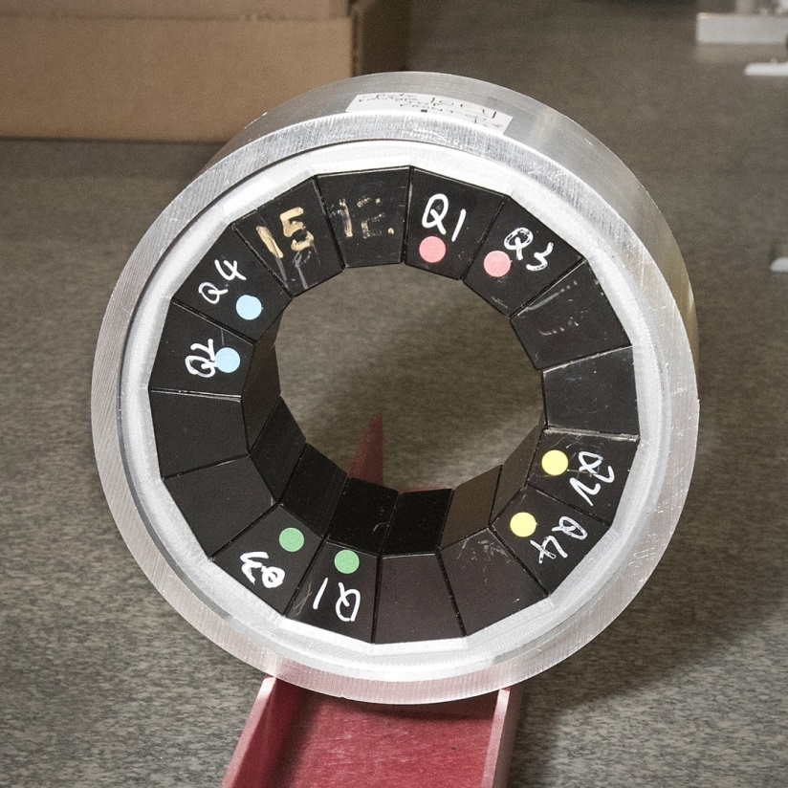

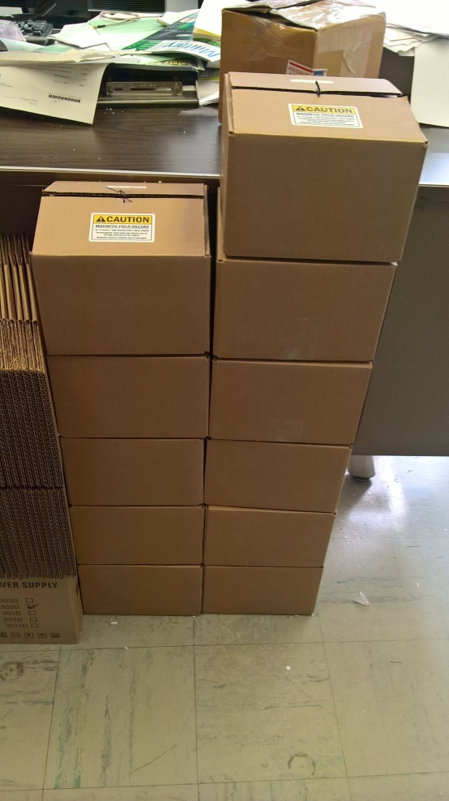

Magnets built as part of CBETA R&D had iron rods inserted and were used to build an FFA test girder

Slide 32
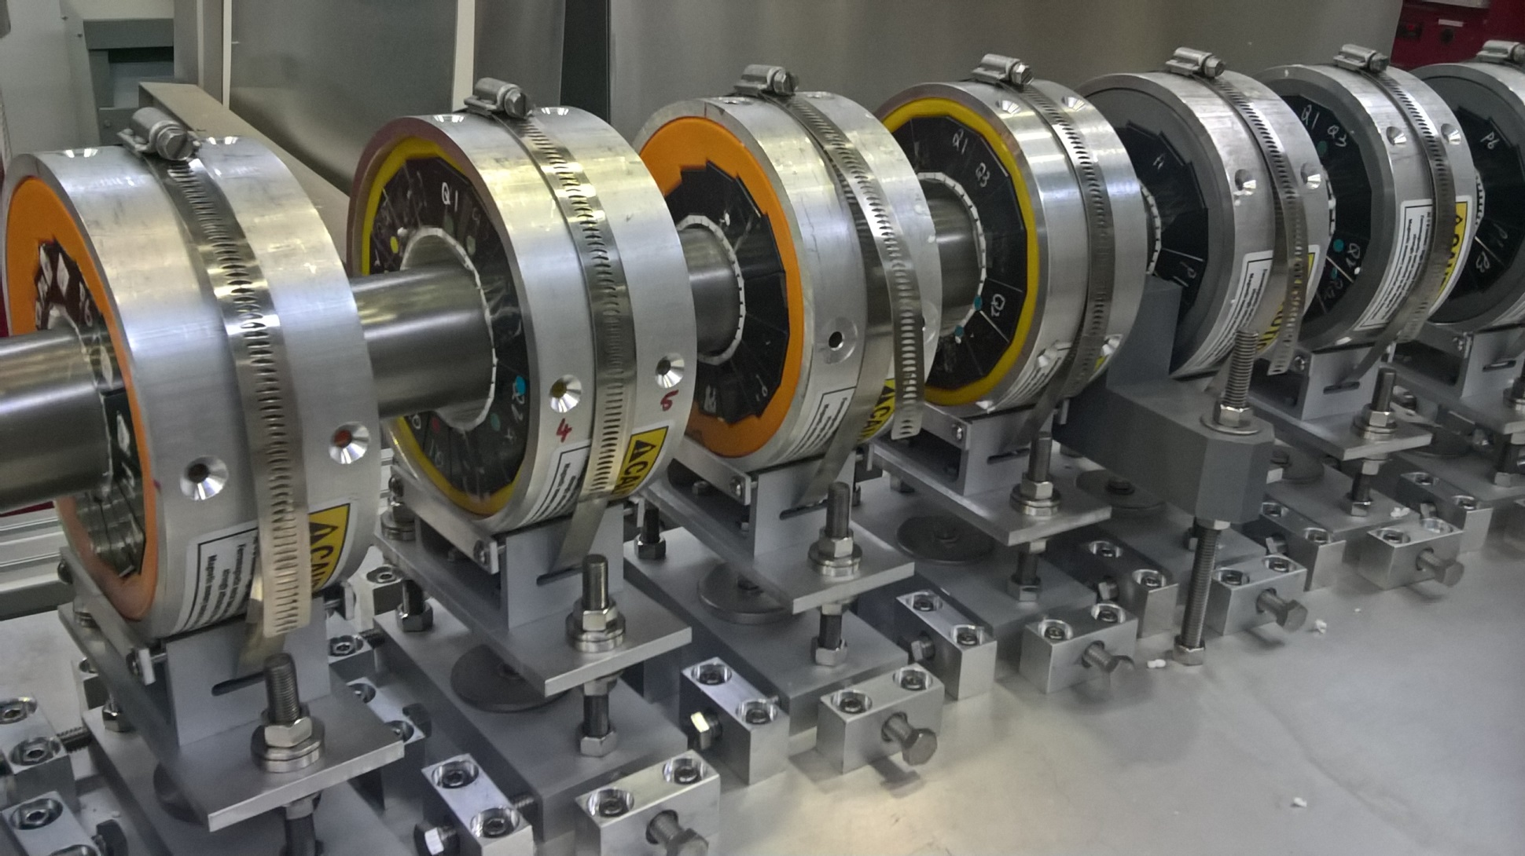
FFA Test Girder (18-70MeV)
Apr 7, 2017

Slide 33
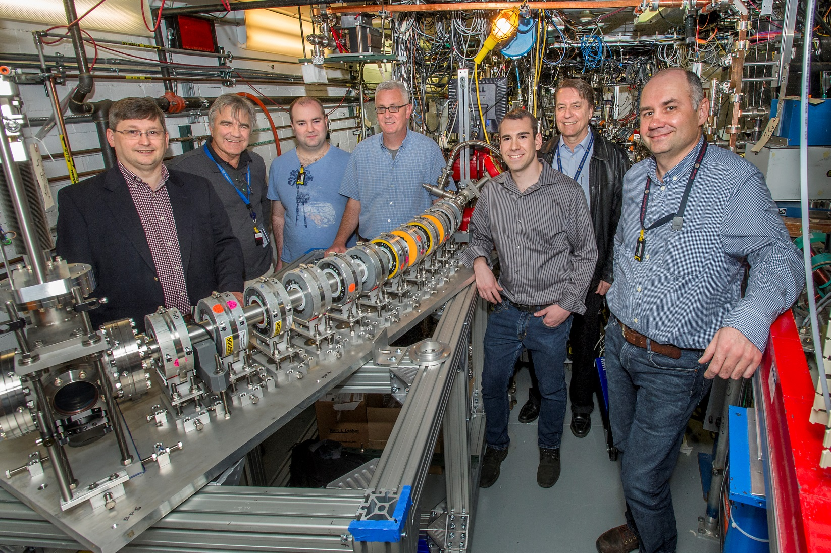
Installed at BNL ATF (Accelerator Test Facility)
ATF experiment AE79
May 1, 2017

Slide 34
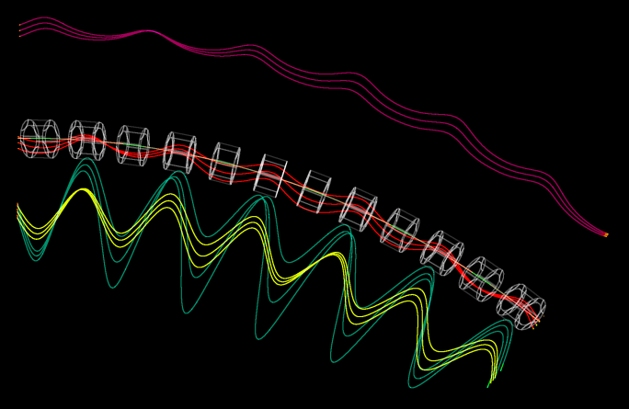
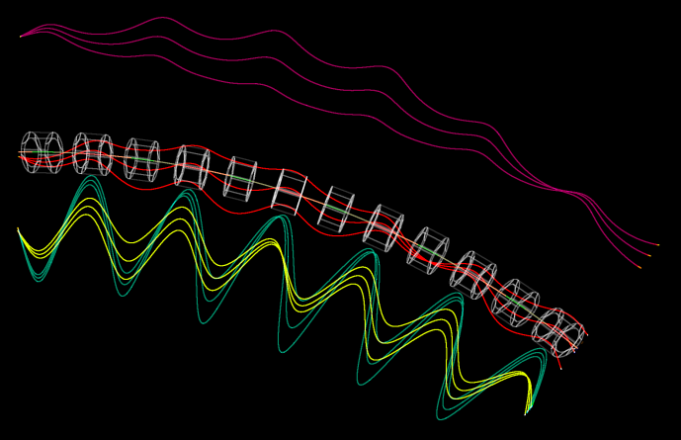
Tracking of (x,x’) Offsets
Trajectories have been magnified transversely by 16x for visibility
x_{in} ±1mm
x’_{in} ±10mrad

Slide 35
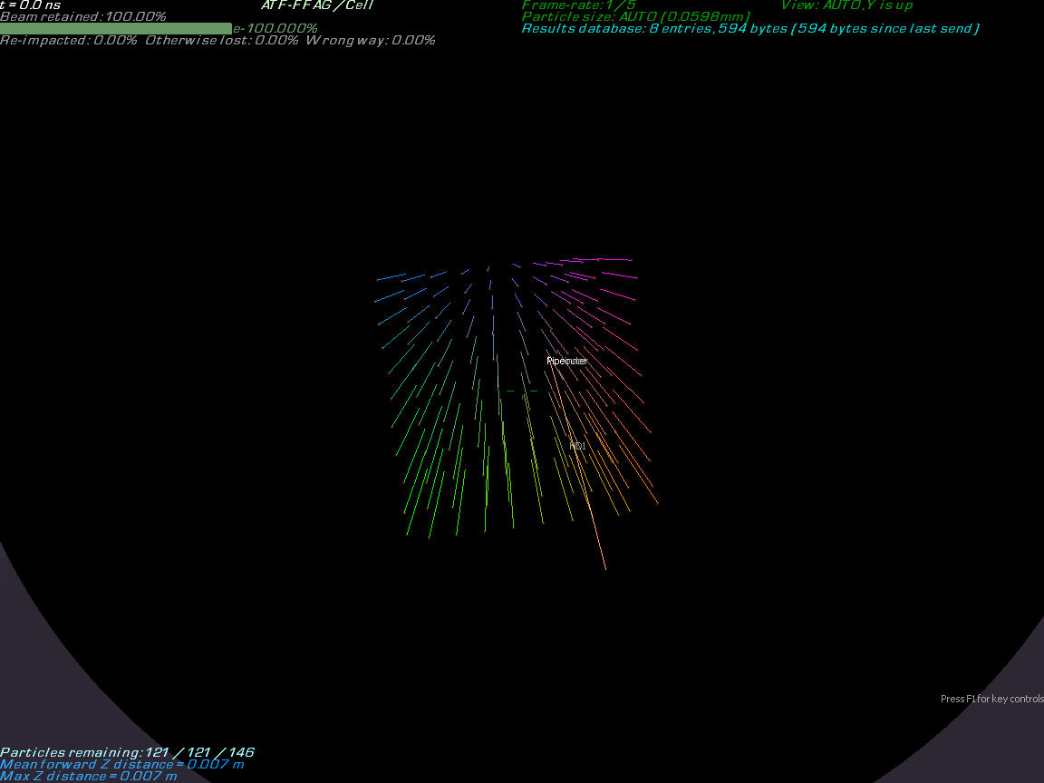

Slide 36
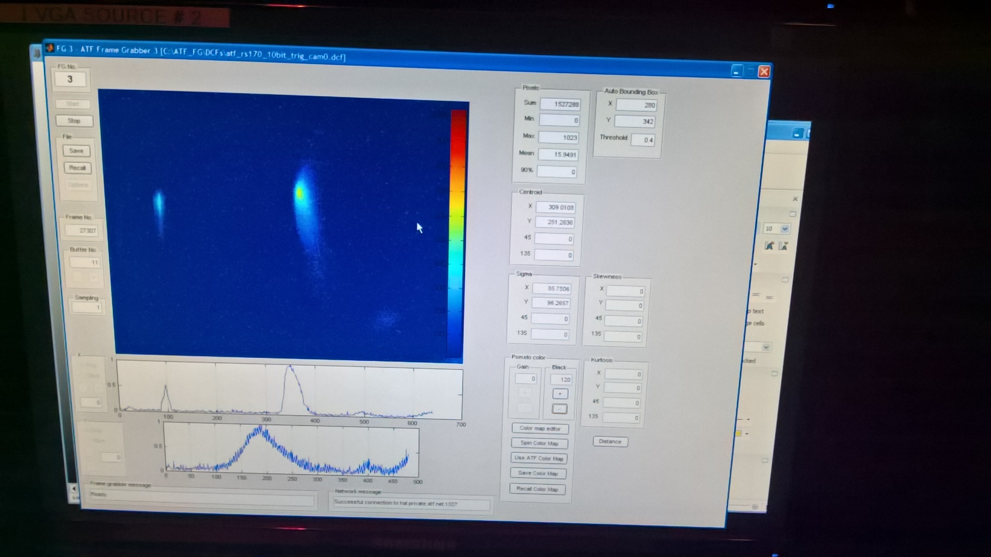
First Beam during Fault Studies
54MeV was the first energy to be tested
May 4, 2017

Slide 37
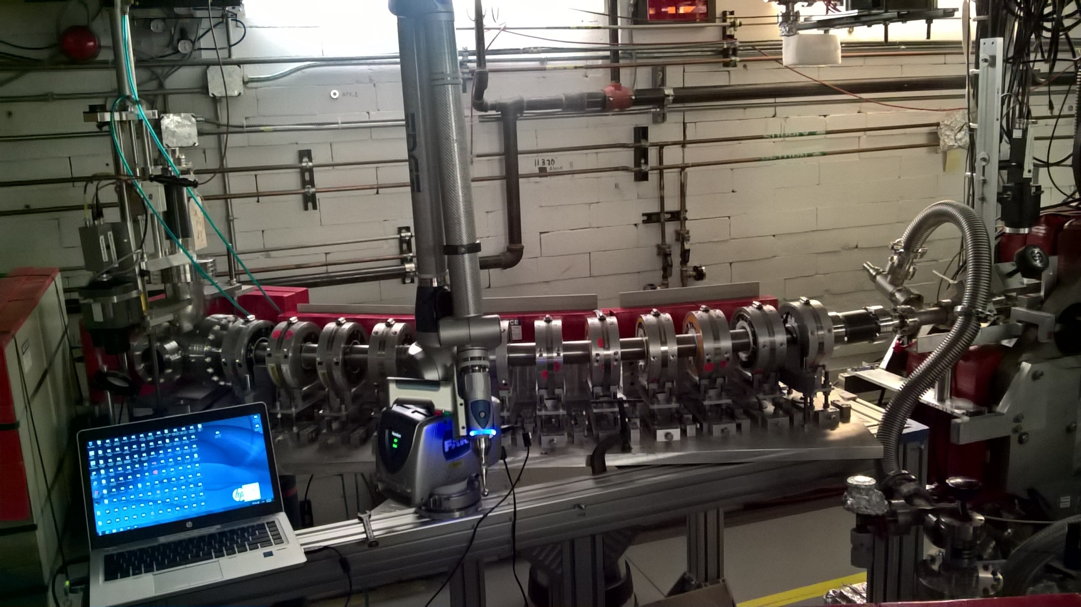
With Survey “Faro Arm” Attached
Most magnet offsets <0.2mm; RMS 0.1mm or better
May 5, 2017

Slide 38
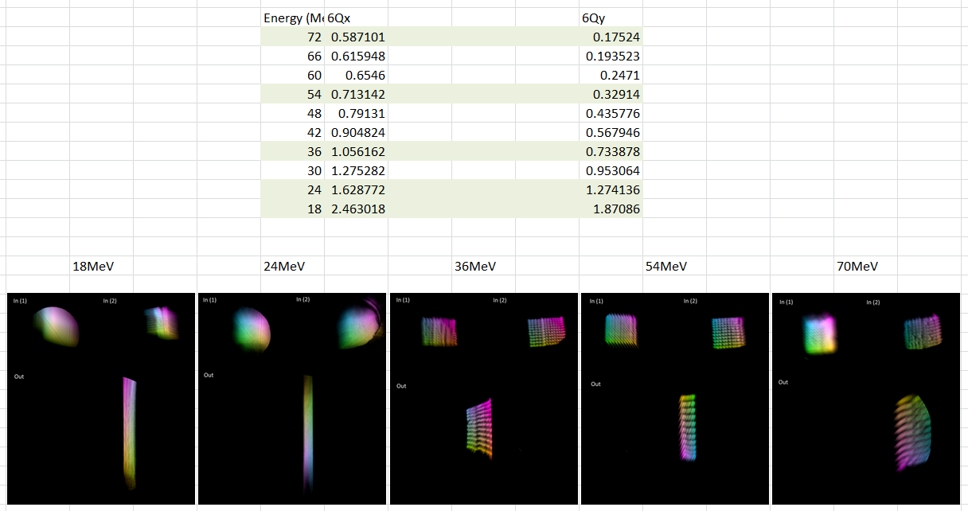
All Energies Phase Advance

Slide 39
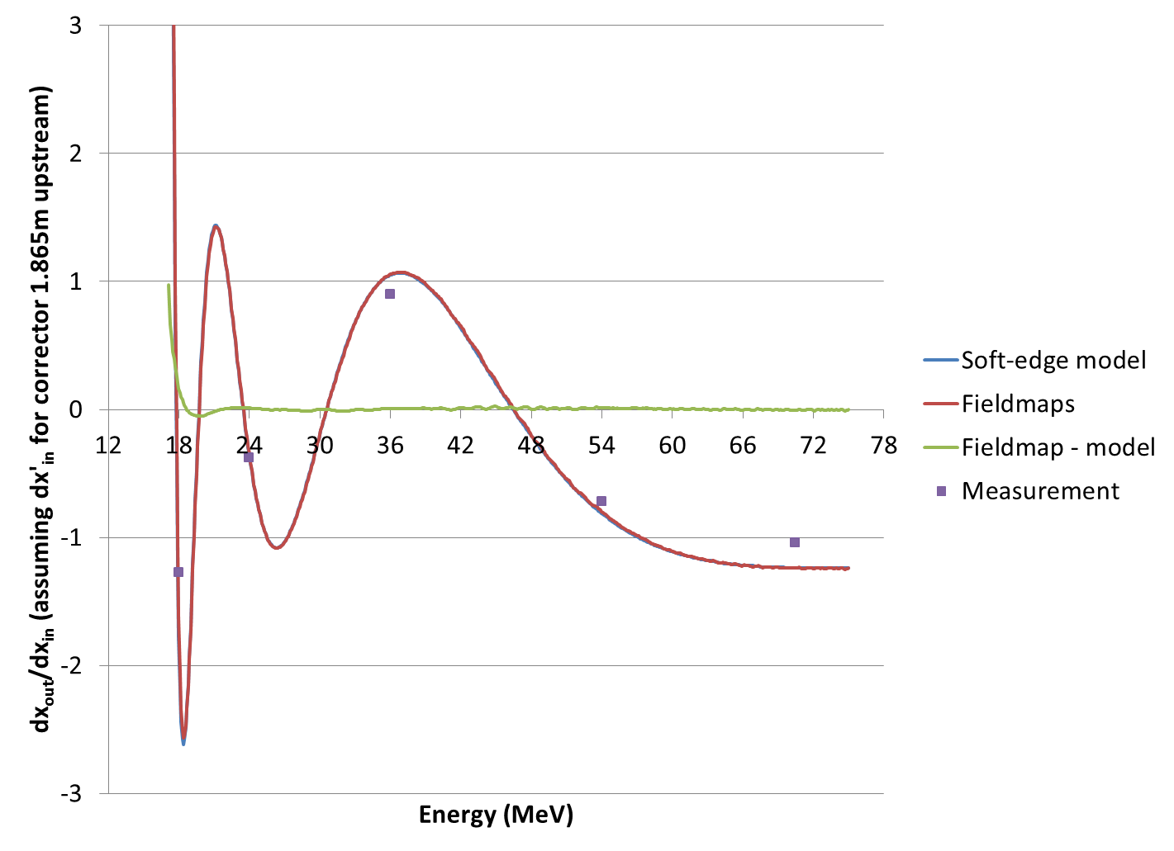
Transfer Matrix XX Element
“Measurement” is just taking the difference of a pair of centroids in the good area of the scan

Slide 40
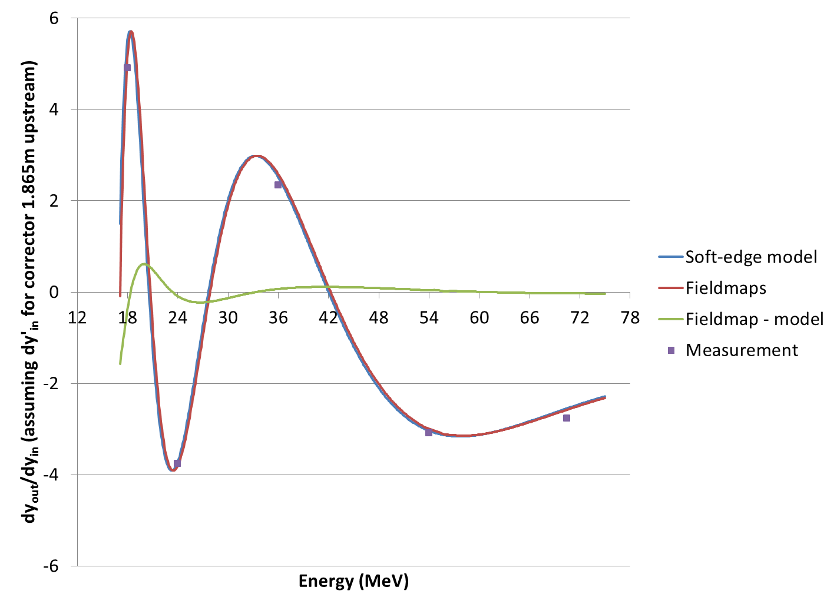
Transfer Matrix YY Element

Slide 41
Simulation Conclusions
Correction scheme simulations can be as important as the original design
  Easy/cost effective path to higher accuracy
  Can be automated, integrated into manufacturing
  Don’t just simulate “errors” and then stop
Empirical retuning of simulation assumptions based on measurements?
  Reality is always slightly different to ideal case

Slide 42
References
A. Bartnik et al., "CBETA: First Multipass Superconducting Linear Accelerator with Energy Recovery", Phys. Rev. Lett. 125, 044803 (July 2020)
Stephen Brooks et al., "Permanent magnets for the return loop of the Cornell-Brookhaven energy recovery linac test accelerator", Phys. Rev. Accel. Beams 23, 112401 (2020); doi:10.1103/PhysRevAccelBeams.23.112401
Stephen Brooks, CBETA note 035 "CBETA Halbach Magnet Production Run", available from https://www.classe.cornell.edu/CBETA_PM/index_notes.html
Stephen Brooks et al., "Production of Low Cost, High Field Quality Halbach Magnets", Proc. IPAC2017, pp. 4118-4120; doi:10.18429/JACoW-IPAC2017-THPIK007 available from http://jacow.org/ipac2017/papers/thpik007.pdf

Slide 43
BACKUP

Slide 44

Only tuned magnets shown (2 “rejects” removed)
BDT1
BDT2
BD
QD
QF
QFH

Slide 45




Production and Testing Flow
KYMA
assembly
3
4
AllStar
PM wedges
1
BNL
tuning
2
Helmholtz testing at AllStar, 100% of blocks but not temperature controlled
Temperature-controlled Helmholtz test of ~15% sample at BNL for verification
Remainder of blocks shipped directly to KYMA, who also re-test ~10% sample
Rotating coil measurement of bare magnet at BNL
Rotating coil measurement of tuned magnet at BNL
5
Accept

Slide 46


Helmholtz Measurements
Example: AllStar data for wedge types P1 through P16 (BD magnet)
Angle errors Strength variation

Slide 47

Magnetisation Angle Distributions
Requested that factory re-make types P15 and P16 to reduce systematic error.
These are the smallest blocks, so not critical, but re-make will improve quality of untuned magnets.
General request was for 1 degree RMS error, but can cope with some above and some below as we have here (see next slide)

Slide 48

Magnet Error Model
Both the strength and angle error distribution can be put back into the field simulation
Example: BD magnet using AllStar’s data set.
1000 magnets were generated, some with position errors. Histogram is binned by the “units FOM”.
Green = easy to tune
Red = possible problems
Based on first girder experience.

Slide 49

100% complete (excl. spares*)
215 / 215 magnets (0 remaining)
* We have 4 “spare” QFs, 2 BDs for replacing first girder magnets, plus two spare BDT2 magnets, with more spares to be delivered from KYMA

Slide 50

Permanent magnet total: 216
QF: 107
BD: 32
BDT2: 20
BDT1: 28
QD: 27
QFH: 1 (half length)
BDH: 1

Slide 51
Final Measurement Rate
Main Production
Magnets tuned | 200 (excl. early samples)
Rotating coil measurements | 545
Start date | July 9, 2018
End date | November 14, 2018
Total weeks | 18.2
Magnets tuned per week (avg.) | 10.96
Rotating coil meas. per week (avg.) | 29.88
Rotating coil meas. per magnet (avg.) | 2.73

Slide 52

Example Harmonics (QD 2412)

Slide 53

Water Cooling Stability

