Slide 1
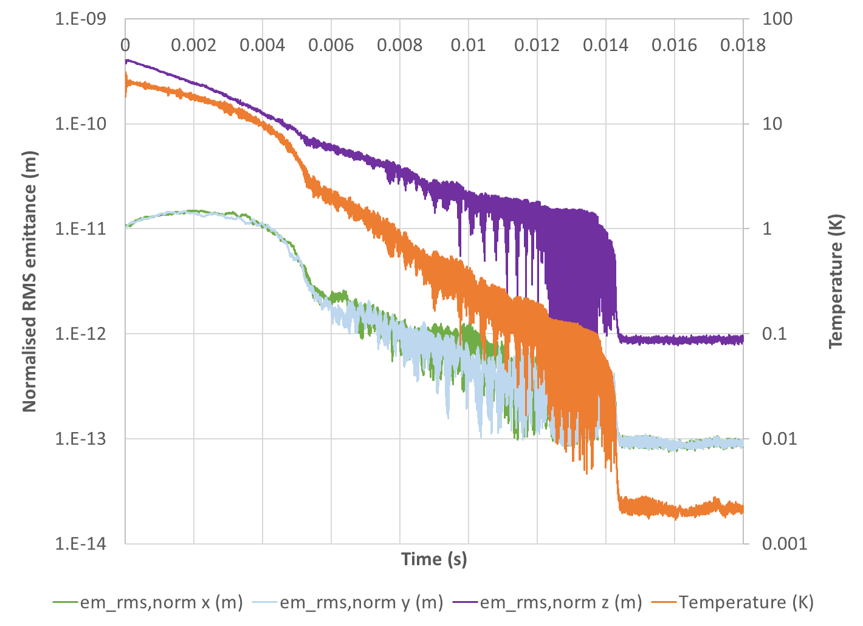
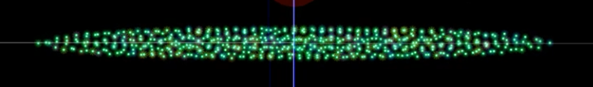
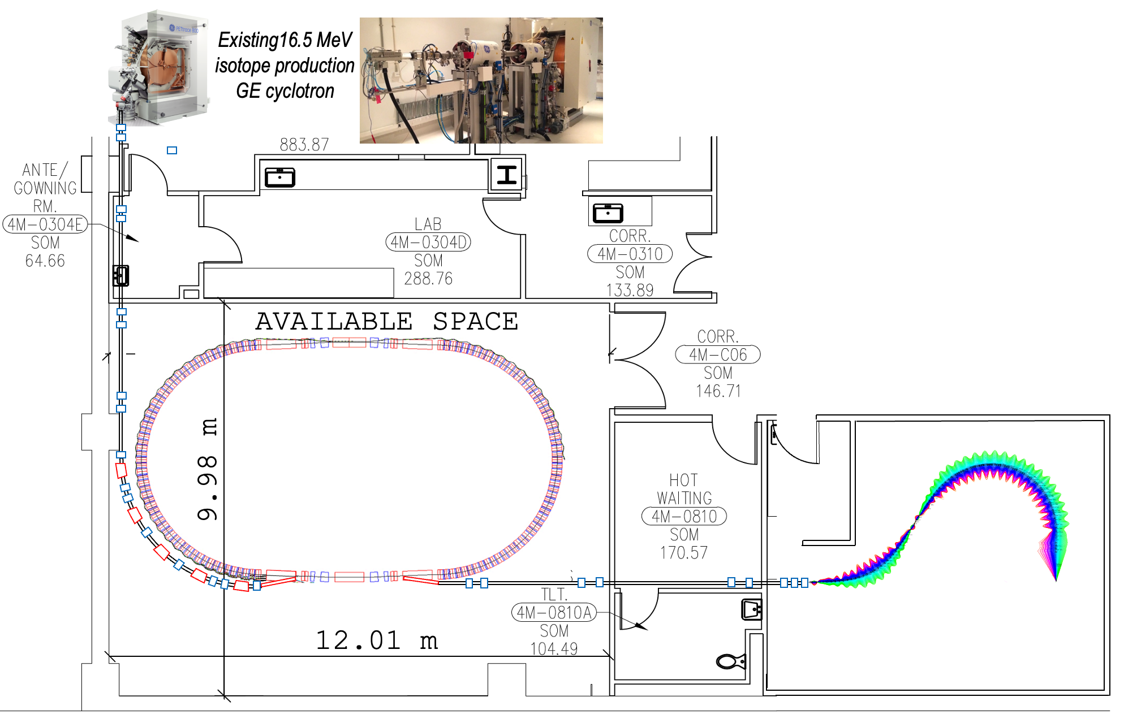
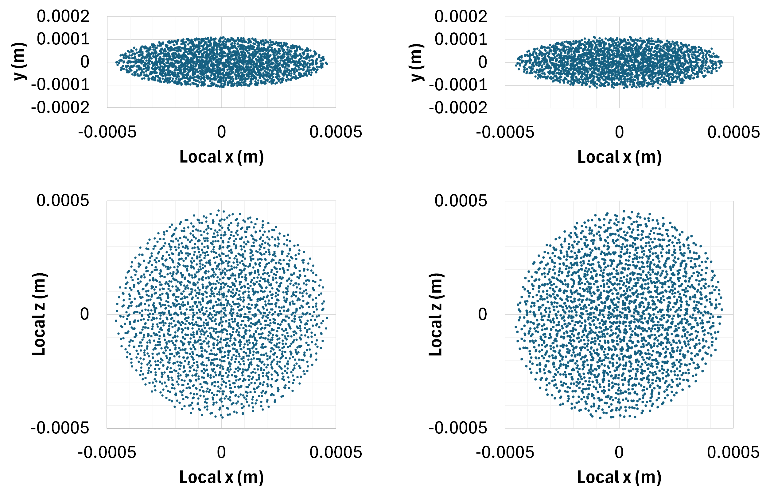
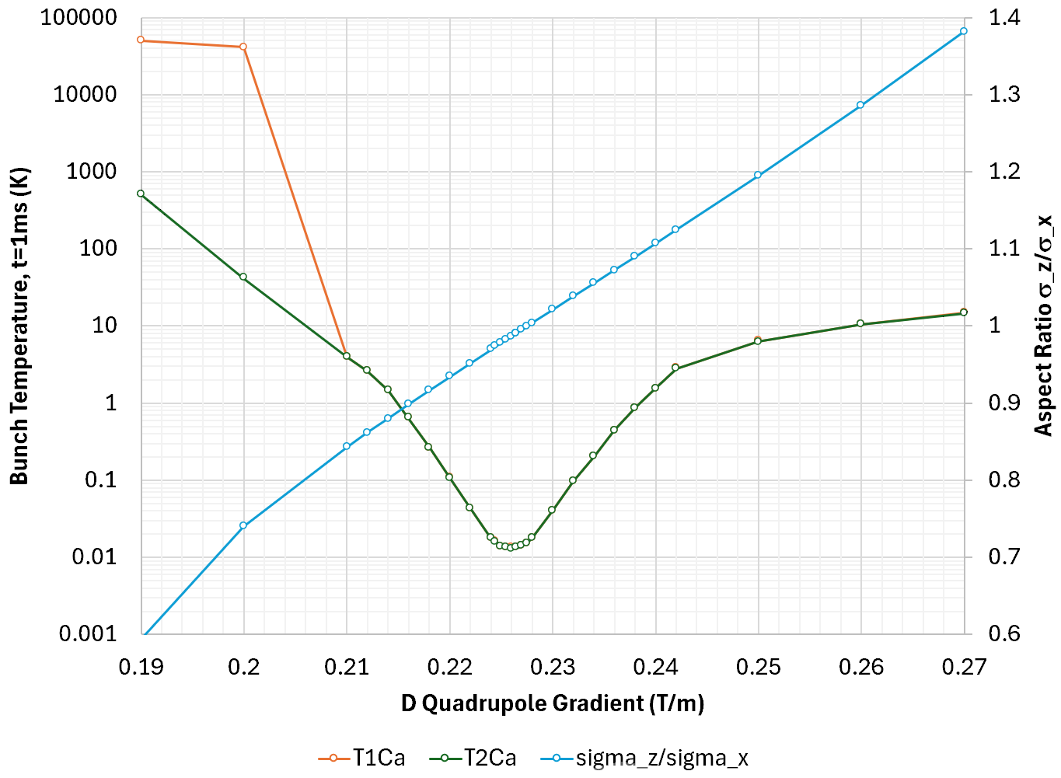
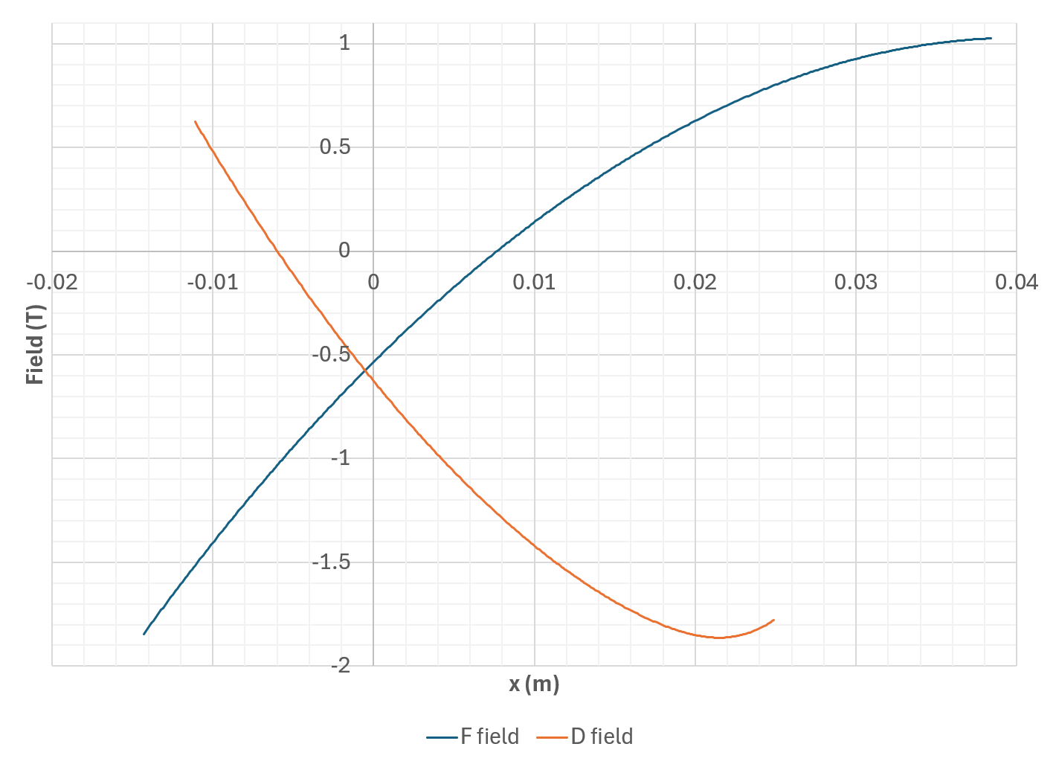
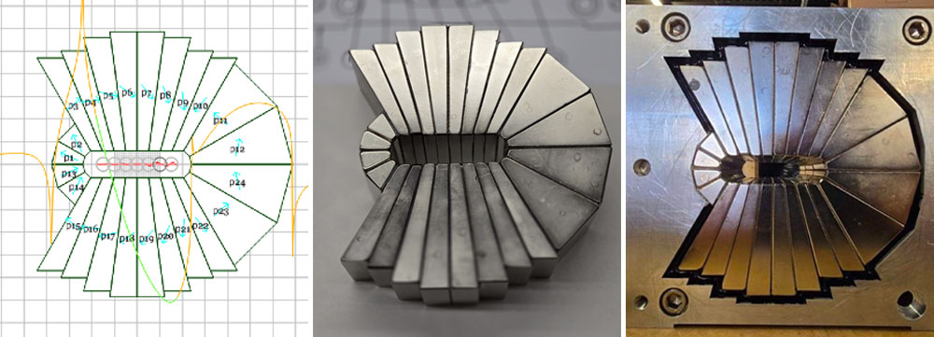
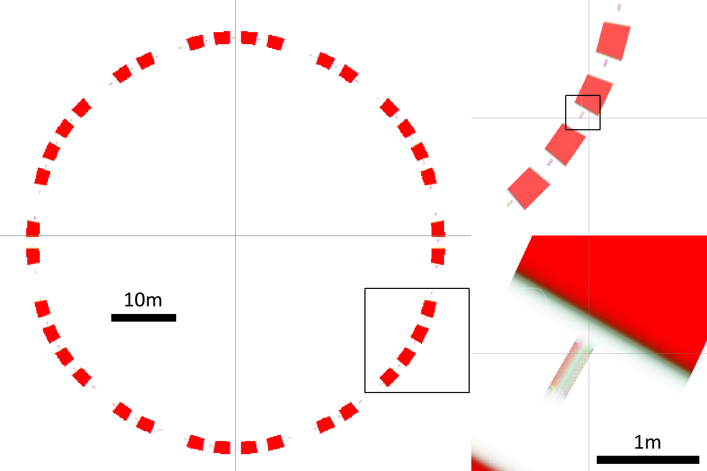
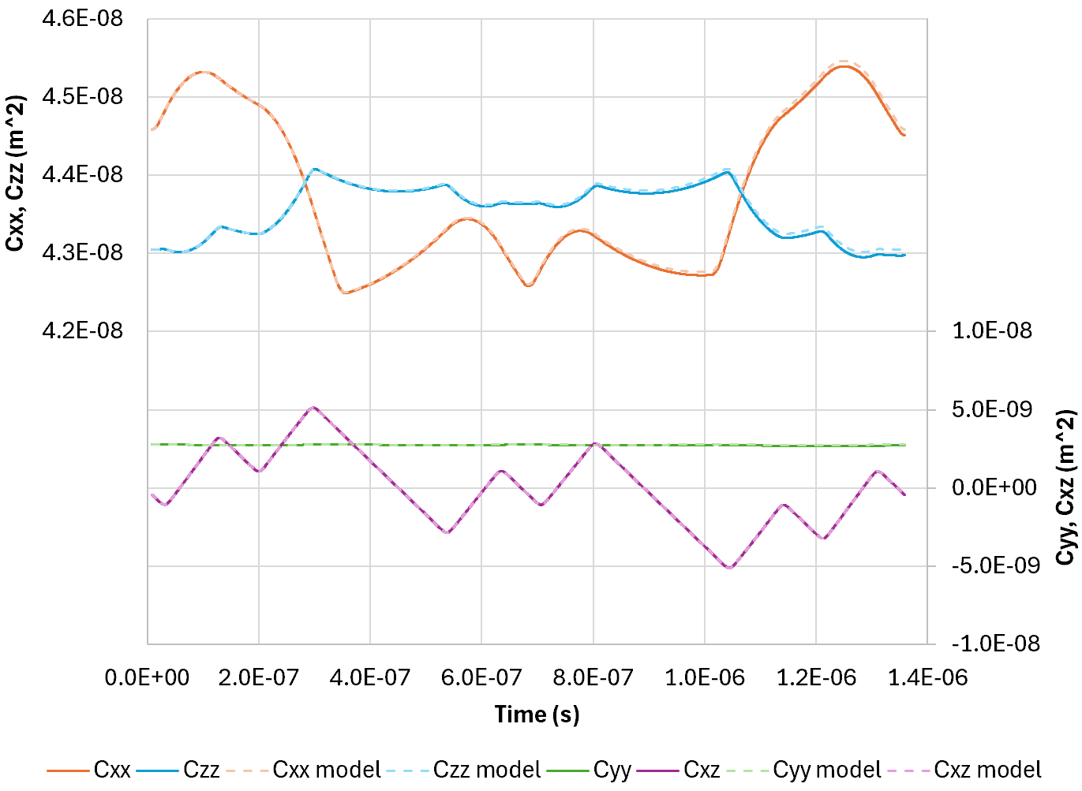
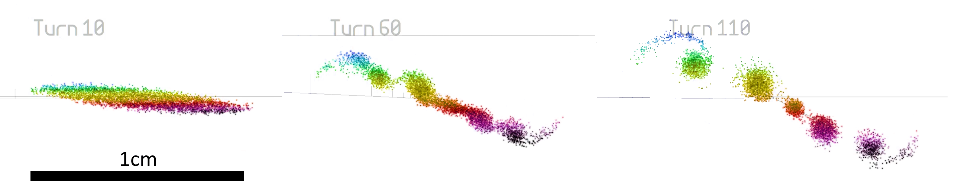
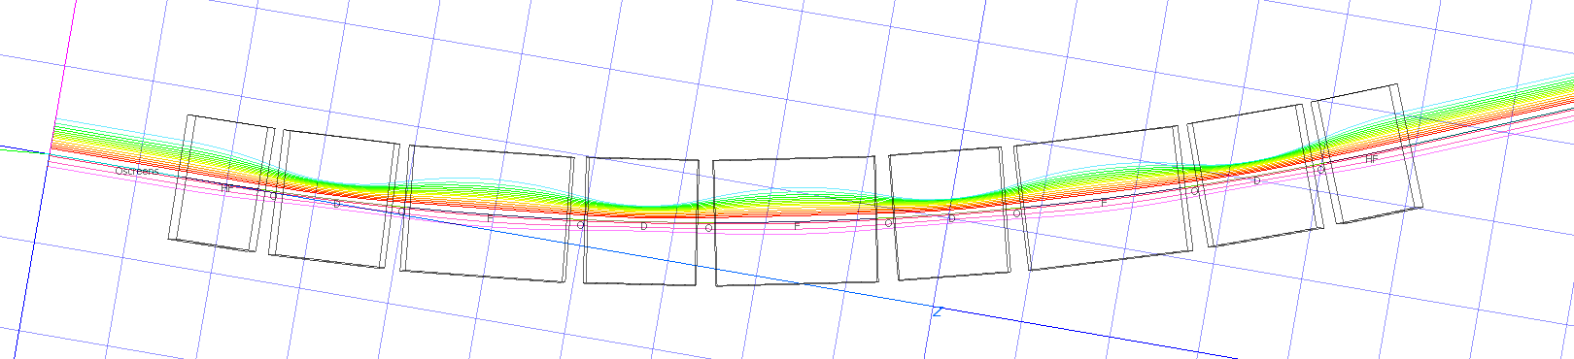
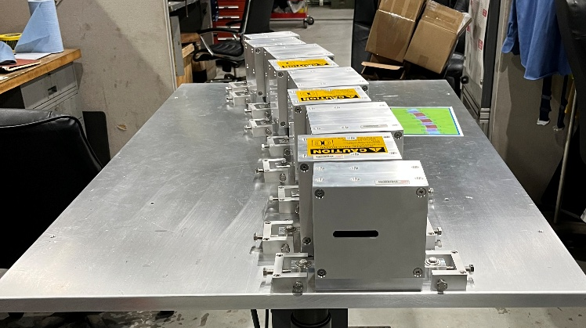
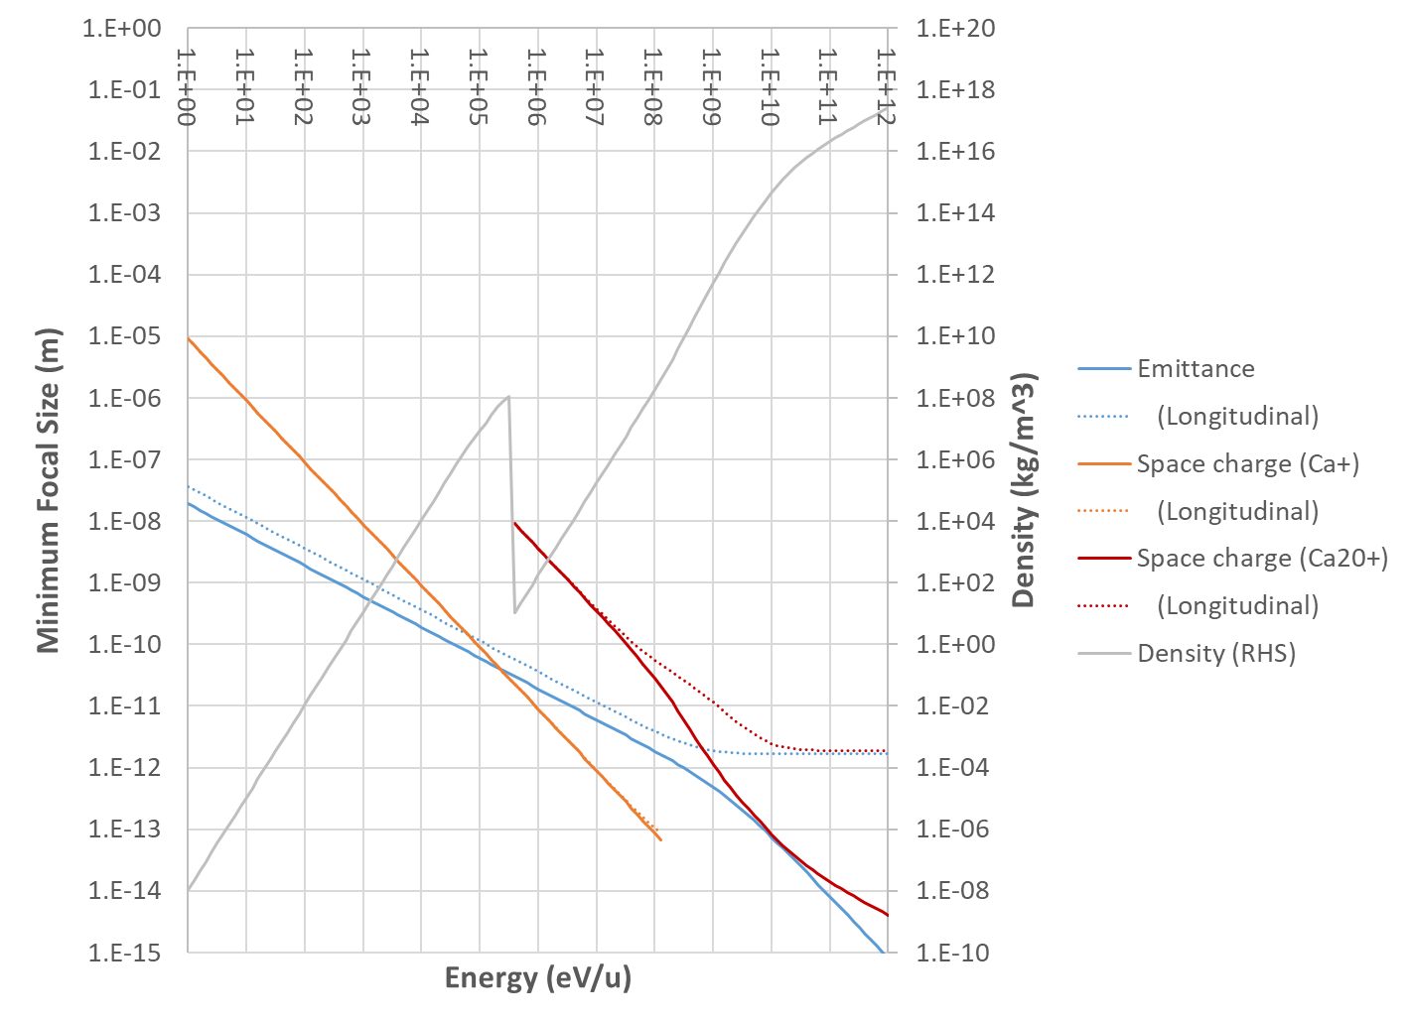
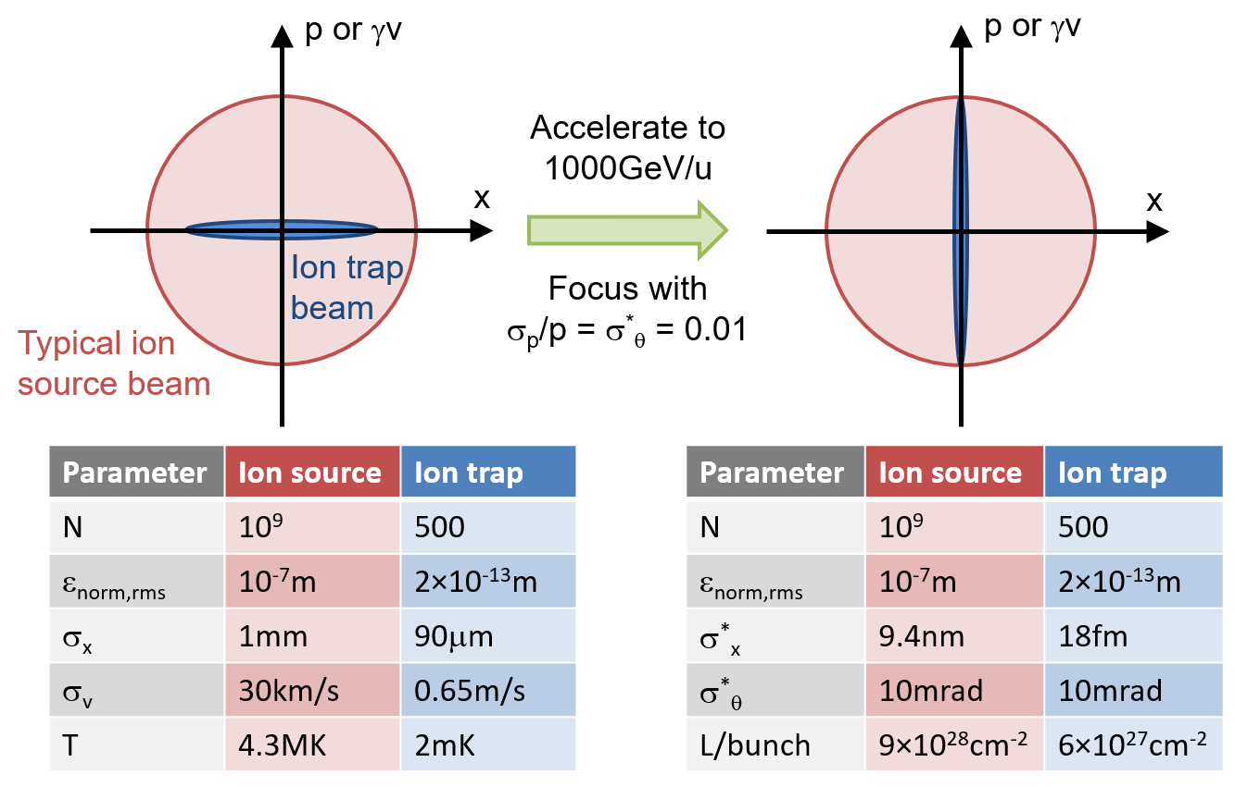
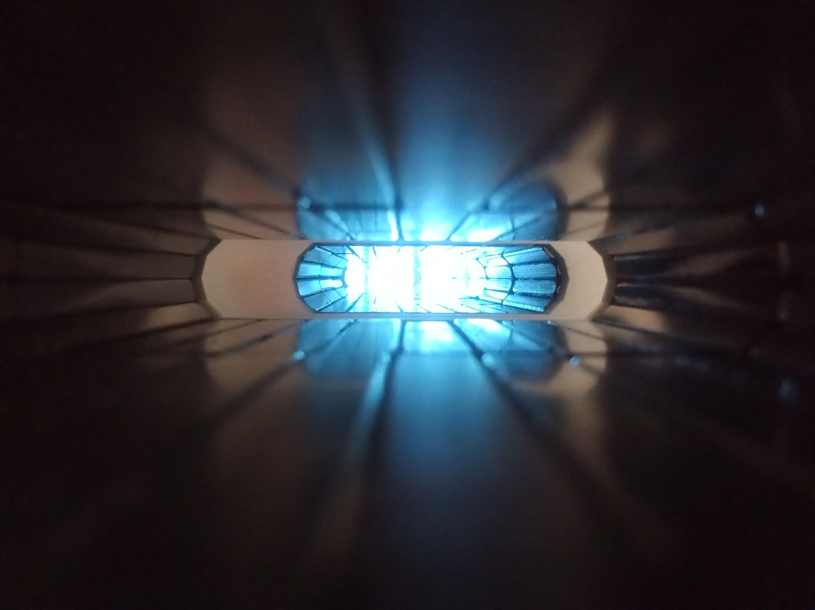
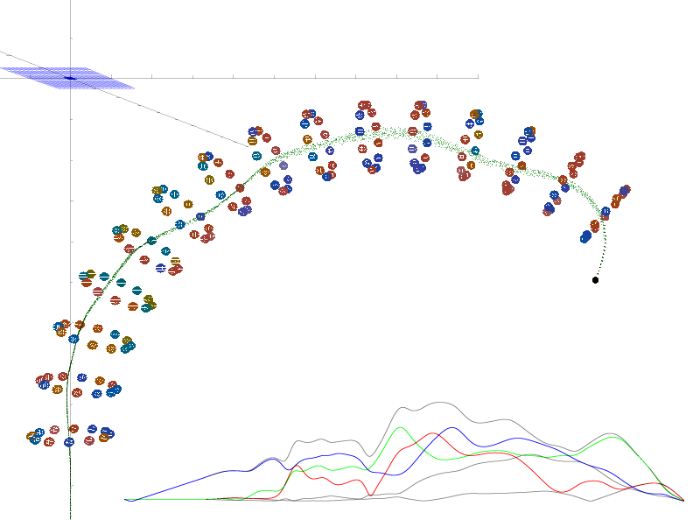
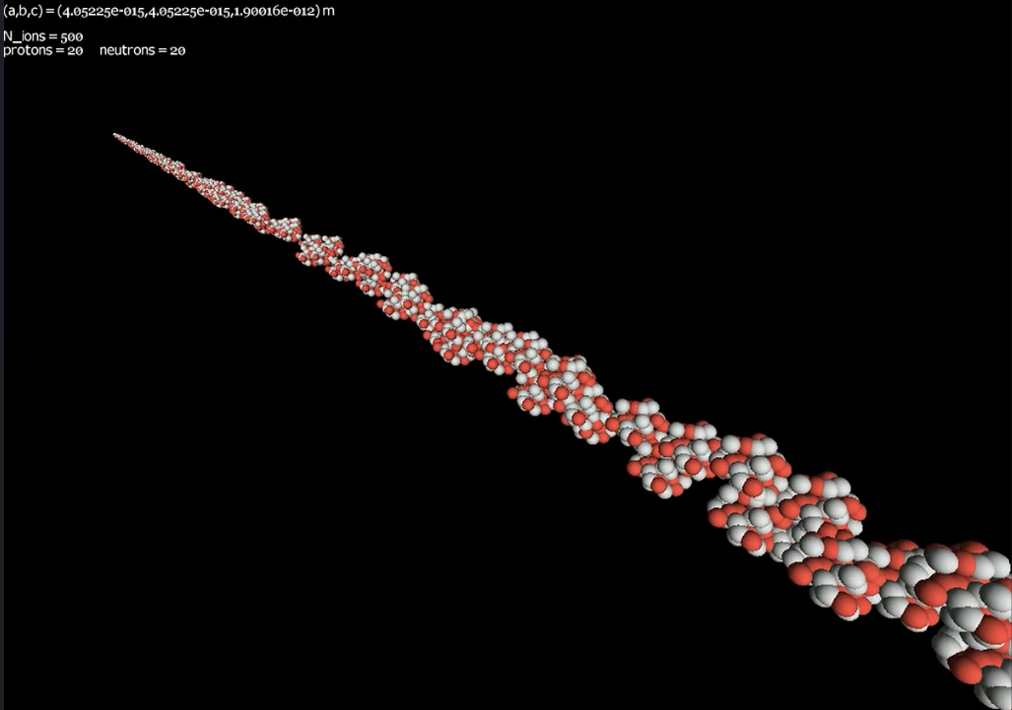
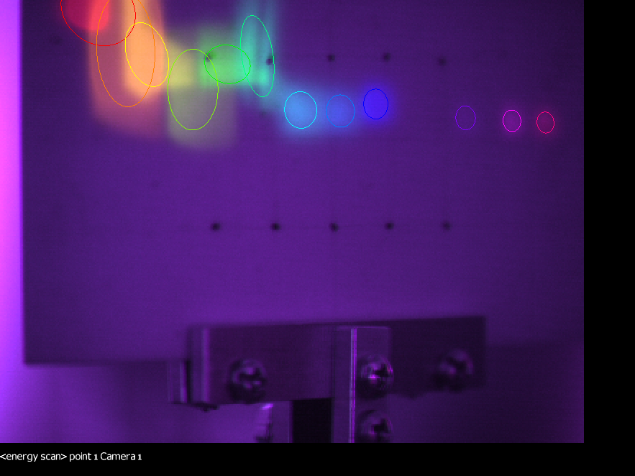
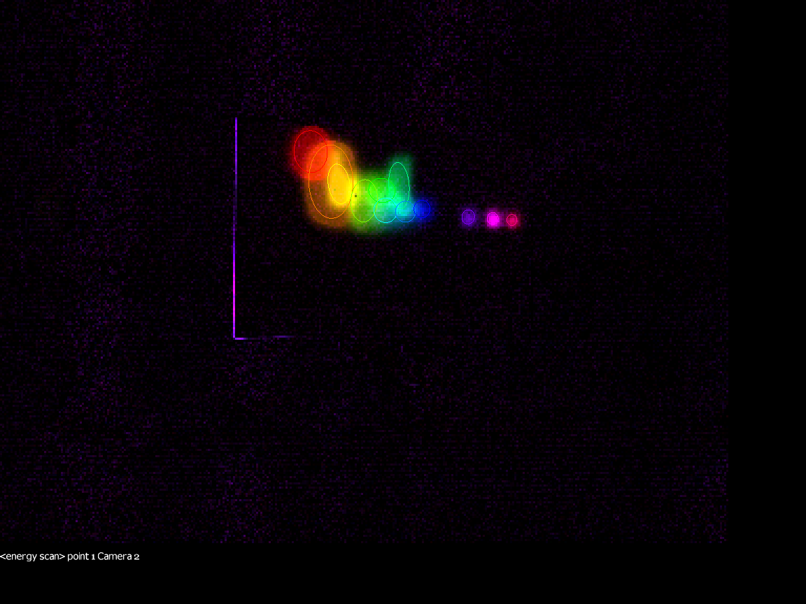
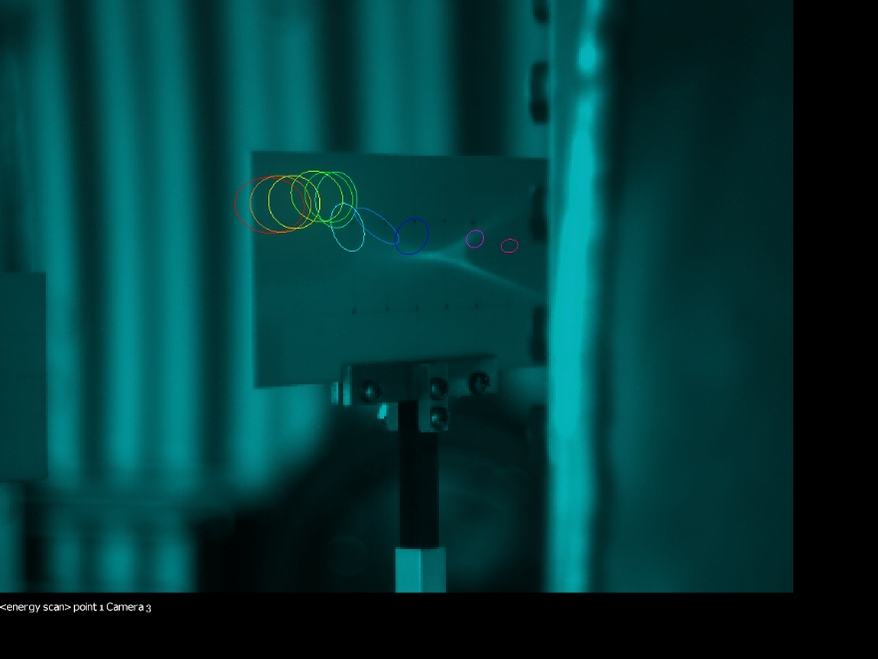
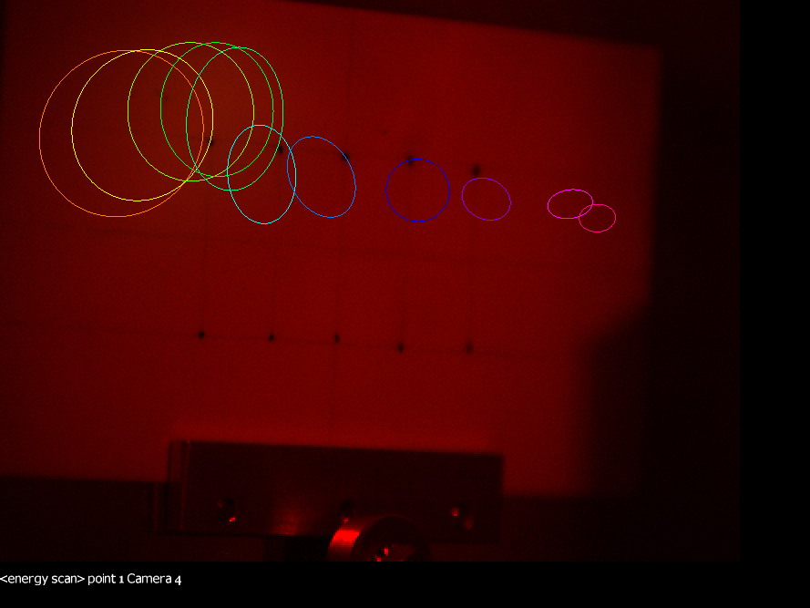
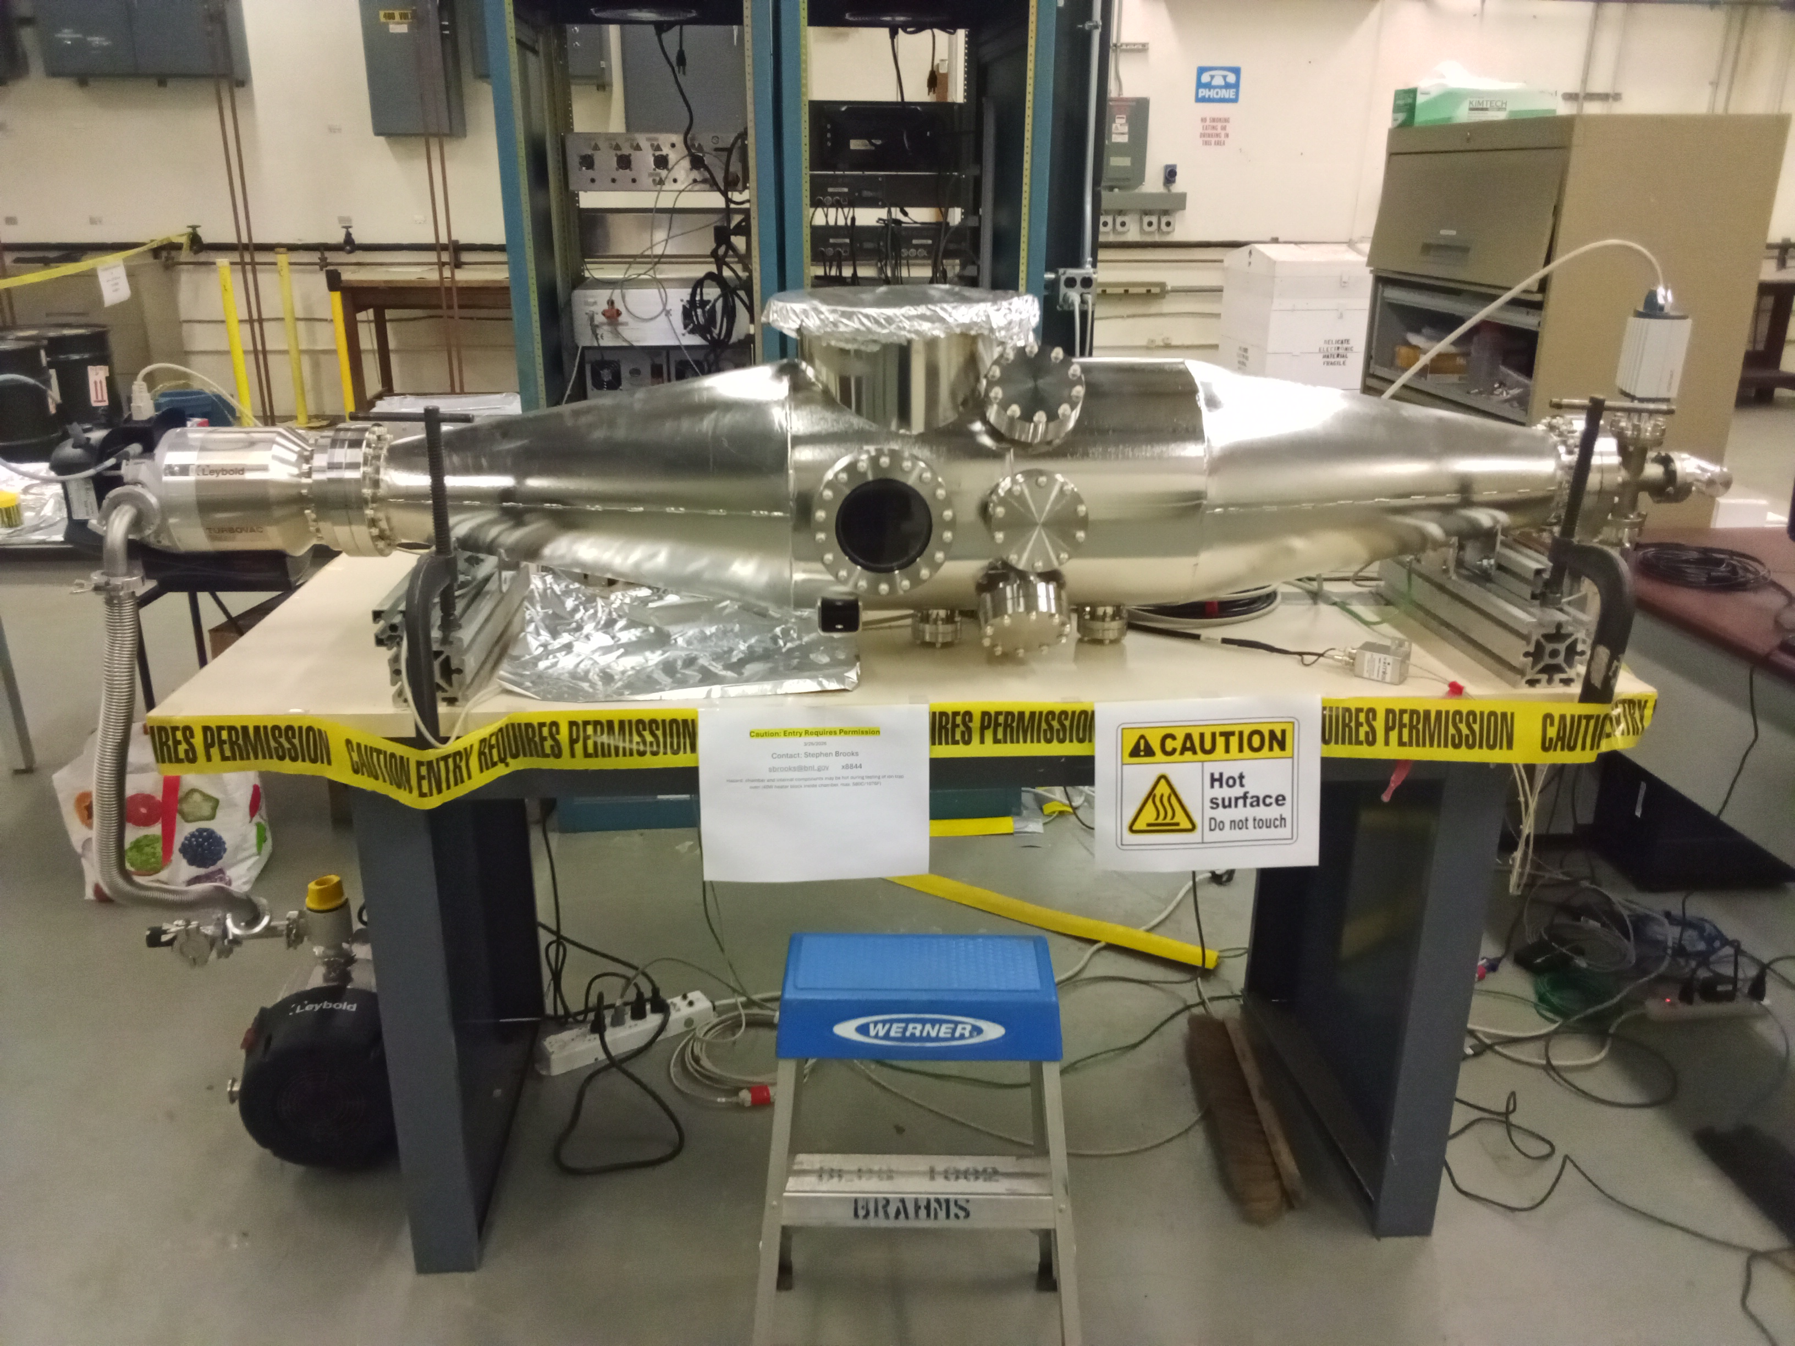
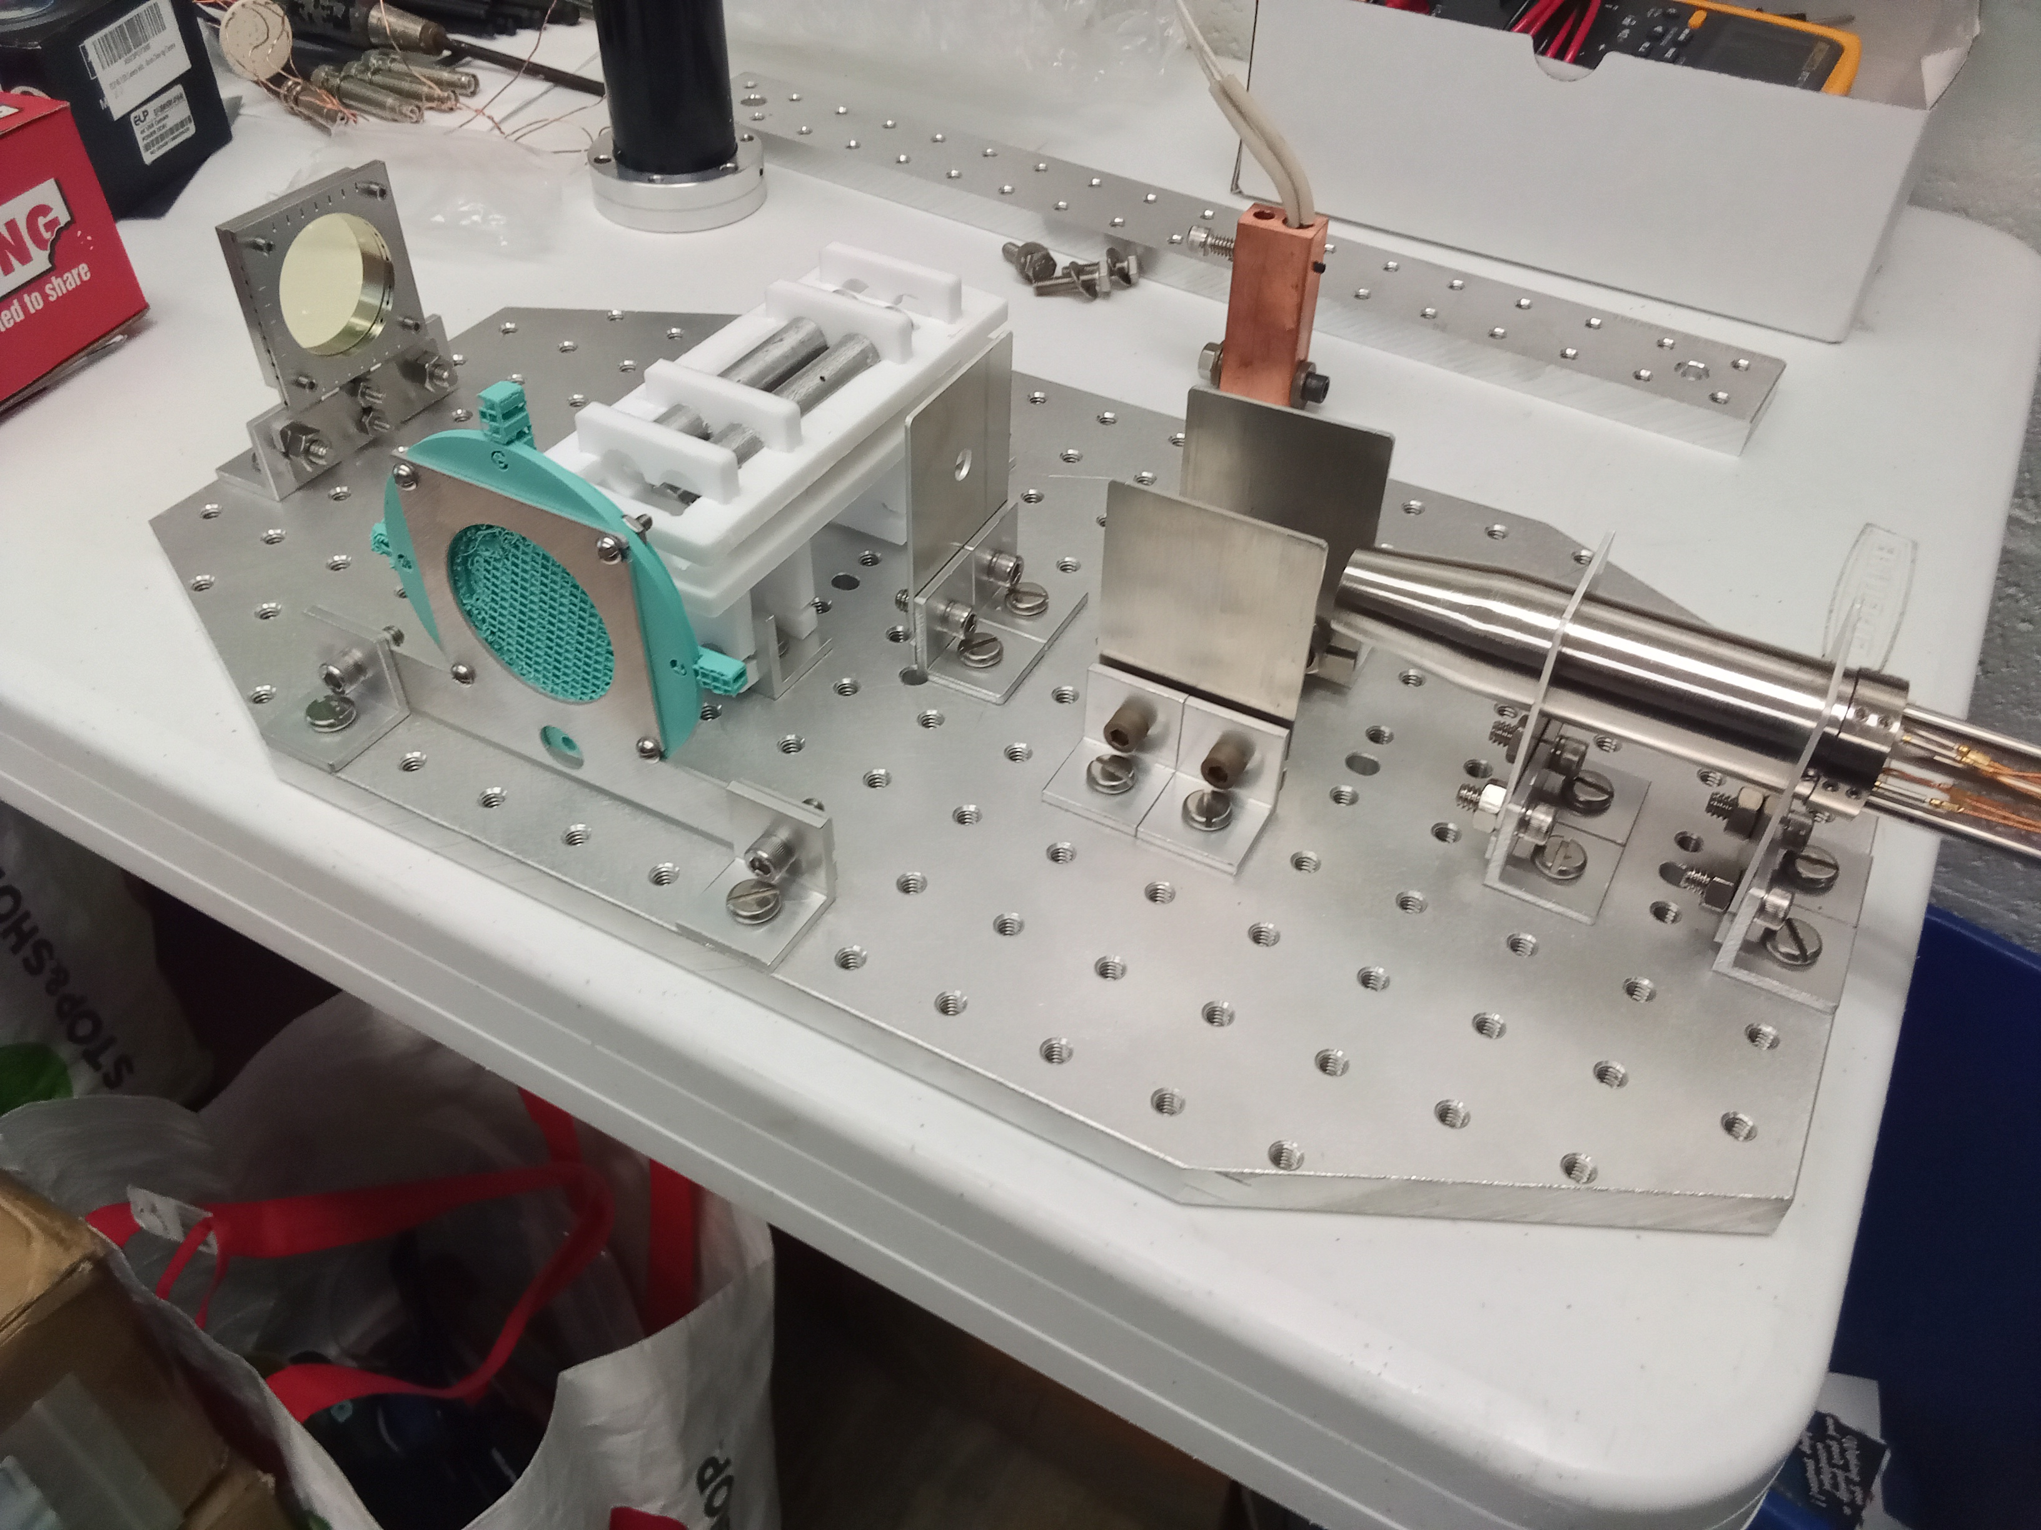
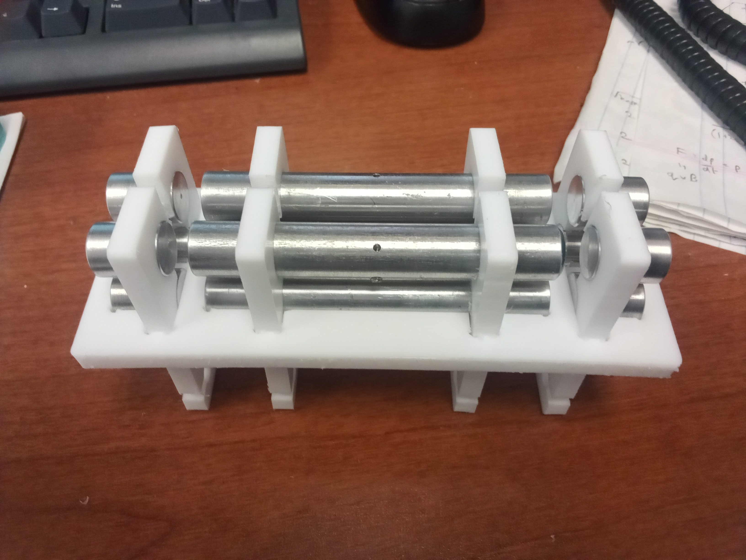
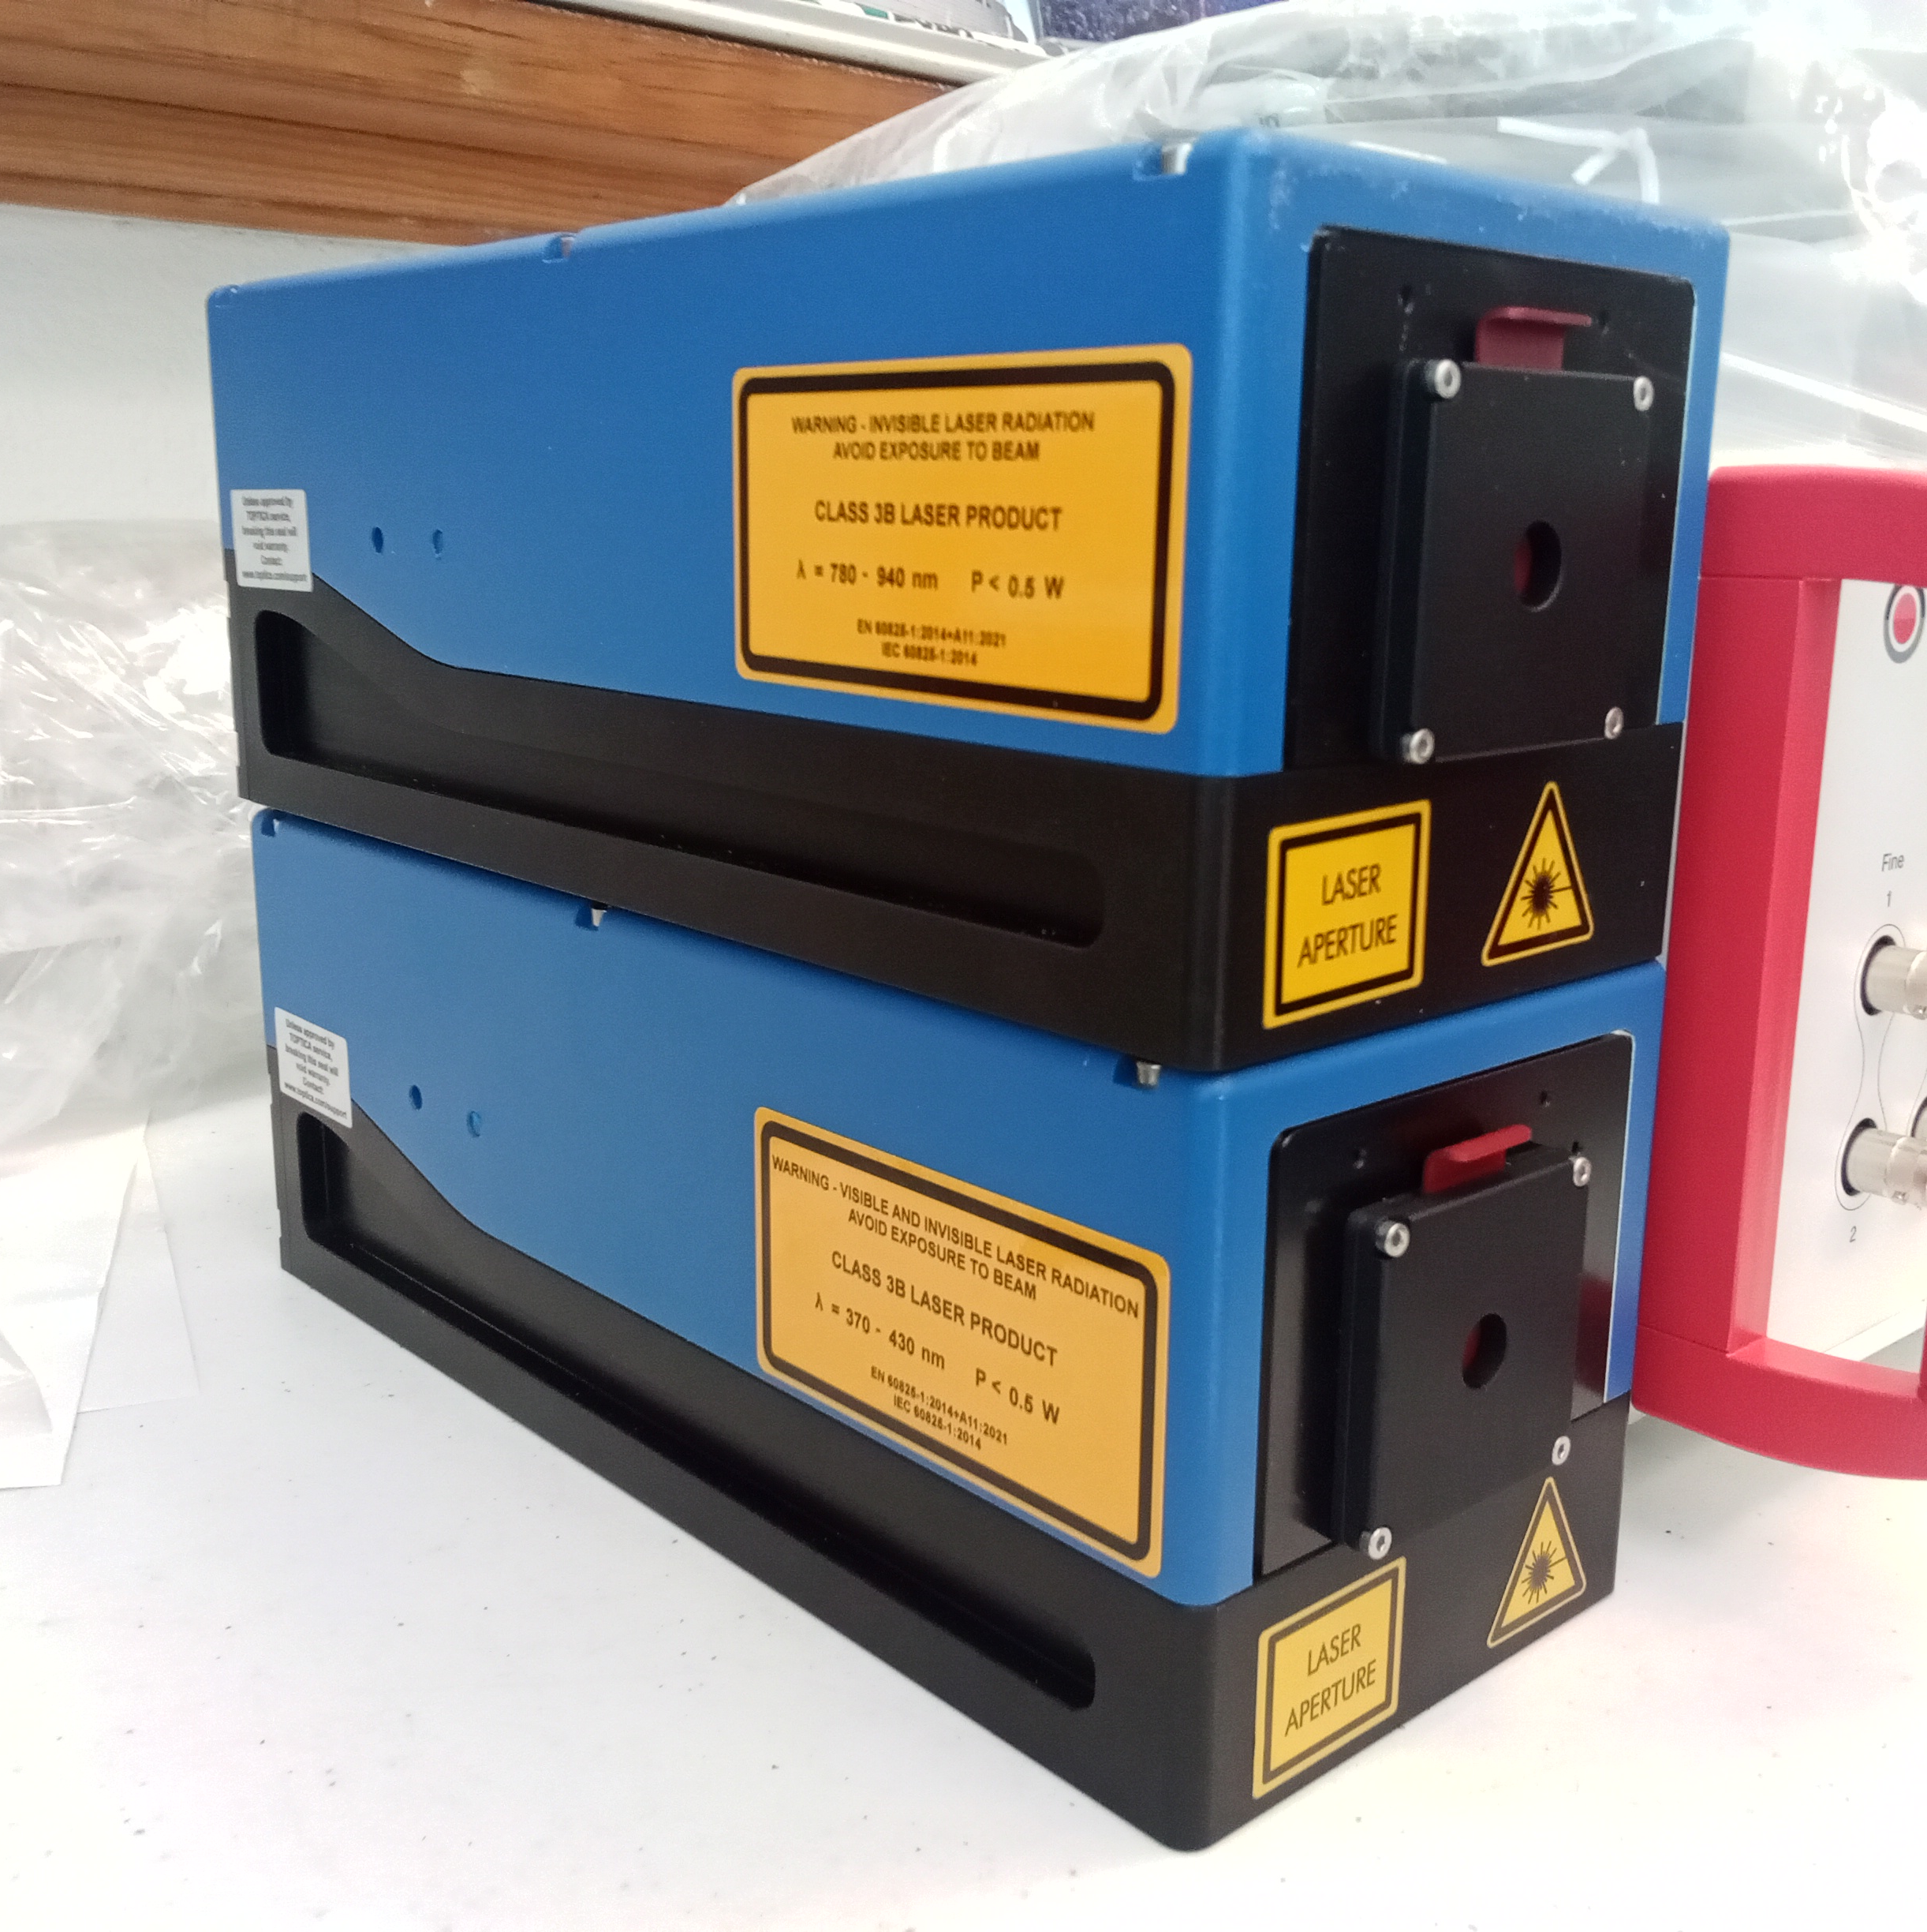
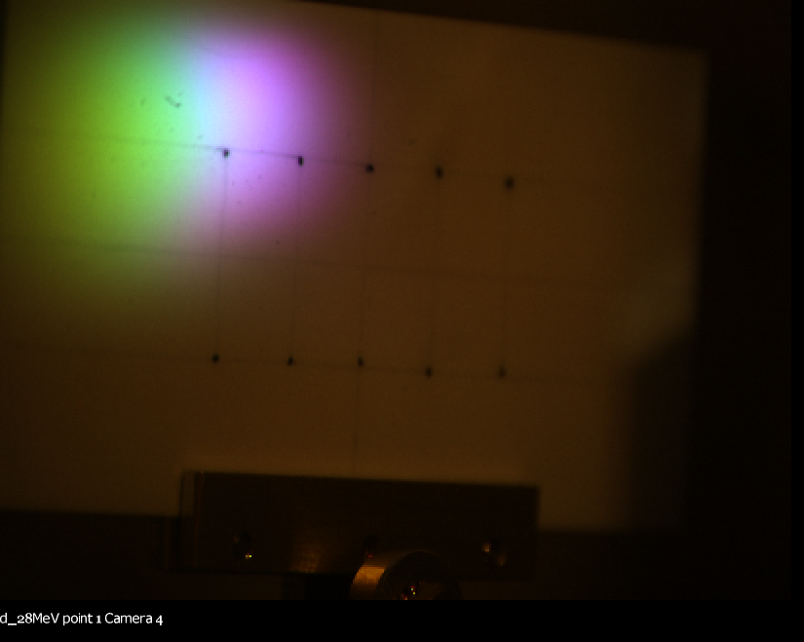
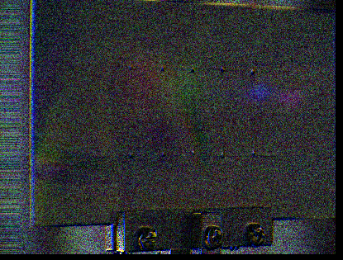
Advanced Accelerator Research at BNL
S.J. Brooks {sbrooks@bnl.gov}, D. Trbojevic, G. Mahler, Brookhaven National Laboratory, Upton, NY, USA
LDRD 22-013 (Type B) High-Gradient Permanent Magnets for Emerging Accelerator Applications
LDRD 24-010 (Type B) Section of Fast-Cycling FFA Synchrotron
LDRD 24-006 (Type B) Ion trap test stand and laser cooling studies of ultra-low emittance bunches for high luminosity
LDRD 26-055 (Type C) Laser System for Doppler Ion Cooling
Permanent Magnet Accelerator Design for Fast Hadron Therapy Treatments
Fixed-field accelerators (FFAs) allow the acceleration of beams without ramping magnetic fields: the orbit shifts to higher field regions instead. This avoids limits on machine cycle rate from magnetic inductance and forms the basis of the very-rapid-cycling medical accelerator facility shown below, producing high dose rates required for FLASH therapy as well as rapid energy scanning for 3D coverage of the tumor.
The wide 10-250MeV energy range of the accelerator is allowed by NdFeB permanent magnets with a peak field of 1.85T, shown below. The specially-designed nonlinear field profile keeps the machine tune constant throughout acceleration.
Beamline Tested at NSRL and Tandem
A 100% scale, full-field section of the arc with nine magnets (22.5°) was built and tested for beam transmission across the entire energy range: 50-250MeV protons at NSRL and 10-50MeV at BNL Tandem.
Simulations of Crystalline Beam Stability in the BNL Booster
Such a crystal distribution was placed into a magnetic field model of the BNL Booster synchrotron for 5500 turns (45ms). Quadrupole settings were found that reduced heating rates to less than 1K/s and preserve the solid state, even without additional laser cooling.
Nuclear Density Focal Point Formation
The 10⁵ times smaller velocity spread of a crystalline beam compared to a typical plasma source can be converted into a 10¹⁵-fold increase in density of a final focus, achieving the nuclear density around 1TeV/u.
Ion Trap Test Stand at BNL
Hardware for a Ca⁺ ion Paul trap with laser Doppler cooling has been purchased at BNL. This system will be a source of ultra-low emittance crystalline bunches and allow studies of their beam dynamics.
Laser Doppler cooling can cool ion bunches into solid “Coulomb crystals”, for example this simulated Ca⁺ crystal at 2mK temperature.
Parameter | Value | Unit
Injection E_{k} | 10-30 | MeV
Extraction E_{k} range | 65-250 | MeV
Arc radius | 3.5 | m
Machine cycle rate | 500-800 | Hz
Energy gain / turn | 30-45 | kV
Treatment charge | 60 | nC
Treatment time | 75-250 | ms
1mm
Example layout at Stony Brook Hospital
t=0ms
ε_{V}=1.13×10⁻¹³m
ε_{H}=8.86×10⁻¹³m
t=45ms
ε_{V}=4.82×10⁻¹³m
ε_{H}=1.90×10⁻¹²m
Heating rate:
0.5291K/s
Left: magnetic field model of the Booster.
Center: bunch sizes and correlations in one Booster “superperiod” (1/6 of a turn).
Below: a non-crystalline bunch in the same accelerator setting also spontaneously forms into circular solitons under the space charge “vortex effect”.
1cm grid
10MeV
HF
D
F
D
F
D
F
D
HF
250MeV
10cm grid
Nuclear density 2.5e17
Water 1e3
For N = 500 ions
σ_{p}/p = σ*_{θ} = 0.02
ε_{L} = 1.9ε_{T}
Above: focal density achievable as a function of beam kinetic energy.
Near right: generalized focusing beamline that makes a 3D aberration-free focus with 166 optimized parameters.
Far right: 500 Ca⁺ nuclei shown to scale at the 1TeV/u nuclear density focus (long due to relativistic effects).
View through the magnet apertures
10fm
Composite image of the 12 input beams from 10MeV (left) to 250MeV (right) at both facilities.
Lower plots show ellipses fitted to the output beams.
Beam in
Beam out
Tandem
NSRL
Vacuum chamber, turbopump and racks
Experimental board with electron gun, ion trap and phosphor screen
Electrostatic quadrupole Paul type ion trap
Narrow-linewidth lasers at 397 and 866nm for Doppler cooling of Ca⁺

