Slide 1
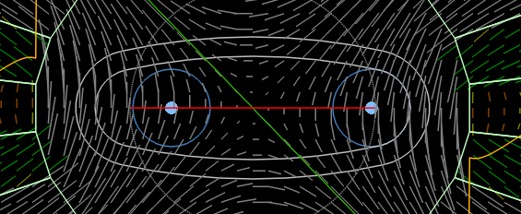
8mm
18.4mm
6mm
24.4mm
3mm (guessed – can it be thinner?)

