Slide 1
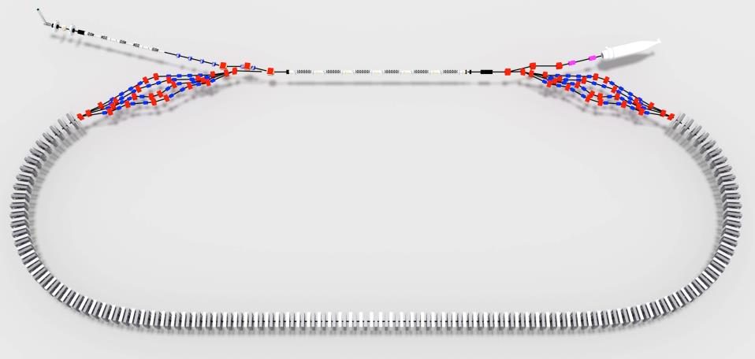

Page Headline
CBETA Lattice and Beam Dynamics

Slide 2
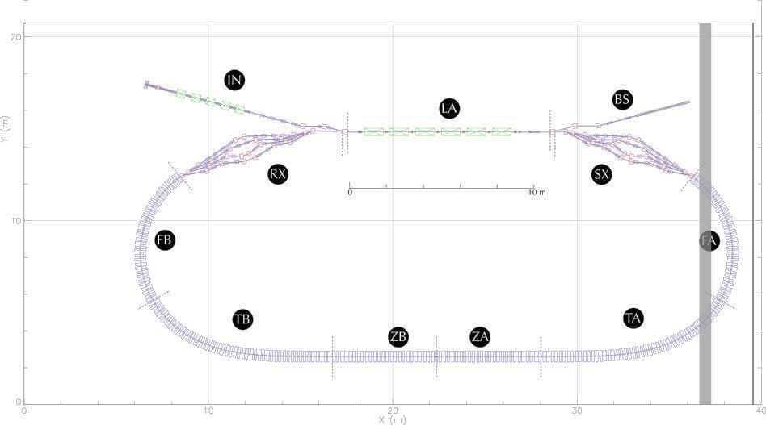
Page Headline
Layout in L0E Hall

Slide 3
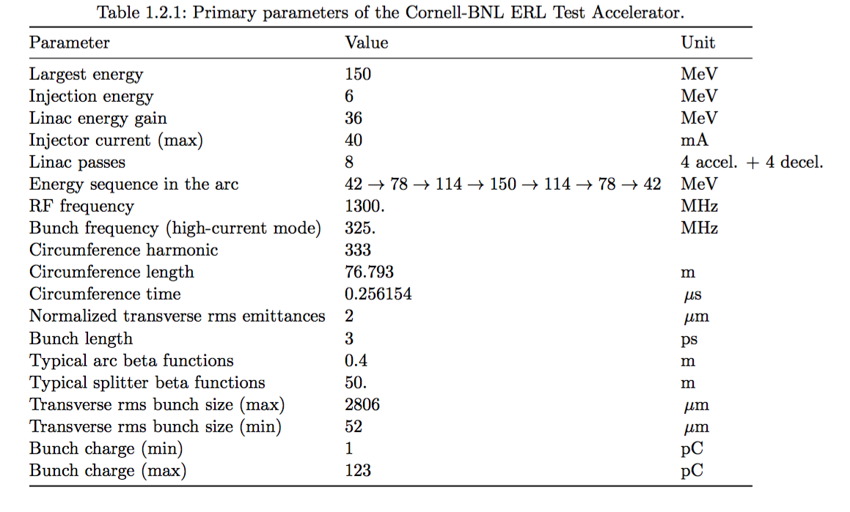
Basic Parameters
Page Headline

Slide 4
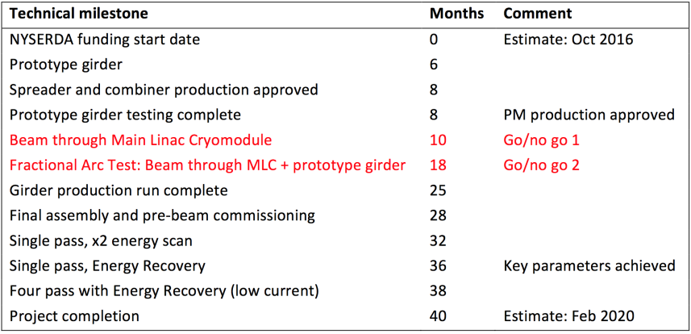
Schedule as of Last Week
Also potentially x2 energy scan
Steve Peggs

Slide 5
Layout Geometry
Page Headline

Slide 6
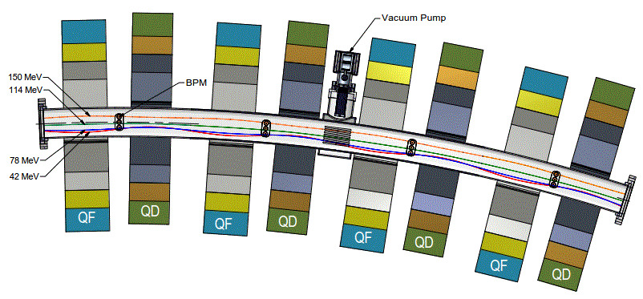
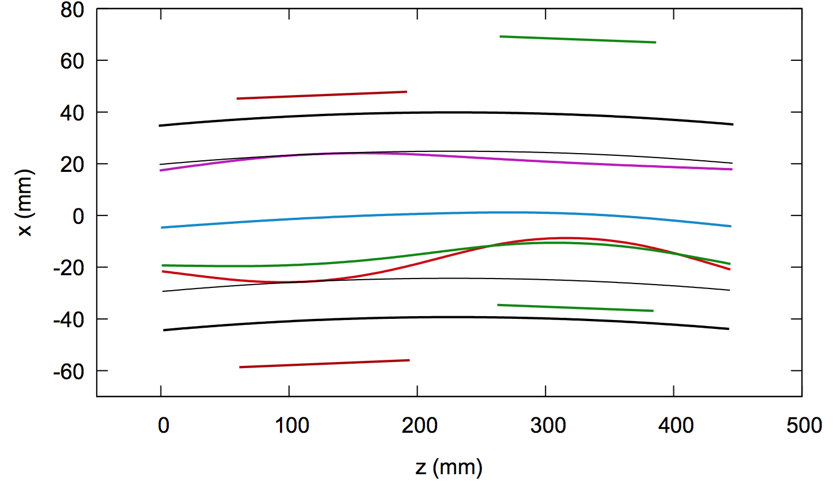
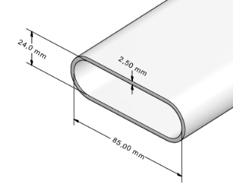
FFAG Arc Cell section
Page Headline

Slide 7
FFAG Arc Cell Orbits and Optics
Page Headline
Gradient: -10 T/m
Offset: -4 mm
Length: 12 cm
Gradient: 10 T/m
Offset: 17 mm
Length: 7 cm

Slide 8
FFAG Arc Cell Orbits and Fields
Page Headline
Cell optimization procedure
Original cell design: Hard edge quads
2D quad profile design
3D quad model
Tracking with 3D fields
Adjust gradients & offsets, go to step 2
Find ‘equivalent’ hard edge design

Slide 9
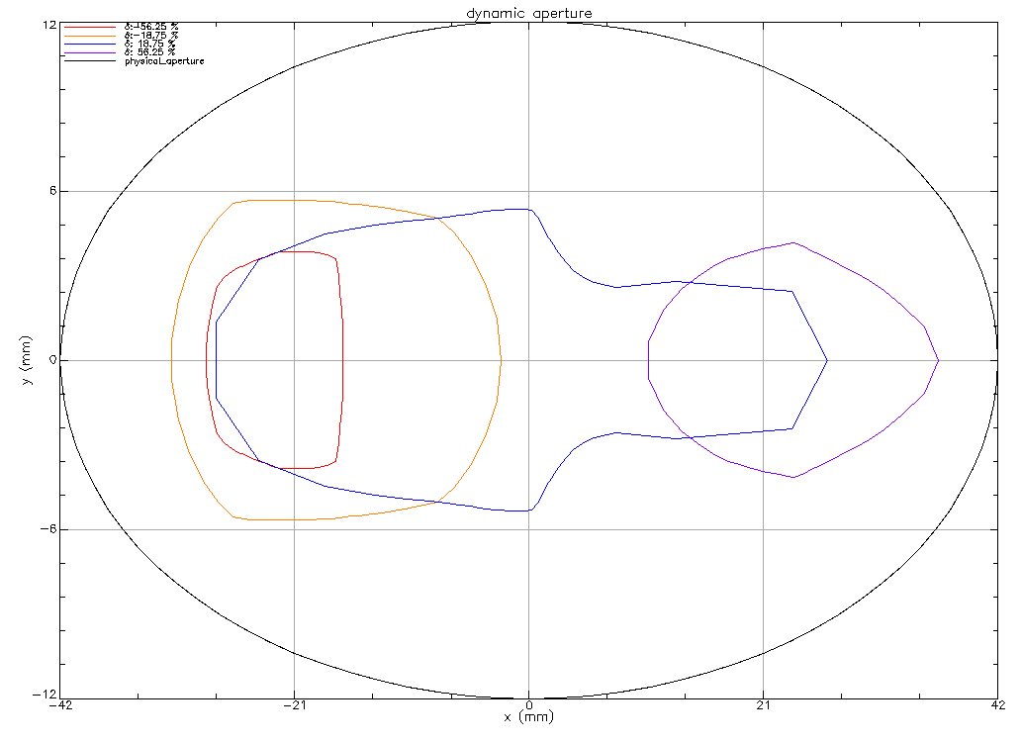
FFAG Arc Cell Orbits and Fields
Page Headline
Cell geometric aperture estimate
78 MeV
114 MeV
150 MeV
42 MeV
Particles starting with orbits displaced transversely relative to the stable orbit will survive the FFAG cell for 1000 turns.
Note that we will use a flatter chamber than this.

Slide 10
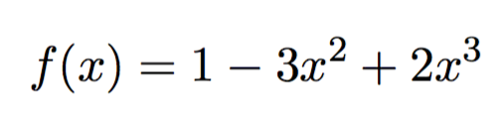
Page Headline
Designed FFAG Arc, transition, straight
Offsets, angles scaled by factor:

Slide 11
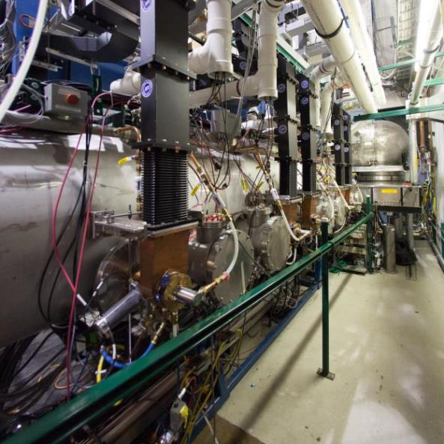
Page Headline
Cornell ERL Prototype Injector

Slide 12
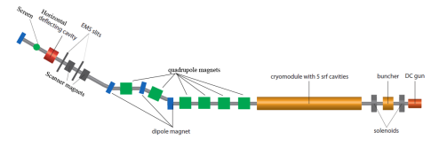
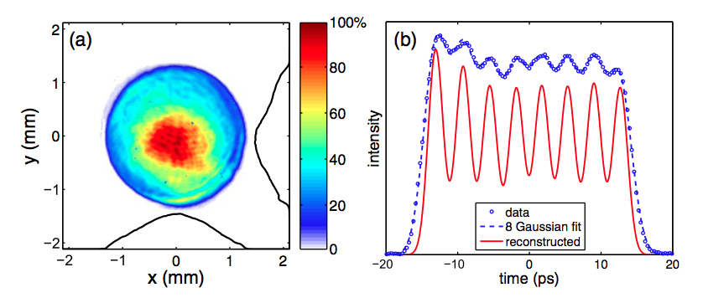
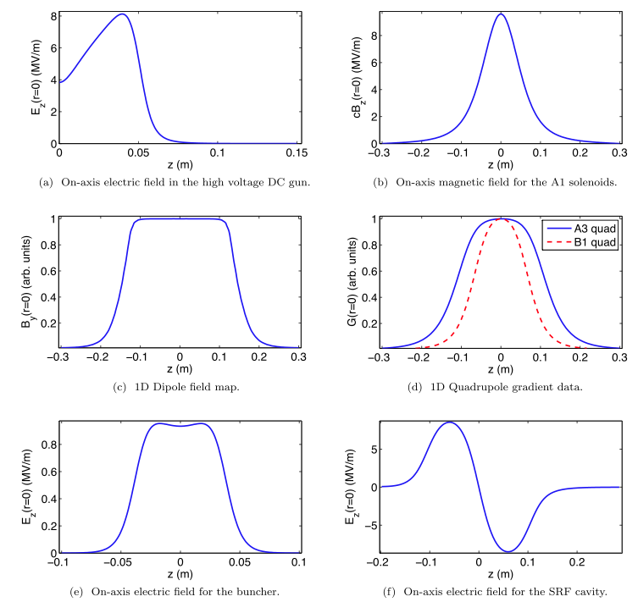
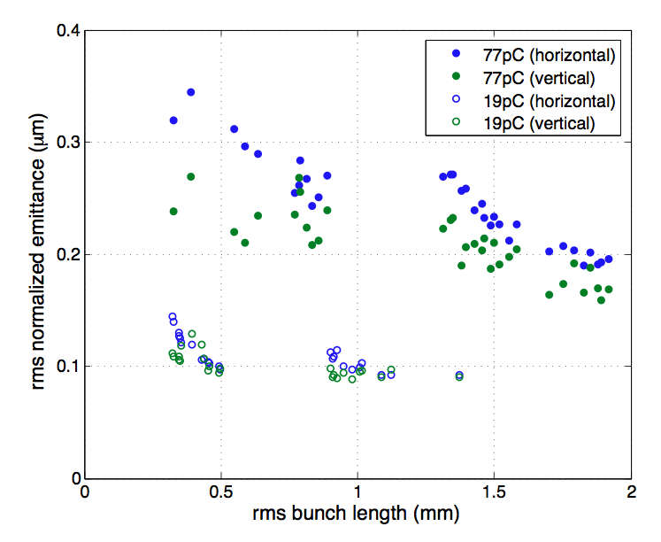
Injector modeling and optimization
Page Headline
Model
Laser shaping
Understand the fields
Optimize
Gun
Solenoid
Dipole
Quad.
Buncher
Cavity

Slide 13
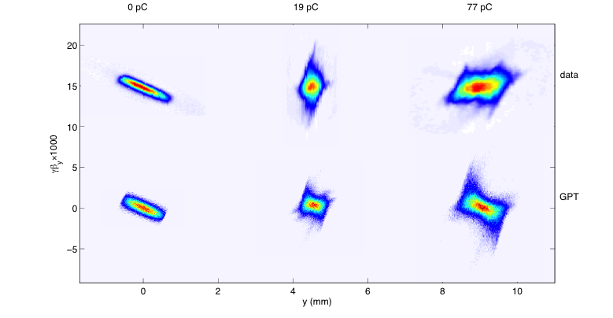

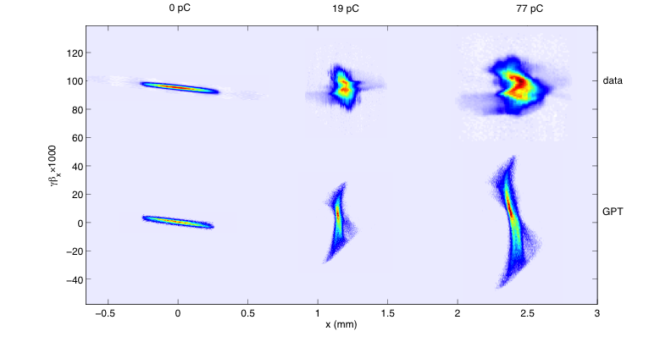

Injector measurements vs. simulation
Page Headline
0 pc
19 pc
77 pc
data
Data Type | enorm(100%) (mm-mrad) | enorm(90%) (mm-mrad)
Projected (EMS) | 0.20 (0.40) | 0.14 (0.29)
GPT | 0.16 (0.37) | 0.11 (0.25)
γβ_{y} X 1000
GPT
y (mm)
data
Data Type | enorm(100%) (mm-mrad) | enorm(90%) (mm-mrad)
Projected (EMS) | 0.33 (0.69) | 0.23 (0.51)
GPT | 0.31 (0.72) | 0.19 (0.44)
γβ_{x} X 1000
GPT
x (mm)
13
Gulliford et al., Phys. Rev. ST Accel. Beams 16, 073401 (2013)

Slide 14
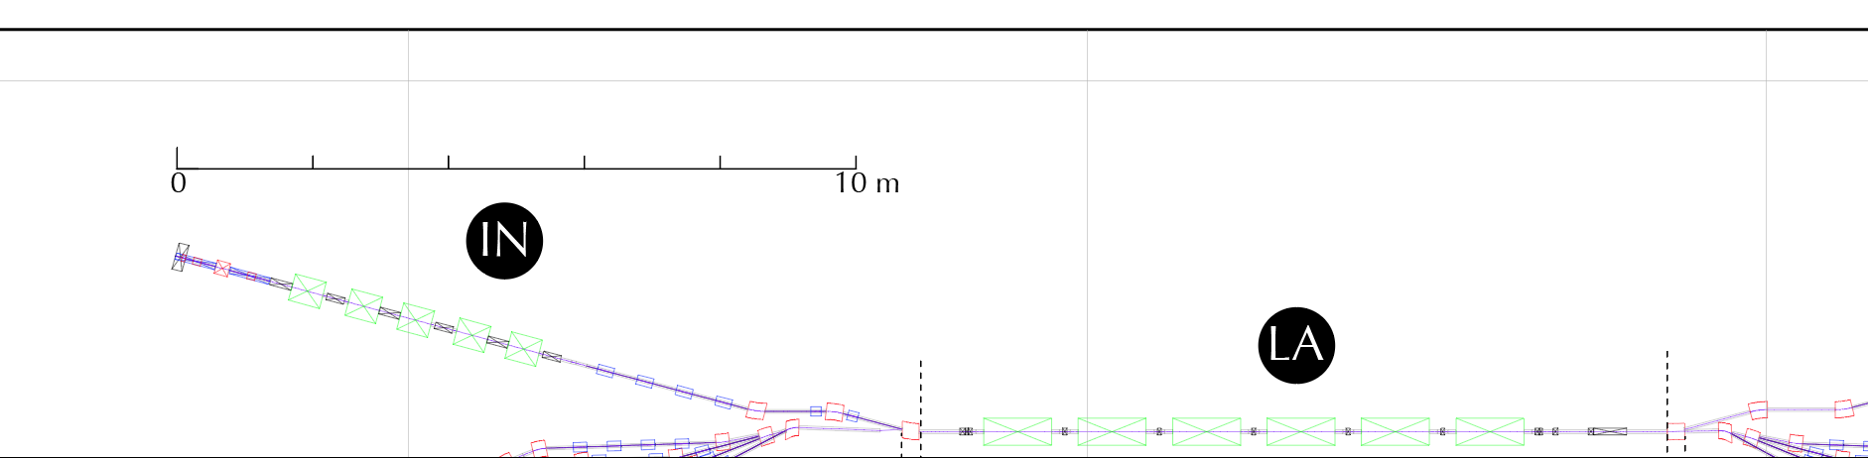
Page Headline
Space Charge optimization through LA
The beam is optimized with space charge using GPT to match specified beam sizes and divergence at the end of the first pass of the Linac.

Slide 15
Splitter and Recombiners (SX, RX)
Page Headline
Receive beams on-axis from LA
Match each energy beam onto its stable orbit in FA
Match optics for each energy beam
Momentum compaction (r56) adjustment
Path lengths: (S1 + FA pass 1) = (S2 + FA pass 2) =(S3 + FA pass 3)
Allow path length adjustment
Dipole fields < 0.8 T
Quad fields < 4 T/m
Realistic transverse element sizes

Slide 16
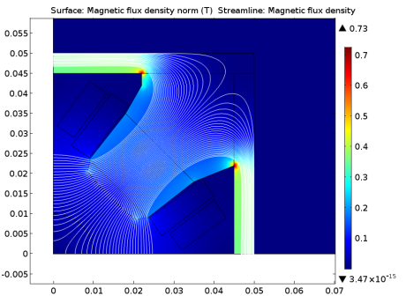
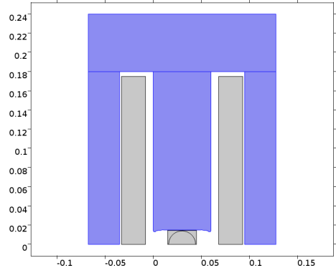
Splitter magnet concepts
4 T/m Quadrupole
0.9 T dipole

Slide 17
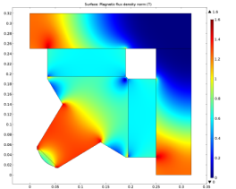
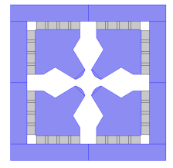
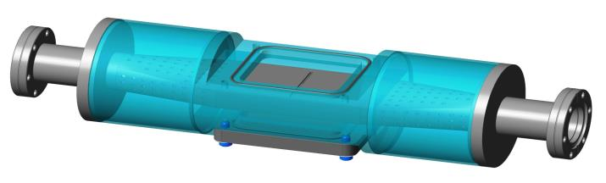
Other work at BNL
FFAG permanent magnet with iron poles (Holger Witte)
Possible upgrade to resistive-based BPM (Peter Thieberger)

Slide 18
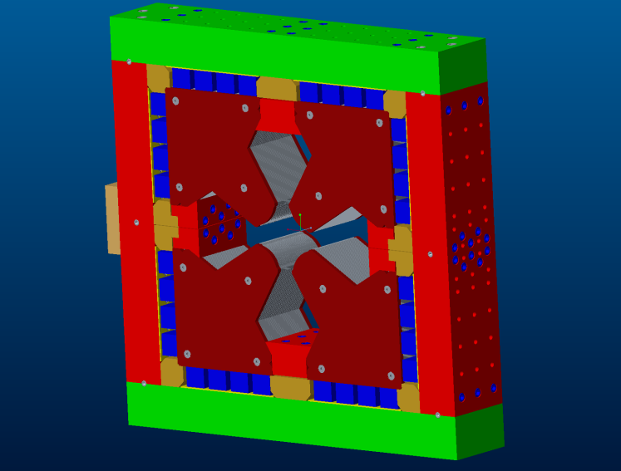
Mechanical Design of FFAG Quad
George Mahler

Slide 19
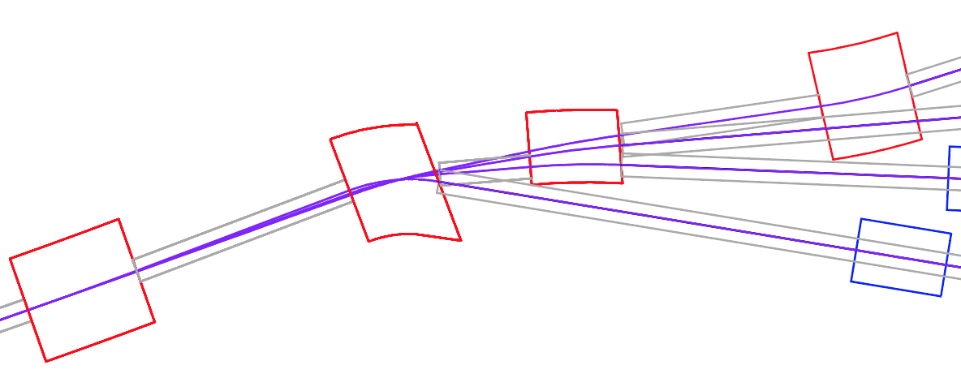
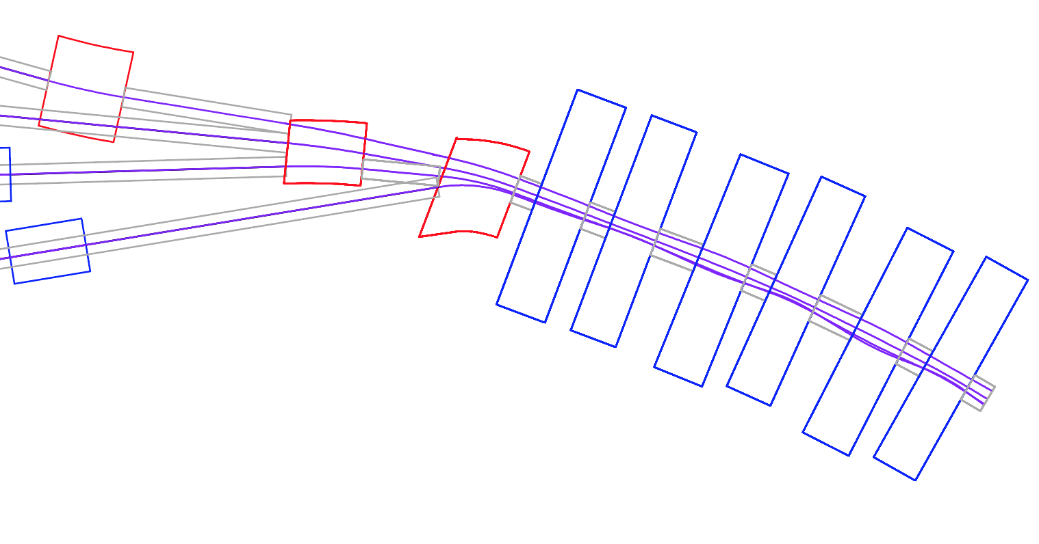
SX demerge and merge
0.41 T
S4: 150 MeV
BS
0.16 T
0.36 T
S3: 114 MeV
S2: 78 MeV
S1: 42 MeV
0.0126 T
S4
FA
S3
S2
S1

Slide 20
Splitter and Recombiners (SX, RX)
Page Headline

Slide 21
Page Headline
Path length: 1-pass ERL

Slide 22
Path length: 2-pass ERL
Page Headline

Slide 23
Path length: 3-pass ERL
Page Headline

Slide 24
Path length: 4-pass ERL
Page Headline

Slide 25
4-pass Optics Design
Page Headline
Design
Match into Energy 3 (114 MeV) line

Slide 26
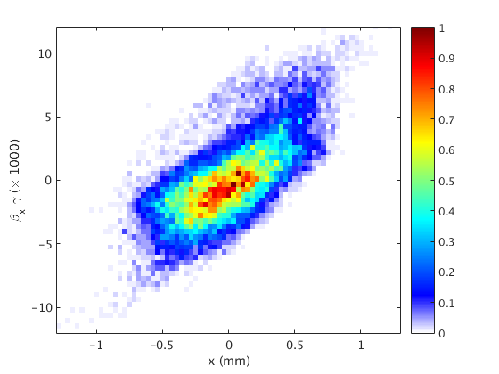
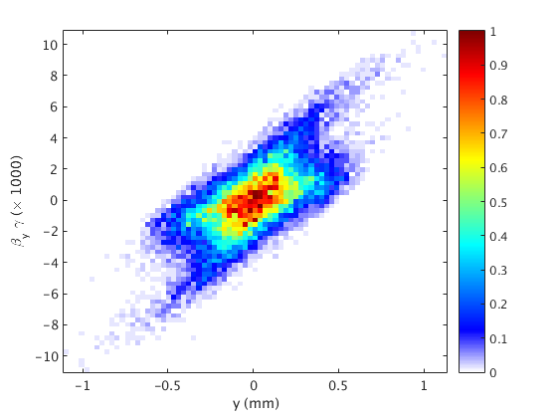
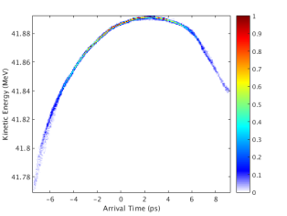
Page Headline
Start-to-End tracking
100 pC bunch calculated from GPT with space charge
…spliced into Bmad 4-pass model

Slide 27
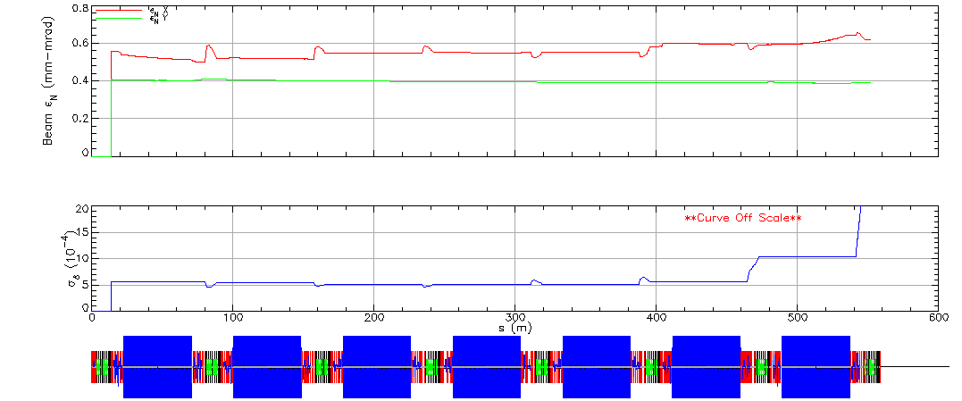
Page Headline
Start-to-End tracking

Slide 28
Page Headline
Orbit correction simulation
200 um offset errors in all quads
Simultaneously corrected: h corrector in QF, v corrector in QD

Slide 29
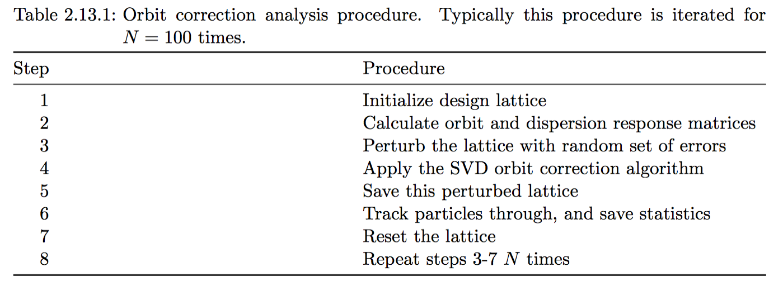
Page Headline
Corrector strength scaling for offsets

Slide 30
Page Headline
Roughness and Resistive wall
Rough estimate of the total wakefield from about 7 passes through the FFAG sections
Estimate for bunch with 500 pC charge, 2 ps duration:
2% energy spread at 6 MeV
To Do: beam tracking with these

Slide 31
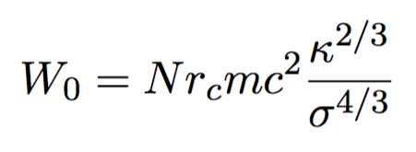
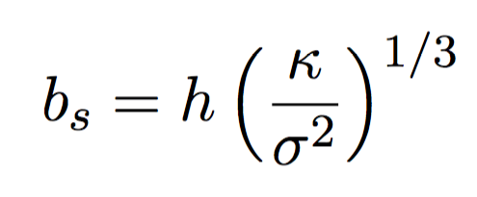
Page Headline
Coherent Synchrotron Radiation (CSR)
CSR wakefield pattern with shielding
Effect of shielding
The CSR wakefield scales as:
Its effect can be shielded according to:
where h is the full chamber height

Slide 32
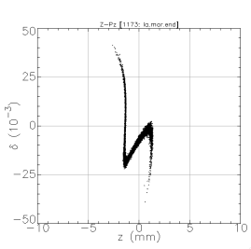
Page Headline
Sources of particle Loss
Beam
Rest Gas Scattering (rough estimate: 10 pA loss)
Touschek Scattering
Defocusing by ion trapping
Longitudinal Tails:
From injection
Z-Pz mismatch
Caused by Coherent Synchrotron Radiation
Other wakefields
Non-Beam (Dark Current)
Cavity field emission
Halo from cathode

Slide 33
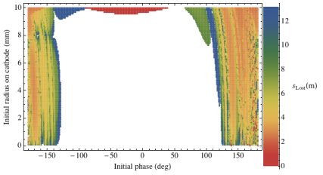
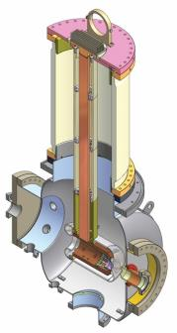
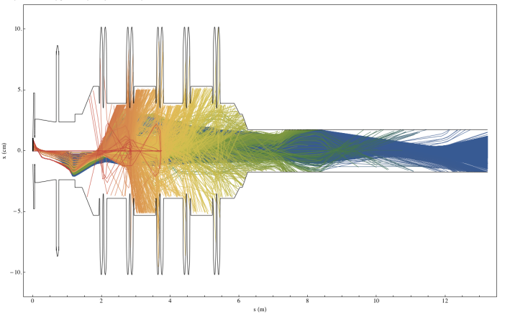

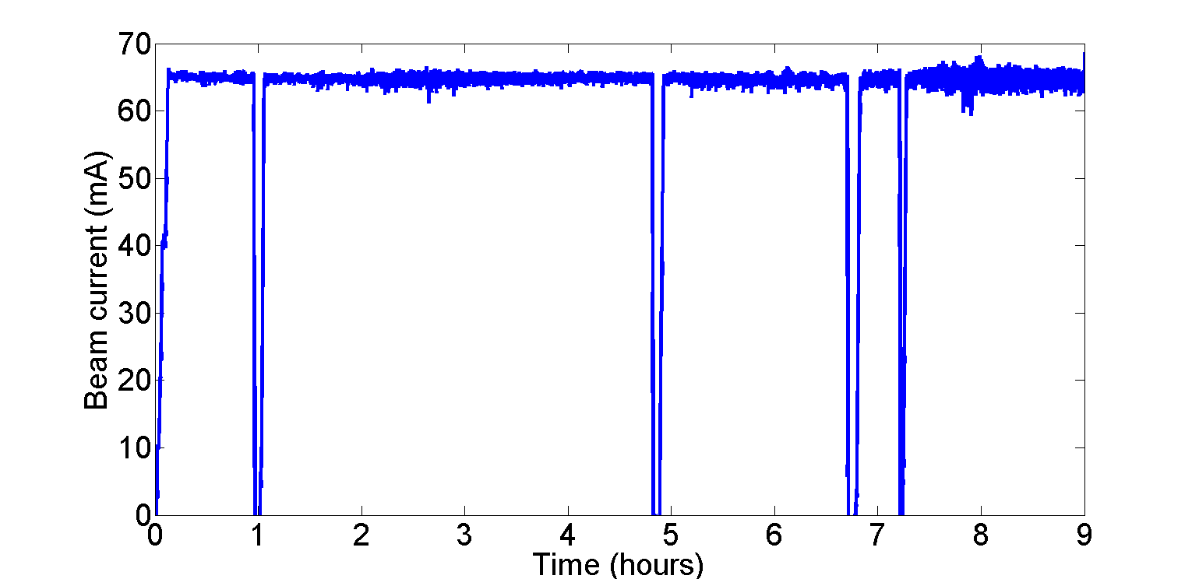
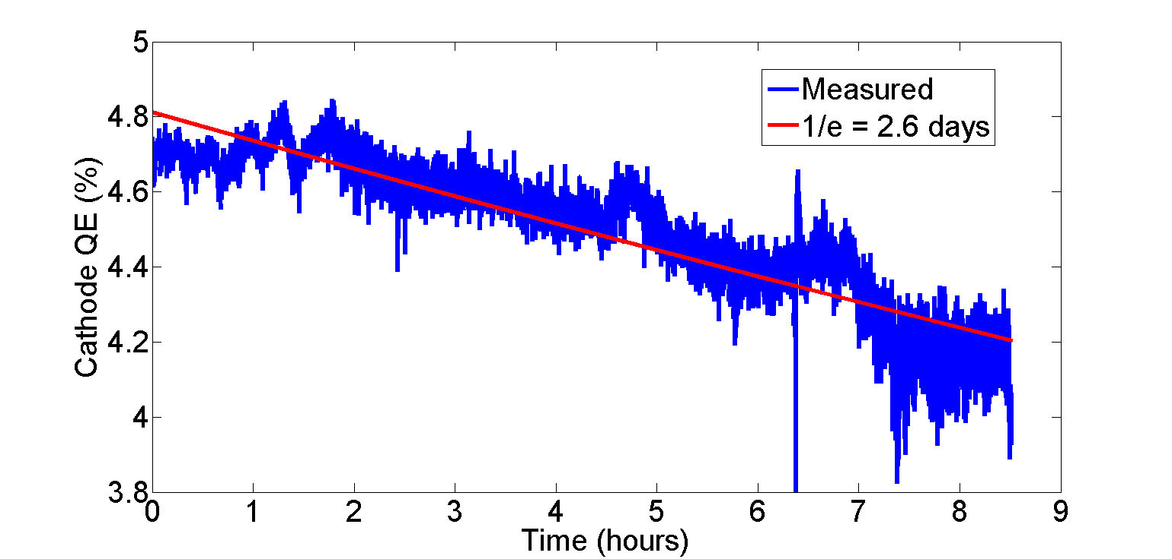
Cathode Dark Current in Injector
Highest Current Ever from NaK₂Sb:
75 mA, 65 mA sustained for 8 hours
May 24, 2013
May 24, 2013

Slide 34
Page Headline
Summary of beam dynamics issues
Injector + Linac space charge optimization
Complete 4-pass start-to-end lattice
Fieldmap tracking in FFAG cell (many codes)
Start-to-end tracking with no collective effects
CSR 1-pass tracking
Resistive wall and roughness wakefields
Orbit and optics correction
Tolerance & stability analysis
BBU
RGS
Touschek scattering
Longitudinal Tails
Dark current tracking & collimation
Ion trapping
Realistic Splitter magnet design
CSR 4-pass tracking, with longitudinal phasing/shaping
Halo from cathode
microbunching
Well under control
Straightforward
Difficult

Slide 35
Current Status
Page Headline
Soon will change the ring harmonic number from h=333 to h=343 to get 11 eRHIC-like bunch trains instead of 5, plus more room in the ring
Having to build another prototype of the FFAG permanent magnet with iron poles because the first one wasn’t built right
Resistive-based BPM was tested at ATF two weeks ago but they got an extended signal due to the RF transformer not working as expected

Slide 36
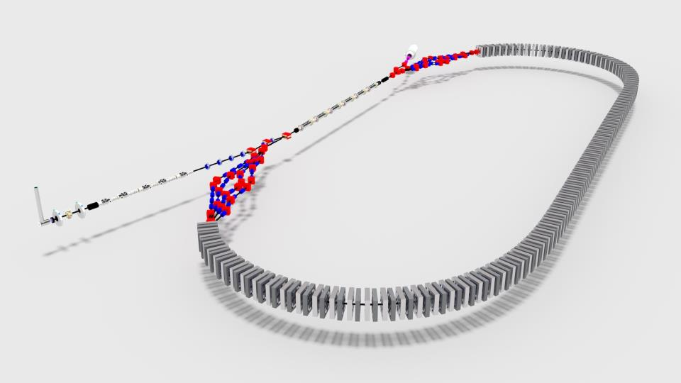
END
Page Headline

