Slide 1
Muon1 “Dynamic Aperture” Scan
Using the first girder cell from CBETA note #1

Slide 2
Setup
70 cells (just under a turn)
5000 particles
Particles killed at magnet apertures R~40mm
Vary fieldmap strengths from 0.88x to 1.08x
Nominal is 0.98x on both
Colour points by transmission fraction

Slide 3
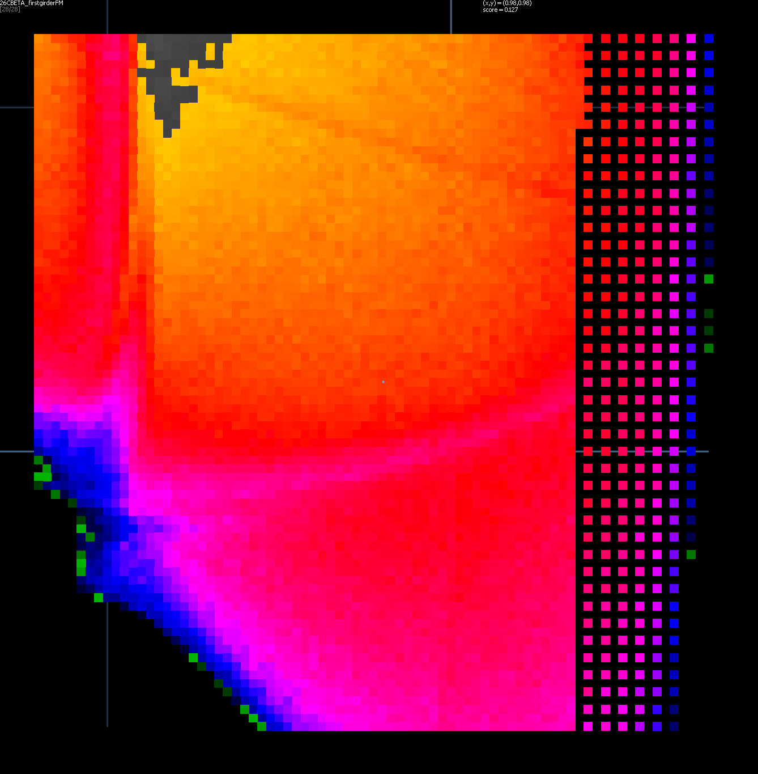
Circular beam R=1cm
0.90
1.00
QF strength
100% = π cm²
= 314 mm²
25% = 78.5 mm²
10% = 31.4 mm²
5% = 15.7 mm²
0.90
(0.98,0.98)
1.00
BD strength

Slide 4
Circular beam R=1cm
0.90
1.00
QF strength
100% = π cm²
= 314 mm²
25% = 78.5 mm²
10% = 31.4 mm²
5% = 15.7 mm²
Qy=1/4 (?)
0.90
Qx=1/3
(0.98,0.98)
1.00
Qy=1/3
BD strength

Slide 5
Circular beam R=3cm
0.90
1.00
QF strength
100% = 9π cm²
= 2827 mm²
5% = 141 mm²
2% = 56.5 mm²
1% = 28.3 mm²
0.90
(0.98,0.98)
1.00
BD strength

Slide 6
Results
I only see n/3 and n/4 (faintly) resonances
Francois and Scott have seen 2/5 and 3/8
Where’s the difference? Possibilities:
Different test particle distribution/algorithm
Francois is scanning in energy rather than field
I’m staying in the same place rather than re-matching the closed orbit each time
I don’t vary angles, just entrance positions

Slide 7
Future
I can try doing what Francois is doing
Scan in energy
Find closed orbit at each energy
Launch particles around it in Muon1
Francois can try and do what I’m doing
Vary the strength of the 2 fieldmaps
Test the transmission of ~70 cells in Zgoubi

