Slide 1
Cornell-BNL ERL Test Accelerator
Technical Review
FFAG Magnet and Girders
George Mahler, Steven Trabocchi, J. Tuozzolo, Stephen Brooks

Slide 2
Presentation Outline
WBS Level 2 Scope
Engineering Design Progress
Pre-production plans and testing
Engineering Production Plans

Slide 3
Scope
Design, Fabricate, and Test:
211 Consistent Halbach permanent magnets, (5 types)
211 Powered correctors for beam line, (2 types)
Install on “girder” assemblies with vacuum chamber
Production planning:
Complete preproduction development and testing
Develop a fabrication plan and procurement documents
Vendor interface, proposal and bid statement of works and specification.
Bid and place orders
Acceptance testing and production oversight
BNL final assembly & ship to Cornell

Slide 4
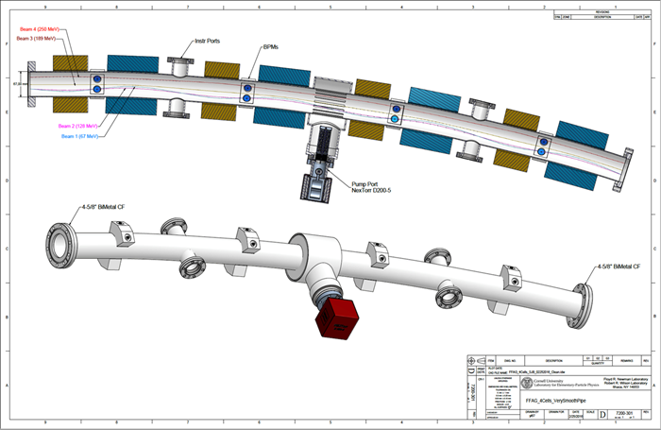
Interfaces
Cornell/BNL physics, Halbach magnet and corrector specifications
Cornell power supply group, corrector power supply specifications
Cornell vacuum group, vacuum chamber/pump support/BPM clearance and alignment
Cornell civil, magnet stabilization water supply
Cornell civil, space, cable tray, installation, & survey

Slide 5
Consistent Halbach Magnets
Proof-of-principle (PoP) magnets
Demonstrated consistent field strength magnet to magnet.
Demonstrated the ability to tune the magnet with interior steel rods to reduce multipoles.
To be proven with prototype and pre-production magnets
PoP magnets used a single batch of permanent magnet material blocks. Larger batches have larger variations in field strength. Magnets will be shimmed with gaps between PMM to vary field strength.
PoP magnets used plastic frames and were not designed to be split for vacuum chamber installation. Production magnets will have aluminum frames with designed splits.
Mechanical tolerances: larger batches of PMM may have greater variation of dimensional tolerances. Shimming also adjusts for small variations in block dimensions.

Slide 6
Consistent Halbach Magnets
Permanent Magnet Material (PMM) specifications with magnetic tolerances for field vector (strength and direction) and dimensional mechanical tolerances. (Brooks)
Specifications, method, and equipment for acceptance testing PMM field vector. (Brooks)
Solid PMM mounting frame design with minimum deflection and accurate alignment. (Mahler)
Method for shimming PMM for matching field strength. (Mahler)
Method for analyzing block field measurement results to define strength shimming dimension. (Brooks)
Method for analyzing magnet measurement results for multipole tuning. (Brooks)
Magnet mounting and alignment method and tolerances.

Slide 7
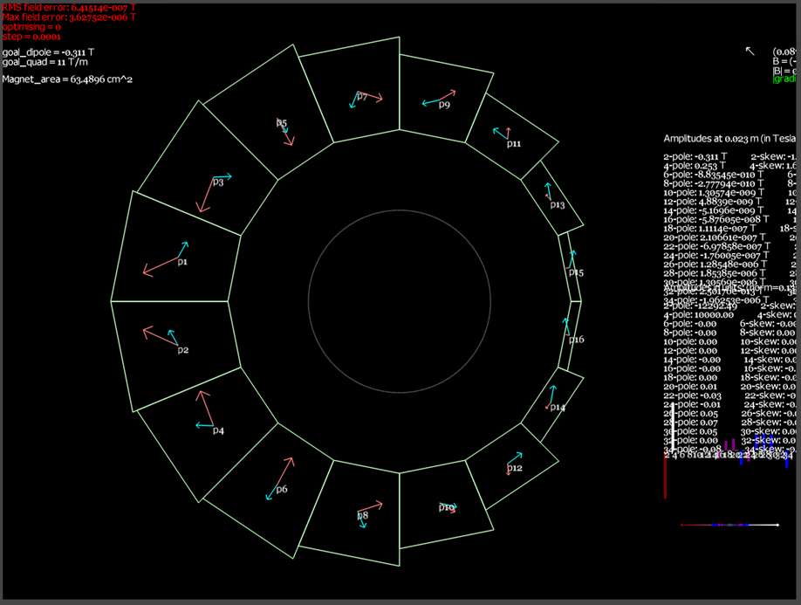
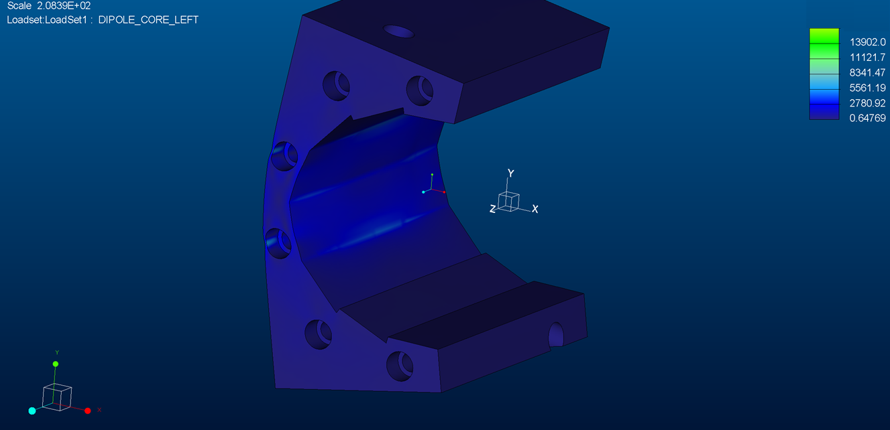
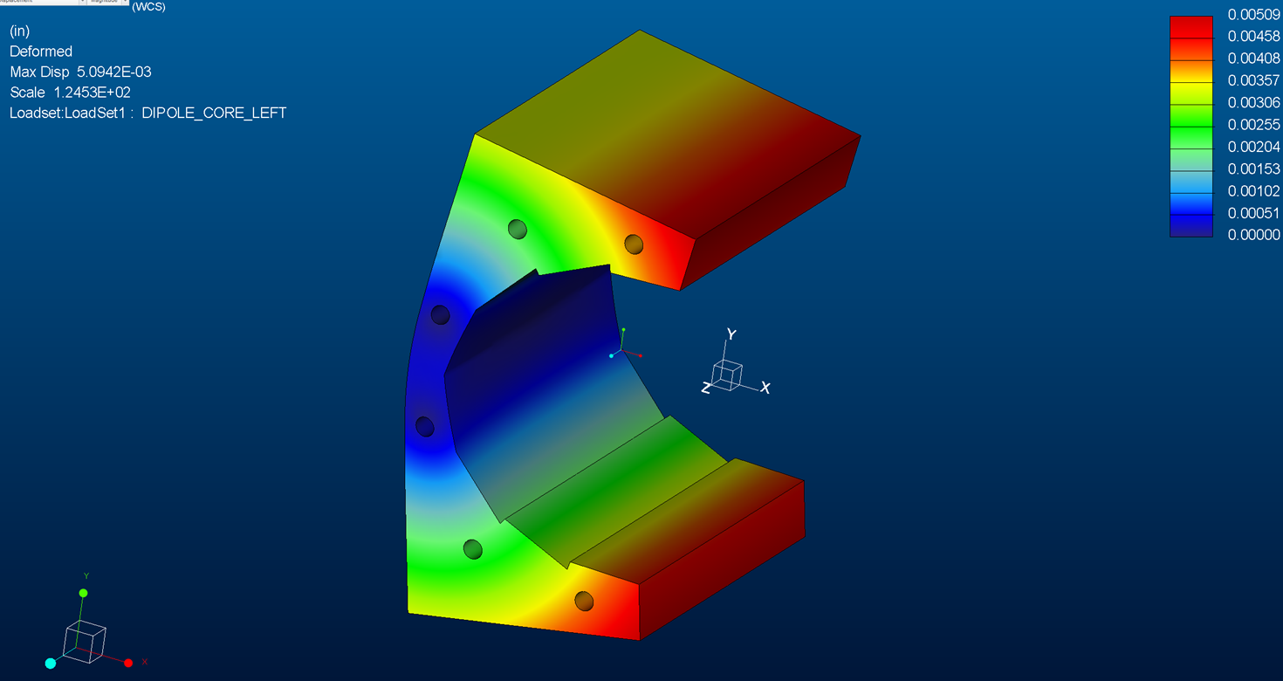
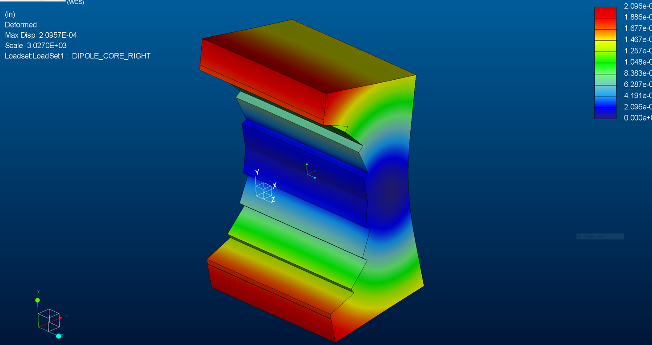
Halbach Magnet Frame Design
Split Magnet Deflection Analysis
Ansys using permanent magnet forces – worse case BD, thin side
Max. deflection .005” (.13mm) in + .0002" out
Max. stress 14,000 ksi

Slide 8
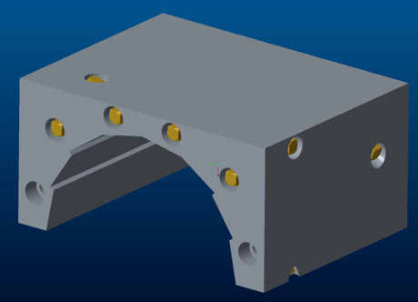
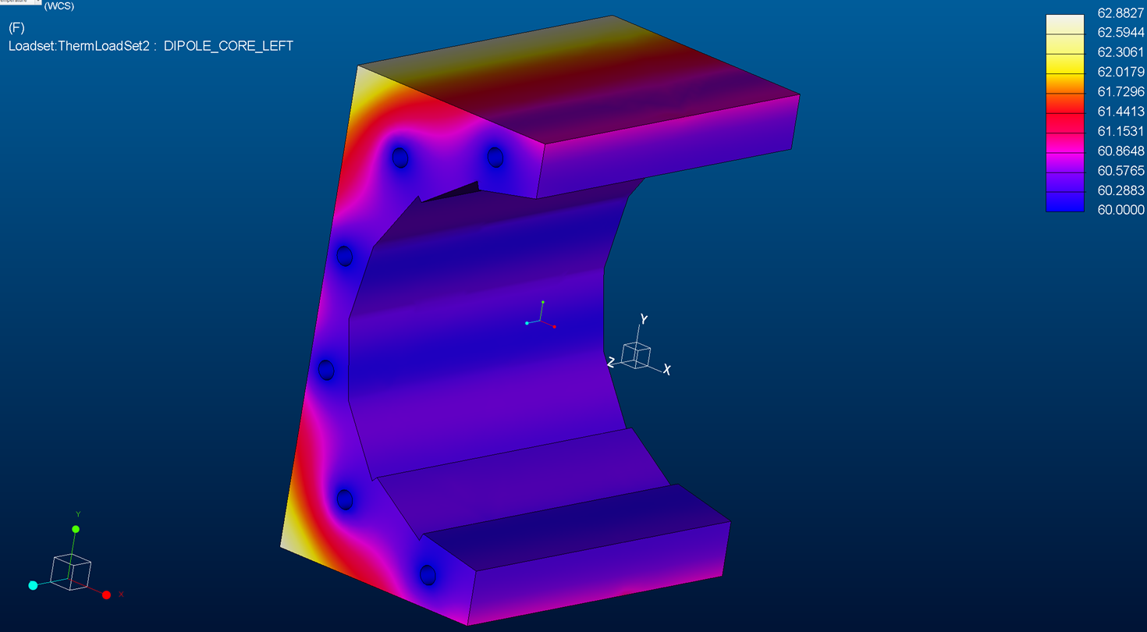
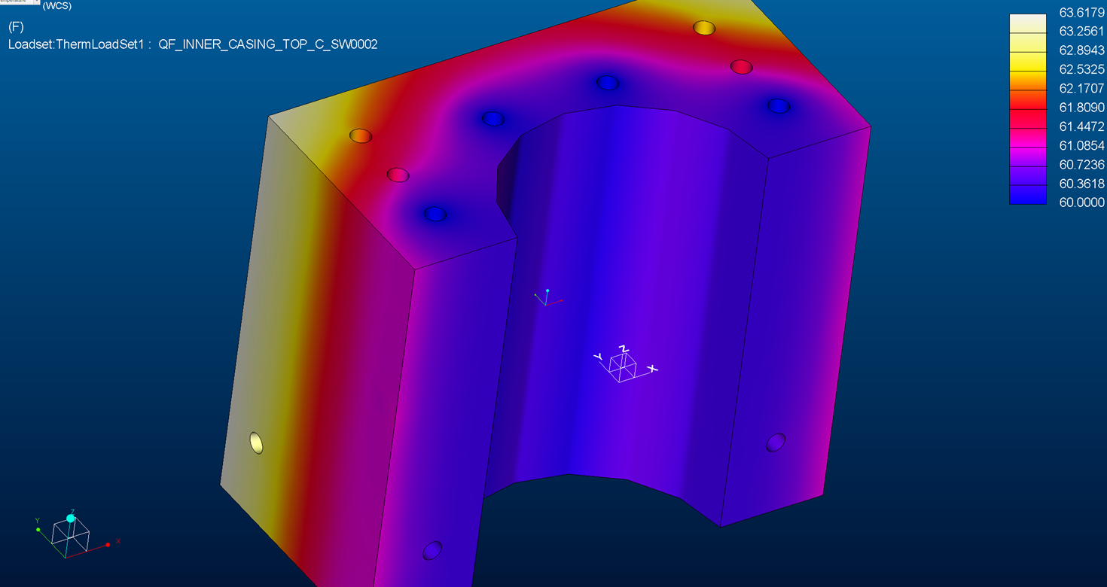
Halbach Magnet Frame Design
Thermal Analysis, Water Stabilized +/- 1C
15 C water temp, 5 W/m^2 = H, 100 Watts top, 50 Watts sides
Re-analyze for corrector specifications
Cross drilled water passages & plugs
Interface for civil construction water systems
Aluminum components
Temperature stabilized (+/- 1.0 C)

Slide 9
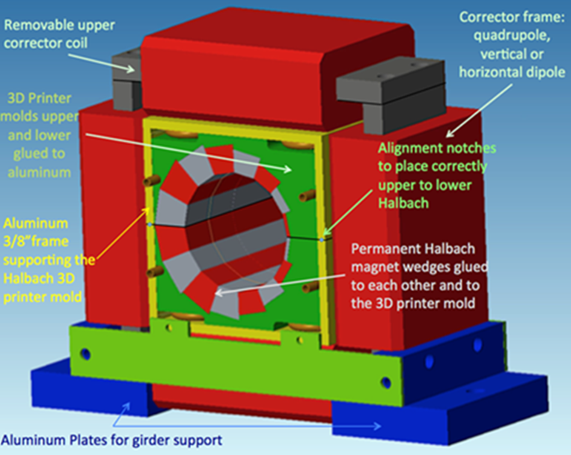
Halbach Magnet Frame Design
Final frame models/drawings with alignment pins

Slide 10
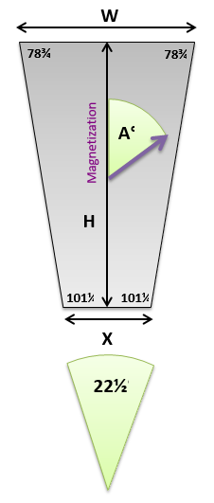
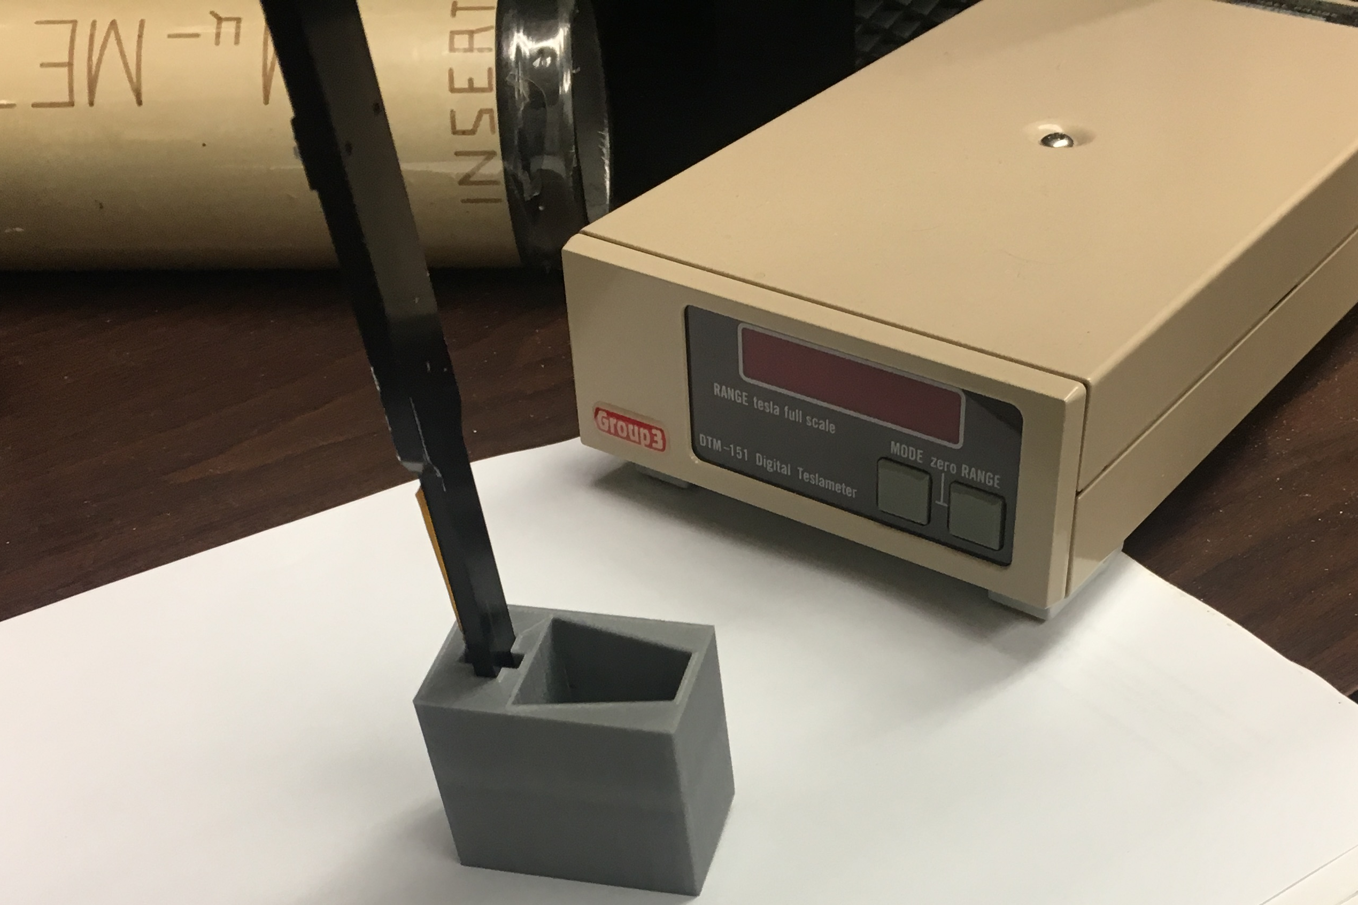

Shimming for Field Strength
Shimming design allowance 0.1mm to 0.8mm circumferentially between blocks.
Radial adjustment 0.2 mm to 2.2 mm.
PMM blocks of each type are measured for field strength and direction.
Measurement results are recorded and compared. Shim thickness specified.
Shims
Adhesive

Slide 11
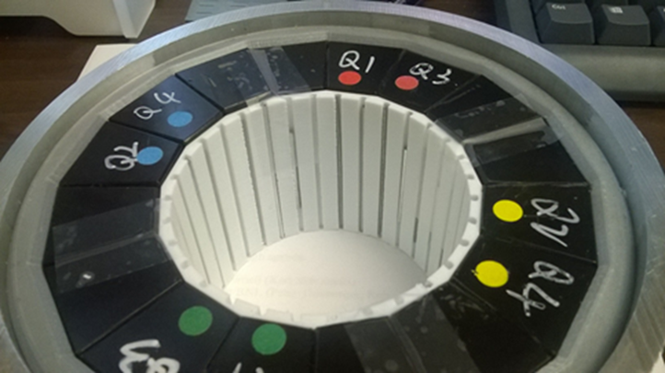
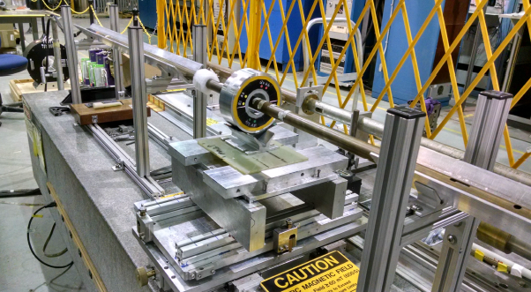
Magnetic Measurement - Tuning
To reduce multipole errors a plastic shim holder is installed in the aperture.
Steel wires of various diameters and lengths inserted into the magnet bore., shown in Fig. 3.1.8.
There are 32 wire holders evenly-spaced around the bore of the magnet
If necessary shim holders for 48 or 64 wires can be used to increase tuning strength & accuracy.

Slide 12
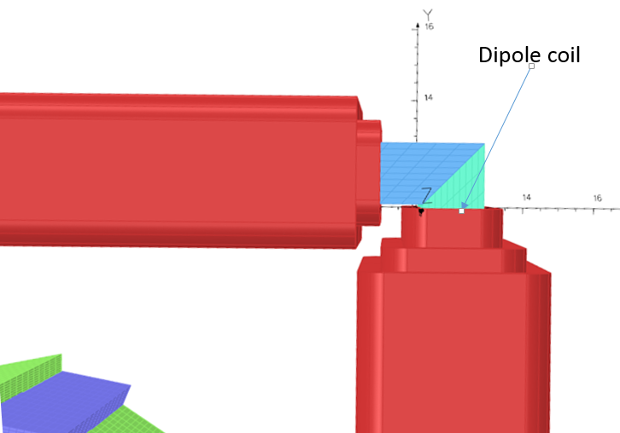
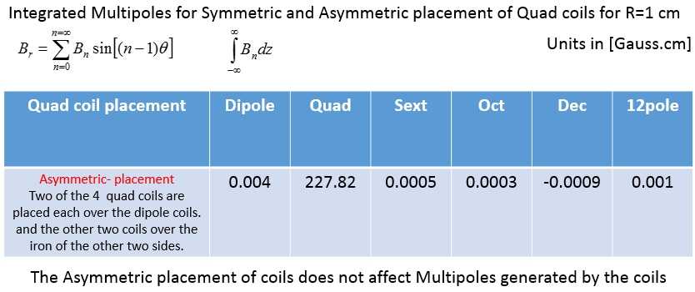
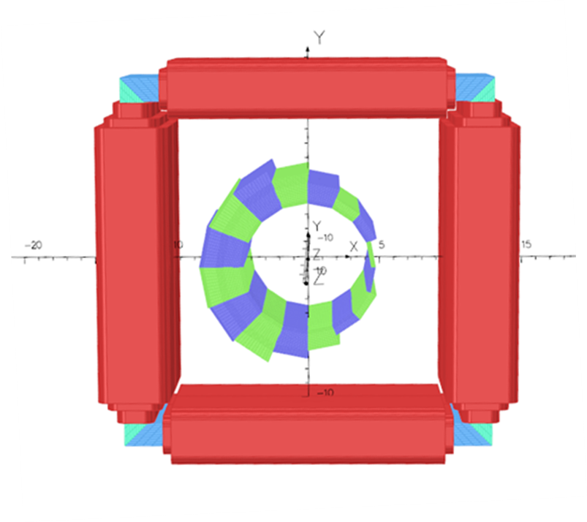
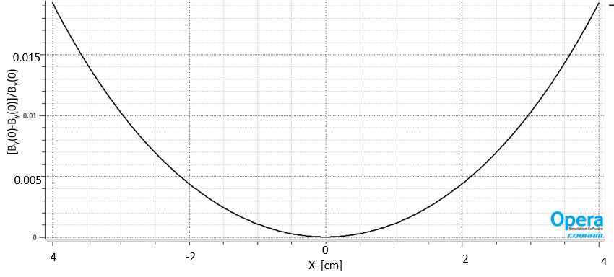
Halbach Corrector Magnets
Halbach Corrector Magnet details:
BD and QF correctors be the same configuration
Alternating horizontal & vertical correction for orbit correction.
Dipole coils on steel core for efficient and best field quality
Asymmetric quadrupole correction coils for Halbach field strength correction, if needed. Good quality quadrupole field.
Dipole Field
Flatness

Slide 13
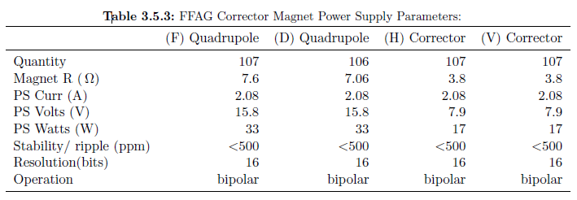
Halbach Corrector Magnets
Design model
Dipole and Quadrupole field strength interface.
PS specifications, Quadrupole corrector power supplies will not be procured until field measurements verify the need.

Slide 14
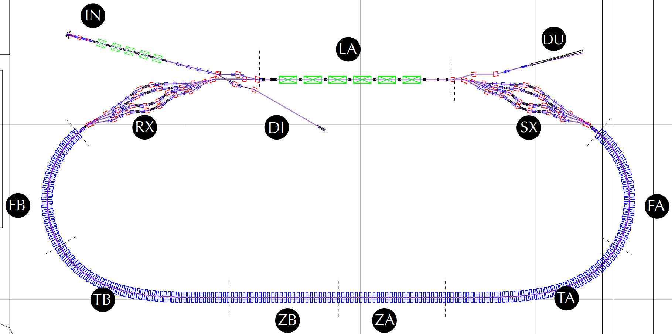
Girder Types and Positions
Gate Valves (11)
10 RF shielded
3 New to CBETA
NT
NexTorr Pump (28)
GV
CT
CapaciTorr Pump (34)
IP
Ion Pump (2)
GA
Ion and Pirani Gauges (8)
GV
GV
NT
GV
NT
GA
GA
IP
CT
CT
IP
NT
CT
GV
CT
NT
NT
NT
GV
NT X4
GV
GV
NT X4
CT X4
CT
GV
GA
GA
CT
CT X4
NT
CT
GA
CT
GA
(0,10m)
(10,10m)
NT
(20,10m)
GV
FB-GD04
CT
CT
FA-GD01
GV
FB-GD03
CT
NT
FA-GD02
NT
GA
CT
CT
GA
FB-GD02
FA-GD03
NT
FB-GD01
NT
CT
FA-GD04
CT
NT
TB-GD06
NT
ZB-GD02
ZB-GD01
ZA-GD03
ZA-GD02
CT
TA-GD01
CT
NT
CT
NT
CT
CT
NT
CT
CT
NT
CT
CT
NT
CT
CT
NT
TB-GD05
TA-GD02
(0,0)
TB-GD04
TA-GD03
TB-GD03
TB-GD02
TB-GD01
ZB-GD03
ZM-GD
ZA-GD01
TA-GD06
TA-GD05
TA-GD04

Slide 15
Girder Types and Positions
4 Cells per Girder, 2 Magnets per cell

Slide 16
Girder Types and Positions
Define and design table top
Alignment specifications:
+/- 0.2 mm (.008”) horizontal and vertical maximum allowance
+/- 0.1 mm (.004”) horizontal and vertical goal to provide corrector magnet design margin.
Allowance to resurvey and “retune” magnet positions after initial commissioning with beam (no shims or pins).
Magnet mounts – jacking screws for horizontal and vertical survey
Magnet mounts – separate mounts for Halbach and Corrector
Crane lift points that do not cause deformation and misalignment, magnet assembly weight/girder assembly weight, deflection analysis
2. Stand design

Slide 17
Pre-production Girder Assembly
Halbach magnets
Permanent Magnet Material Ordered for 6 (3 BD, 3 QF).
BNL PMM QA acceptance, measurement, shim determination
Aluminum frames designed, BNL machining.
BNL shim PMM, magnet assembly
BNL field measurement, wire rod tuning, field measurement
split/realignment testing/field measurement
Corrector magnets
Designed, steel ordered, in house machining
BNL or vendor winding
BNL field measurement
split/realignment testing/field measurement

Slide 18
Production Manufacturing Plan
PMM: Request for Proposal, build to print and specification
BNL or PMM vendor inspection & field measurement
If vendor does field measurement, BNL will sample test/verify.
Halbach Magnets: Request for Proposal, build to print and specification
BNL supplied PMM, PMM sorted & shimming specified by BNL.
Vendor fabricates frames, installs PMM, completes water lines.
BNL magnetic field testing or magnet vendor option to measure.
BNL reviews field measurement results, specifies tuning
First article magnets then release for production, option to cancel.
Corrector Magnets: Request for Bids, build to print.
First article magnets then release for production, option to cancel.
BNL magnetic field testing, random sampling.
Girders and Stands: request for bids, build to print.
Girder assembly and survey: BNL

Slide 19
Summary
BD & QF Halbach designs complete, PMM ordered
BD & QF frame designs complete, fabrication drawings underway, material ordered
Corrector magnet design complete, fabrication drawings underway
Interface items are defined, understood, and in agreement
Girder configurations defined, detailed design underway
Pre-production magnet material ordered

Slide 20
Extra Slides

Slide 21
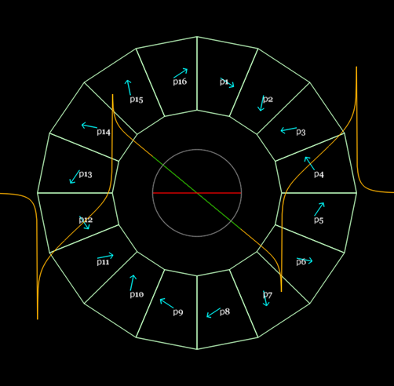
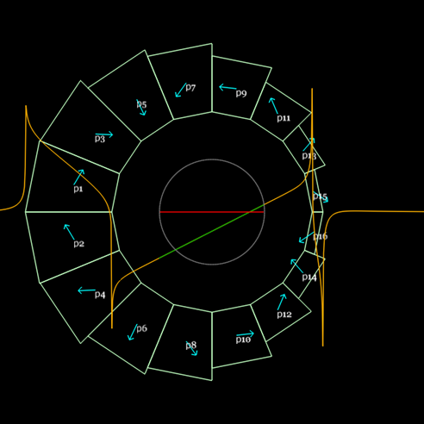
Permanent Magnet Block Dimensions

Slide 22
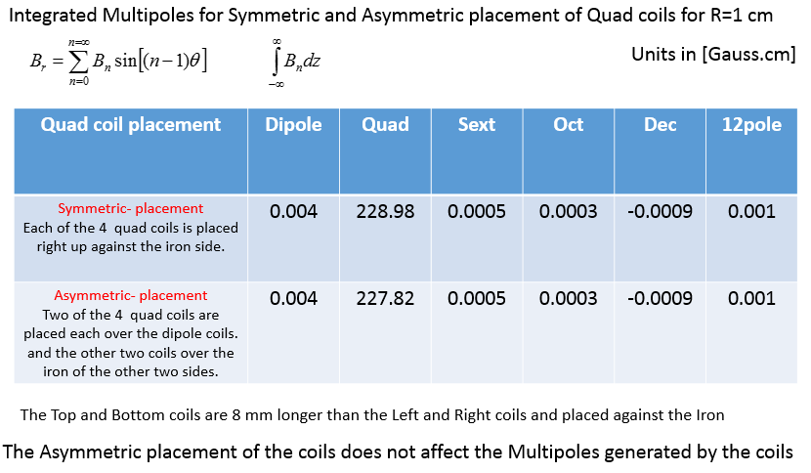
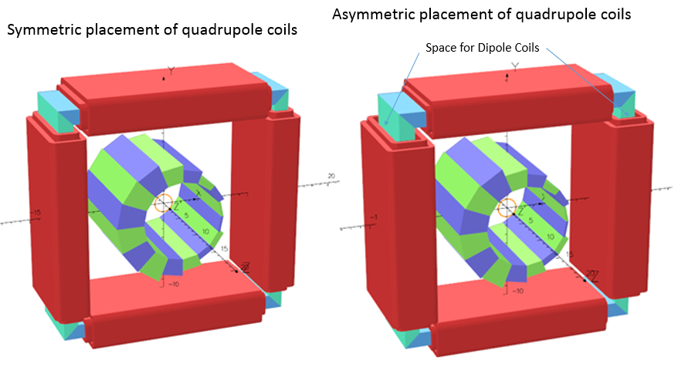
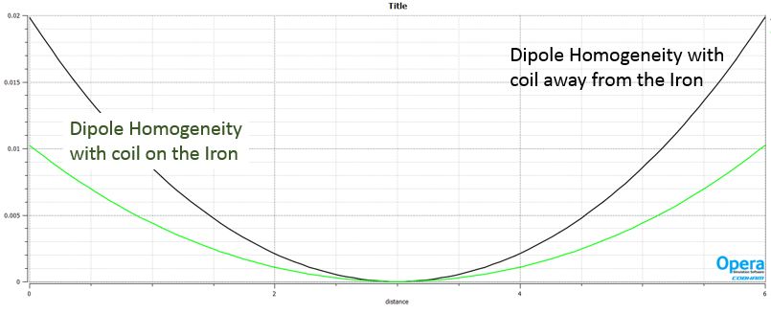
Halbach Corrector Magnets - Asymmetric
Halbach Corrector Magnet details:
BD and QF correctors be the same configuration
Alternating horizontal & vertical correction for orbit correction.
Dipole coils on steel core for efficient and best field quality
Asymmetric quadrupole correction coils for Halbach field strength correction, if needed. Good quality quadrupole field.

Slide 23
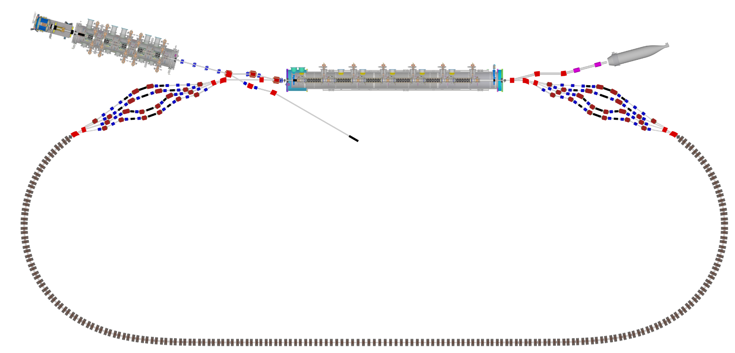
Girder Types and Positions

