Slide 1
PM_Correct CBETA Magnet Software

Slide 2
Introduction
Command-line utility that runs on Windows
Uses a config.txt file that specifies:
Target parameters for all magnets
Different types are identified by numerical id ranges
Wire tuning parameters
Systematic file input/output locations
Re-centers the harmonics and also outputs tuning wire lengths

Slide 3
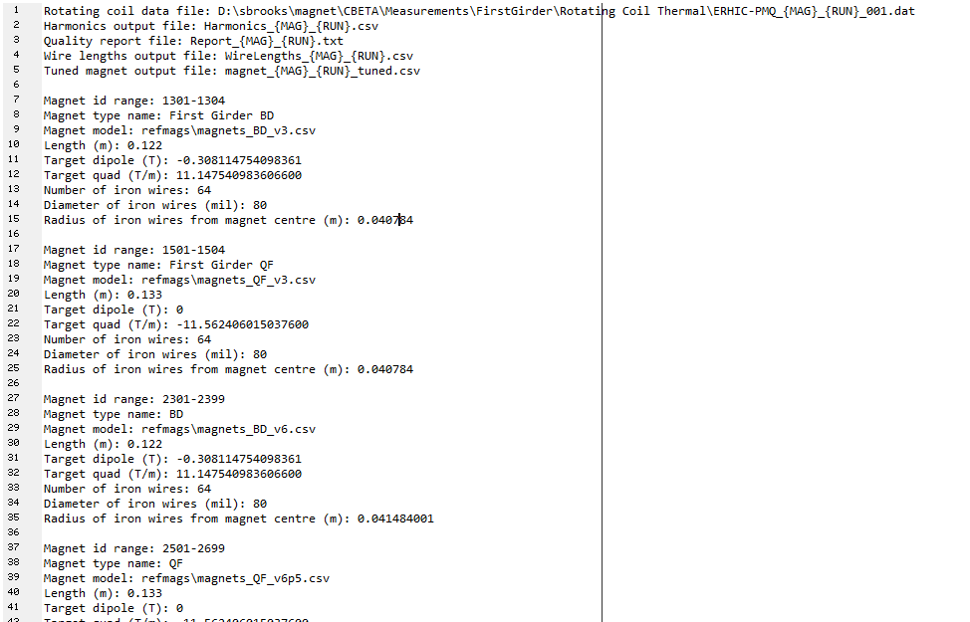
Config File

Slide 4
Adjustment to Goal Parameters
I recently found magnet tuning targets were out of date in my software
Scott Berg confirmed the baseline parameters were also out of date
I had to re-do a pair of tuning wire cartridges
New fields targets about 1% stronger, based on 3D not 2D models (as it should be)
Most magnets should be fine, the BD1 is now slightly marginal as we’ll see

Slide 5
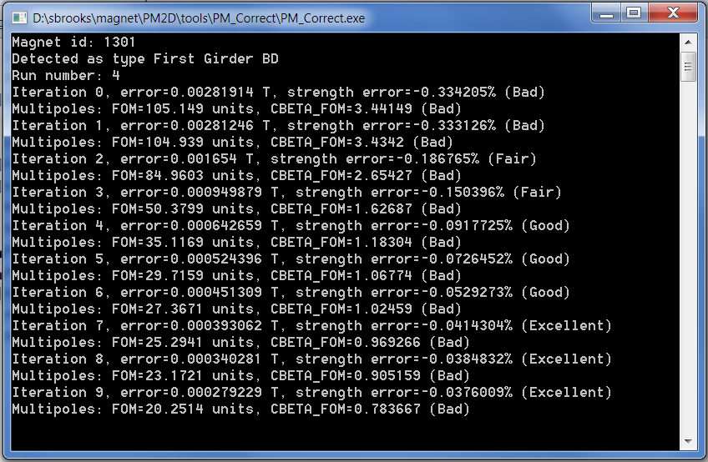
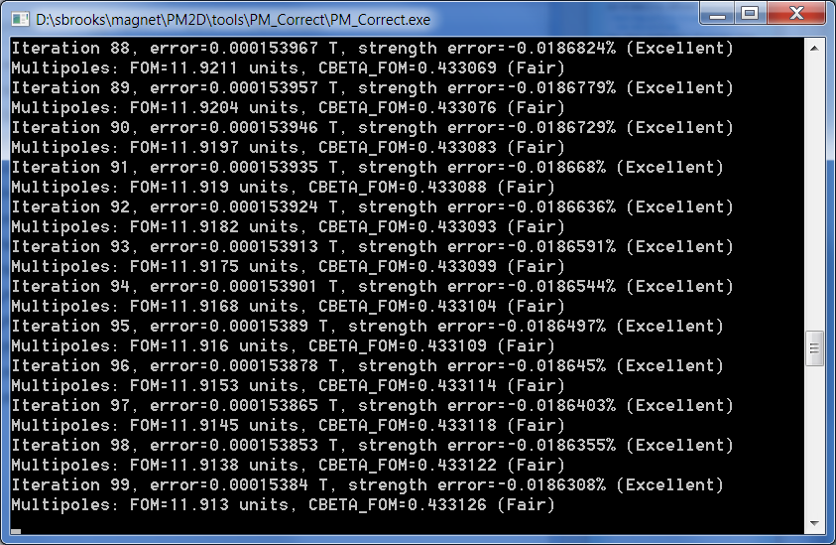
Running on BD1 Run 4

Slide 6
Initially Arbitrary Quality Feedback
CBETA multipoles FOM
>0.75 Bad, 0.5-0.75 Marginal, 0.25-0.5 Fair, 0.1-0.25 Good, <0.1 Excellent
Quad strength error
>0.2% Bad, 0.1-0.2% Fair, 0.05-0.1% Good, <0.05% Excellent
We can customise this

Slide 7
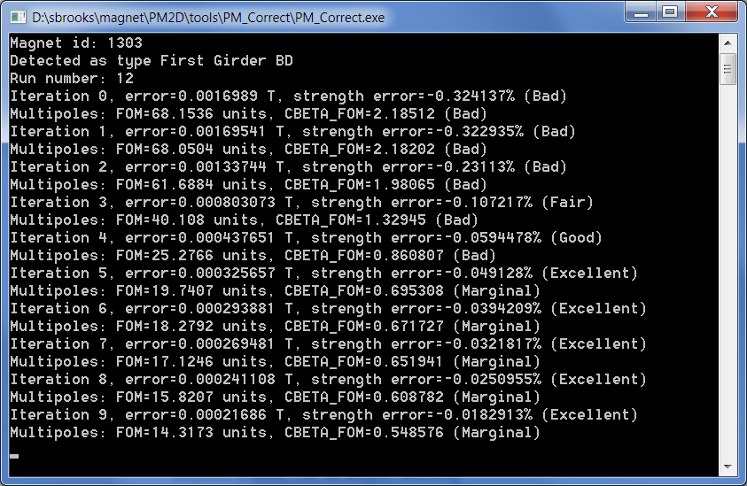
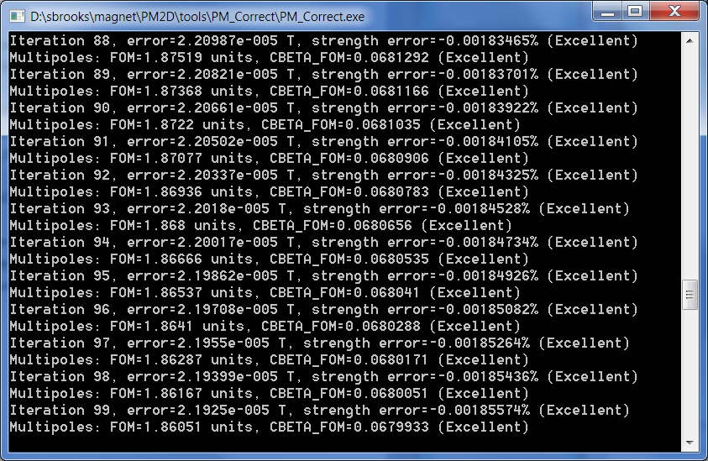
Running on BD3 Run 12

Slide 8
Program Outputs
CSV table of re-centered harmonics
Includes displacement and rotation relative to coil
Tuned magnet design CSV file include wire lengths
Not yet implemented, can be if needed:
Human-readable log/quality report
(More) human-readable wire lengths table
Subsequent iterations based on results from an already-tuned magnet

Slide 9
Storage Update
Currently have access to two SMD shares:
\\DISCOVERY\C_Beta
Contains random LEREC files(?), probably needs to be pointed at a different folder
I have write access on \\DISCOVERY\C_Beta\NOTES
\\DISCOVERY\NewData
Contains rotating coil .dat files in the format my software can read
Not sure how long files stay on there so I should probably copy them into the CBETA share too

