Slide 1
CBETA Magnets 1304, 1501
First girder BD4, QF1

Slide 2
Last Week
Tue: BD4 first 85F measurement, 1st iteration
Wed: a.m. JC out, BD4 2nd iteration
  Discovered coil roll angle change since BD3 over Thanksgiving
Thu: BD4 3rd iteration
Fri: BD4 E4E to re-determine roll angle
Mon: QF1 first 85F measurement, 1st iteration
  George has built new mount for QF types

Slide 3
1304 / FG BD4 History
Run # | Max error on midplane (Gauss) | Quad strength error | Multipole sqrt(sumsq) (units) | CBETA FOM | Notes
3 | ? | Wrong temperature | 9.13 | 0.247 | Iteration 2 but at wrong temp.
4 | 31.59 → 23.46 | -1.052% | 6.40 | 0.159 | Remeasured 85F
5 | 6.90 → 3.04 | -0.167% | 10.24 | 0.174 | Wire iteration 1
6 | 4.84 → 0.97 | -0.023% | 12.97 | 0.182 | Wire iteration 2
7 | 4.80 → 0.91 | -0.021% | 12.93 | 0.183 | Attempt electrical fix to coil roll angle
8 | 3.41 → 0.99 | +0.042% | 11.61 | 0.167 | Wire iteration 3
9 | 3.44 → 1.03 | +0.045% | 11.62 | 0.167 | E4E normal survey
10 | 3.76 → 1.11 | +0.045% | 11.72 | 0.167 | E4E reversed

Slide 4
What are the Blue Numbers?
Old “max error” used magnet position and rotation based on getting 2,4-pole right at x=0
  Possible to do better by optimising for error over the entire relevant orbit range on the midplane
Shifts = norm, sk. dipole; rotation = sk. quad
Before
After
Before
After
ΔB_{x,y}
ΔB_{x}
x
x

Slide 5
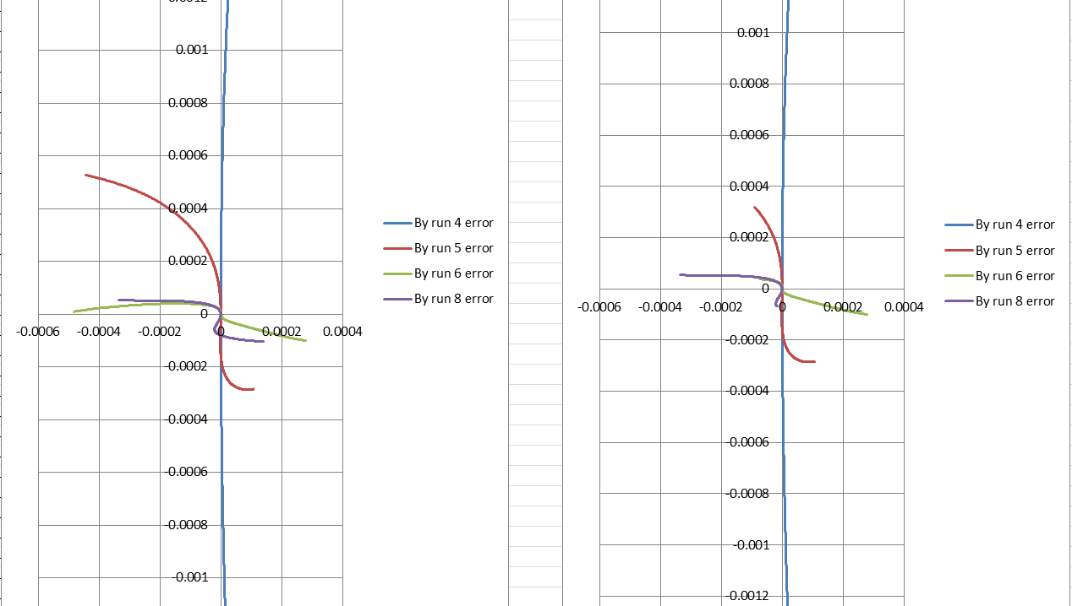
BD4 Midplane Field Error
Only -15mm to +25mm
(BD beam range)

Slide 6
BD4 Comments
I thought we were having trouble but perhaps even iteration 2 (Run 6) was passable?
  Iteration 1 was dealing with large strength error
While going through history, found that over Thanksgiving between runs on BD3, the coil calibration angle changed from ~0.075rad to ~0.010rad
  Another reason to do the E4E survey run on BD4 as it seems stable since then

Slide 7
1501 / FG QF1 History
Run # | Max error on midplane (Gauss) | Quad strength error | Multipole sqrt(sumsq) (units) | CBETA FOM | Notes
2 | ? | Wrong temperature | 3.38 | 0.114 | Iteration 1 but at wrong temp. with 63mil shims
3 | 21.74 → 12.85 | +0.519% | 62.66 | 2.043 | Bare magnet remeasured at 85F
4 | 3.44 → 1.81 | +0.048% | 6.62 | 0.168 | Wire iteration 1

Slide 8
QF1 Comments
Removed the old 63mil shims
  Wrong wire size and falling out
Iteration 1 is big improvement, not quite at 1 Gauss level by new method yet

Slide 9
Harmonics BD4, QF1
1.360612 | 0
-11050.9 | 6.64E-13
10000 | 9.70E-15
-1.127 | -7.63624
-2.39637 | -6.82503
0.359779 | 3.90476
1.761732 | -1.88512
-0.1728 | 0.337291
-0.62196 | 0.349857
-0.1618 | 0.124287
0.04354 | 0.045593
-0.14602 | -0.26831
-0.22012 | -0.29377
0.165124 | -0.00127
0.046115 | 0.072098
0.088711 | -0.02312
0.055706 | -0.03886
0.030746 | 0.0606
0.027049 | 0.099092
0.10783 | -0.02541
0.057361 | -0.08214
Displaced magnet by DX (m) | -0.00069
DY (m) | -0.0014
Rotated A/C by (rad) | 0.011035
(deg) | 0.632261
-1.53854 | 0
-5.70E-61 | -6.37E-61
10000 | 1.22E-12
-5.57456 | -2.87231
1.001928 | 0.384225
-1.09271 | 0.031152
0.54862 | 0.680538
-0.15007 | -0.72066
-0.40661 | -0.3567
0.341819 | 0.28695
-0.38685 | 0.08611
0.277603 | 0.132149
-0.07543 | -0.08855
0.125711 | 0.05831
-0.09969 | -0.07516
0.100032 | 0.114031
-0.06289 | -0.1353
-0.0961 | 0.02307
-0.00076 | -0.03197
0.023362 | 0.074221
0.058155 | -0.00737
Displaced magnet by DX (m) | 0.000257
DY (m) | -0.00142
Rotated A/C by (rad) | 0.007622
(deg) | 0.436706

Slide 10
All FG Magnets Status
Magnet name | Max error on midplane (Gauss) | Quad strength error | Multipole sqrt(sumsq) (units) | CBETA FOM | Notes | Run #
BD1 (rb) | 8.06 → 4.07 | +0.058% | 23.55 | 0.773 | New iter 1 | 20
BD2 | 3.49 → 2.63 | -0.196% | 19.28 | 0.539 | 105mil wire | 8
BD3 (rb) | 2.08 → 0.98 | +0.030% | 9.05 | 0.265 | New iter 2 | 15
BD4 | 3.44 → 1.03 | +0.045% | 11.62 | 0.167 | New iter 3 | 9
QF1 | 3.44 → 1.81 | +0.048% | 6.62 | 0.168 | New iter 1 | 4
QF2 | ? | Wrong goal | 7.30 | 0.149 | Old iter 1 | 8
QF3 (ra) | ? | Wrong goal | 4.79 | 0.099 | Old iter 2 | 17
QF4 (ra) | ? | Wrong temp | 21.25 | 0.273 | Old iter 1 | 3
Scott Berg says that field errors on BD3 and BD4 look acceptable now
(rb) = rebuilt, (ra) = reassembled from halves

Slide 11
Next Week
Tue: QF1 iter 2 and/or E4E survey
Wed: QF2 and iteration 1
Thu: QF2
Fri: QF3
Mon: QF3
  Need to do HMAC-requested extra iterations on BD1 and BD2 later
  BDH might be made some time around here

