Slide 1
CBETA Magnet 1504 and Survey
First girder QF4

Slide 2
Last Week
Tue: one iteration on QF4, was OK, surveyed plus E4E survey
Wed: George unmount QF4
Thu: (Weds and today John C. out sick)
Fri: Earth’s magnetic field & amplifier test
  Sat: BDH assembled
Mon: BD1 iteration with 105mil wire
  Drilled pins into BDH

Slide 3
1504 / FG QF4 History
Run # | Max error on midplane* (Gauss) | Quad strength error | Multipole sqrt(sumsq) (units) | CBETA FOM | Notes
3 | ? | Wrong temperature | 21.25 | 0.273 | Iteration 1 but at wrong temp. and reassembled badly
4 | 11.33 | -0.170% | 28.49 | 1.123 | Bare magnet remeasured at 85F
5 | 1.35 | +0.068% | 6.48 | 0.200 | Wire iteration 1, surveyed
6 | 1.58 | +0.076% | 6.70 | 0.204 | E4E survey
* New definition with retuned position

Slide 4
QF4 Comments
Did quite well in a single iteration
  Didn’t quite get to 1 Gauss error, but close
  One of our best bare magnets too
Finished off with an E4E to check coil roll angle

Slide 5
Harmonics QF4
-1.53884 | 0
-1.31E-61 | -2.46E-61
10000 | 1.24E-12
-1.86477 | 2.610895
-3.18878 | -1.90281
3.02891 | -1.348
0.195031 | 0.410219
-1.09532 | 0.305111
1.196406 | -1.16666
0.757533 | 0.79611
-0.96574 | -0.02911
0.019095 | -0.43973
0.38387 | 0.175195
-0.16887 | 0.143262
-0.12216 | -0.17685
0.133611 | 0.004752
-0.02808 | 0.070035
-0.05599 | -0.08572
0.145224 | 0.058035
0.004062 | -0.00866
-0.04747 | 0.006167
Displaced magnet by DX (m) | -0.00041
DY (m) | -0.00142
Rotated A/C by (rad) | 0.008458
(deg) | 0.484594

Slide 6
1301 / FG BD1 History
Run # | Max error on midplane* (Gauss) | Quad strength error | Multipole sqrt(sumsq) (units) | CBETA FOM | Notes
1 | ? | +3.436% | 175.68 | 5.131 | Very large panel gap
4 | 26.64 | -0.334% | 105.15 | 3.441 | Rebuilt for alignment
19 | 4.07 | +0.060% | 23.79 | 0.780 | Wire tuning iteration 1 (80mil)
20 | 4.07 | +0.058% | 23.55 | 0.773 | Redone on Friday
21 | 4.23 | +0.046% | 23.43 | 0.770 | End-for-end rotated
22 | 3.64 | -0.267% | 20.54 | 0.670 | 105mil iteration based on run 20, possible error
* New definition with retuned position

Slide 7
All FG Magnets Status
Magnet name | Max error on midplane* (Gauss) | Quad strength error | Multipole sqrt(sumsq) (units) | CBETA FOM | Notes | Run #
BD1 (rb) | 4.07 | +0.058% | 23.55 | 0.773 | New iter 1 | 20
BD2 | 2.63 | -0.196% | 19.28 | 0.539 | 105mil wire | 8
BD3 (rb) | 0.98 | +0.030% | 9.05 | 0.265 | New iter 2 | 15
BD4 | 1.03 | +0.045% | 11.62 | 0.167 | New iter 3 | 9
QF1 | 1.82 | -0.036% | 6.18 | 0.118 | New iter 2 | 6
QF2 | 1.06 | -0.047% | 7.22 | 0.110 | New iter 1 | 34
QF3 (ra) | 0.94 | -0.006% | 10.26 | 0.226 | New iter 2 | 20
QF4 (ra) | 1.35 | +0.068% | 6.48 | 0.200 | New iter 1 | 5
* New definition with retuned position
(rb) = rebuilt, (ra) = reassembled from halves

Slide 8
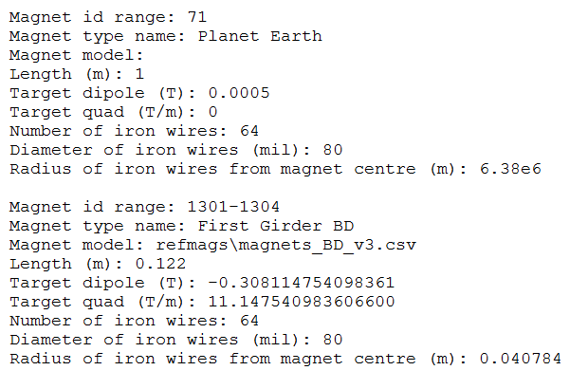
Earth’s Field
Nominal length is 1m so harmonic values that follow are just in Tesla, Tesla/m etc.

Slide 9
Earth’s Field
-5.84E-05 | 0
10000 | -1.37E-12
-236.242 | 79.30331
10.62145 | 22.1937
-1.74972 | 5.823054
-1.58629 | 0.106668
5.185104 | 3.909303
0.684718 | 0.384219
-0.52332 | -1.20218
-0.38583 | 0.588972
0.196431 | -1.66913
-0.68447 | -0.42182
0.443626 | -1.16287
0.817974 | -1.71284
0.569647 | 0.820994
1.055952 | -0.33229
-0.29859 | 1.958616
-1.15328 | -1.70581
0.111302 | -2.13486
2.093805 | -0.82845
-0.82551 | -0.78096
Displaced magnet by DX (m) | 0
DY (m) | 0
Rotated A/C by (rad) | -0.44327
(deg) | -25.3977
0.584 Gauss field pointing at 25.4 degrees from vertically downward
Coil gets 0.584 Gauss.m
Our integrated gradients are ~1.35 T for BD for example (NB: short magnets!)
Corresponds to displacement of 0.584e-4/1.35 = 43 microns
Of course we don’t know what the Earth’s field is in the L0E hall but at least we can subtract it here.

Slide 10
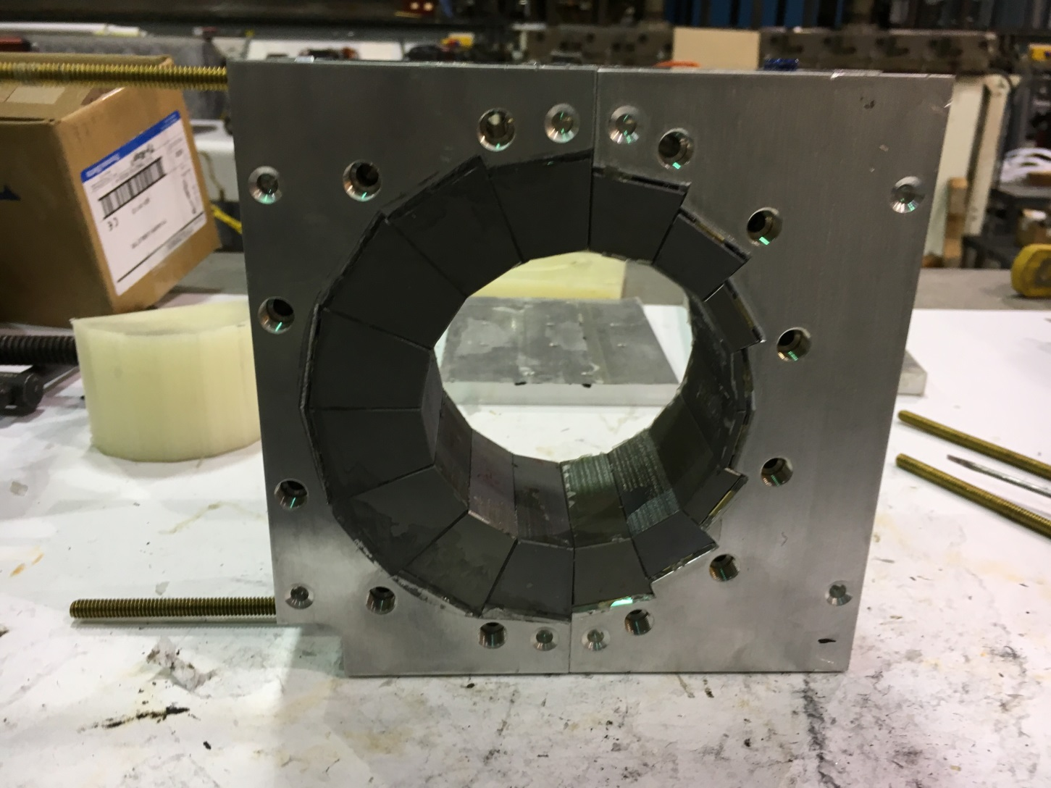
BDH almost done
Thanks to George for putting this together on Saturday
Pinned on Monday

Slide 11
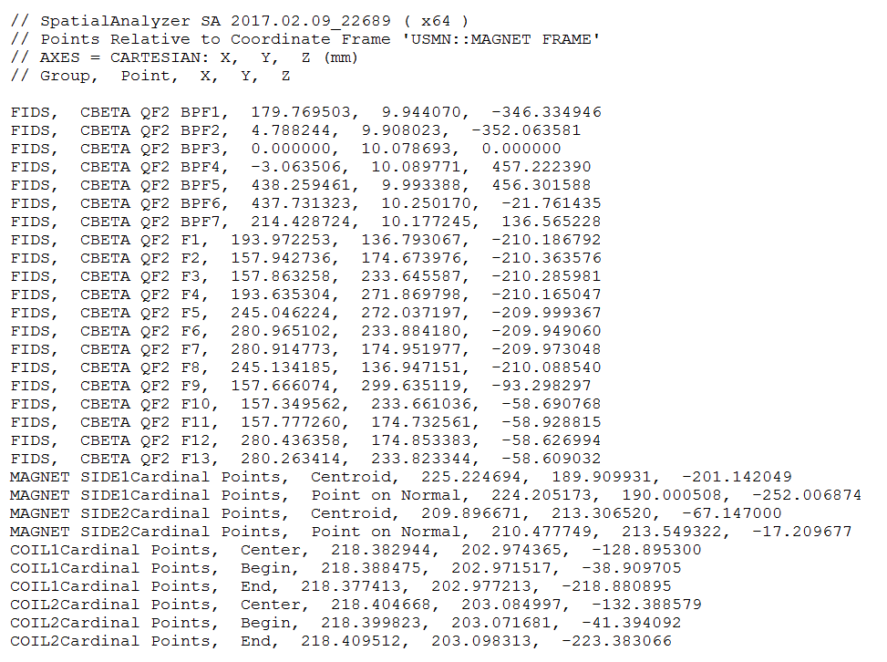
Raw Survey Data Files
Have these for all magnets now, double for the four E4E runs (QF1,4, BD1,4)
Fairly minimal: just the magnet and baseplate fiducials, the coil axis and magnet endplanes.

Slide 12
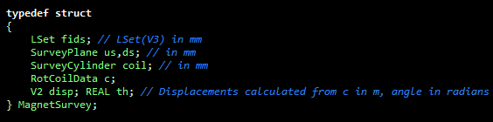
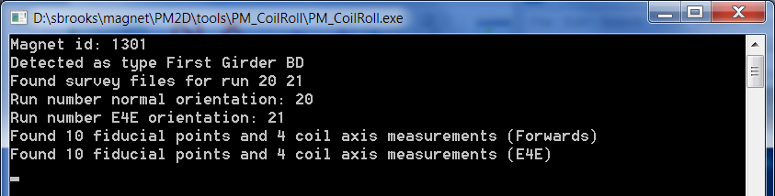
PM_CoilRoll
← Currently filling in this data structure

Slide 13
Next Week
Tue: BDH measurement
Wed: BDH tuning
Thu, Fri, Mon: Back to finishing BD1, BD2
  And then we’ll be done for magnet fields
  I’ll continue to develop survey software

