Slide 1
CBETA Production Magnets
QD 2427*
QF 2570, 2572*, 2579-2585
QFH 2751
* Remade from halves

Slide 2
61% complete
132 / 214 magnets (82 remaining)

Slide 3
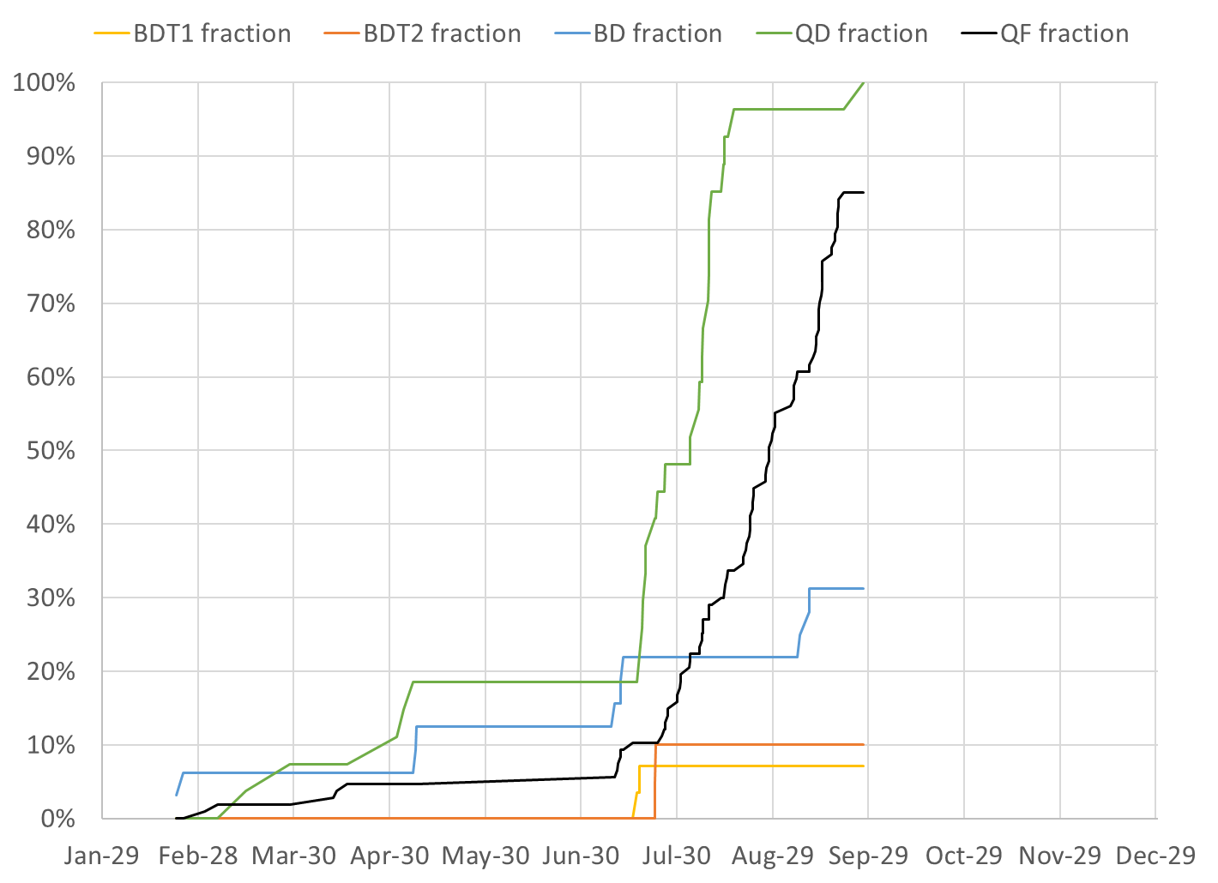
BDT1 2 / 28 magnets (26 remaining)
BDT2 2 / 20 magnets (18 remaining)
BD 10 / 32 magnets (22 remaining)
QD 27 / 27 magnets (0 remaining)
QF 91 / 107 magnets (16 remaining)

Slide 4
Projections
Method | Rotating Coil Measurements per Week | Magnets Tuned per Week | Projected Finish Date | Speed-up Required to Finish Nov-30
Magnets rate since main production start |  | 10.23 | Nov-26 | 4 calendar days spare
Rotating coil rate last 3 weeks plus model | 23.0 | 7.99 | Dec-11 | 19.7%
Rotating coil rate since start | 26.0 | 9.12 | Dec-02 | 4.9%
Required to hit deadline | 27.2 | 9.57 | Nov-30 | 0%

Slide 5
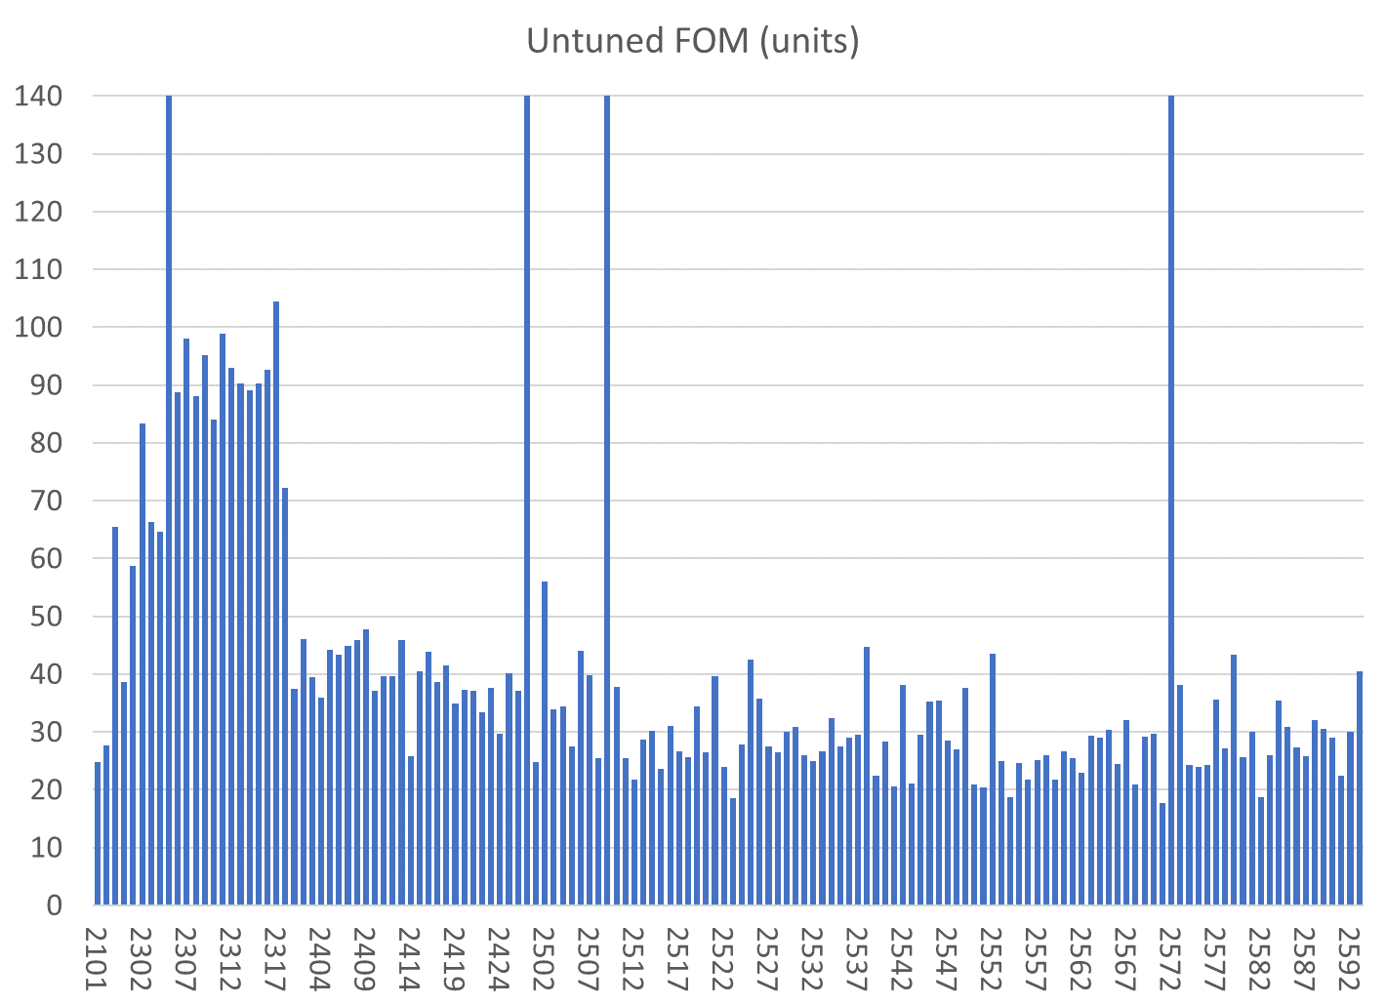
All magnets are shown
Reject
BDT1
BDT2
BD
QD
QF
Reject/have replaced half
Reject/com,bined with 2572
Reject/have replaced half
QFH

Slide 6
All magnets are shown
BDT1
BD
QD
QF
BDT2
QFH
Correcteed in aluminium
Reject
Reject/have replaced half
Reject/com,bined with 2572
Reject/have replaced half

Slide 7
Only tuned magnets shown (2 “rejects” also removed)
BDT1
BD
QD
QF
BDT2
QFH

Slide 8
Only tuned magnets shown (2 “rejects” also removed)
BDT1
BD
QD
QF
BDT2
QFH

Slide 9
Only tuned magnets shown (2 “rejects” also removed)
BDT1
BD
QD
QF
BDT2
QFH

Slide 10
Tuned Magnets Criteria
Midplane error (G) | Units FOM | CBETA FOM | Quad error at x=0 (rel.)
≤ 1.5 | ≤ 10 | ≤ 0.375 | ≤ 0.05% (Q)
For full data see spreadsheets “initialmagnets” “finalmagnets”
Midplane error generally hardest to achieve
May go in and out of spec slightly (~0.5G) due to chiller cycle
Achieving all the above triggers “quick accept”

Slide 11
Status
Slightly reduced coil rate last 2 weeks
Slower period waiting for BD crate to arrive
Coil #76 electronics problem last week Weds-Fri
QFH magnet is made (counted as QF in stats)
Two magnets made & tuned from good halves
QF 2572 from 2572 and 2509’s good half
QD 2427 from 2427 good half + new half
QF 2523, BD 2310 glue failures, repaired OK

Slide 12
Rotating Coil Failed Circuit Board

Slide 13
Girders
We are mostly going to be making FA and FB arc girders, when tuned BD magnets are ready
Might make one transition girder using existing two each of BDT1, BDT2
ZA GD1
ZA GD2
ZA GD3
ZM GD
ZB GD1
ZB GD2
ZB GD3
FA GD1 old
FA GD1 new
FA GD2
FA GD3
FA GD4
FB GD1
FB GD2
FB GD3
FB GD4
TA GD1
TA GD2
TA GD3
TA GD4
TA GD5
TA GD6
TB GD1
TB GD2
TB GD3
TB GD4
TB GD5
TB GD6
Not started
Under construction
Complete at BNL
Delivered to Cornell

