Slide 1
CBETA Production Magnets
BDT1 2107-2128
QF 2594

Slide 2
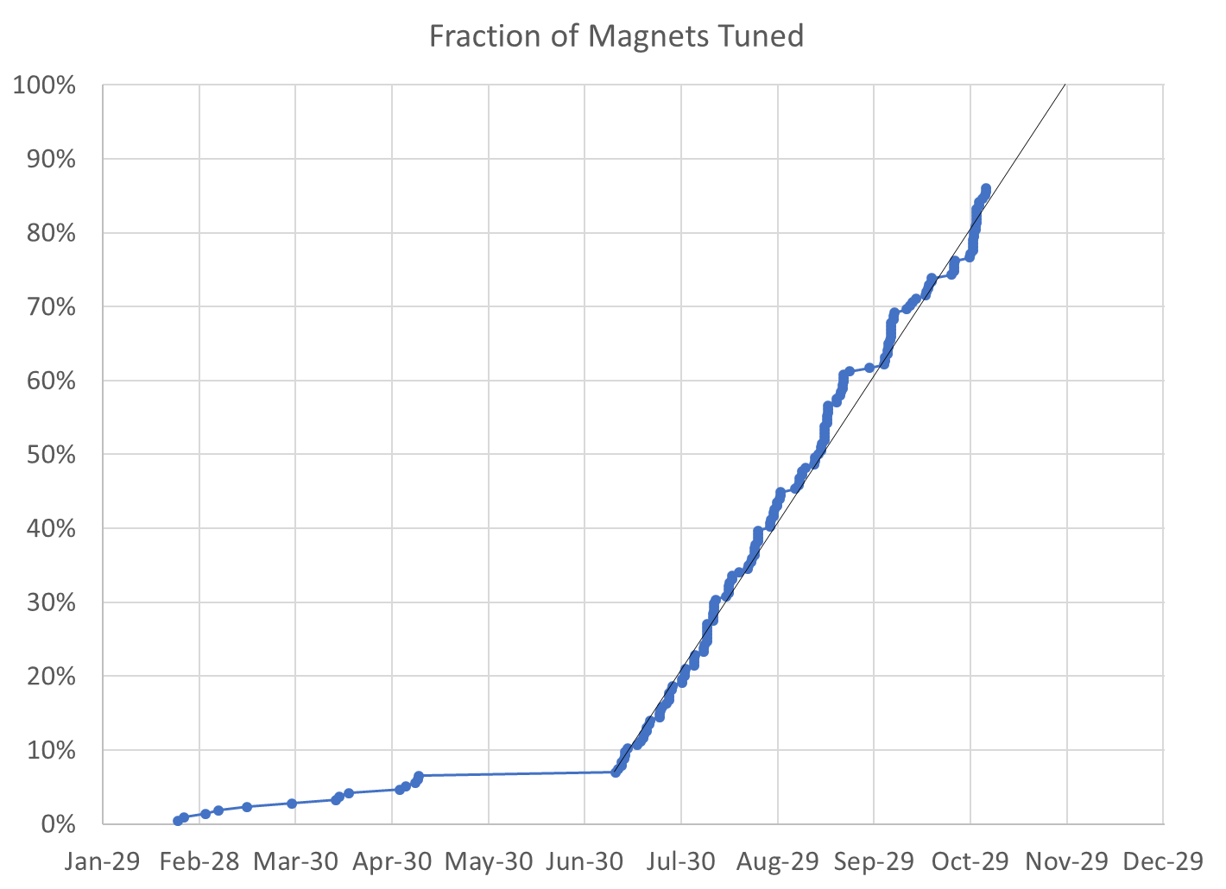
85% complete
184 / 215 magnets (31 remaining*)
* Includes 4 “spare” QFs, 2 BDs for replacing first girder magnets

Slide 3
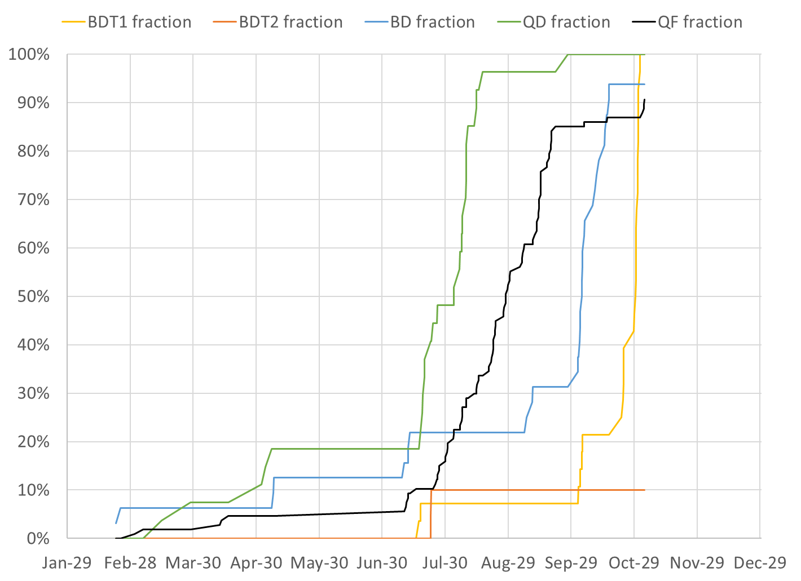
BDT1 28 / 28 magnets (0 remaining)
BDT2 2 / 20 magnets (18 remaining)
BD 30 / 32 magnets (2 remaining)
QD 27 / 27 magnets (0 remaining)
QF 97 / 107 magnets (10 remaining)
QFH 1 / 1 magnet (0 remaining)

Slide 4
Projections (NB: does not account for holidays in November)
Method | Rotating Coil Measurements per Week | Magnets Tuned per Week | Projected Finish Date | Speed-up Required to Finish Nov-30
Magnets rate since main production start |  | 10.12 | Nov-25 | 5 calendar days spare
Rotating coil rate last 3 weeks plus model | 31.3 | 11.24 | Nov-23 | 7 calendar days spare
Rotating coil rate since start | 26.9 | 9.57 | Nov-26 | 4 calendar days spare
Required to hit deadline | 23.9 | 8.40 | Nov-30 | 0%

Slide 5
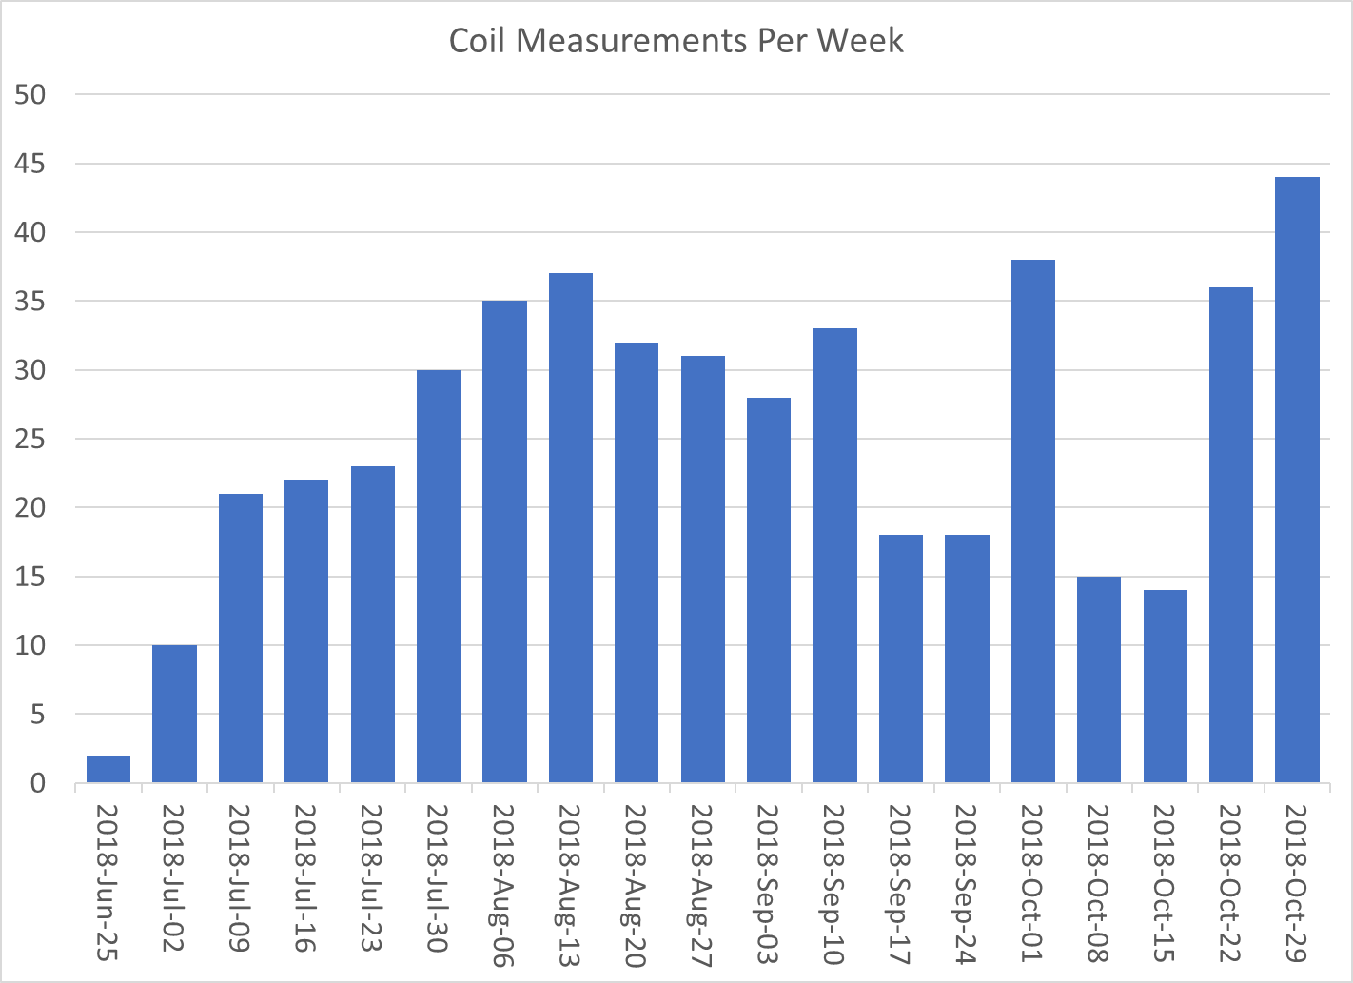

Slide 6
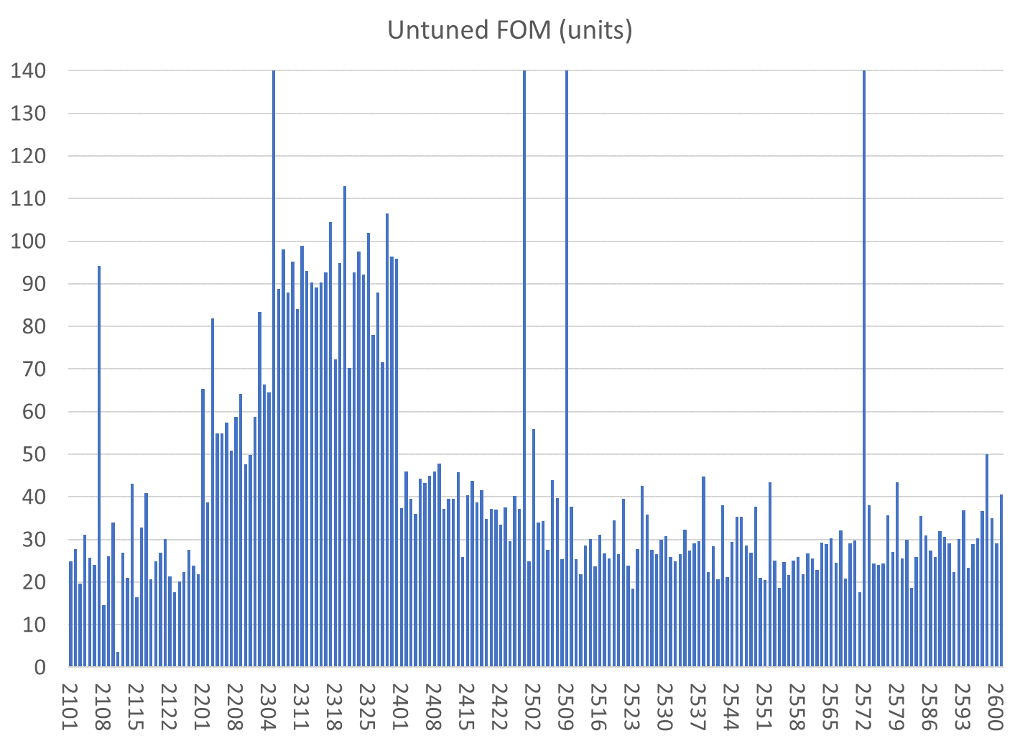
All magnets are shown
Reject
BD
QF
Reject/com,bined with 2572
BDT1
BDT2
Reject/have replaced half
Reject/have replaced half
QD
80 shims
Tuned with 96 shims
QFH

Slide 7
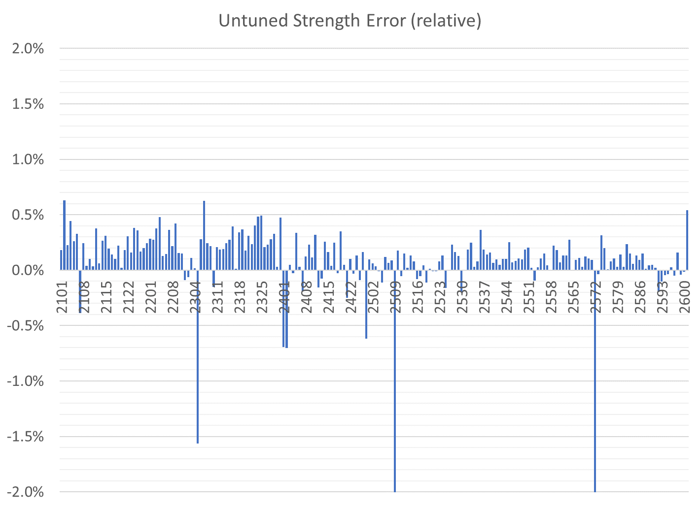
All magnets are shown
BDT1
BDT2
BD
QD
QF
QFH
Correcteed in aluminium
Reject
Reject/have replaced half
Reject/com,bined with 2572
Reject/have replaced half

Slide 8
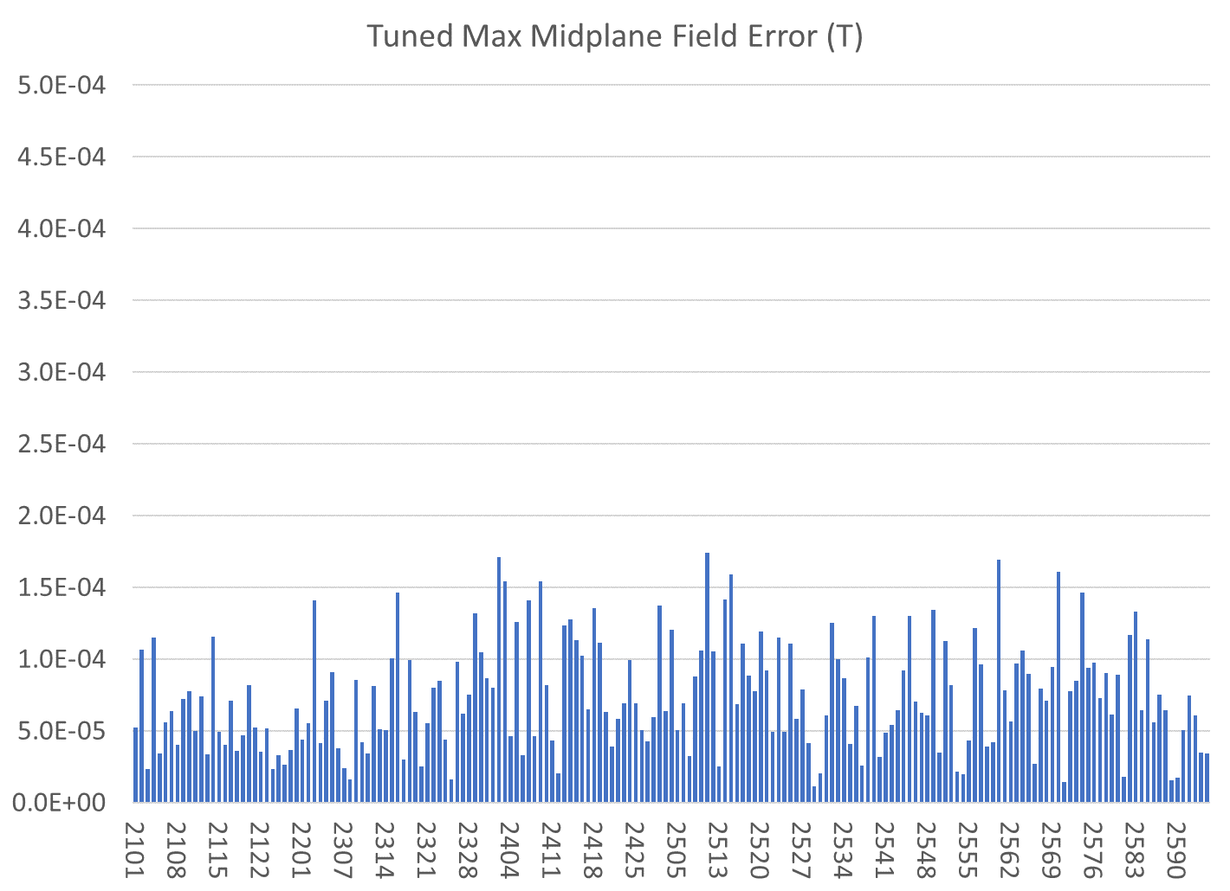
Only tuned magnets shown (2 “rejects” also removed)
BDT1
BDT2
BD
QD
QF
QFH

Slide 9
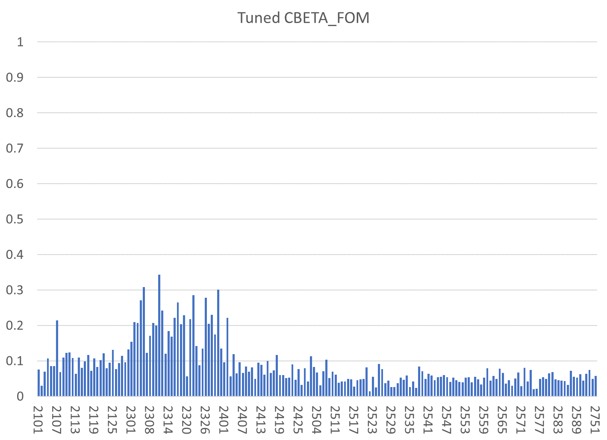
Only tuned magnets shown (2 “rejects” also removed)
BDT1
BDT2
BD
QD
QF
QFH

Slide 10
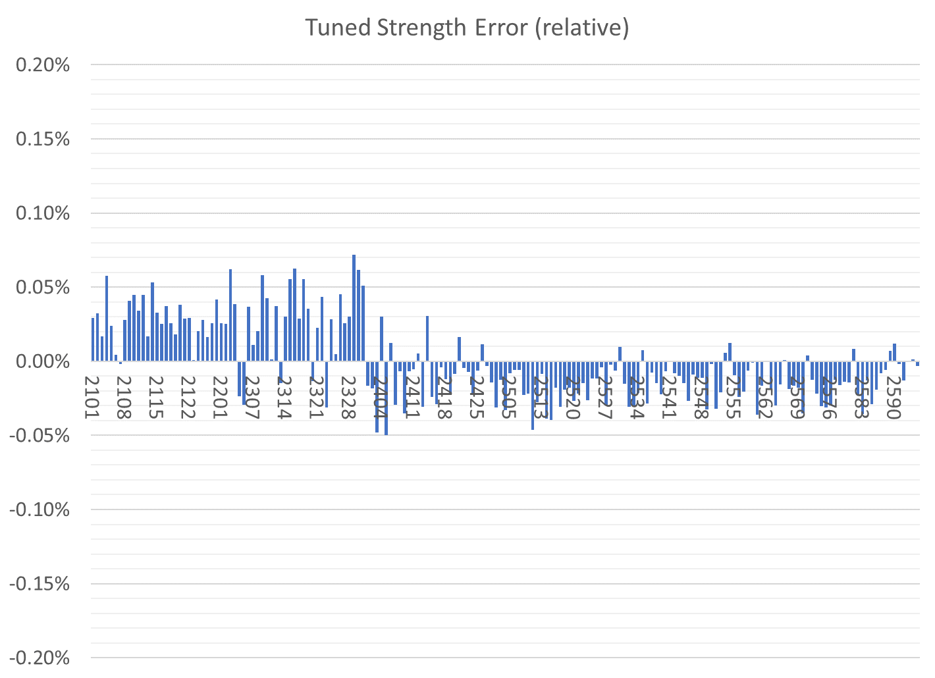
Only tuned magnets shown (2 “rejects” also removed)
BDT1
BDT2
BD
QD
QF
QFH

Slide 11
Tuned Magnets Criteria
Midplane error (G) | Units FOM | CBETA FOM | Quad error at x=0 (rel.)
≤ 1.5 | ≤ 10 | ≤ 0.375 | ≤ 0.05% (Q)
For full data see spreadsheets “initialmagnets” “finalmagnets”
Midplane error generally hardest to achieve
May go in and out of spec slightly (~0.5G) due to chiller cycle
Achieving all the above triggers “quick accept”

Slide 12
Status
Last week
Chiller on coil #71 broke
Replaced by other coil’s chiller
Recalibrated strength vs. previously measured magnet
Coil #76 was then fixed
Original repaired chiller from #71 used there
Recalibrated strength for this coil too
Both coils now working on remaining ~7 QF and ~17 BDT2 magnets required for deadline

Slide 13
Girders
Need vacuum chambers FB GD4 and TB GD1
Also waiting for vacuum pipe support legs
Rest are waiting for QF and BDT2 magnets
And some more QF-type corrector frames
ZA GD1
ZA GD2
ZA GD3
ZM GD
ZB GD1
ZB GD2
ZB GD3
FA GD1 old
FA GD1 new
FA GD2
FA GD3
FA GD4
FB GD1
FB GD2
FB GD3
FB GD4
TA GD1
TA GD2
TA GD3
TA GD4
TA GD5
TA GD6
TB GD1
TB GD2
TB GD3
TB GD4
TB GD5
TB GD6
Not started
U/C Chamber only
Under construction
Complete at BNL
Delivered to Cornell
In crates

