Slide 1
eRHIC Source Merging Schemes
Summary of various options for converting bunch charge and rep. rate from polarised electron source

Slide 2
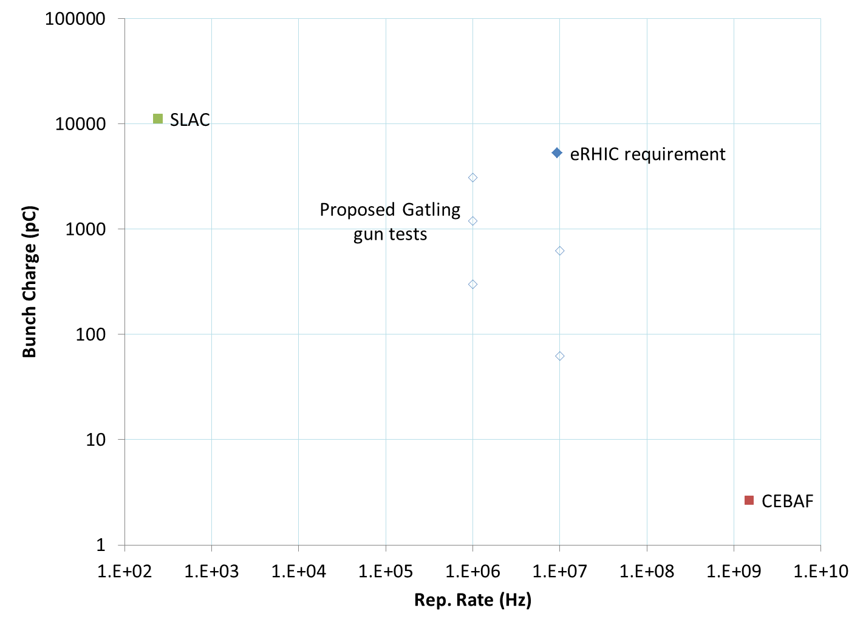
Rep. Rate vs. Bunch Charge Space

Slide 3
Ratios: Existing Sources to eRHIC
Rate x 39098
Charge OK
Avg. current x 18479 (can’t have 18000 guns)
Rate OK
Charge x 1988
Avg. current x 12.4
maybe OK with
multiple guns

Slide 4
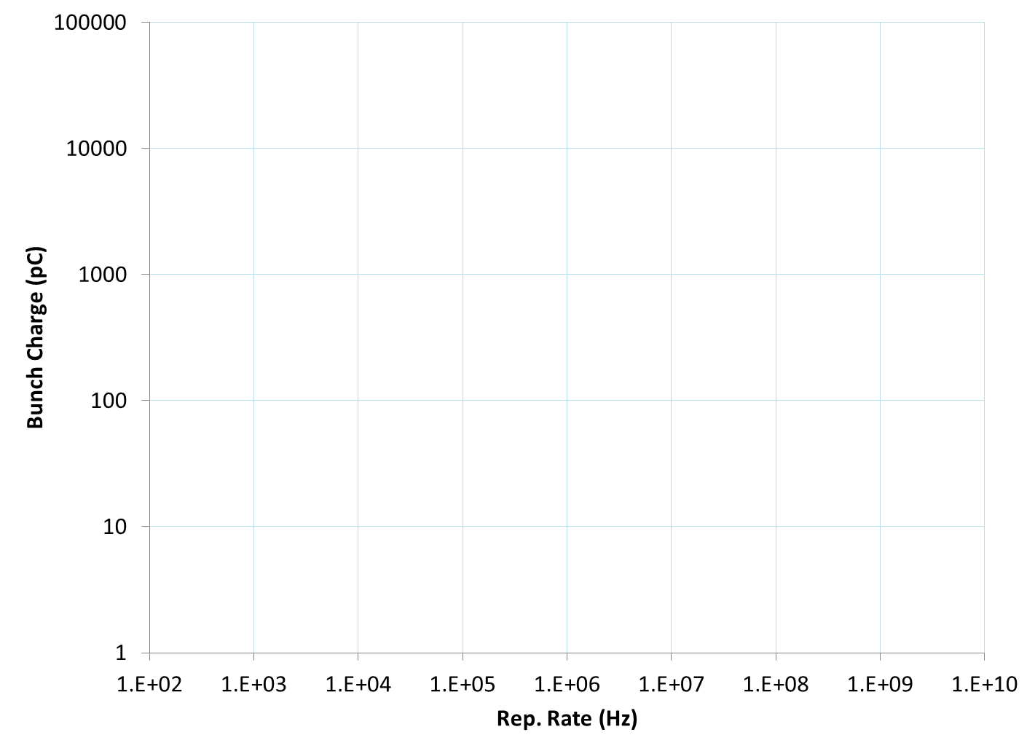
Conversion Methods
DC combiner septum (multiple sources)
Combiner ring (single source)
Gatling gun or RF funnel (multiple sources)
De-rate
source

Slide 5
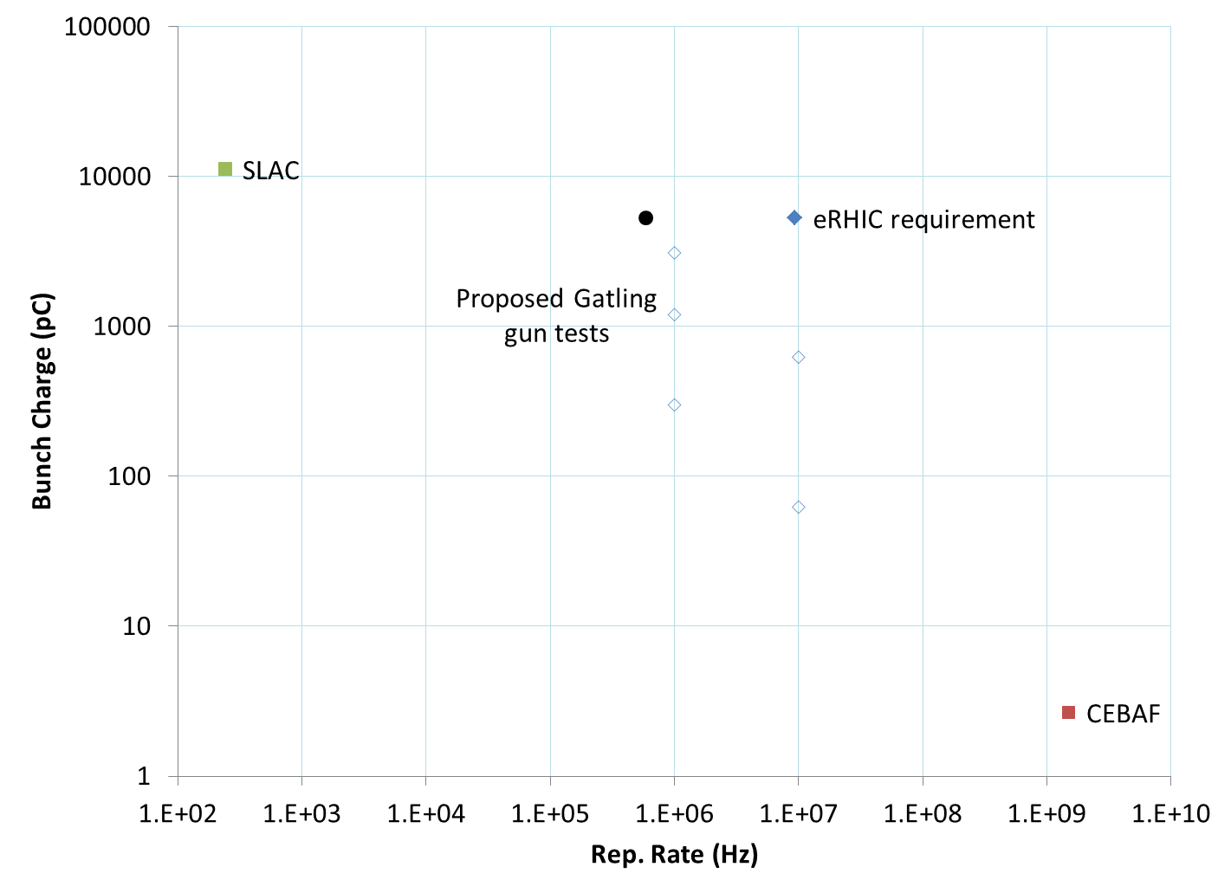
Gatling Gun Route
16-way Gatling gun
16 sources
0.58MHz, 5300pC

Slide 6

8-way RF Funnel Route
8-way funnel
8 sources
1.2MHz, 5300pC

Slide 7

Low Charge Route
4x4 (16 turn) combiner ring
3x3 combiner septum
9 sources
150MHz, 37pC

Slide 8

Low Charge Route (conservative)
3x3 (9 turn) combiner ring
7-way combiner septum
7 sources
84MHz, 84pC

Slide 9
Low Charge Route (easy/lucky)
7-way combiner septum
← This test works

Slide 10
DC Multi-way Septum
Sources are synchronised, put bunches side-by-side in X and Y simultaneously
  But don’t make anything out of permanent magnets due to losses in this region
+
=

Slide 11
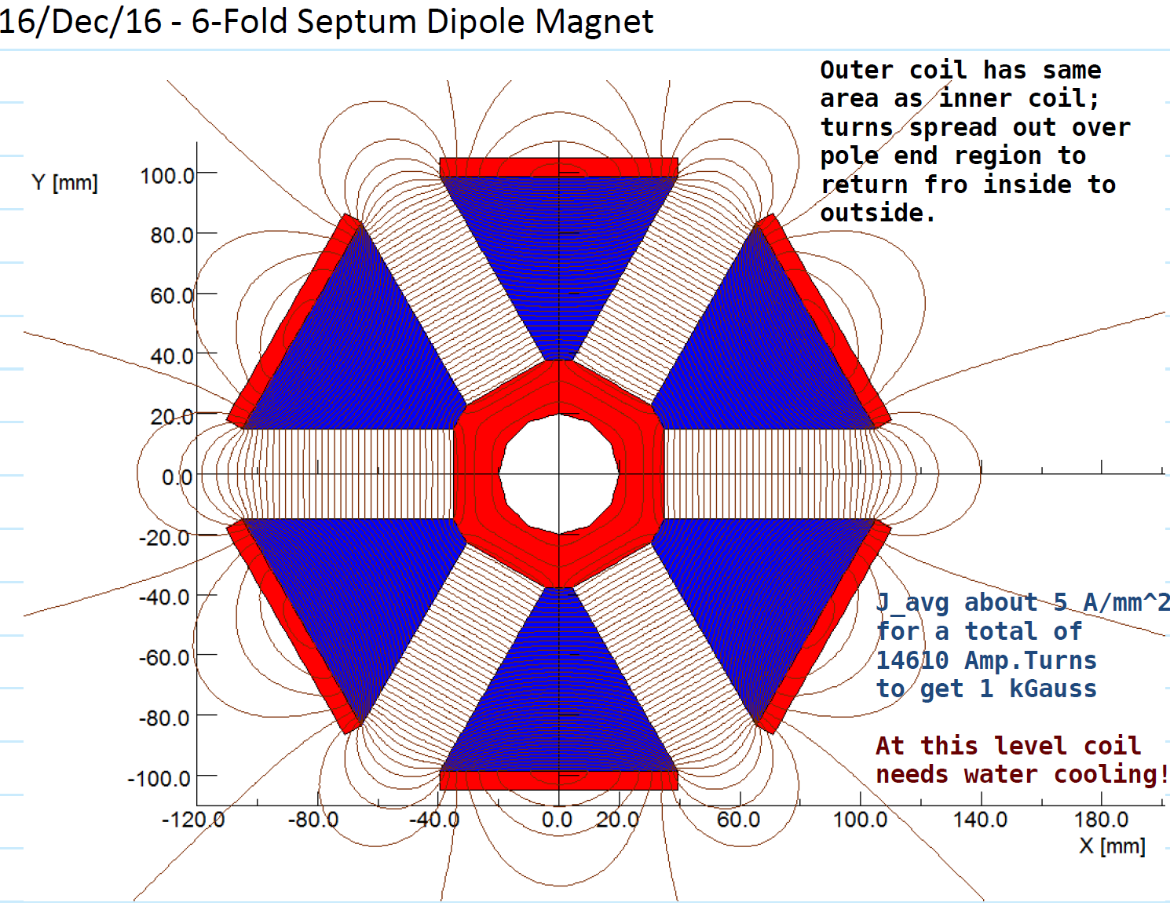
Brett Parker’s Septum Design

Slide 12
Stacking in Real Space
y
Form N x N grid of beams
x’
Reinterpret as beam with N times larger β_{x}, β_{y}
x
x
Efficiency? (Ignoring septum width)
Product = ½ = 50%
Circle in square = π/4 ~= 78.5%
Square in circle = 2/π ~= 63.7%

Slide 13
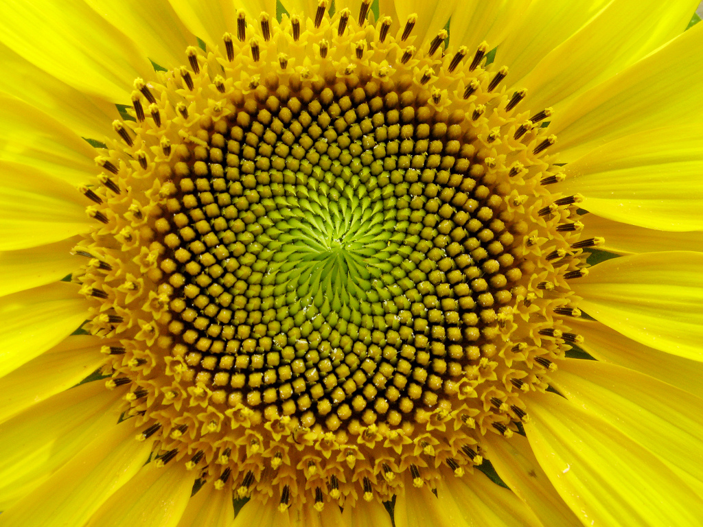
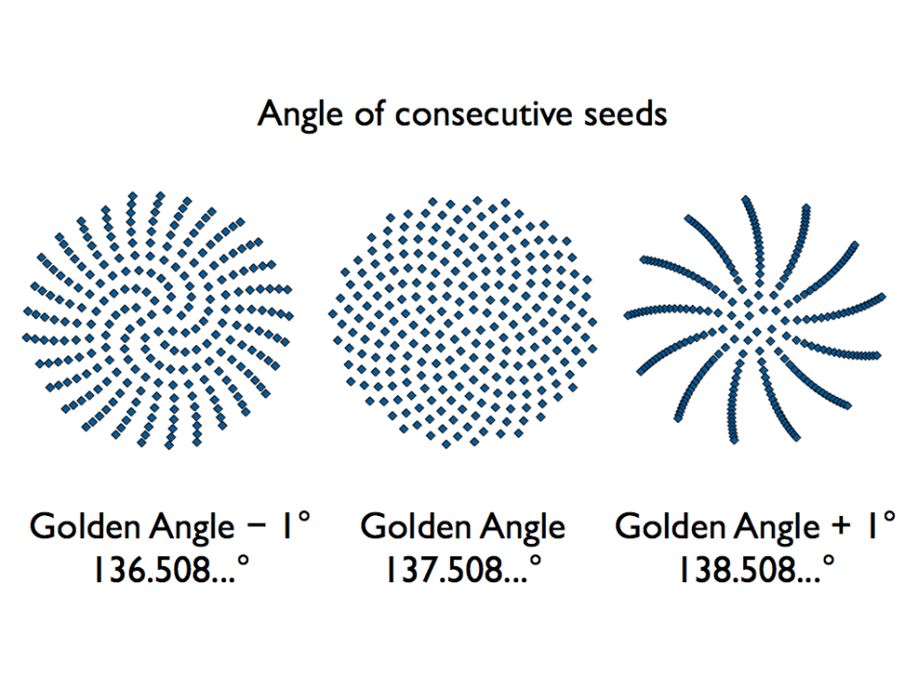
Stacking in Phase Space
x’
Relies on phase-space rotation for packing
Amplitude can be varied by a fast RF deflector or sweeping magnet to paint in 2D
Relatively efficient packings exist but may not be achievable with septum (see below)
Septum fills entire vertical slice of phase space, so a lens-shaped area is wasted
x

Slide 14
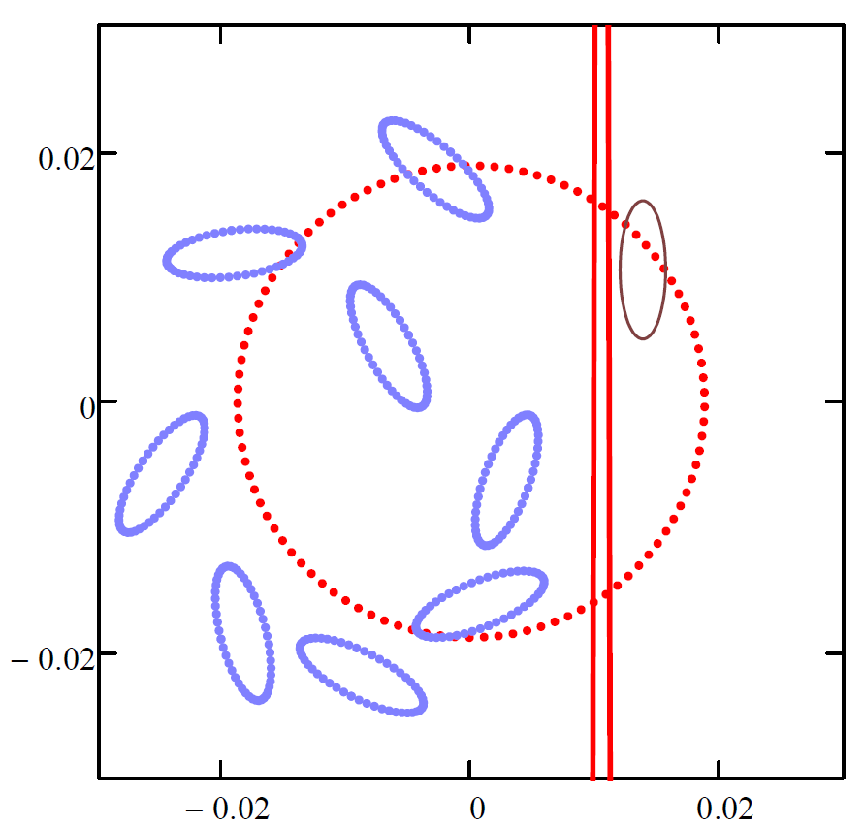
Ring with 8 Sources (Ferdinand)
As I understand:
Each injection septum is at a different y height, so stacks in real space in Y, but uses ring tune to stack in phase space in X-X’ plane, total 8*8=64 beams.
Also includes some time-varying deflectors to do phase space painting.

Slide 15
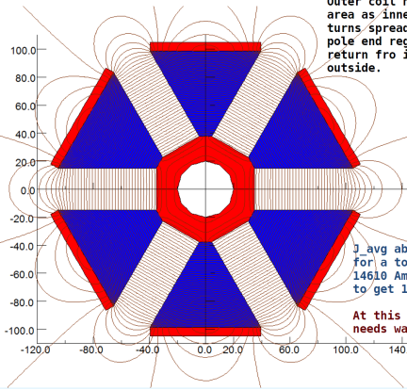
Merge-then-Ring Scheme
Merge sources with DC septum first, then pre-accelerate to improve space charge conditions: long path length (ring) done at higher energy/low space charge.
We don’t want a booster linac for every source, so makes sense to do the septum merge first. Use large beta functions through septum: physically large beams have lower space charge and septum thickness smaller relative to beams.
This ring would stack in X and Y using septums as described on the next slides.

Slide 16
Combiner Ring
Increases charge and decreases rep. rate
Only requires a single input
Three DC septa, one extraction kicker
All DC magnets except extraction kicker
Tunes are integers and intentional dipole defect gives automatic horizontal stacking
Circumference is one input bunch spacing more (or less) than output bunch spacing

Slide 17
Combiner Ring Transverse Stacking
1. Injection septum (turn 8)
2. Diagonal kick septum
3. Drift
4. Un-kick with septum
5. Injection septum (turn 9)
6. Extraction kicker

Slide 18

Combiner Ring Layout
Ring tune = 2
90 degrees per triplet + half dipole
Abnormally-strong dipole
Gives kick centred on 90 degrees phase advance
Becomes X inward offset
Diagonal kick septum
Un-kick septum
Extraction kicker
Injection septum

Slide 19
Combiner Ring Bunch Pattern
Beam direction →
876i6543e210
087i7654e321
108i8765e432
210i9876e543
321i1987e654
432i2198e765
543i3219e876
654i4321e087
765i5432e108
Numbers indicate bunches stacked per bucket
i = injection, e = extraction
Temporal period of 9
  = 9.38MHz eRHIC freq.
Ring circumference 10
  = 35.498…m
Completely regular injection and extraction frequencies
  Formed naturally by extraction pattern

