Slide 1
FFAG Designs for eRHIC and Cβ Return Loops
Stephen Brooks
Accelerator R&D Division, C-AD

Slide 2
eRHIC Overview
Loops
1.7-5.0
6.7-20.0
1.67 GeV
arXiv:1409.1633

Slide 3
eRHIC Motivation
The eRHIC ERL is passed through 24 times
12 accelerating and 12 decelerating passes
1.67GeV of linac can make 20GeV top energy
FFAGs allow 2 return loops to hold 12 energies
Once-through nature of ERL means electron beam can have high interaction parameter
FFAGs use fixed magnetic fields for operation with continuous wave beams (like cyclotrons)

Slide 4
FFAG Arc Cells Parameters
Parameter | FFAG1 (low energy) | FFAG2 (high energy)
Energy range | 1.667 – 5.000 GeV | 6.667 – 20.000 GeV
Energy ratio | 3.00× | 3.00×
Turns (1.666…GeV linac) | 3 | 9 (or 8 + separate turn)
Synchrotron power (* L=2138m arcs) (* I=-10mA) | 0.009MW | 3.89MW @ 20GeV 1.63MW @ 15GeV 0.62MW @ 10GeV
TOF range | 30.1ppm (6.4cm) | 35.3ppm (7.5cm)
Long drift space | 40.0cm | 40.0cm
Tune range | 0.031 – 0.345 | 0.031 – 0.345
Orbit range (quads) | 19.6mm (r_{max} = 13.2mm) | 19.6mm (r_{max} = 13.2mm)
Max |B| on orbit | 0.114 T | 0.458 T
Max quad strength | 8.672 T/m | 34.686 T/m

Slide 5
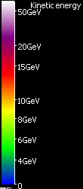
Orbits in Cells (Muon1 simulation)
Transverse exaggeration x64

Slide 6
FFAG Arc Cells Lattice (2.78m long)
Element | Length (m) | Angle (mrad) | Gradient (T/m) | Offset (mm) *
BD2 | 1.004701 | 2.643951 | 34.686326 | -7.009056
DS2 | 0.2 | 0.526316
QF2 | 1.179936 | 3.105095 | -34.686326 | 3.386913
DL2 | 0.4 | 1.052632 |  | * Relative to chord
Element | Length (m) | Angle (mrad) | Gradient (T/m) | Offset (mm) *
BD1 | 1.004701 | 2.643951 | 8.671581 | -7.009056
DS1 | 0.2 | 0.526316
QF1 | 1.179936 | 3.105095 | -8.671581 | 3.386913
DL1 | 0.4 | 1.052632 |  | * Relative to chord
Provisional 3+9 turn lattice from Scott Berg
1.67GeV 648MHz linac/12 turns was a recent change. After this section, results are presented for the previous 1.322GeV 422MHz linac/16 turn design.

Slide 7
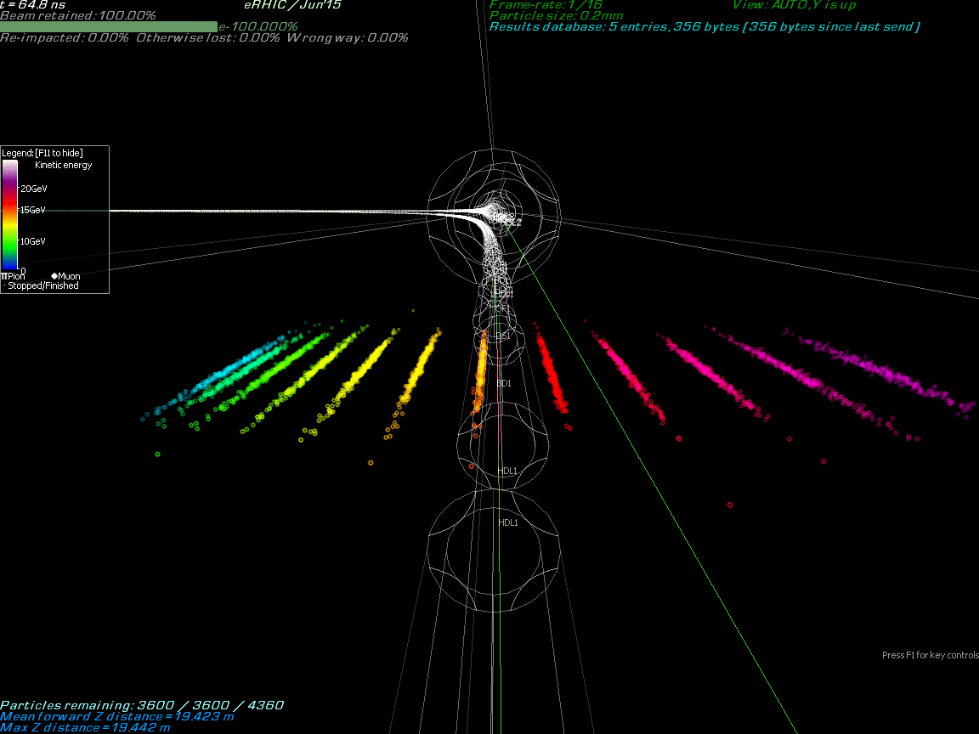
Previous design high-energy FFAG

Slide 8
Tunes

Slide 9
Path Length and TOF

Slide 10
Synchrotron Loss and Max B Field
If replaced by separate turn

Slide 11
Historical High-Energy Cells
Parameter | Jan’14 (50T/m FODO) | Oct’14 (30T/m doublet) | Jun’15 (4+12 turns)
Energy range | 7.944 – 21.164 GeV | 7.944 – 21.164 GeV | 6.622 – 21.164 GeV
Energy ratio | 2.66× | 2.66× | 3.20×
Turns (1.322GeV linac) | 11 | 11 | 12
Synchrotron power (* L=2138m arcs) (* I=-10mA) | 5.44MW @ 21.1GeV 2.04MW @ 15.8GeV 0.64MW @ 10.5GeV | 4.95MW @ 21.1GeV 1.90MW @ 15.8GeV 0.60MW @ 10.5GeV | 6.31MW @ 21.1GeV 2.27MW @ 15.8GeV 0.92MW @ 10.5GeV
TOF range | 22.4ppm (5cm) | 38.0ppm (9cm) | 56.9ppm (12cm)
Drift space | 28.8cm | 45.0cm (and 6.0cm) | 18.0cm
Tune range | 0.035 – 0.369 | 0.033 – 0.410 | 0.024 – 0.346
Orbit range (quads) | 12.6mm (r_{max} = 9.1) | 21.6mm (r_{max} = 15.8) | 30.5mm (r_{max} = 21.7)
Max |B| on orbit | 0.451 T | 0.416 T | 0.467 T
Max quad strength | 49.515 T/m | 29.256 T/m | 28.870 T/m

Slide 12
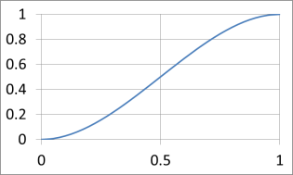
eRHIC FFAG Straight Sections
High energy FFAG
Low energy FFAG
Orbits exaggerated transversely x1000
Quadrupole offsets and curvature adiabatically removed over 17 transition cells.
Scaling factor for each cell:
a = 3p²-2p³, p = cell#/18
As dipole component disappears, all orbits move to straight centre line with small errors:
± 0.436 mm in low-energy ring
± 0.066 mm in high-energy ring
…that can be corrected with fine adjustments

Slide 13
Arc-to-Straight Adiabatic Only
~0.1mm errors
Transverse exaggeration x2500

Slide 14
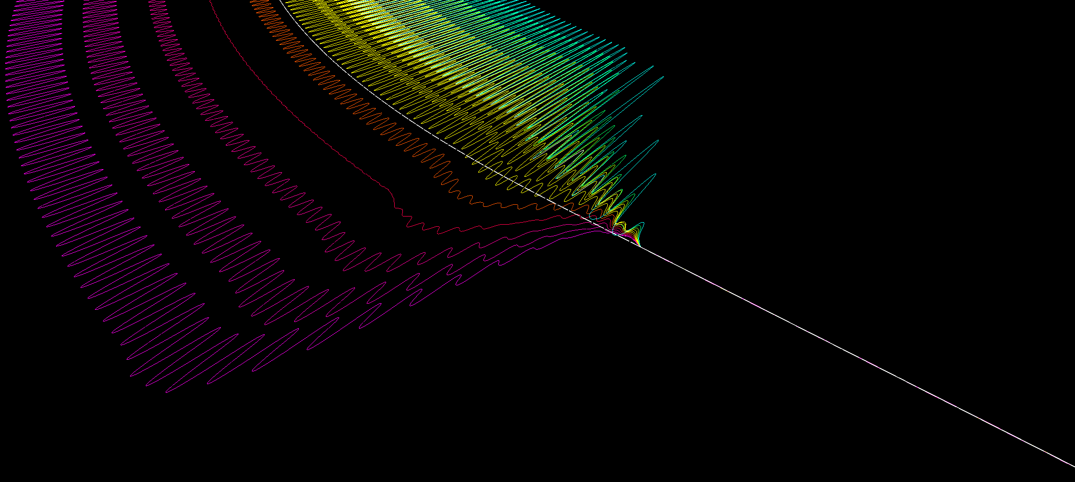
Arc-to-Straight Improved
Fine-tuned using the 17 cells in the matcher
~2.5um errors

Slide 15
Fine Tuning Dipole Fields (T)

Slide 16
Muon1 Response Output
For each “ResponseBPM” j,
a CSV file containing the matrix:
…and the uncorrected
positions:
Muon1 simulation
Any constrained linear optimisation tool
Corrector vector
as lattice input
Any attribute can become a corrector, e.g. adding a ResponseDipole=1e-6 attribute will vary that Dipole by 1e-6 Tesla in the numerical differentiation.

Slide 17
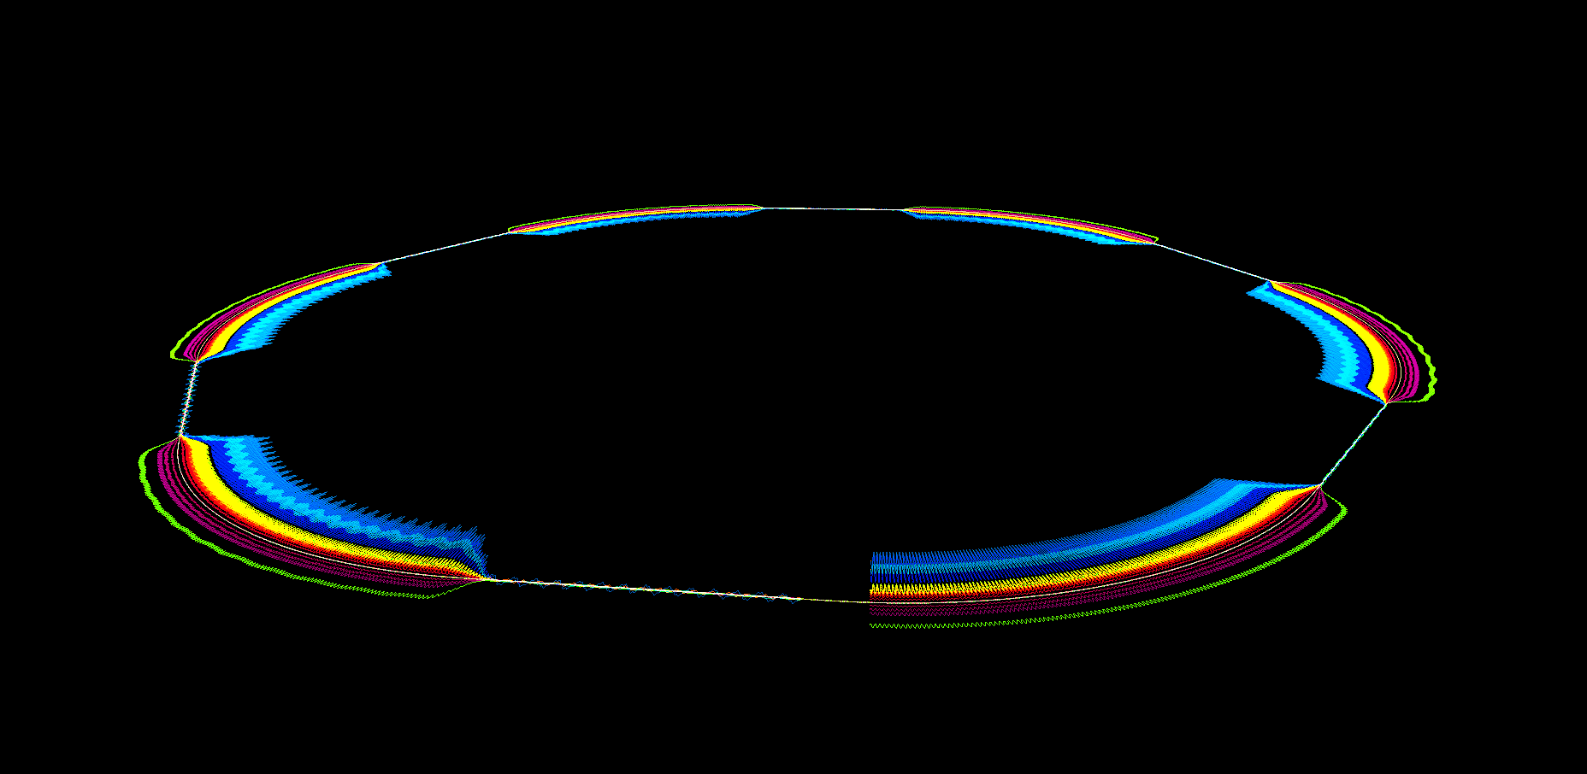
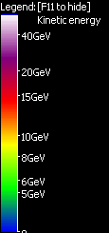
eRHIC FFAG Rings in Perspective
Orbits exaggerated transversely x5000, shape of hexagonal RHIC is evident

Slide 18
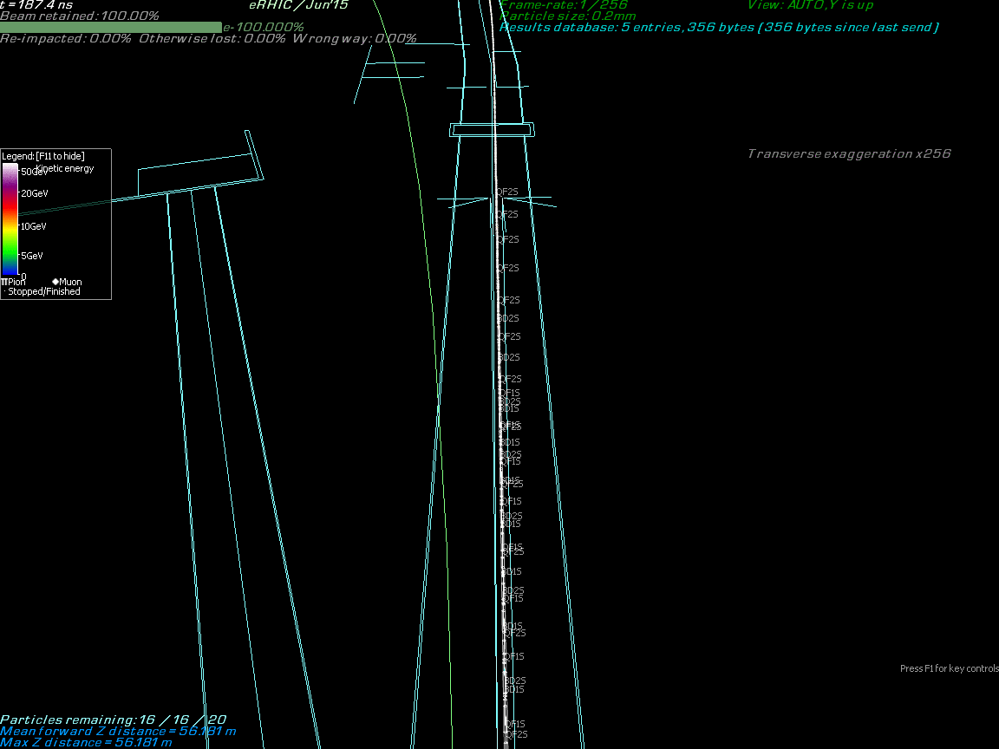

Slide 20
Full Lattice Strategy: Outline
Break the FFAGs into sections
Each piece must be fine-tuned
MAD-X export has been developed
Muon1 can lay out whole ring overlaid on RHIC tunnel plan
Also can output lists of survey coordinates

Slide 21
FFAG Special Sections
Straight
Splitter/Combiner
Crossover straight
Linac
Arc
Matcher
Bypass straight

Slide 22
Alternative Without Separate Pass
Straight
Splitter/Combiner
Linac
Crossover straight
Extraction arc
Arc
Matcher
Bypass straight

Slide 23
Matched Section Names (r = ring #)
Straight
rM12
rA11
Splitter/Combiner
rC10
Zero datums
Linac
rA09
rM03
rB08
rB06
rC04
rA07
rA05

Slide 24
Entry Energies (x = 60° SR)
Straight
rA11
rA01
Splitter/Combiner
rC10
E-x
E-x
Linac
E-2x
E
E-2x
The arc-like sections require smoothed SR loss option in Muon1
rA09
rA03
E-3x
E-5x
E-3x
E-5x
rB08
E-4x
rB06
E-4x
rC04
rA07
rA05

Slide 25
Design Levels of Detail Level 1: Circle
Arc

Slide 26
Level 2: Hexagon
Straight
Arc
Matcher

Slide 27
Level 3: All FFAG Sections
Straight
Crossover straight
Arc
Matcher
Bypass straight

Slide 28
Level 4: Closed ERL
Straight
Splitter/Combiner
Crossover straight
Linac
Arc
Matcher
Bypass straight

Slide 29
Level 5: eRHIC Complete
Straight
Dump
Splitter/Combiner
Crossover straight
Linac
Injector
Arc
Matcher
Detectors
IR lines
Hadron ring (not shown)
Bypass straight

Slide 30
Current Lattice Status
Jun’15 (4+12 turn, 422MHz) lattice has been taken to the level 2/“hexagon” level of detail
This hexagon was tuned to fit in the RHIC tunnel
This and the various Muon1 and MAD-X export files have been published to the eRHIC wiki
New cell for 647MHz (3+9 turn) only recently developed so is at the level 1/“circle” stage
Publish to wiki coming soon

Slide 31
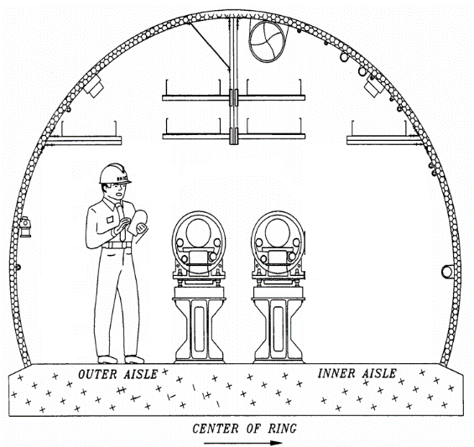
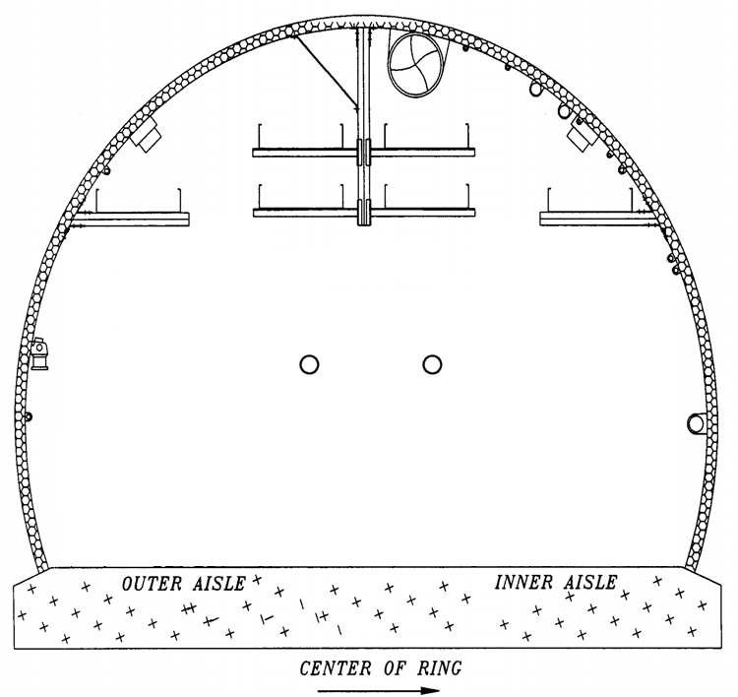
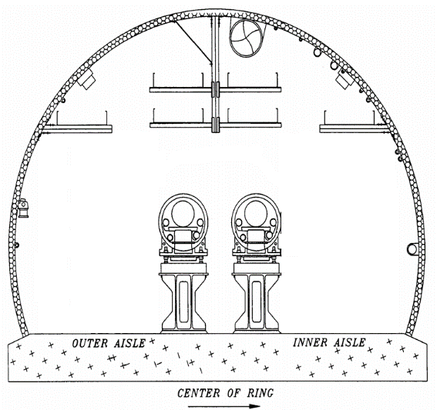
Tunnel Crossover under RHIC Pipe
eRHIC path length must ~= RHIC hadron ring
Can’t stay on inside or outside all the way around
Space under 4 and 10 o’clock no-cryo pipe
Adiabtic scheme similar to bypass gives 3.36m total horizontal displacement
30m central warm section with 1.81m displacement

Slide 32
All Lines Going Through IRs
Hadron ring
Electron FFAGs
High-energy electron line
Greatly exaggerated!
Detectors moved inwards to allow bypass

Slide 33
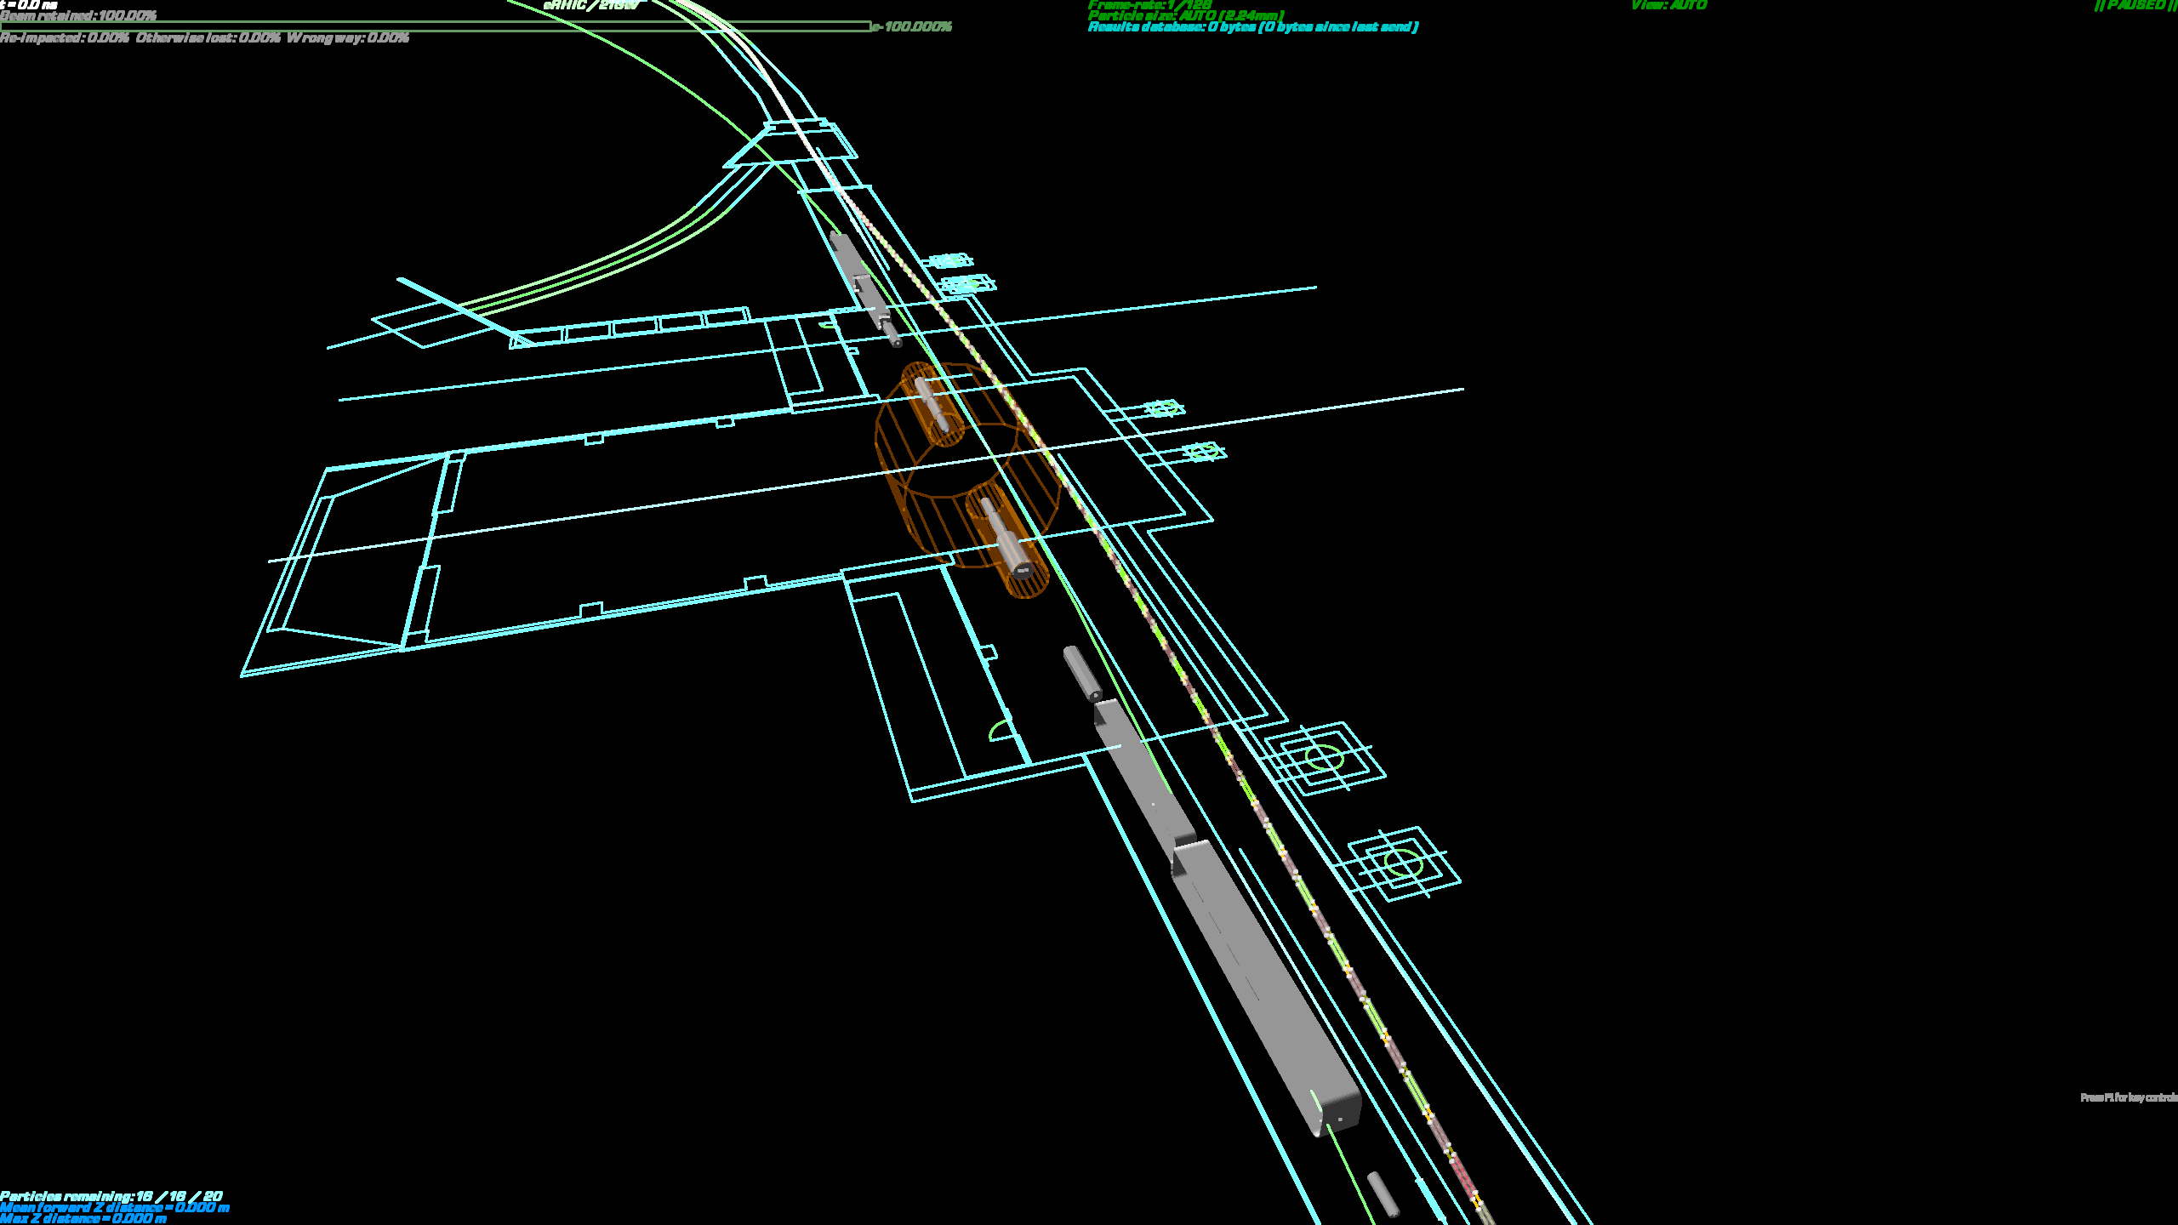
3D Bypass Layout in RHIC Tunnel
Orbits exaggerated transversely x5000
Enough clearance for an R=4.16m (STAR-sized) detector if it is displaced inwards on existing rails by 1.76m. Clearances would be >34cm from beamline centre to walls/detector

Slide 34
Detector Bypasses: a Flexible FFAG
−Δθ
Curvature
Bypass straight
Normal straight
Angle
−2Δθ
Δθ
Δθ
Δθ
Displacement
3
9
9
17
17
9
9
3
90.3m
76 cells
3.08m
Orbits exaggerated 2000x, beamline to scale

Slide 35
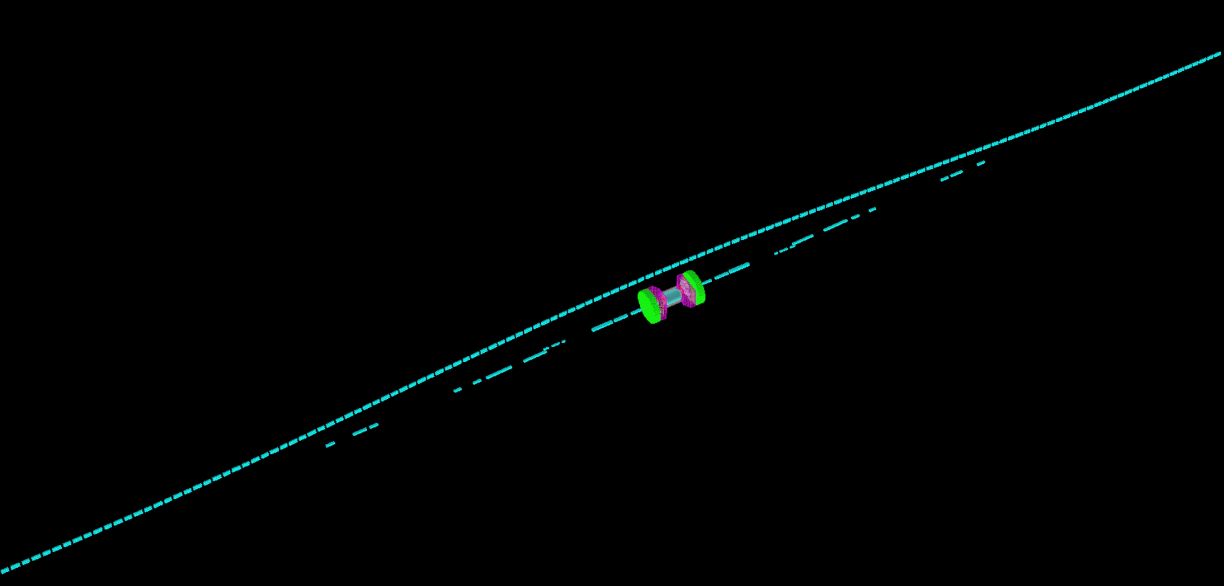
Detector CAD Model
FFAG by-pass
electrons
ions

Slide 36
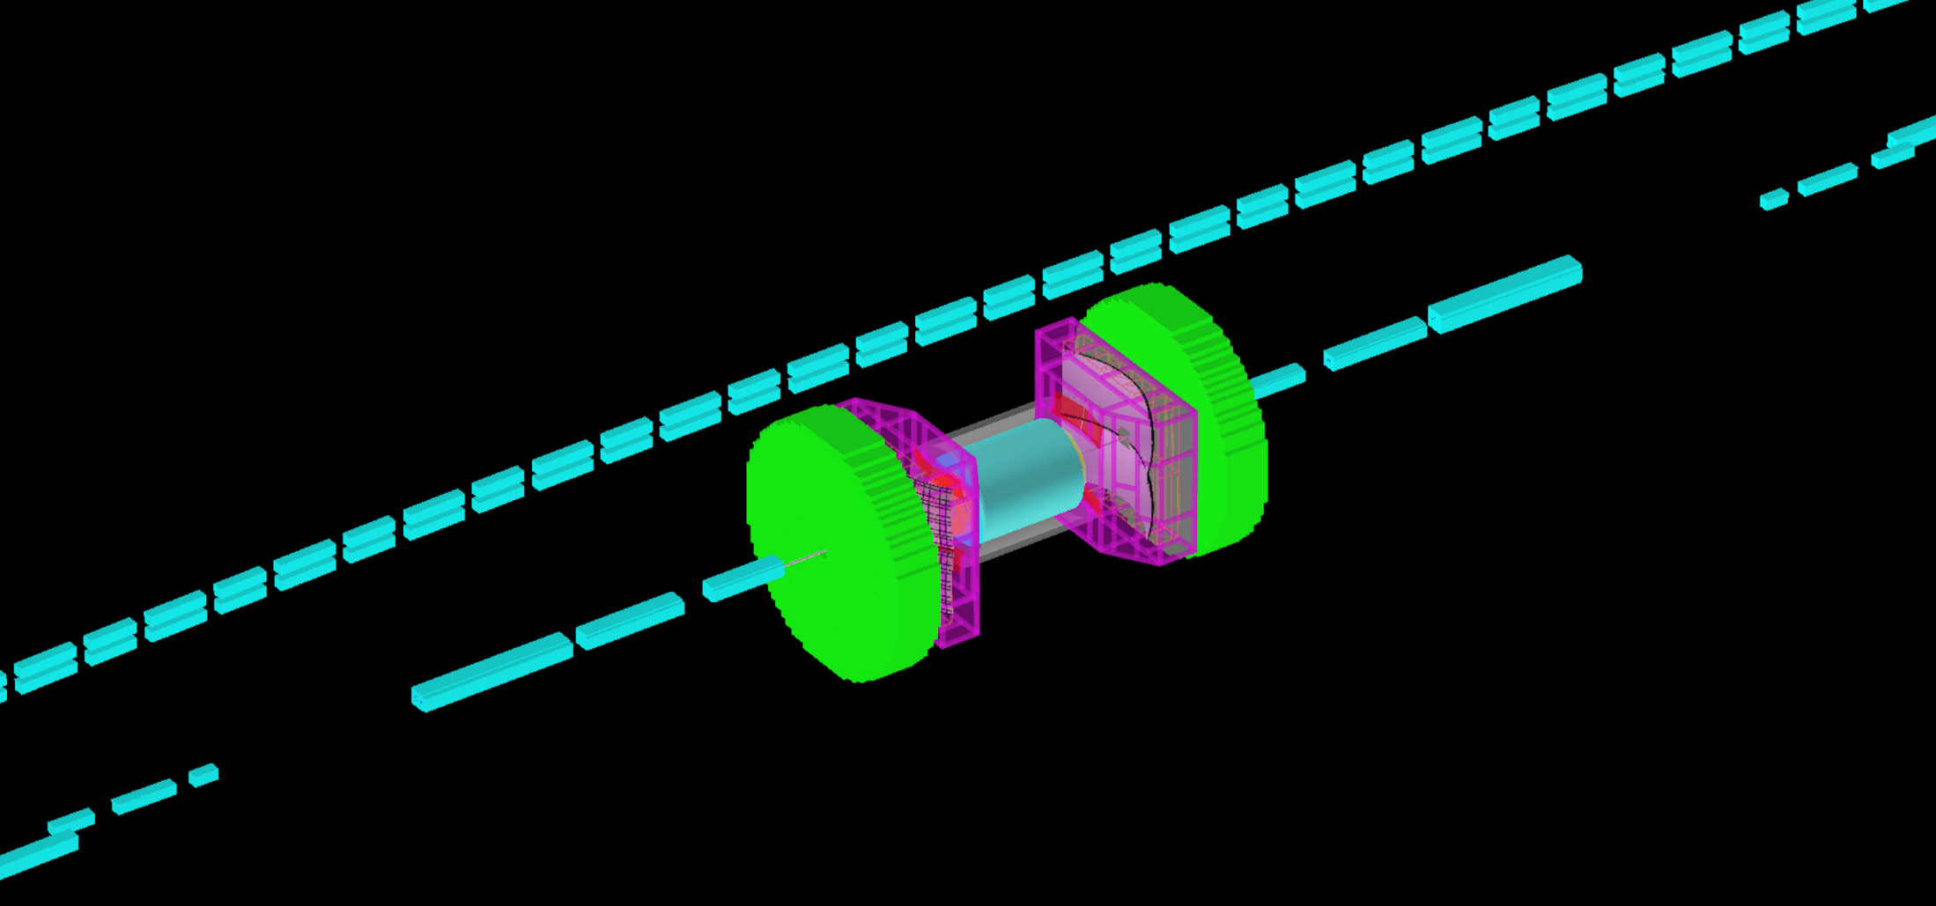
Detector CAD Model Zoom
FFAG By-pass
Electrons
Ions

Slide 37
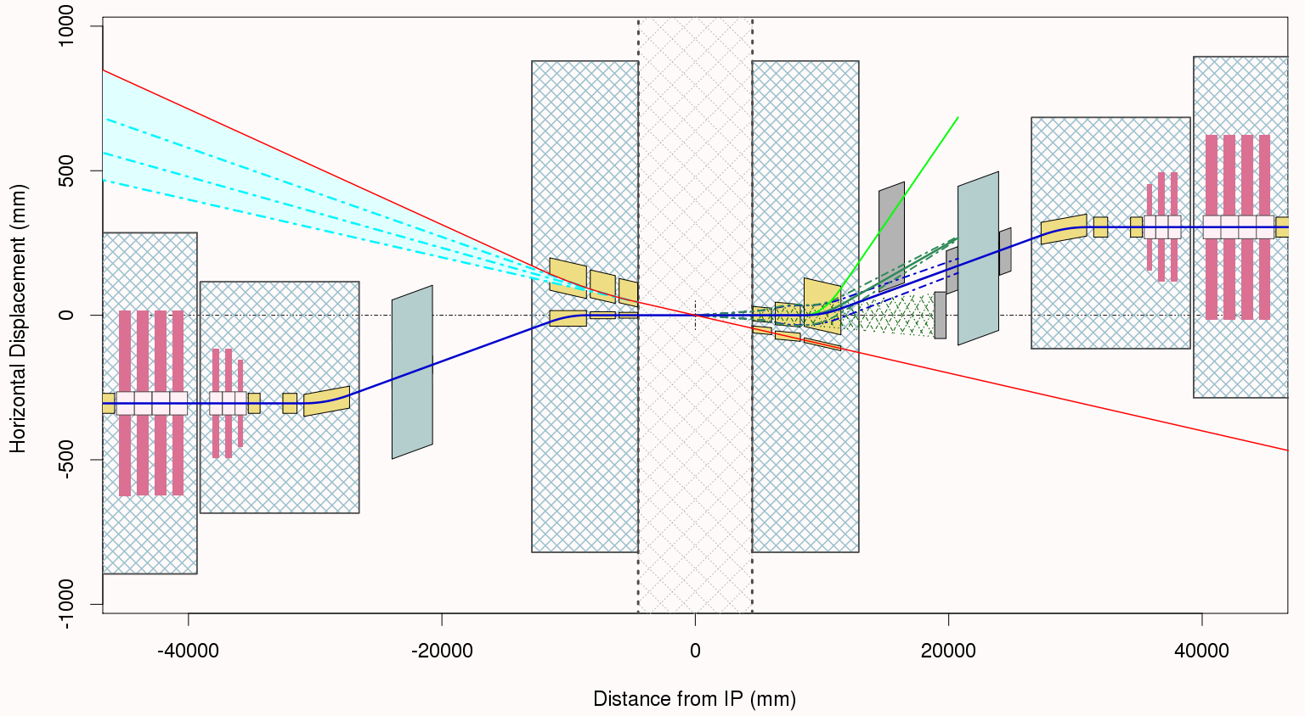
eRHIC IR v2.5, Layout Summary
10 mrad additional electron bending
16 mrad hadron dogleg has spectrometer function for forward going particles
Crab Cavities
Yellow boxes outline the cold beam tube apertures.
Warm Quad
Crab Cavities
Cryostat
Cryostat
Synrad
Cryostat
±4.5m Region
Cryostat
Cryostat
IP
ZDC
Cryostat
Hadrons
Electrons
Crab Cavities
Warm Quad
10 mrad total crossing angle
Crab Cavities
16 mrad hadron dogleg
Brett Parker’s design
The hadron beta functions are symmetric but the bending is antisymmetric.
Electron bending comes after the IP in order to avoid synrad background.

Slide 38
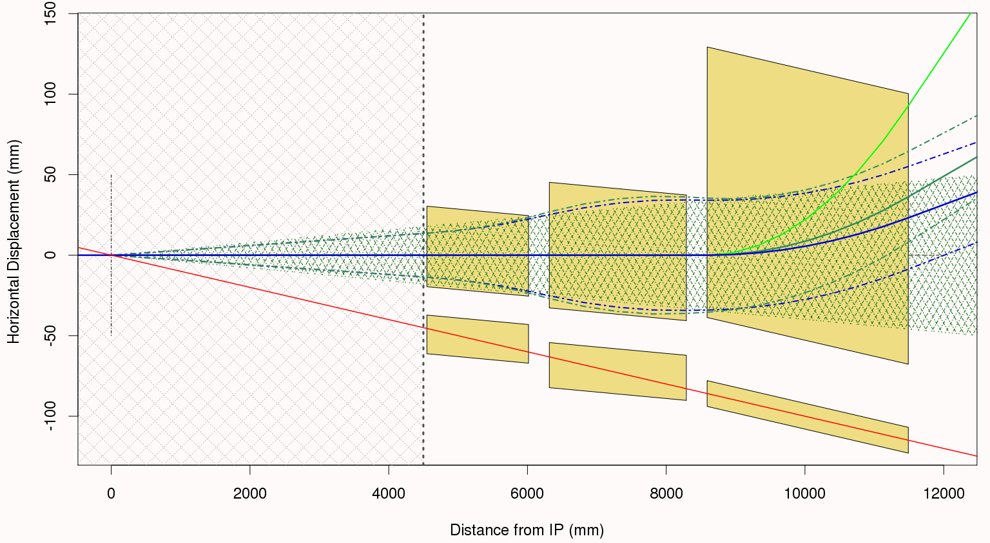
IR Forward Layout Details
Strong dipole bending in this B1 aperture
Strong quadrupole focusing takes place in these, Q1 & Q2 apertures
4 mrad neutron cone acceptance
Low field “sweet spot” shielded
regions for incoming electrons in these apertures.
Note that the coordinate system in these figures is aligned with the center of the 4 mrad neutron cone (neutral vector) indicated by the hatched region on the plot.

Slide 39
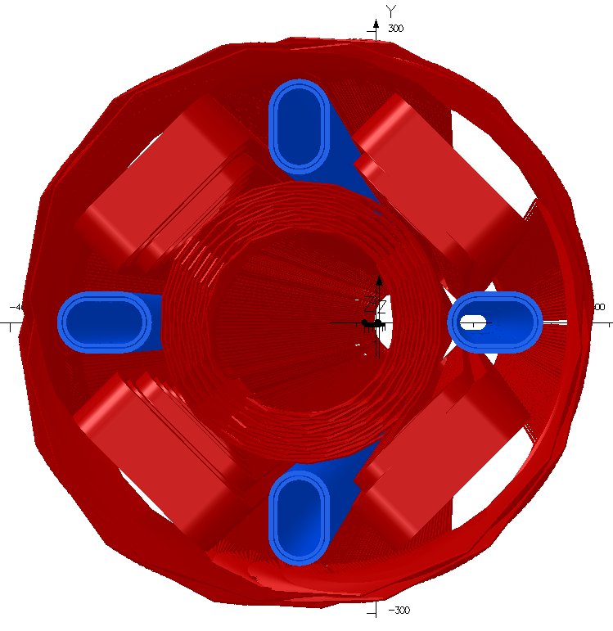
IR Q1 Magnet Forward Details
Q1, Version 2.5 Optics, Full Model
Q1 Version 2.5 Parameters
Magnetic Length = 1.975 m
Main Gradient = 136.9 T/m
Field @ e-Beam < Few Gauss
The Version 2.5 Q1 magnet is longer than before and its aperture had to be increased to maintain desired forward experimental acceptance.
Note that the Q1 sweet spot region comes much closer to the main coil than the previous generic solution.
The Q1 outer coils contribute ~36% of the total gradient and the peak field now reaches 6.2 T on the main coil
Field quality is close to 1 x 10⁻⁴ at R_{ref}=20mm (i.e. about 1 Unit).
Field inside elongated shielded region is less than 1 gauss in the main body.
Coil ends do not preserve the body cross section, so we must carefully optimize end turns. Combining magnetic and superconducting materials, “magnetic cloaking,” may be helpful. https://wiki.bnl.gov/eic/index.php/Magnetic_Cloak

Slide 40
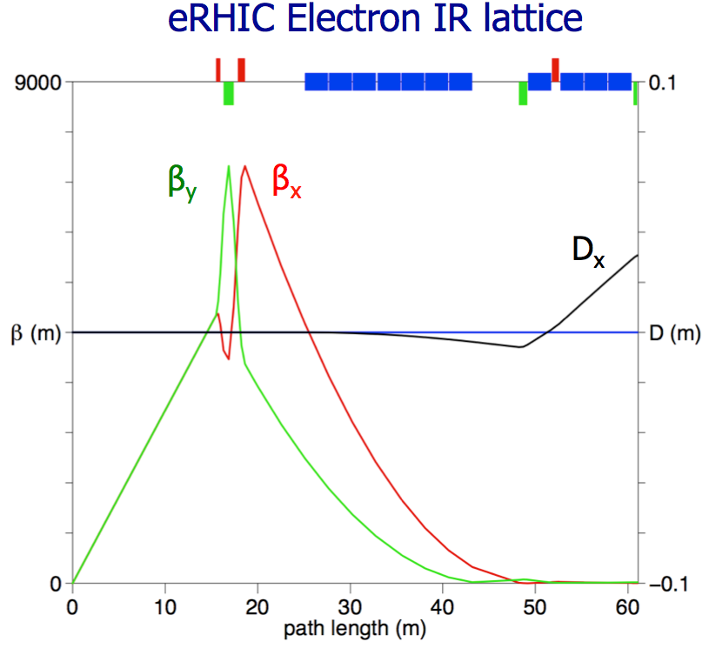
Electron IR lattice
Triplet
3000

Slide 41
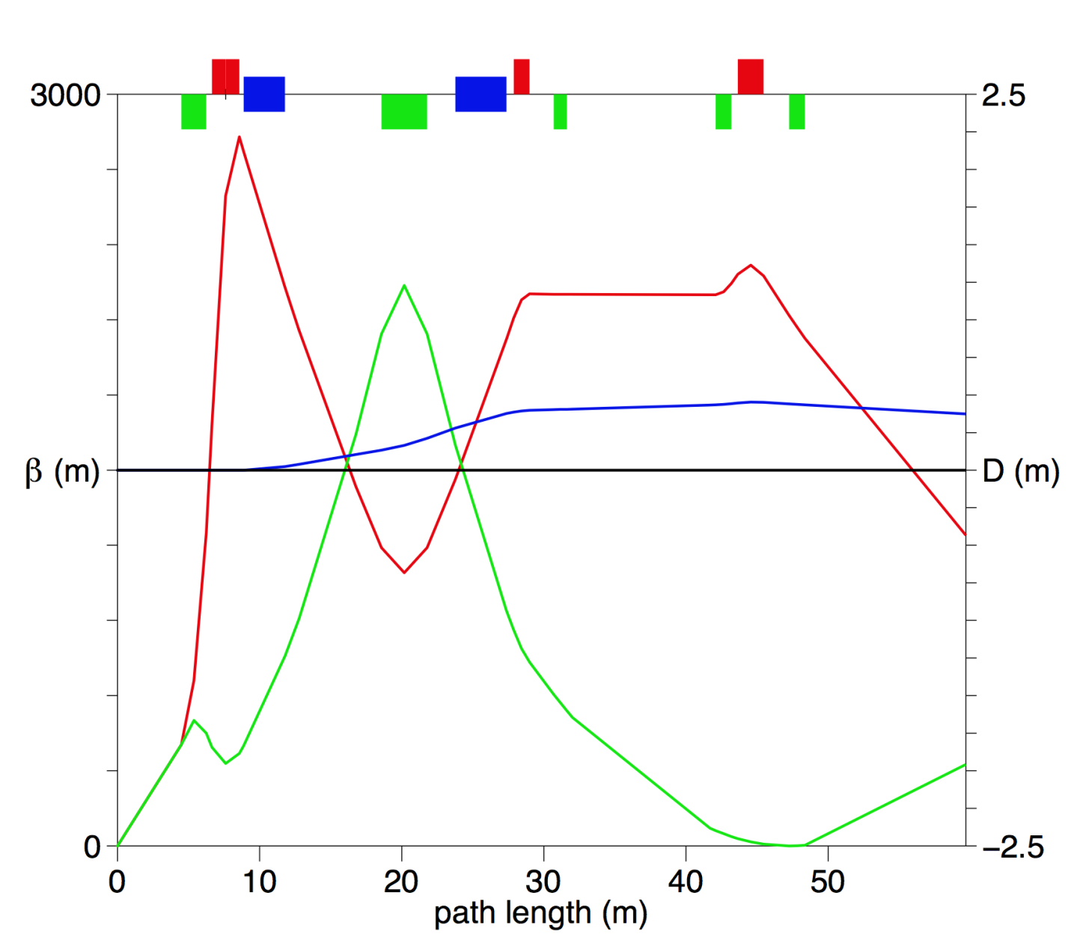
Hadron IR Lattice for β*= 5 cm
Doublet
Cold Regions
90⁰ phase advance and large β for Crab Cavities
16 mrad “Dogleg Dipoles”
While magnet apertures differ, the optics are the same for the forward and rear sides.

Slide 42
FFAG Orbit Correction: Outline
Abstractly, FFAG “fine tuning” and actual orbit correction on the machine are the same
Both use the linear response matrix
Practically, they differ
BPM errors: position offsets, noise, nonlinearities
Target differences to eliminate offset errors
Between multiple beams going through the same BPM
Distinguish turn-by-turn or during commissioning
In arcs, can use double differences (this cell – last)

Slide 43
Dispersion Correction is Important
Even energy spread ~ 10⁻³ in such a long channel can cause phase differences
Of the order of 1000 cells around RHIC tunnel
Natural chromaticity + errors → emittance growth
Must correct orbits to within less than beam size
x’
x’
x’
x
x
x

Slide 44
Projected RMS Emittance Growth
Convolution of beam shape with centroid scatter: σ²_{projected} = σ²_{beam} + σ²_{centroids}
Smallest σ_{beam} ~= 25μm (in FFAG)
Keeping |σ_{centroids}| < 1μm would keep relative emittance growth below 1/25² = 1/625, which I think is tolerable, in every possible case
Larger errors depends on situation, 10μm might be OK, 100μm gives noticeable growth

Slide 45
Field Error Sources
Independent beam errors are the worst case scenario, so model almost all of eRHIC’s errors
Field error source | Relative size | Equivalent displacement | Time scale | Linear / Nonlinear | Mitigation
Material magnetisation | 2e-2 | 200µm | Constant | Both | Magnet tuning on bench
Magnet assembly | 2e-3 | 20µm | Constant | Both | Magnet tuning on bench
Alignment on girder | 1e-2 | 100µm | Constant | Linear | 1% (50G) linear corrector coils
Radiation damage | <1e-3 | <10µm | Years | Unknown | 1% (50G) linear corrector coils
Temperature coefficient | 1e-3/K | 10µm/K | Minutes - hours | Linear (?) | Orbit feedback + corrector coils
Slow vibrations | <1e-3 | <10µm | < few Hz | Linear | Orbit feedback + corrector coils
Fast vibrations | <1e-5 | <0.1µm | > few Hz | Linear | Not corrected (small enough)
Too large for 50G
Model is appropriate
Appropriate if can respond as a function of time (“orbit feedback”)
Residual size OK

Slide 46
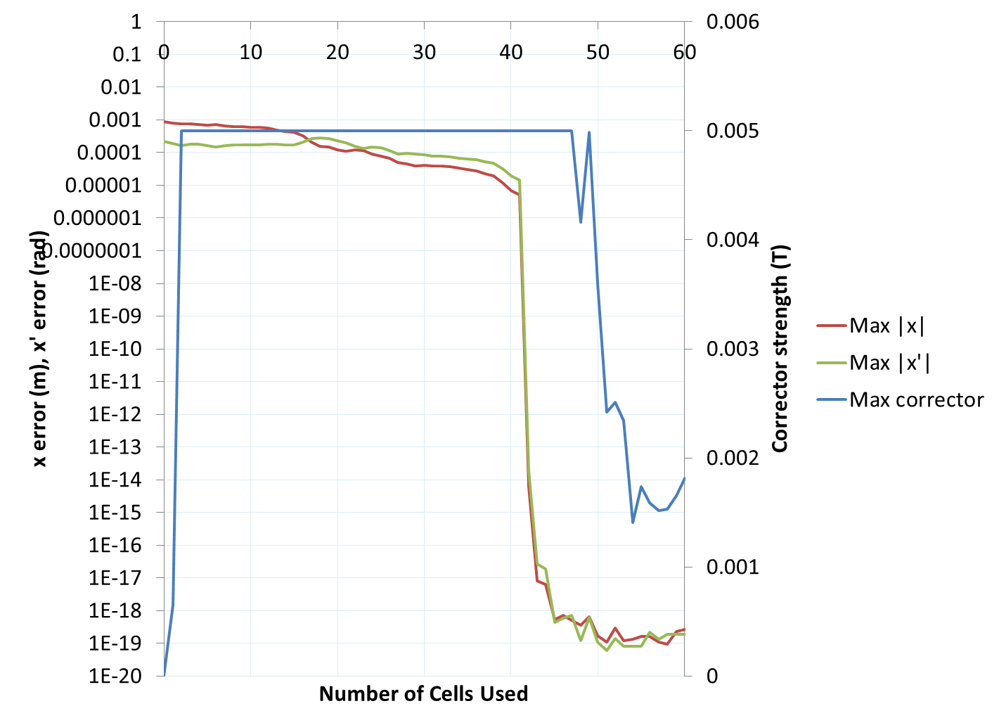
Zero Energy Spread Situation
Just the beam centres with δp/p=0.
Still using 11 beams for this comparison;
6 to 8 beams should be easier.
Log scale
Starting with beams randomly ~1mm off their orbits including errors in dispersion
“Perfect” at 42 cells, 84 correctors.

Slide 47
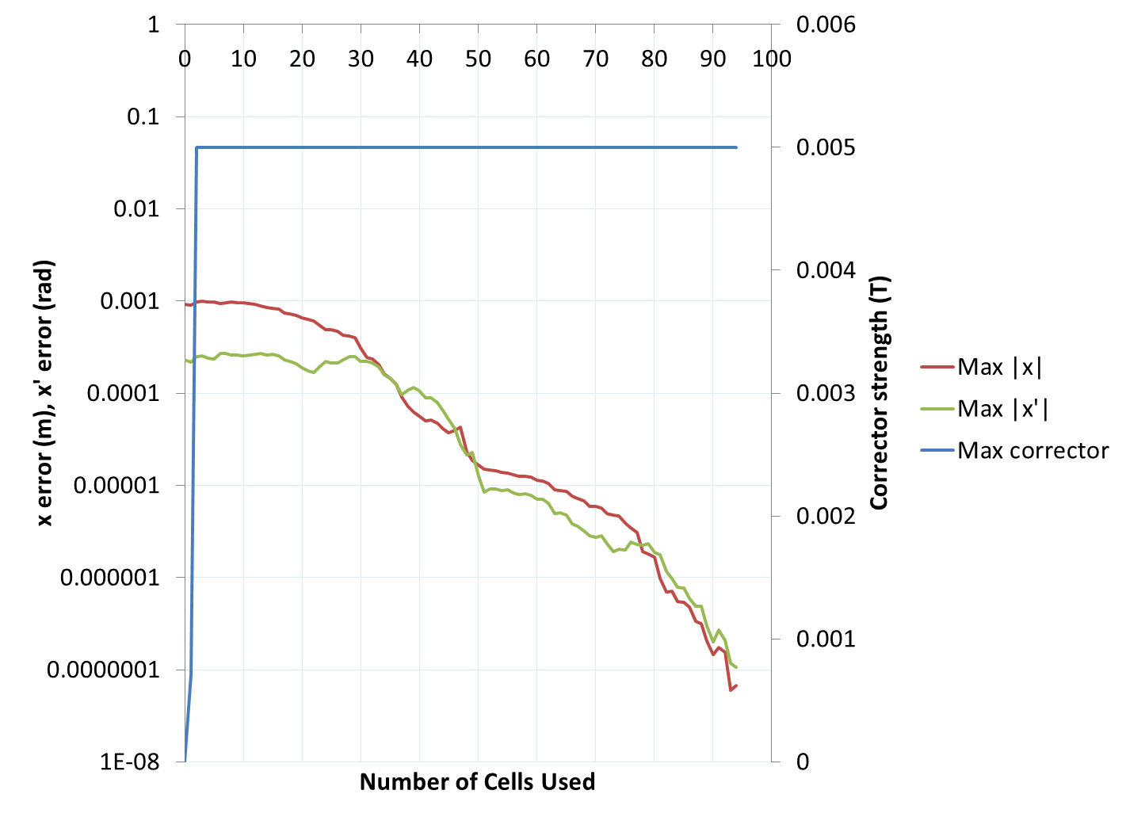
δp/p ±1e-3 Situation
Each beam represented by 5 energies in δp range. All must be corrected to their closed orbit.
Log scale
4 orders of magnitude improvement
Residual offsets no more than 67nm using 94 cells, 188 correctors.
Emittance growth negligible from tracking.

Slide 48
δp/p ±1% Situation
Dominated by first order dispersive errors
Residual offsets no more than 0.35μm using 94 cells, 188 correctors.
Observe scaling of graph with δp/p.
Dominated by beam x errors
Higher-order region?

Slide 49
Emittance Change for δp/p ±1%
5000 particles per energy in Muon1 tracking
No emittance change visible within statistics
Average growth of beamlet -0.0188%

Slide 50
Splitters
All 12 energies must be separated on either side of the linac to match the beta function from ~1m in the FFAG to ~100m in the linac
If this was done adiabatically in an FFAG solution, the FFAG cells would have to be ~100m long!
Splitters also give:
Path-length correction for every energy
R56 control for longitudinal ERL match
Position/launch tweaking for every energy

Slide 51
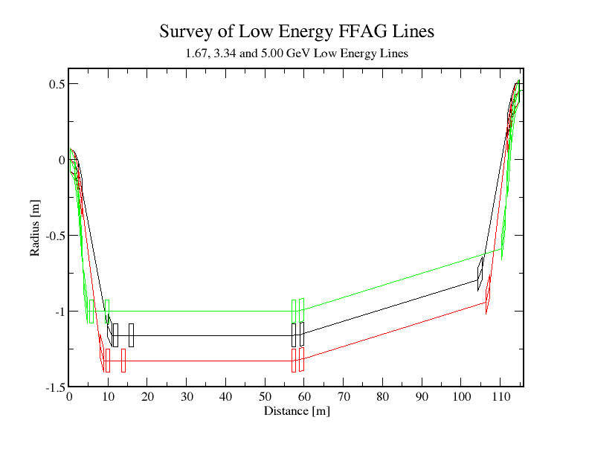
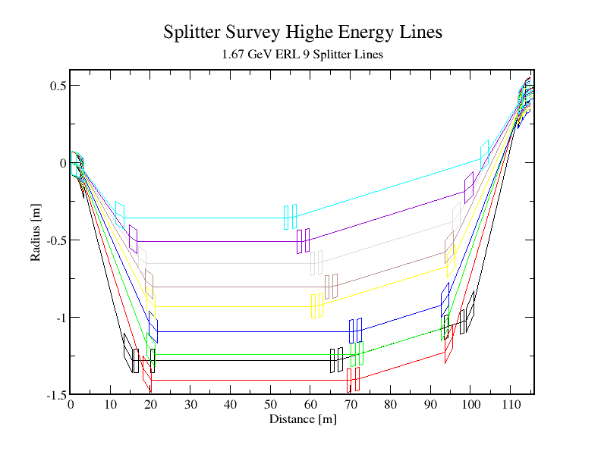
Nick Tsoupas’ Splitter Layout
Updated for 1.67 GeV/12 turn ERL
1.7 to 5 GeV Lines
6.7 to 20 GeV Lines

Slide 52
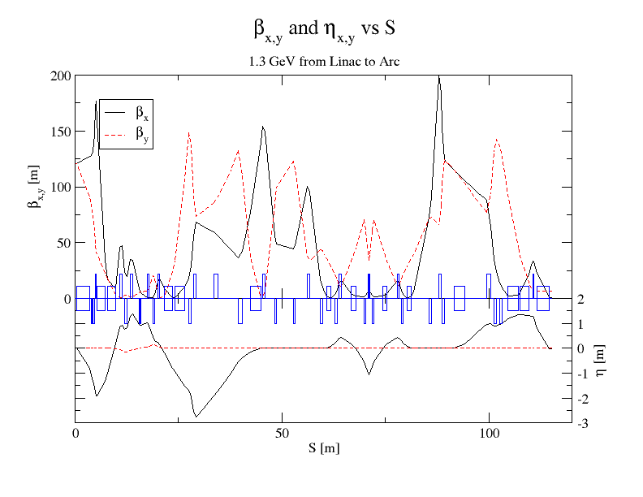
Match-R56
section
Match-R56
section
Match to Arc
section
Splitting
section
Vert. Displ.
section
Hor. Achr.
Section
Begin D_{x}=0
R56/Path
section
Hor. Achr.
section
End D_{x}=0

Slide 53
Path Length Increase in Splitter
16 Lines 1.32 GeV ERL
12 Lines 1.67 GeV ERL
10 Lines 2.0 GeV ERL
 | Energy [GeV] | Path_Increase [cm]
1 | 1.320 | 43.8
2 | 2.656 | 31.8
3 | 3.978 | 25.9
4 | 5.300 | 23.4
5 | 6.622 | 20.7
6 | 7.944 | 16.5
7 | 9.266 | 14.4
8 | 10.558 | 15.1
9 | 11.910 | 12.5
10 | 13.232 | 9.6
11 | 14.554 | 7.3
12 | 15.876 | 5.6
13 | 17.198 | 4.5
14 | 18.520 | 3.4
15 | 19.842 | 2.5
16 | 21.000 | 1.7
 | Energy [GeV] | Path_Increase [cm]
1 | 1.67 | 31.5
2 | 3.34 | 26.0
3 | 5.00 | 16.1
4 | 6.68 | 14.9
5 | 8.35 | 12.8
6 | 10.02 | 9.6
7 | 11.69 | 7.4
8 | 13.36 | 5.4
9 | 15.03 | 4.4
10 | 16.70 | 3.3
11 | 18.37 | 2.40
12 | 20.00 | 1.55
 | Energy [GeV] | Path_Increase [cm]
1 | 2 | 29.4
2 | 4 | 19.8
3 | 6 | 10.2
4 | 8 | 12.2
5 | 10 | 8.75
6 | 12 | 5.8
7 | 14 | 4.6
8 | 16 | 3.4
9 | 18 | 2.3
10 | 20 | 1.5

Slide 54
16-turn Splitter in RHIC Tunnel
Perspective view of survey points

Slide 55
16-turn Splitter in RHIC Tunnel
End, beams merged into 2 stacked FFAGs

Slide 56
eRHIC FFAG Lattice Future Work
Next ~2 months
Agree on 12-turn lattice cell and publish to wiki
Construct lattice to detail level 3/all FFAG sections
Including export to MAD format and ELEGANT for tracking with collective effects
Next ~3 years
Finalise IR line, splitters, linac, injector and dump
Full end-to-end simulation (detail level 5)
Add results to eRHIC CDR for CD-1 timeframe

Slide 57
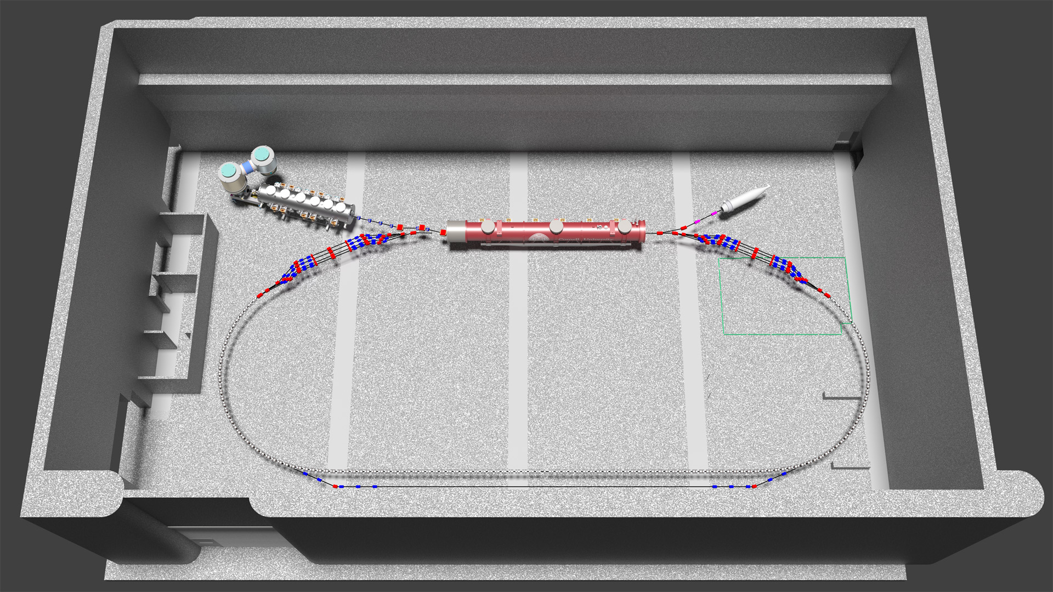
Cβ Overview
Cβ = CBETA = Cornell-BNL Energy recovery Test Accelerator
Render by Chris Mayes (Cornell)
6 MeV
1.3GHz linac
6 MeV
+/- 61 MeV
67, 128, 189, 250 MeV

Slide 58
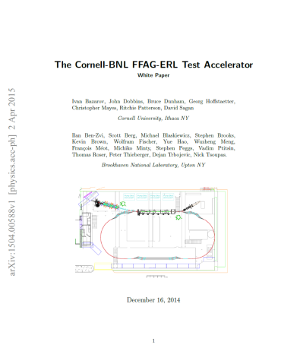
Cβ Motivation
Cβ will be the first accelerator in the world to include any of the following things, which are all required by the eRHIC design
ERL using FFAG recirculating arcs
Linear field FFAG with momentum range of 4x
Adiabatic transition from curved to straight FFAG
Permanent magnets (PMs) used in an FFAG
NdFeB PMs used for main beam steering
PMs used in ERL return arcs
Multi-pass superconducting ERL
arXiv:1504.00588

Slide 59
FFAG Arc Cells Parameters
Parameter | Cβ FFAG (2015 version) | eRHIC FFAG2 (high energy)
Energy range | 67 – 250 MeV | 6.667 – 20.000 GeV
Energy ratio | 3.73× | 3.00×
Turns (1.666…GeV linac) | 4 | 9
Synchrotron power (* I=-10mA) | 0.000007MW | 3.89MW @ 20GeV 1.63MW @ 15GeV 0.62MW @ 10GeV
TOF range | 3.32 × 10⁻³ (10.9cm) | 35.3ppm (7.5cm)
Long drift space | 8.99cm | 40.0cm
Tune range | 0.026 – 0.322 | 0.031 – 0.345
Orbit range (quads) | 29.1mm (r_{max} = 28.6mm) | 19.6mm (r_{max} = 13.2mm)
Max |B| on orbit | 0.623 T | 0.458 T
Max quad strength | 37.195 T/m | 34.686 T/m

Slide 60
Orbits in Cells (Muon1 simulation)
Transverse exaggeration x1
ACTUAL SIZE
Grid is in cm

Slide 61
Racetrack Layout (Muon1)
Transverse exaggeration x64

Slide 62
Arc Cell Lattice (32.99cm long)
Element | Length (m) | Angle (mrad) | Gradient (T/m) | Offset (mm)
QF | 0.08 | 11.083899 | -37.195 | 2.444758
DS | 0.05 | 0
BD | 0.11 | -73.915752 | 24.039 | 18.346488
DL | 0.0899 | 0
This is the lattice we’ve been using for most of this year
It will be updated soon to account for co-optimisation with the magnet bores

Slide 63
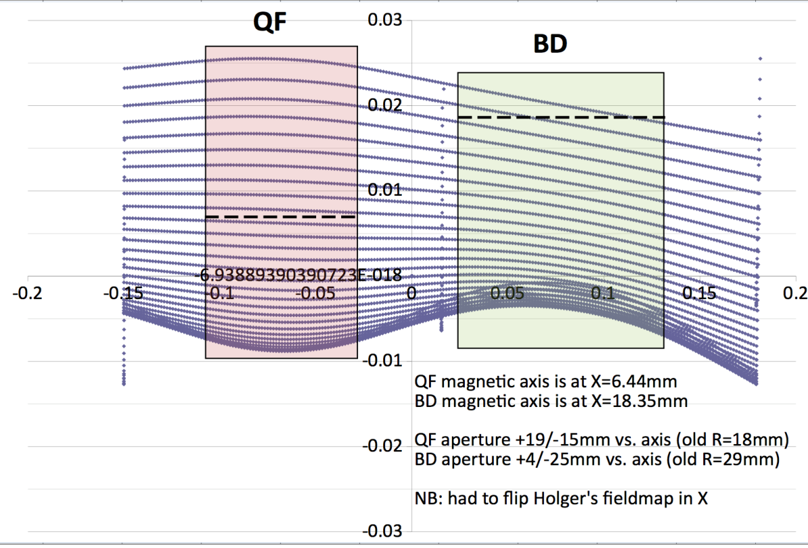
Tracking Through Fieldmaps
Muon1
B-MAD

Slide 64
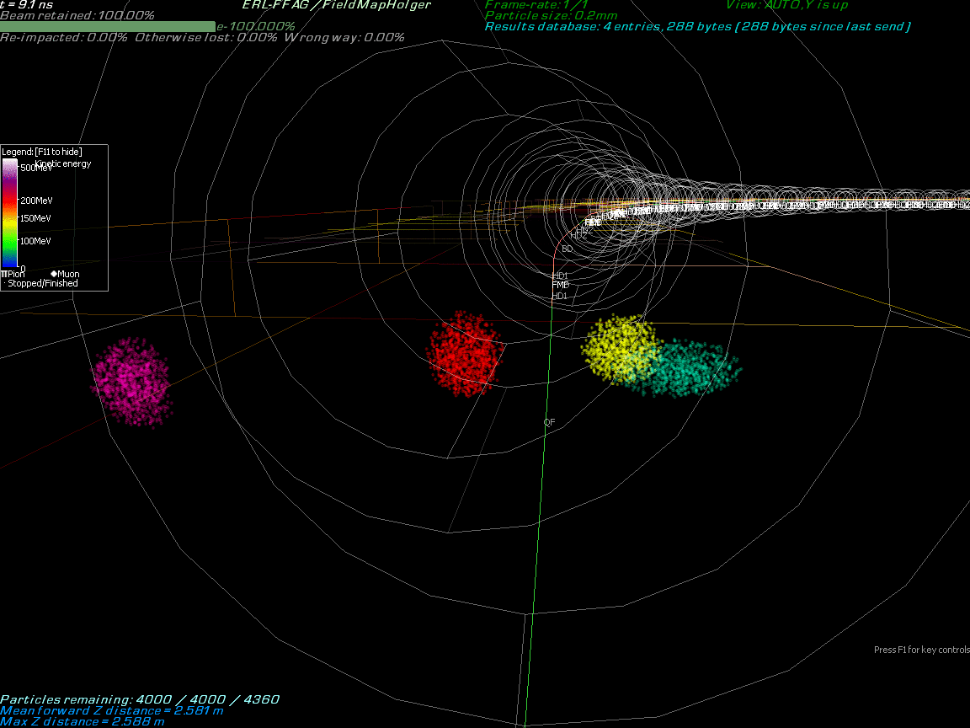

Slide 65
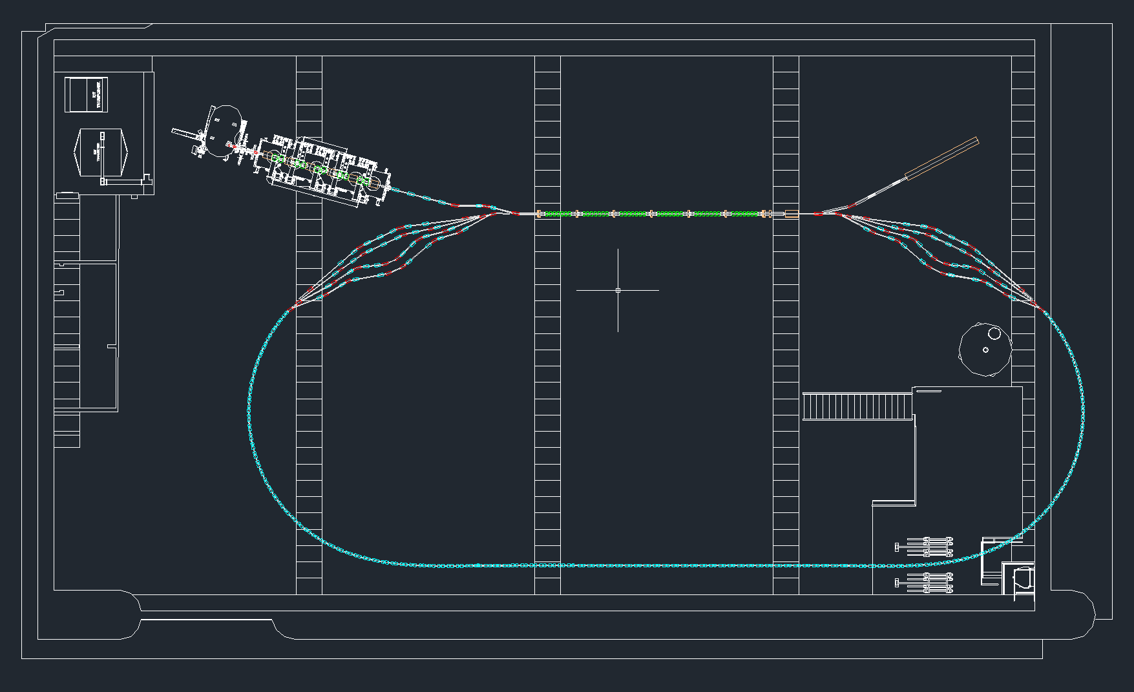
Layout in Cornell L0E Hall

Slide 66
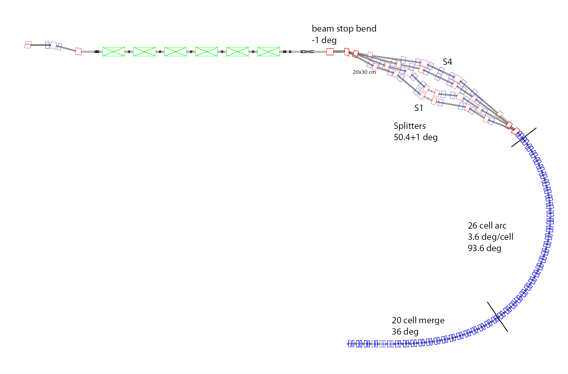
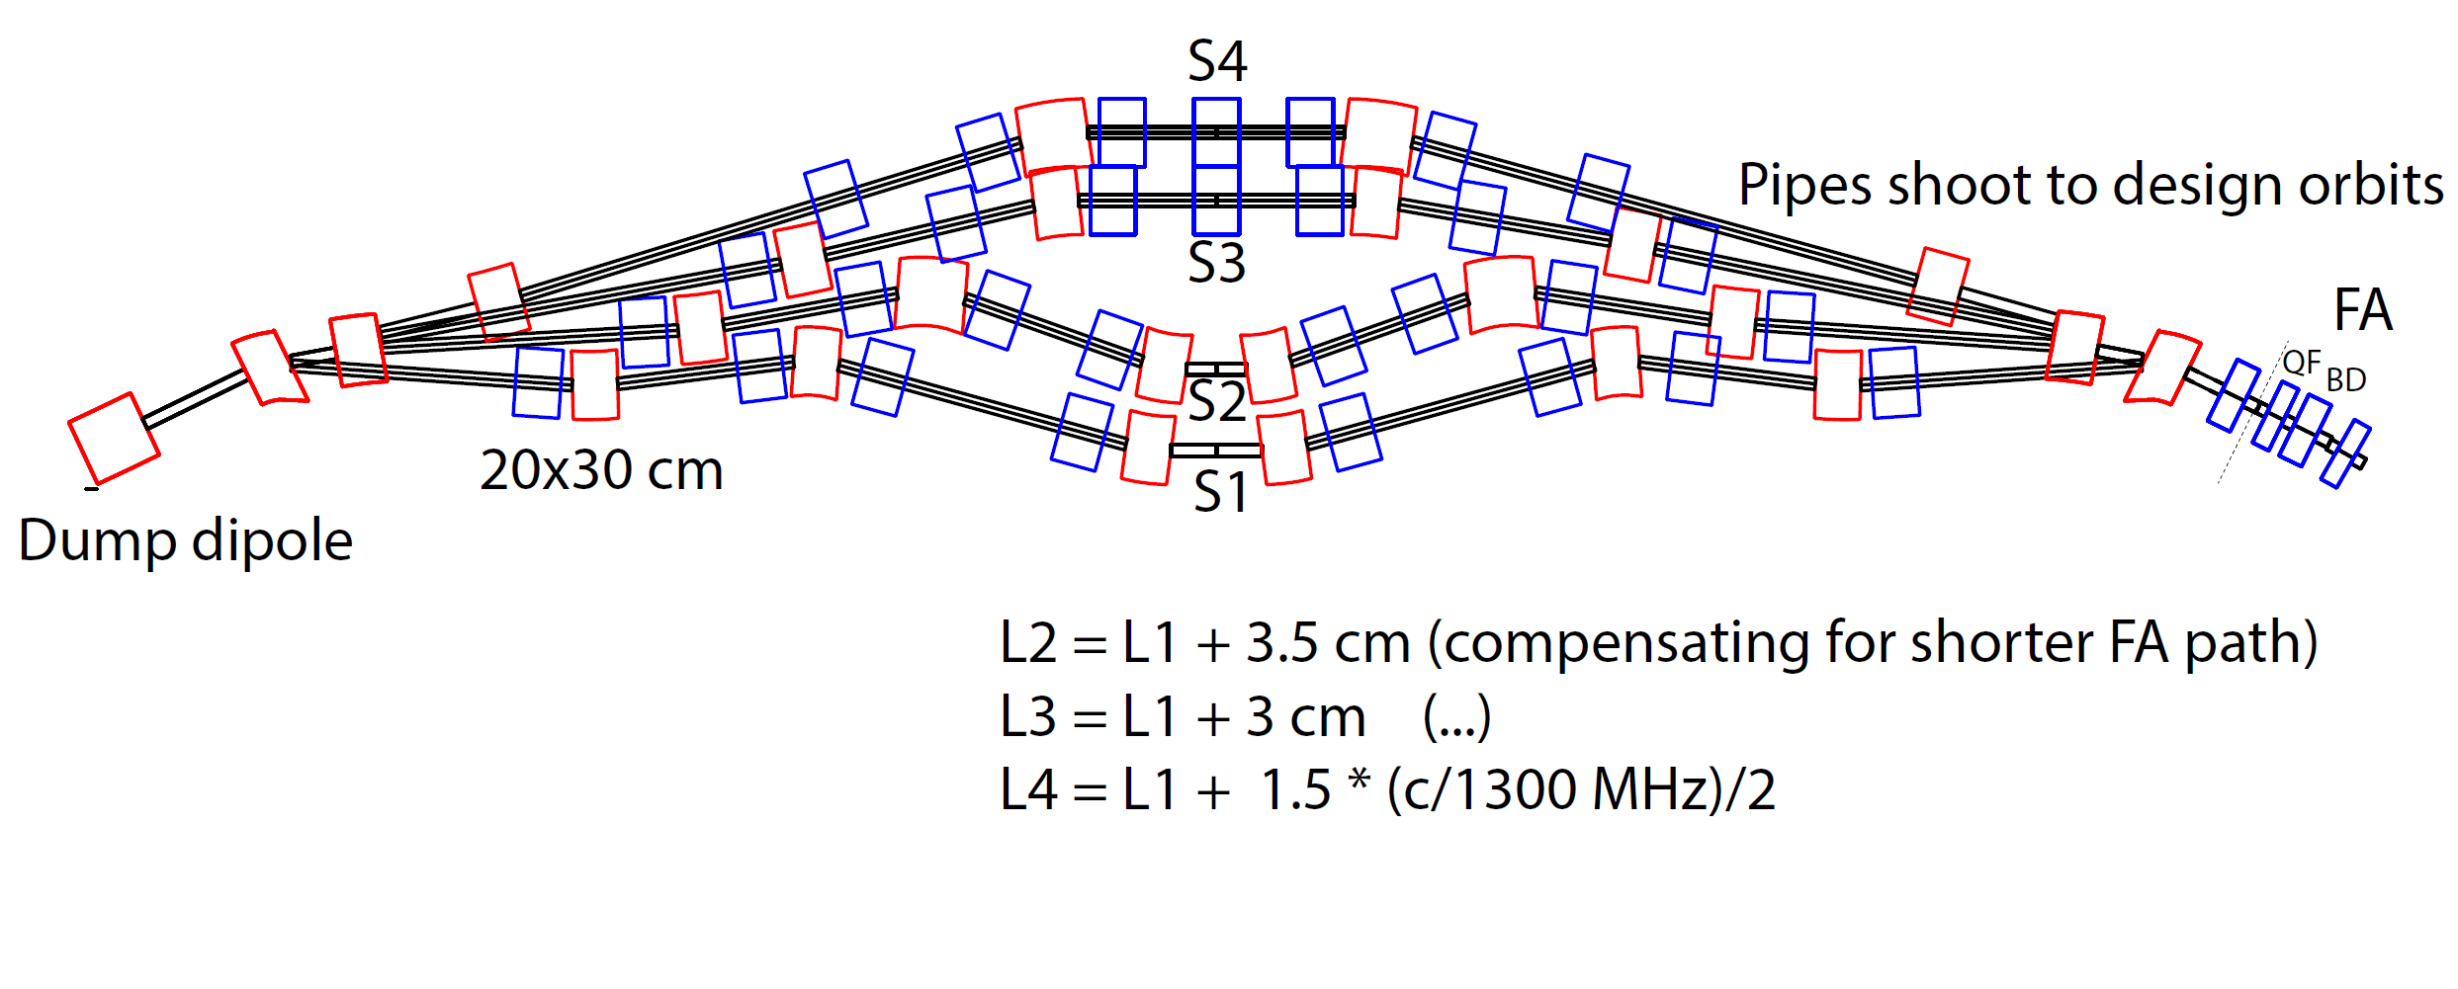
Splitter Layout
By Chris Mayes (Cornell), tracking in B-MAD

Slide 67
Arc-to-Straight Match
By Chris Mayes (Cornell), tracking in B-MAD
Cell
Arc-to-Straight (10 cells)
286 MeV
216 MeV
76 MeV
146 MeV
(m)
(m)
-3.6 deg
Focus
8 cm
42.5 T/m
-0.104 T
Defocus
11 cm
-27.5 T/m
-0.5044 T
(m)

Slide 68
Orbit Corrections
By Chris Mayes (Cornell), tracking in B-MAD
500 um rms x offset errors
SVD correction given BPM readings for separate beams and correction coils on every other dipole
Full FFAG arc
Full FFAG arc

Slide 69
Schedule (Georg Hoffstaetter)
10/01/2016 Design and prototyping complete
10/01/2017 Construction complete with Cornell’s ERL linac
03/01/2018 4-pass ERL operation with low current
10/01/2018 4-pass ERL operation with high current
01/01/2019 eRHIC linac installation
07/01/2019 4-pass ERL operation with eRHIC linac
10/01/2019 4-pass ERL operation with high current
This is based on the monthly resolution of activities listed in the next pages.
Optional synergy phase with eRHIC SRF development program
Oct-15 | Nov-15 | Dec-15 | Jan-16 | Feb-16 | Mar-16 | Apr-16 | May-16 | Jun-16 | Jul-16 | Aug-16 | Sep-16 | Oct-16 | Nov-16 | Dec-16 | Jan-17 | Feb-17 | Mar-17 | Apr-17 | May-17 | Jun-17 | Jul-17 | Aug-17 | Sep-17 | Oct-17 | Nov-17 | Dec-17 | Jan-18 | Feb-18 | Mar-18 | Apr-18 | May-18 | Jun-18 | Jul-18 | Aug-18 | Sep-18 | Oct-18 | Nov-18 | Dec-18 | Jan-19 | Feb-19 | Mar-19 | Apr-19 | May-19 | Jun-19 | Jul-19 | Aug-19 | Sep-19
Design and prototyping
 |  |  |  |  |  |  |  |  |  |  |  | Construction with Cornell's ERL linac
 |  |  |  |  |  |  |  |  |  |  |  |  |  |  |  |  |  |  |  |  |  |  |  | 4-pass ERL operation with low current
 |  |  |  |  |  |  |  |  |  |  |  |  |  |  |  |  |  |  |  |  |  |  |  |  |  |  |  |  | Beam studies and 4-pass ERL with higher current
 |  |  |  |  |  |  |  |  |  |  |  |  |  |  |  |  |  |  |  |  |  |  |  |  |  |  |  |  |  |  |  |  |  |  |  | eRHIC linac installation
 |  |  |  |  |  |  |  |  |  |  |  |  |  |  |  |  |  |  |  |  |  |  |  |  |  |  |  |  |  |  |  |  |  |  |  |  |  |  | low-current 4-pass ERL operation with eRHIC linac
 |  |  |  |  |  |  |  |  |  |  |  |  |  |  |  |  |  |  |  |  |  |  |  |  |  |  |  |  |  |  |  |  |  |  |  |  |  |  |  |  |  |  |  |  | high-current operation
We are here

Slide 70
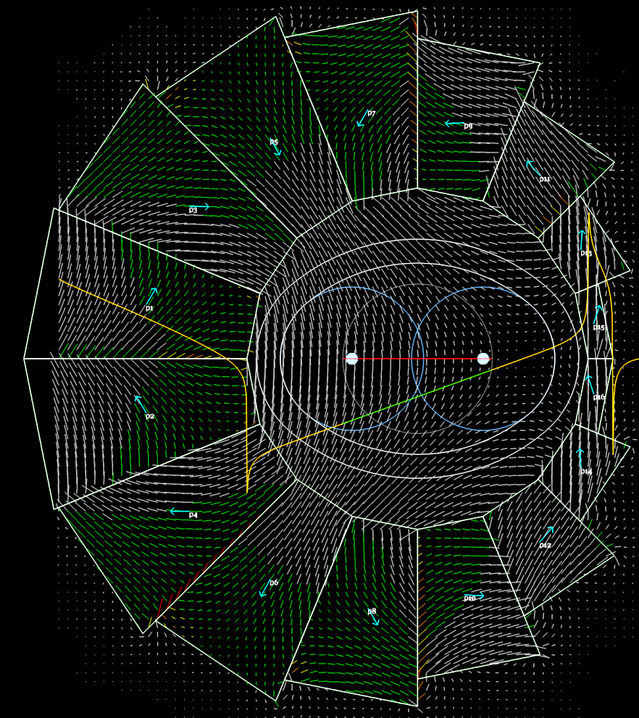
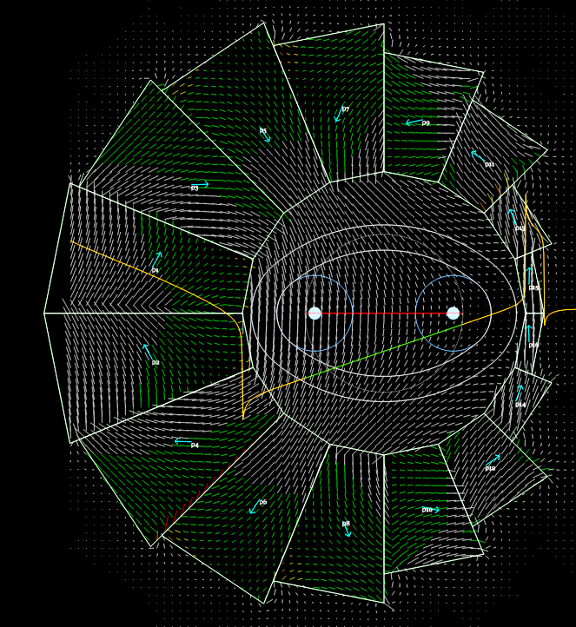
Cell/Magnet Co-optimisation
Recently beam-to-pipe clearance was increased from 6mm to 12mm

Slide 71
Cβ Future Work
Next ~2 months
Find a consistent combination of: FFAG cell beam trajectories, vacuum chamber thickness, magnet apertures and corrector coil design
Track with fieldmaps
Adjust as necessary for realistic fringe fields etc.
Use this to begin writing the Cβ CDR document
Next ~3 years
The entire project (see previous timeline)

Slide 72
Backup

Slide 73
FFAG Lattice Scaling* Laws
* not scaling FFAG laws
Scaling type (by factor a) | Length | Angle | Dipole | Gradient | Quad offset (=dipole/grad) & orbit excursion
Momentum (~energy) | 1 | 1 | a | a | 1
Machine radius | a | 1 | a⁻¹ | a⁻² | a
FFAG beta length (fixed bend radius, fixed cell tune) | a | a | 1 | a⁻² | a²
FFAG arc-to-straight (=row 3/row 2) | 1 | a | a | 1 | a
FFAG radius with fixed orbit excursion and field (row 2*row 1/sqrt(row 3)) | a^{1/2} | a^{-1/2} | 1 | 1 | 1
I’m going to use this one to decrease the curvature while keeping focussing the same

Slide 74
Response matrix

Slide 77
Can Include Dispersive Energies

Slide 78
Dispersive Energies No Fine Tuning

Slide 79
Adiabatic eRHIC Extraction
If an entire top-energy electron ring is built, extraction is simply from the splitters
This scheme extracts from the FFAG and only requires about 1/3 of the ring circumference
FFAG orbits are separated by lengthening the cells, maintaining constant tunnel curvature
Eventually they are far apart enough to extract using septums

Slide 80
FFAG Lattice Scaling* Laws
* not scaling FFAG laws
Scaling type (by factor a) | Length | Angle | Dipole | Gradient | Quad offset (=dipole/grad) & orbit excursion
Momentum (~energy) | 1 | 1 | a | a | 1
Machine radius | a | 1 | a⁻¹ | a⁻² | a
FFAG beta length (fixed bend radius, fixed cell tune) | a | a | 1 | a⁻² | a²
FFAG arc-to-straight (=row 3/row 2) | 1 | a | a | 1 | a
FFAG radius with fixed orbit excursion and field (row 2*row 1/sqrt(row 3)) | a^{1/2} | a^{-1/2} | 1 | 1 | 1
I’m going to use this one to increase the orbit separation in eRHIC FFAG2

Slide 81
Adiabatic Cell Expansion
Length factor goes as a = exp(3p²-2p³)
p = cell#/N_{cells}, 0 → 1 in expansion section
Then reverse (N_{cells}=30 so 60 in total, 56.4° angle)
Cells increase in length by factor e ~= 2.718
Orbits separate by factor e² ~= 7.389
Transverse orbit exaggeration x256

Slide 82
The Expanded Cell
Element | Length (m) | Gradient (T/m) | Expanded Length (m) | Expanded Gradient (T/m)
BD | 1.271956 | 29.256 | 3.446989 | 3.983632
Short drift | 0.06 |  | 0.162599
QF | 1.809009 | -25 | 4.902398 | -3.404115
Long drift | 0.45 |  | 1.219496
Separation of highest energy turns is 2.18cm
Total orbit range ~14cm
Enough room for septum for upper half of orbits
Original cell had 3mm separation, ~2cm range

Slide 83
Extraction Arc Including Matchers
Straight-to-arc [17 cells], Expand orbits [30], Contract orbits [30], Arc-to-straight [17]
So I can launch and collect particles at x=x’=0!
Only the central 30+30 corrected to begin
Transverse orbit exaggeration x512

Slide 84
Emittance Growth Model Setup
The 11 beams are tracked through an extraction sextant to test for nonlinear-dispersion-related emittance growth
dp/p of ±1e-3, uniform distribution
20 mm.mrad initial normalised emittance
Transverse Gaussian distribution
Beams initially have matched β_{x,y}, α_{x,y} functions
5000 particles per beam

Slide 85
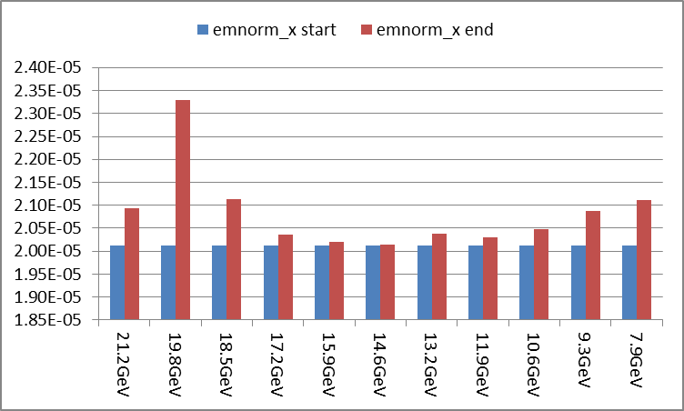
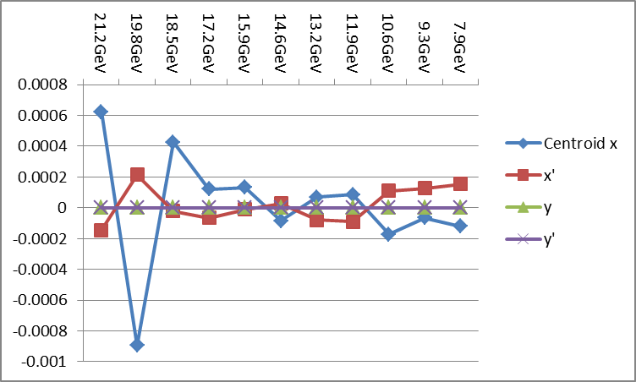
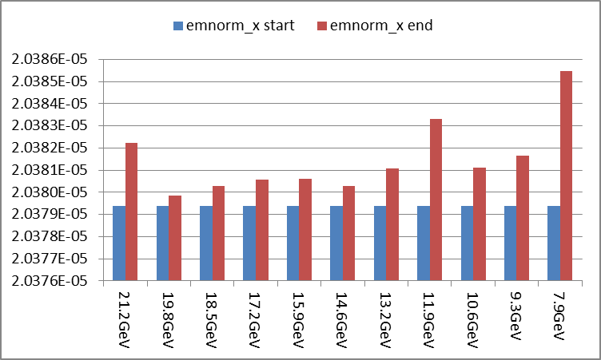
Example Before/After Correction
Moderate emittance growth of 0.13-15.75%
0.1-1mm errors
Uncorrected output beam centroids
x growth ranges from 0.002% to 0.030%
<5um errors
NB: from tracking rather than linear model of tracking; also contains statistical noise

Slide 86
Fine Tuning Strengths (T)

Slide 87
Septum Design Example
Holger Witte’s permanent magnet septum design
0.7T vertical bending field
Field-free region for other beams
5mm septum thickness!
11mrad kick in 1.12m length for 21.2GeV beam

Slide 88
eRHIC Septum Issues
Probably easier to kick beams horizontally in several cells to build up oscillation within pipe
Synchrotron radiation would hit the septum barrier so prefer “massless septum”
POP FFAG massless septum was only 0.1T
Design from Y. Iwashita, A. Noda of Kyoto U. achieves 0.8T although fit of field falloff within 2cm distance is marginal (some leakage)

Slide 89
Iwashita/Noda Septum Design
Mitigations could include smaller aperture (±15mm is used here) and/or putting the penultimate beam on a field zero-crossing with zero integral rather than totally field-free

Slide 90
Dynamics with Three “Septums”
Transverse orbit exaggeration x64
Purple = 21.2GeV (ignore others)
Septum positions:
10cm

Slide 91
RHIC Pipe Crossovers in Tunnel
Space under 4 and 10 o’clock no-cryo pipe
Extracted electron beam 9-8 and 6-5 o’clock
E
E
E
Spin-preserving purely-vertical dog legs

Slide 92
General Situation to be Corrected
Past errors have caused the beams to have pseudo-random errors in x and x’ centroids
Phase advances very different for each beam
D_{x} and D_{x’} errors also present from…
Phase difference = Chromaticity of section * δp/p
If intra-beam phase difference becomes large, higher-order D errors → likely emittance growth
Only consider X plane for now (no roll errors)
Use 50 Gauss horizontal dipole correctors
x’
x’
x’
x
x
x

Slide 93
δp/p ±2e-3 Situation
Residual offsets no more than 68nm using 94 cells, 188 correctors.

Slide 94
δp/p ±5e-3 Situation
Residual offsets no more than 0.13μm using 94 cells, 188 correctors.

Slide 95
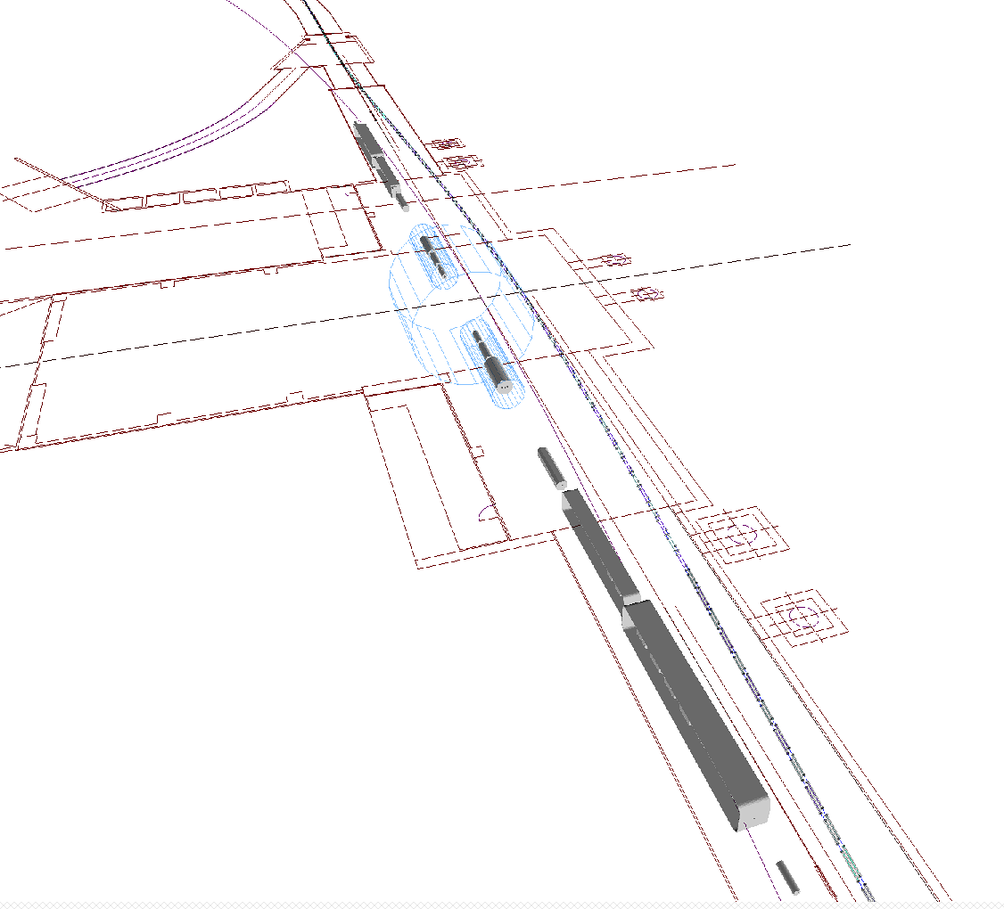
Detector
Solenoid
FFAG-bypass
Ion – Electron
Magnets
Cryostat
Crab Cavities

Slide 96
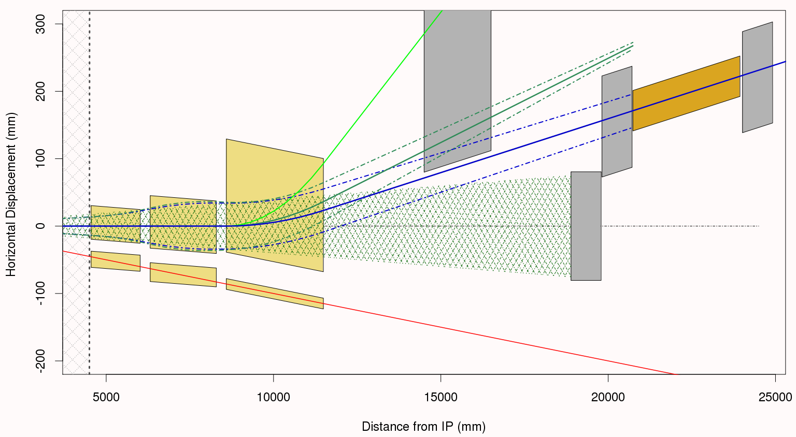
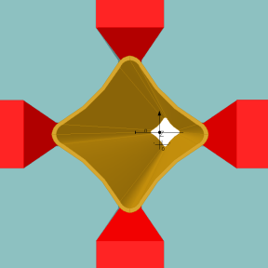
IR Forward Layout Details
Δp/p = 20% P_{o}
±3.5 mrad
Roman
Pots
Δp/p = 50% P_{o}
Forward
Detector
Q2, has HERA style “butterfly shape chamber”
B1
Q1
Q0
4 mrad neutron cone
ZDC
Main Beam ±3.5 mrad
Q2 Front
Measure as much as possible before the next cold accelerator region.
Note that the coordinate system in these figures is aligned with the center of the 4 mrad neutron cone (neutral vector) indicated by the hatched region on the plot.

Slide 97
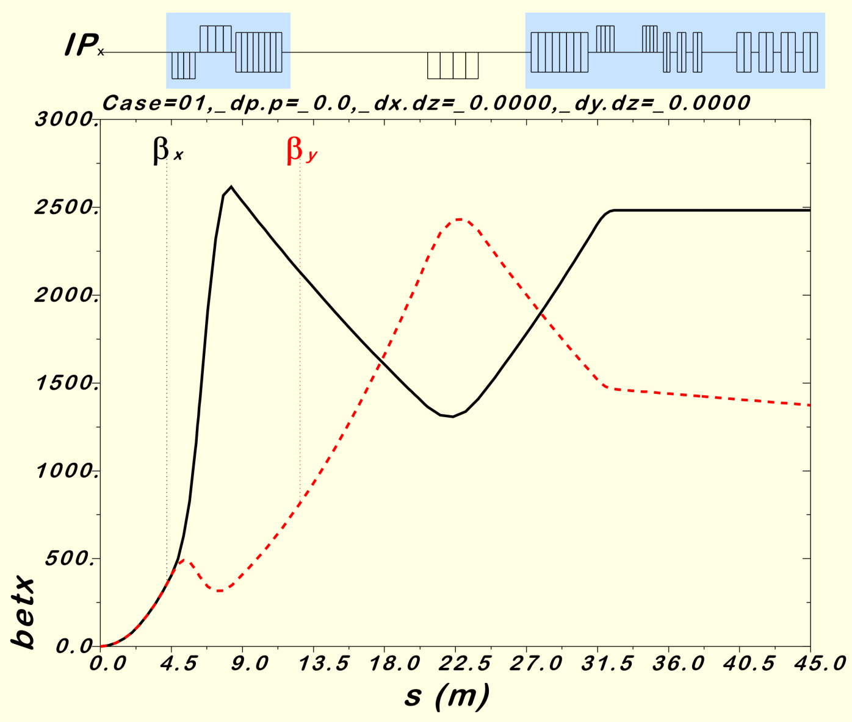
eRHIC IR v2.5, Hadron Optics
16 mrad “Dogleg Dipoles”
Cold Region
Cold Region
Warm Region
The Version 2.5 hadron beta function peaks are lower with respect to earlier optics in order to reduce the hadron beam chromaticity.
Neutrals and some forward off-momentum particles are detected within the first warm region shown here.
These optics are designed to be favorable for Crab Cavities.
We could look to design a secondary focus beyond 45 m.
Detection of forward particles after Crab Cavities seems ok.
90⁰ phase advance and large β for Crab Cavities
Smaller peak betas to reduce the chromaticity
While magnet apertures differ, the optics are the same for the forward and rear sides.

Slide 98
16-turn Splitter in RHIC Tunnel
Start, near linac

Slide 99
16-turn Splitter in RHIC Tunnel
Beam separation

Slide 100
16-turn Splitter in RHIC Tunnel
Low and high energy in two different planes

Slide 101
Tunes

Slide 102
Path Length and TOF

Slide 103
Synchrotron Loss and Max B Field

Slide 104
Splitter Optics
By Chris Mayes (Cornell), tracking in B-MAD

