Slide 1
Permanent Magnets for Emerging Accelerator Applications
CBETA permanent magnet results
Advanced PM design variants
PMs for PETRA-IV parameters

Slide 2
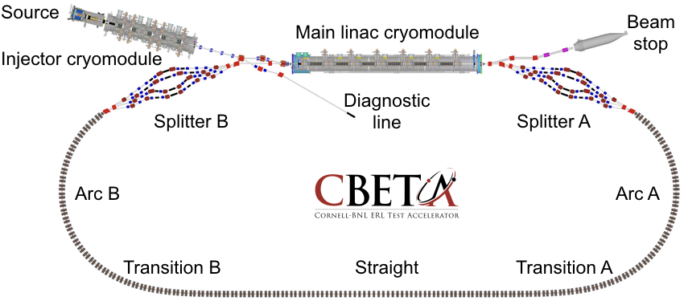
What is CBETA?
It’s a 4-turn energy-recovery linac (ERL)
  CW operation with superconducting RF
The return loop uses FFA (fixed-field accelerator) technology with permanent magnets
  Returns energies of 42-150MeV in same pipe
  “Non-scaling FFA” (linear field) focussing
    Small dispersion (few cm), short cell length (~45cm)

Slide 3
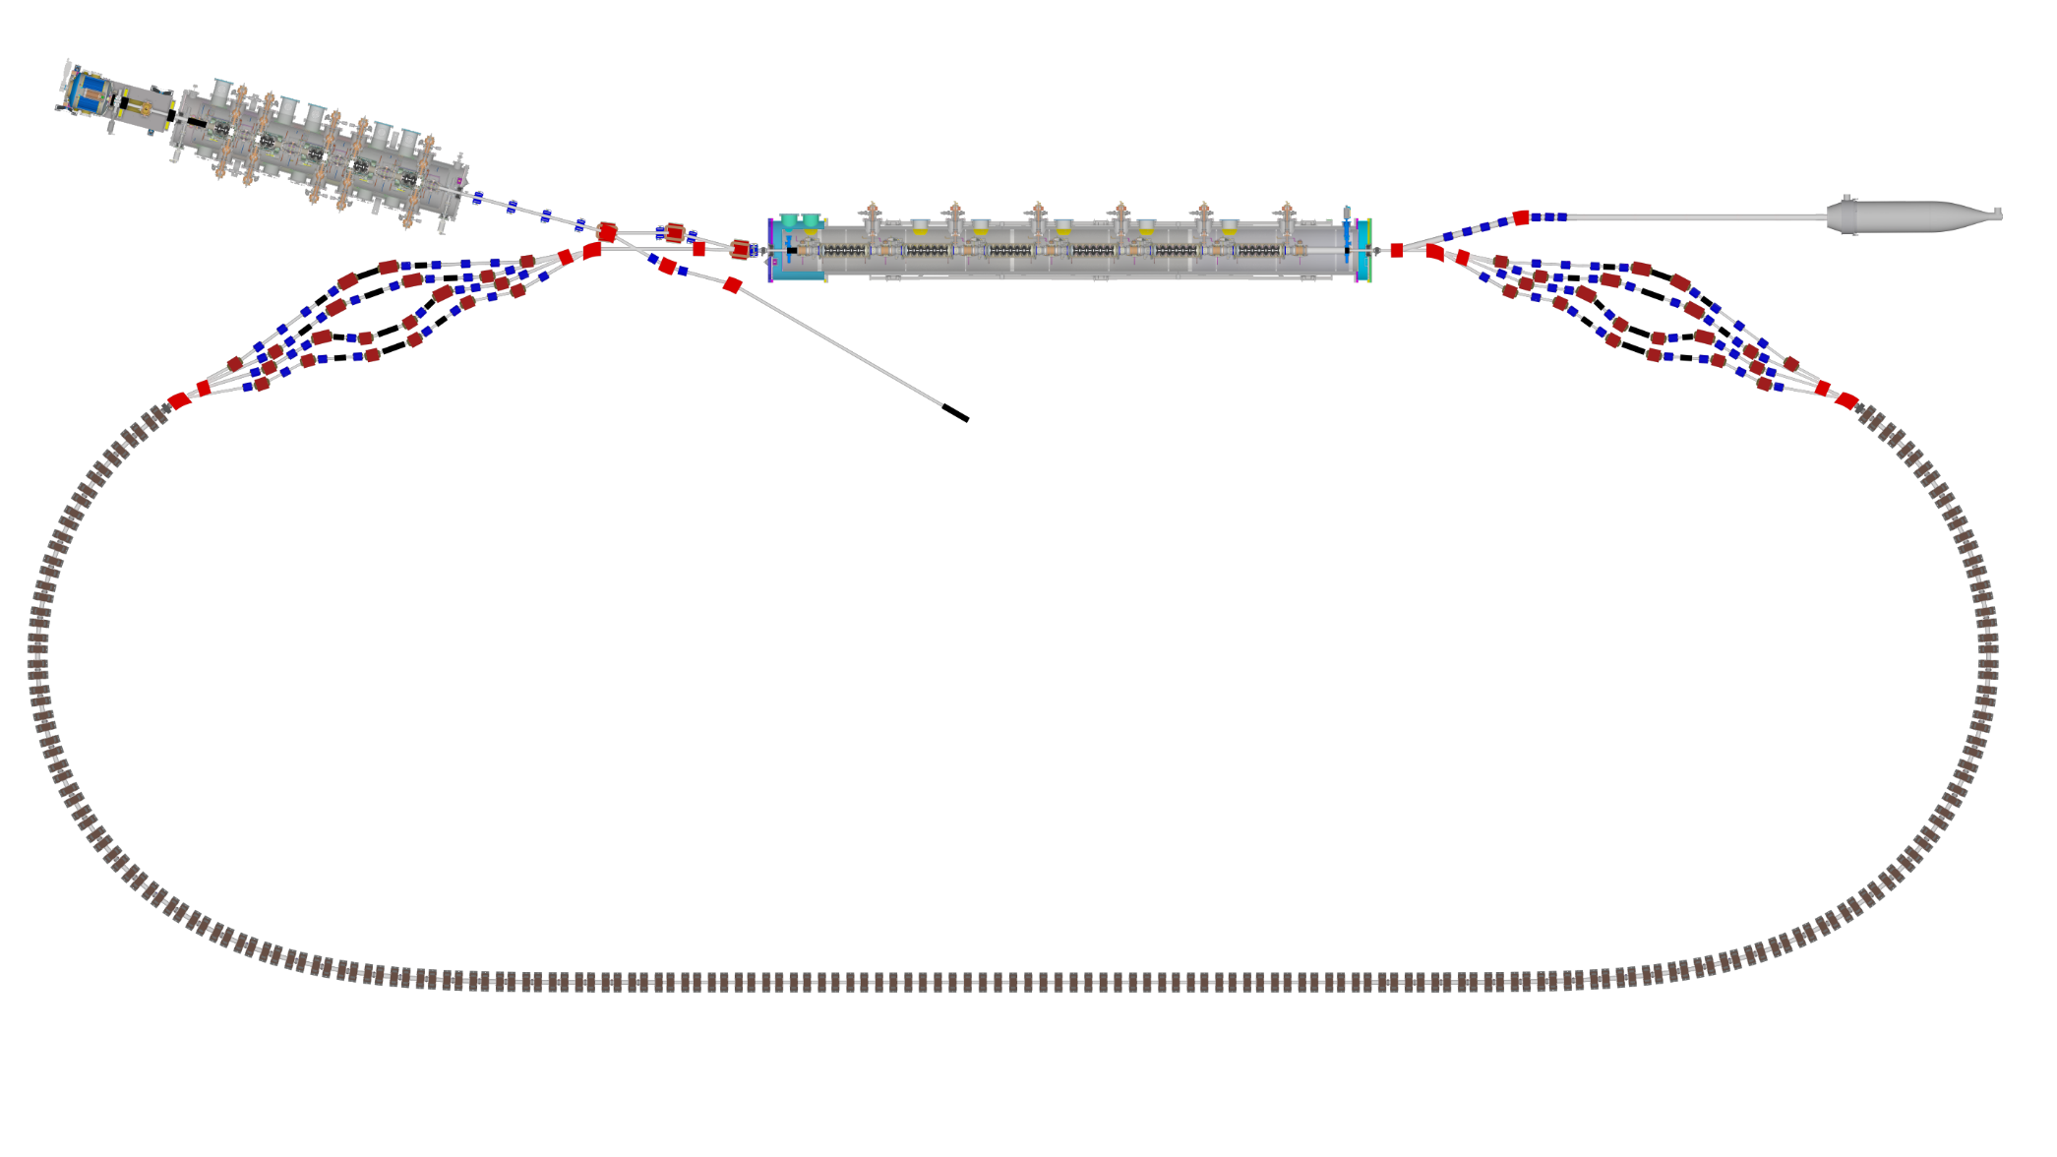

Layout & Parameters
Main linac is a 1.3GHz SCRF module with six 5-cell cavities
Source
±36MeV
Beam stop
Main linac cryomodule
Injector cryomodule
6MeV
6MeV
Diagnostic line
Splitter B
Splitter A
42,78,114,150MeV
Arc A
Arc B
42-150MeV
Transition B
Straight
Transition A

Slide 4
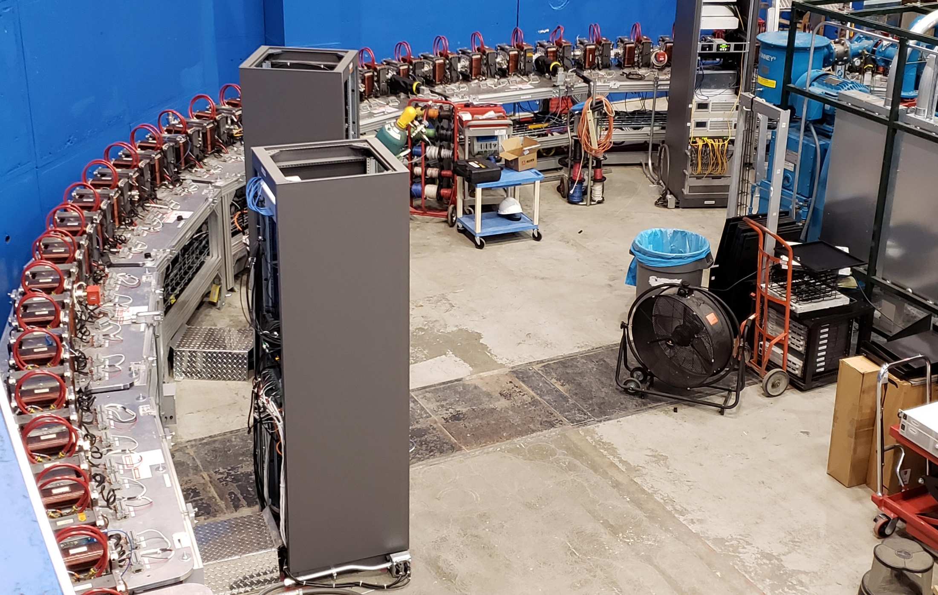
Fixed-Field Return Arc

Slide 5
Fixed-Field Return Loop Optics
Beams with 4x rigidity range transmitted through same overall radius of curvature in arcs
Adiabatically merged to zero curvature, separation in straights
Beam cell tune decreases as a function of energy

Slide 6
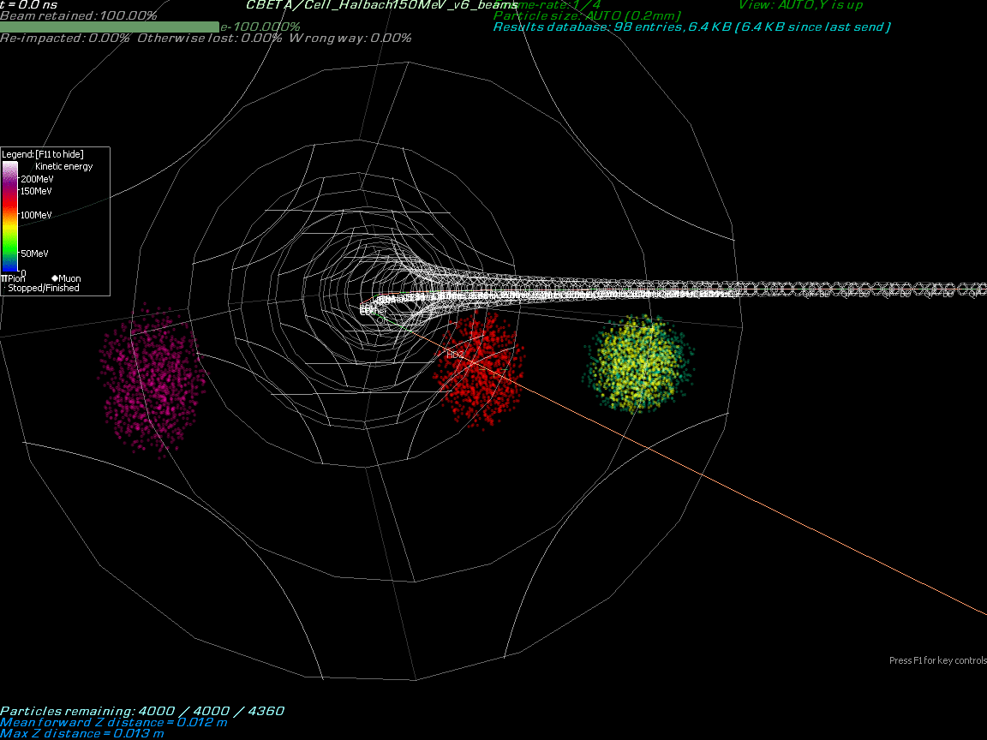

Slide 7
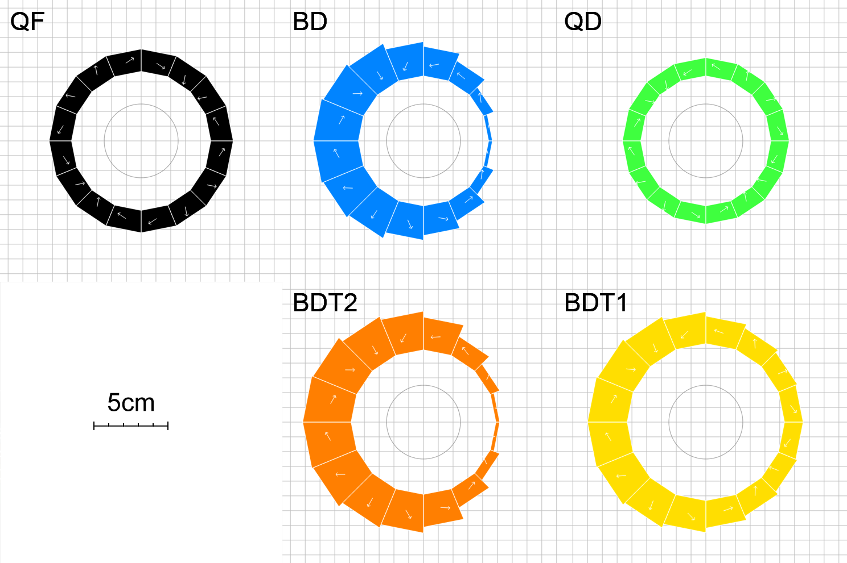
Magnet Types and Parameters
Magnet | Dipole (T) | Quad (T/m) | Good field radius (mm) | Aperture radius (mm) | Max field (T) (good region) | Max field (T) (aperture)
QF | 0 | -11.5624 | 25 | 43.1 | 0.2891 | 0.4983
BD | -0.3081 | 11.1475 | 25 | 40.1 | 0.5868 | 0.7551
BDT2 | -0.2543 | 11.1475 | 25 | 44.938 | 0.5330 | 0.7552
BDT1 | -0.1002 | 11.1475 | 25 | 49.085 | 0.3789 | 0.6474
QD | 0 | 11.1434 | 25 | 40.1 | 0.2786 | 0.4469

Slide 8
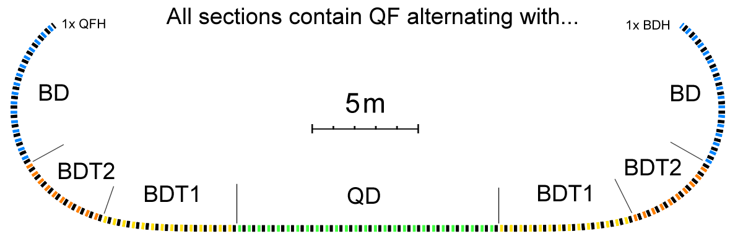
Layout and Magnet Counts
Permanent magnet total: 216
QF: 107
BD: 32
BDT2: 20
BDT1: 28
QD: 27
QFH: 1 (half length)
BDH: 1

Slide 9
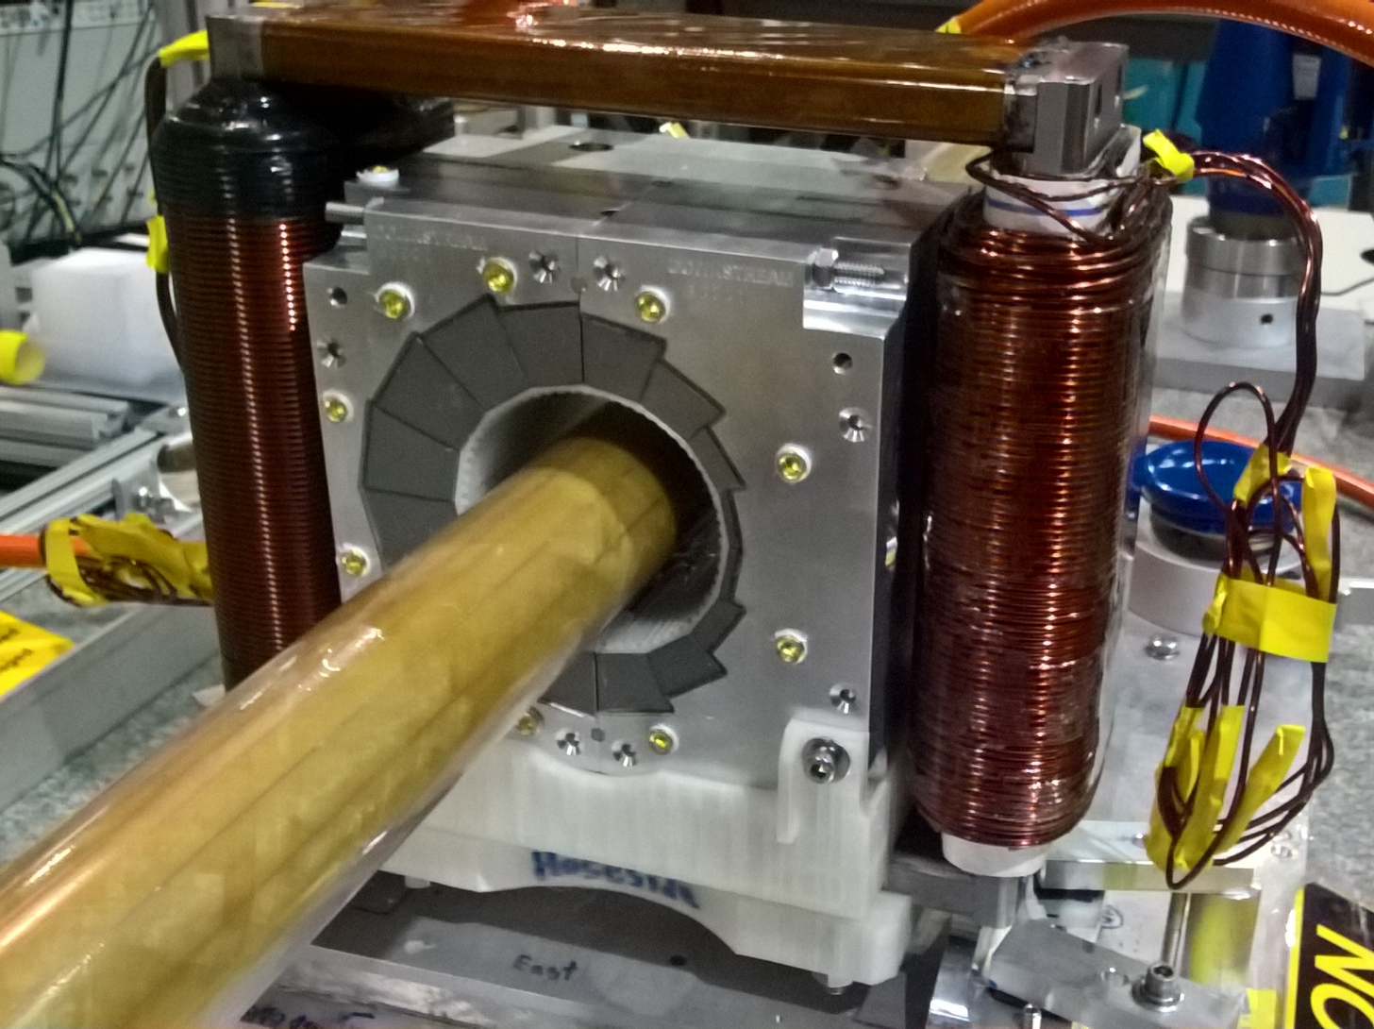
Permanent Magnet Design
Halbach design made of NdFeB material
This is a combined dipole+quad
Being measured on rotating coil at BNL
3D printed multipole corrector pack inside
Windowframe corrector coil outside
Temperature stabilised by water (orange hoses)
Stephen Brooks et al., "Permanent magnets for the return loop of the Cornell-Brookhaven energy recovery linac test accelerator", Phys. Rev. Accel. Beams 23, 112401 (2020); doi:10.1103/PhysRevAccelBeams.23.112401

Slide 10
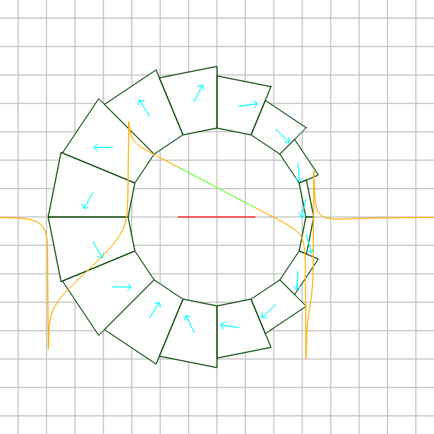
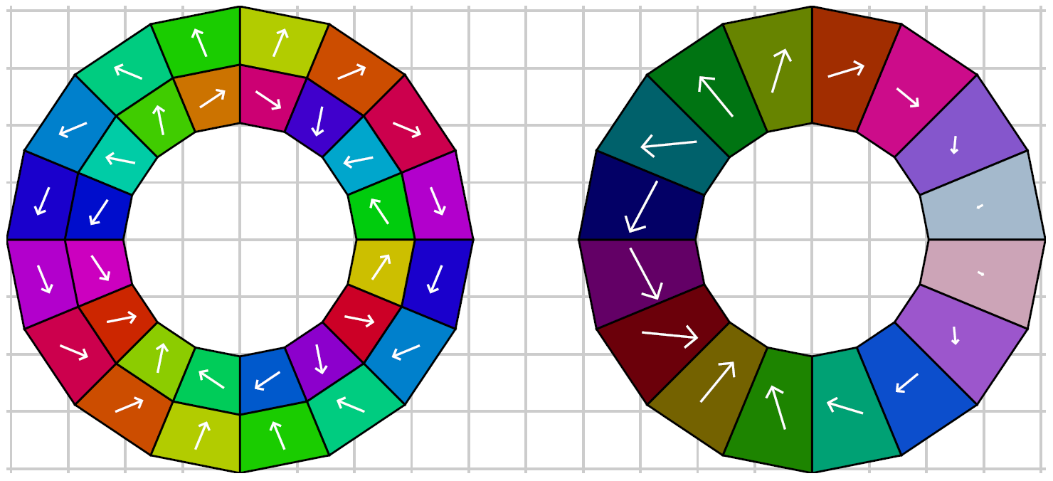
Combined-Function Magnet
Improvement over nested Halbach dipole and quadrupole (shown below) can be made by taking vector sum of the two layers and implementing as a layer with constant magnetisation magnitude but variable wedge thickness.

Slide 11
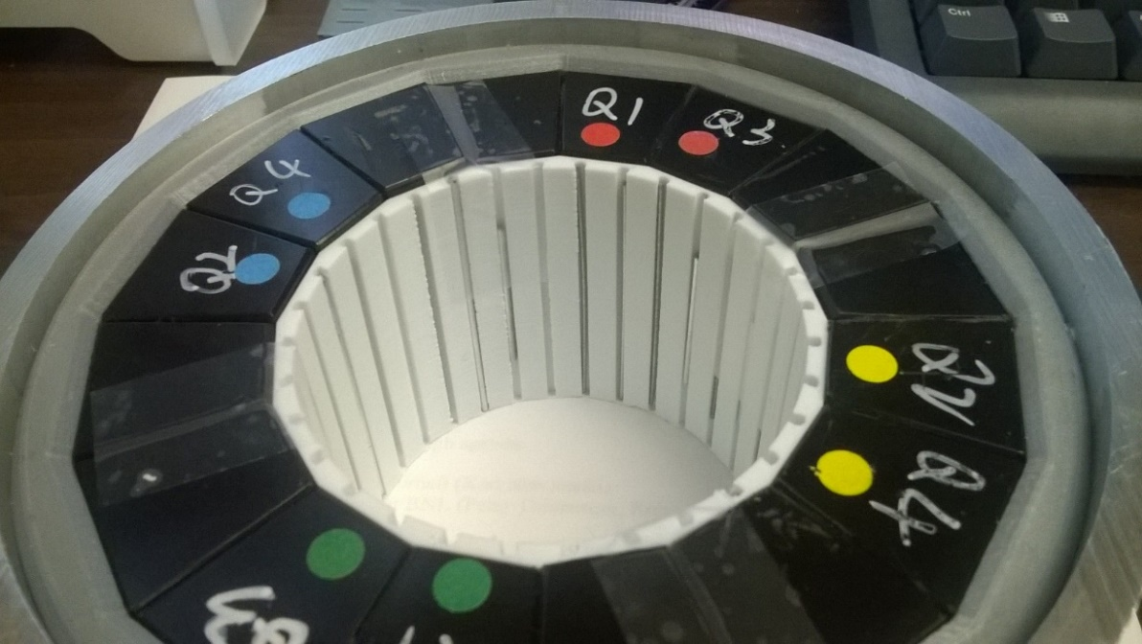
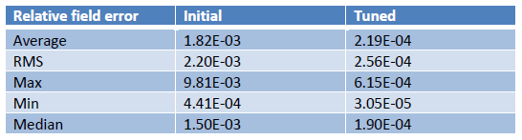
Iron Wire Correction Method
Measure bare magnet harmonics, then calculate lengths of iron wires to be inserted around the aperture
8x reduction in field errors
R&D prototype magnet
3D printed slot insert

Slide 12
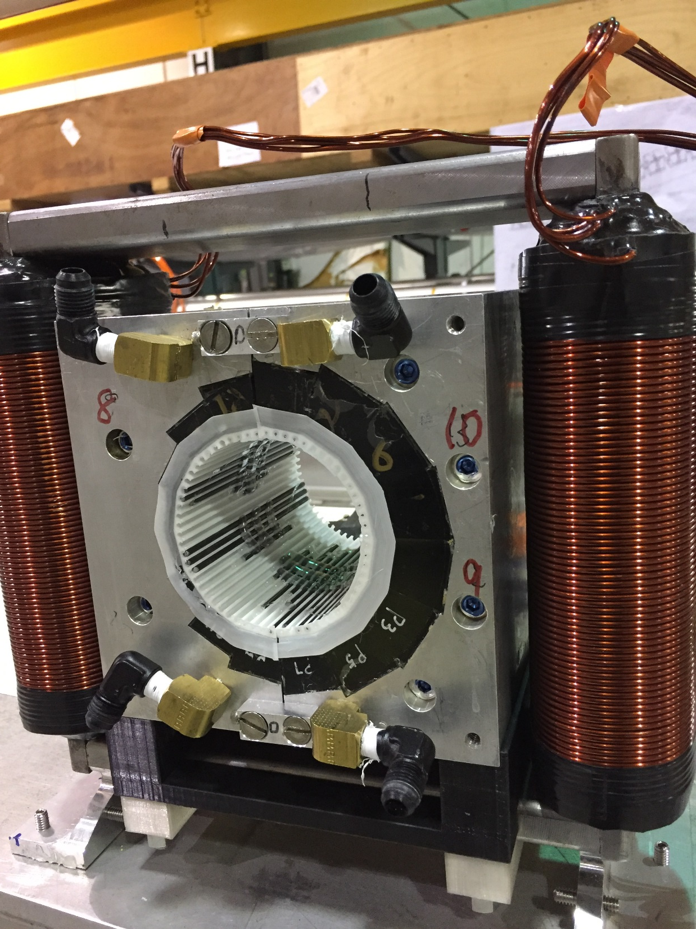
CBETA permanent magnet containing tuning wire insert
Electromagnetic corrector coil outside

Slide 13
CBETA permanent magnet containing tuning wire insert

Slide 14




Production and Testing Flow
KYMA
assembly
3
4
AllStar
PM wedges
1
BNL
tuning
2
Helmholtz testing at AllStar, 100% of blocks but not temperature controlled
Temperature-controlled Helmholtz test of ~15% sample at BNL for verification
Remainder of blocks shipped directly to KYMA, who also re-test ~10% sample
Rotating coil measurement of bare magnet at BNL
Rotating coil measurement of tuned magnet at BNL
5
Accept

Slide 15
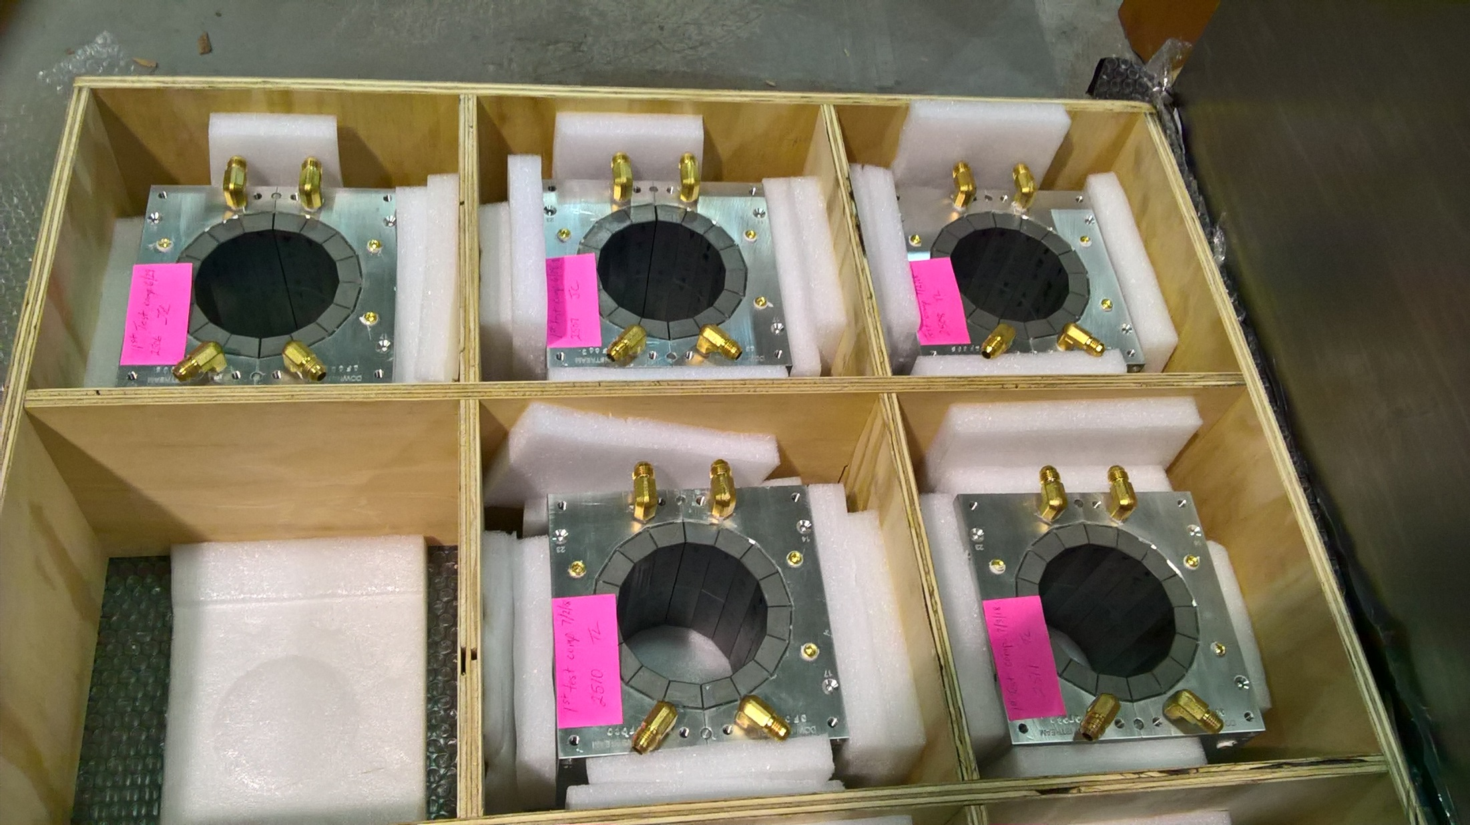
Permanent magnets shipped from KYMA

Slide 16
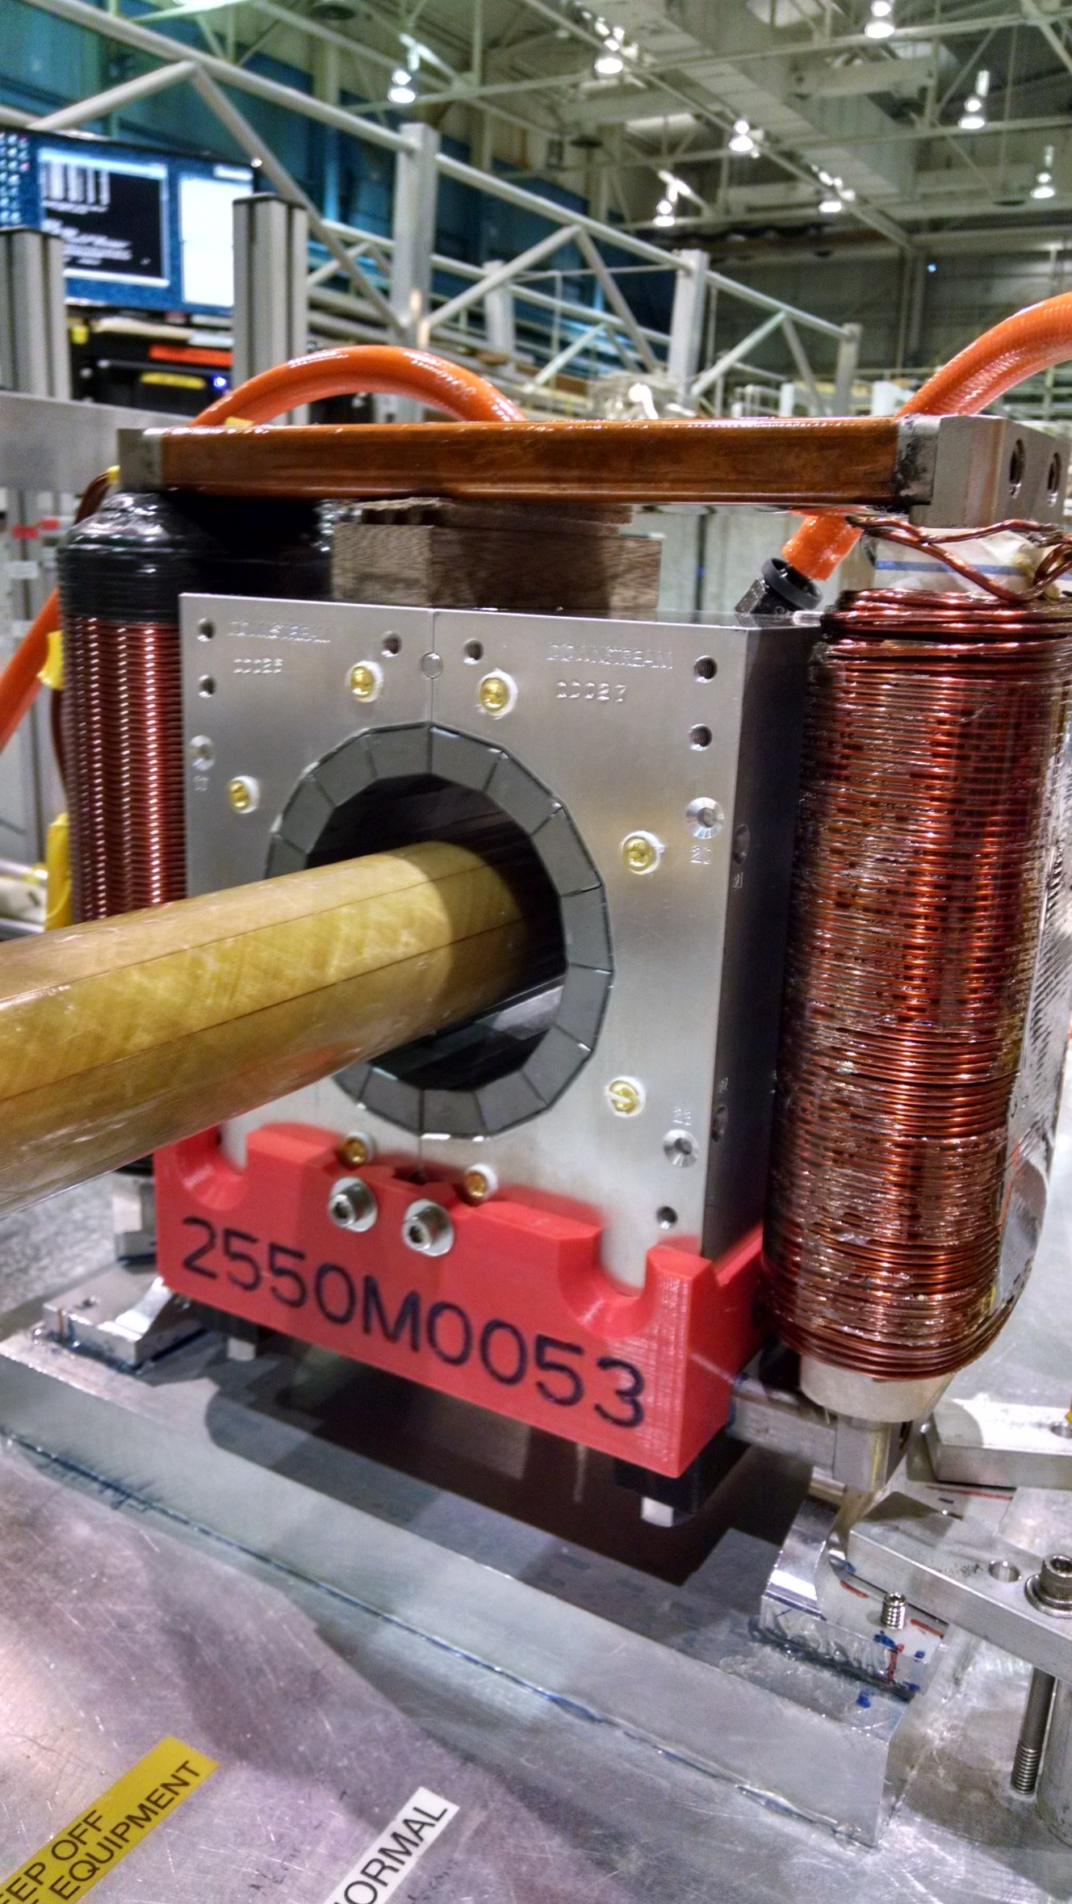
Rotating coil magnet measurement at BNL

Slide 17
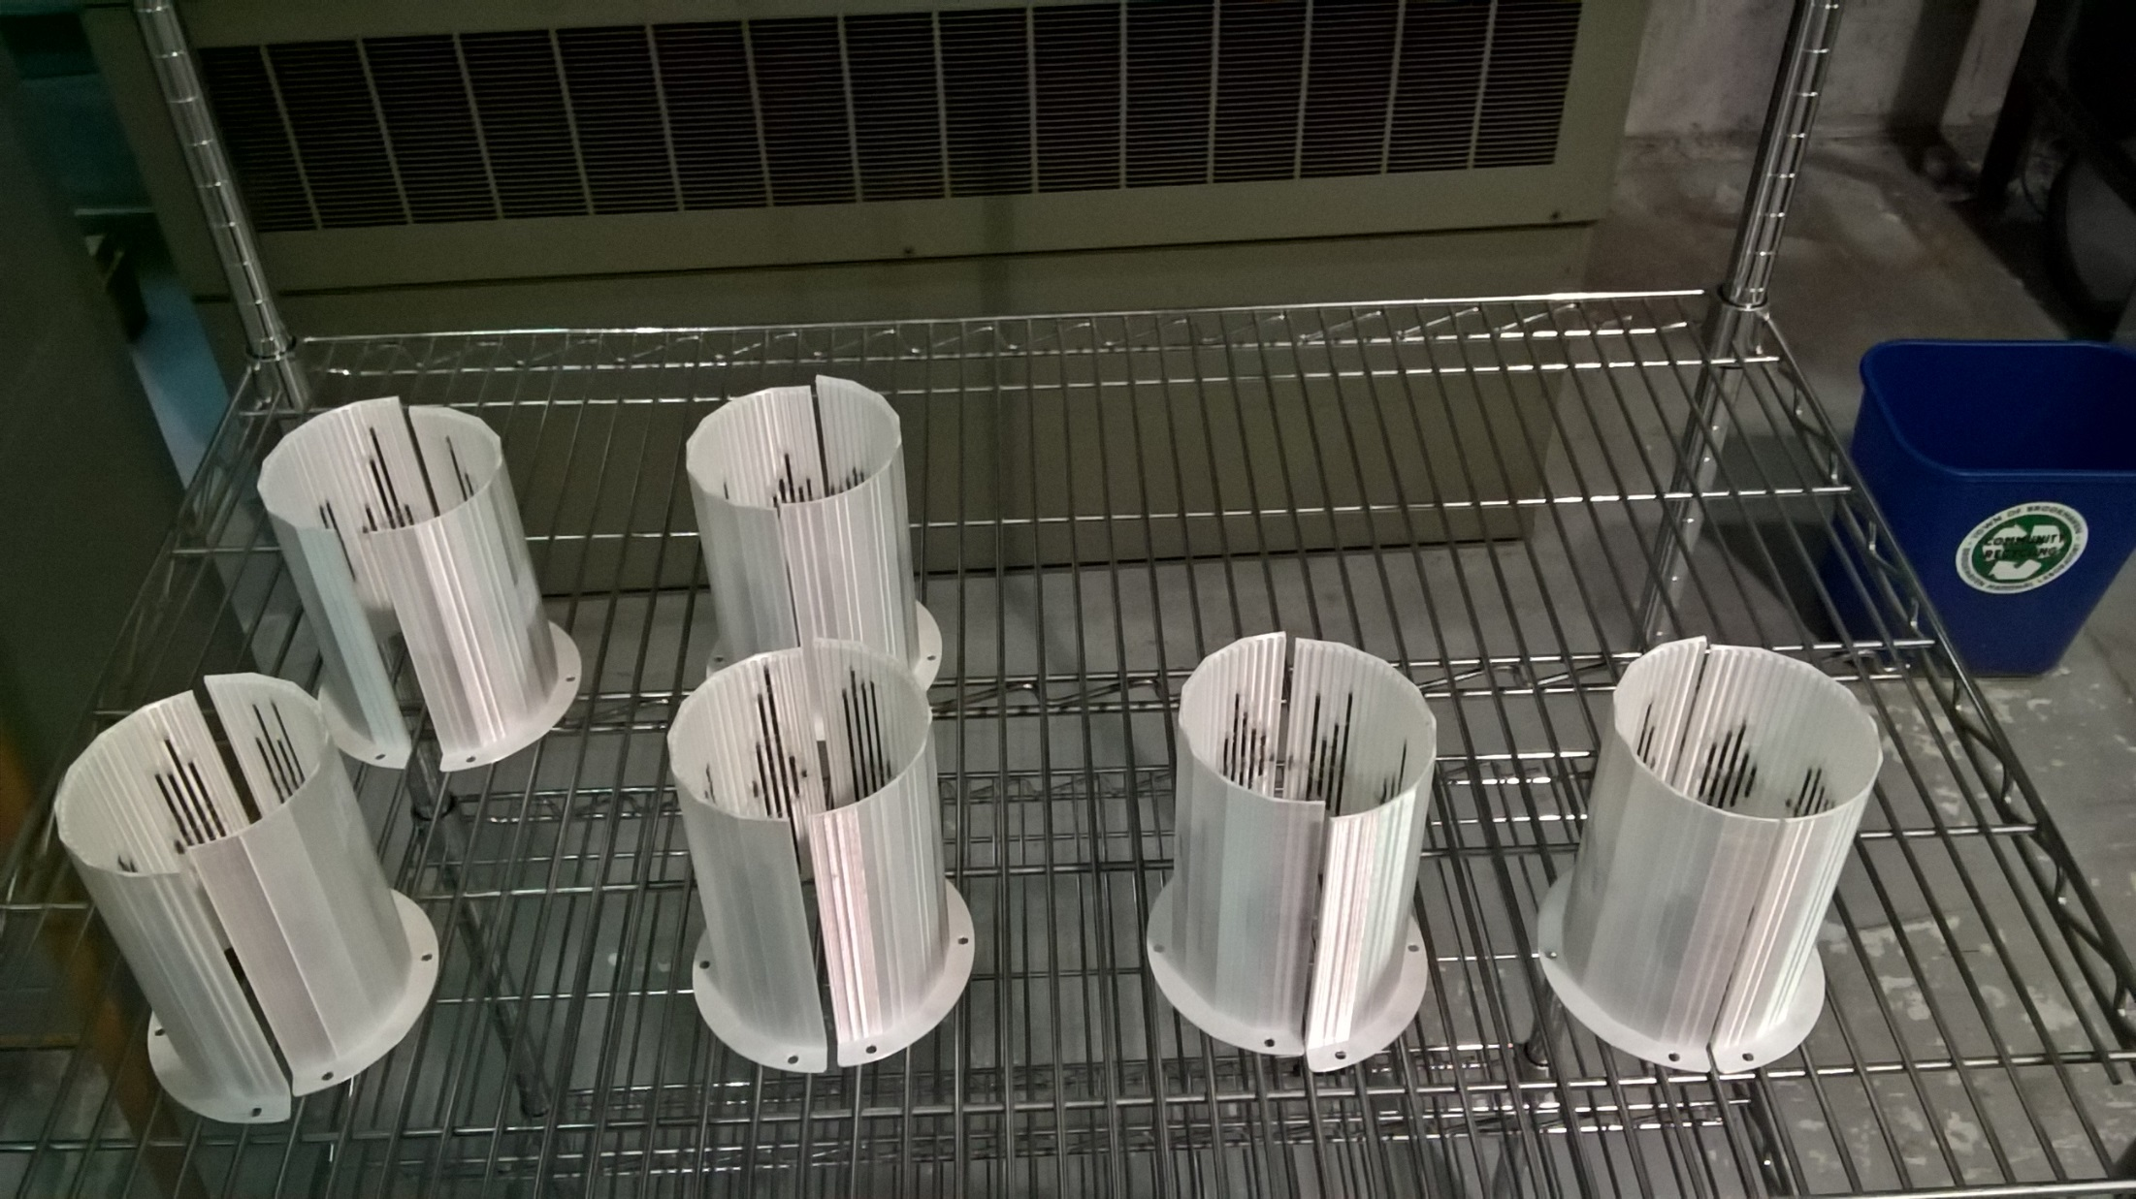
Wire tuning packs for CBETA magnets

Slide 18
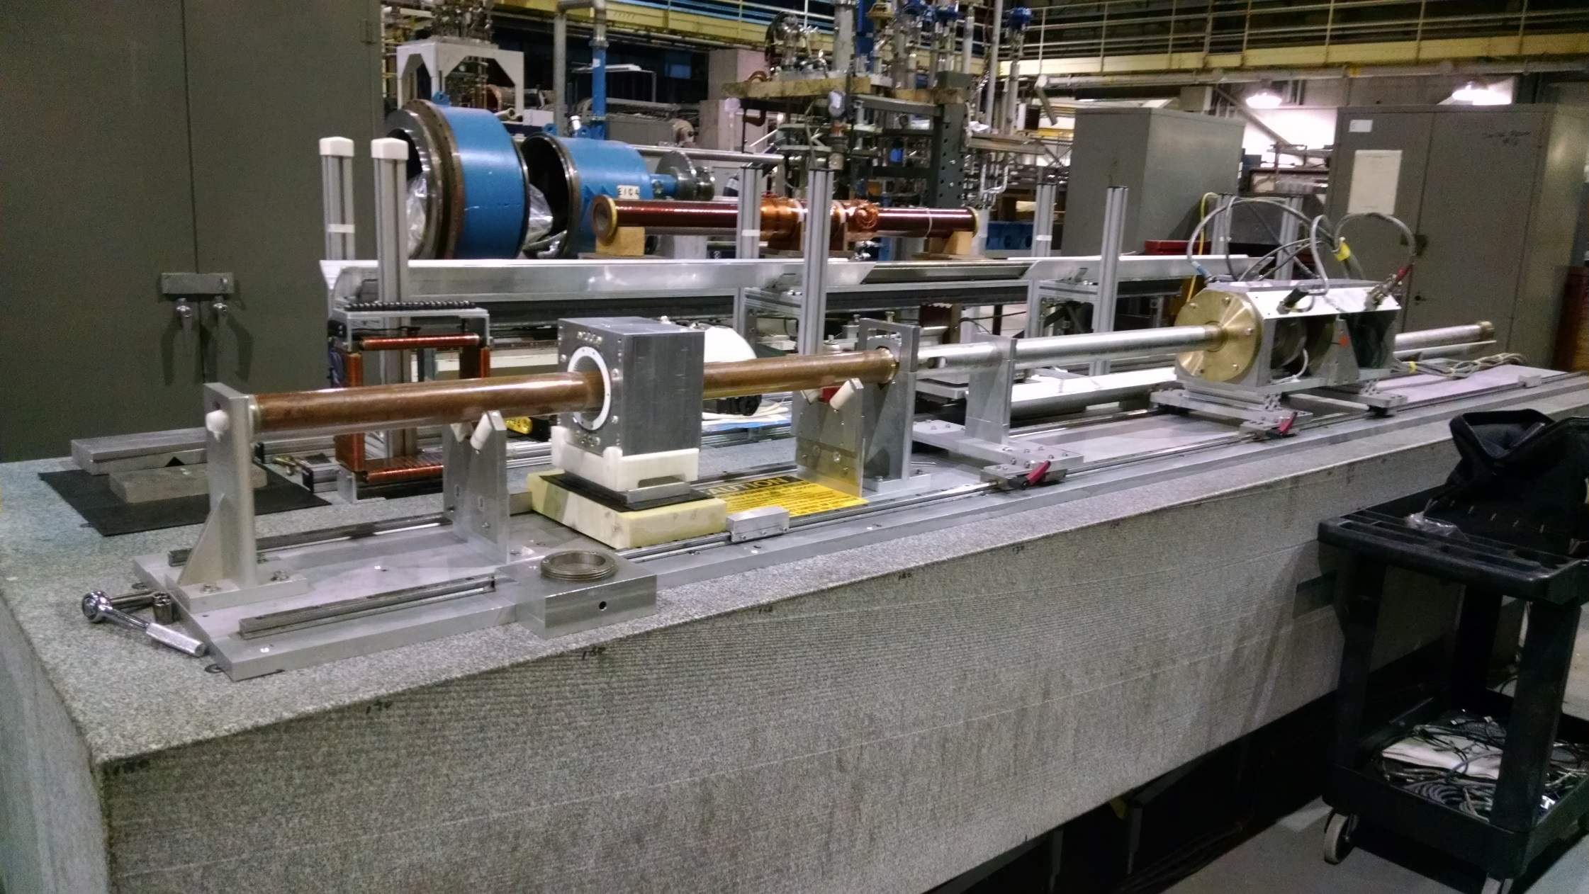
Rotating coil magnet measurement at BNL

Slide 19
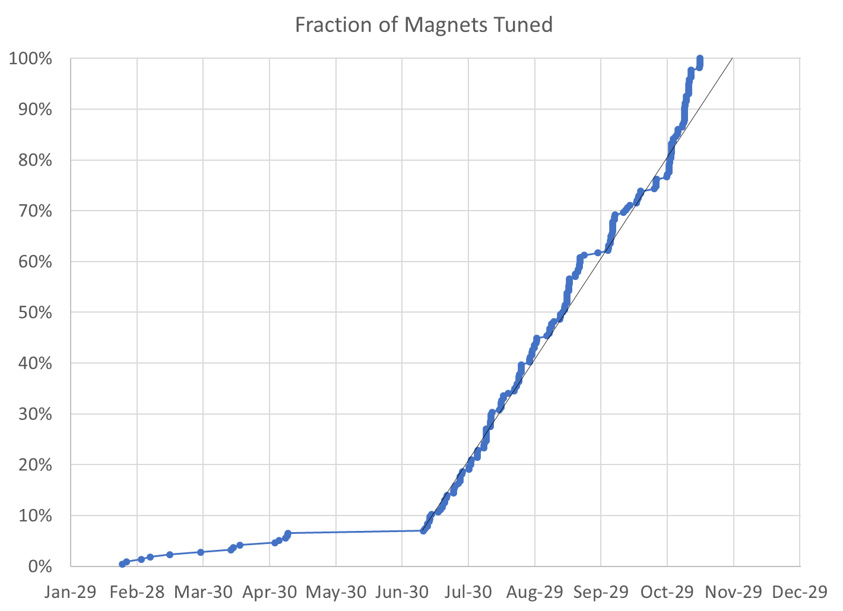
100% complete (excl. spares*)
215 / 215 magnets (0 remaining)
* We have 4 “spare” QFs, 2 BDs for replacing first girder magnets, plus two spare BDT2 magnets, with more spares to be delivered from KYMA

Slide 20
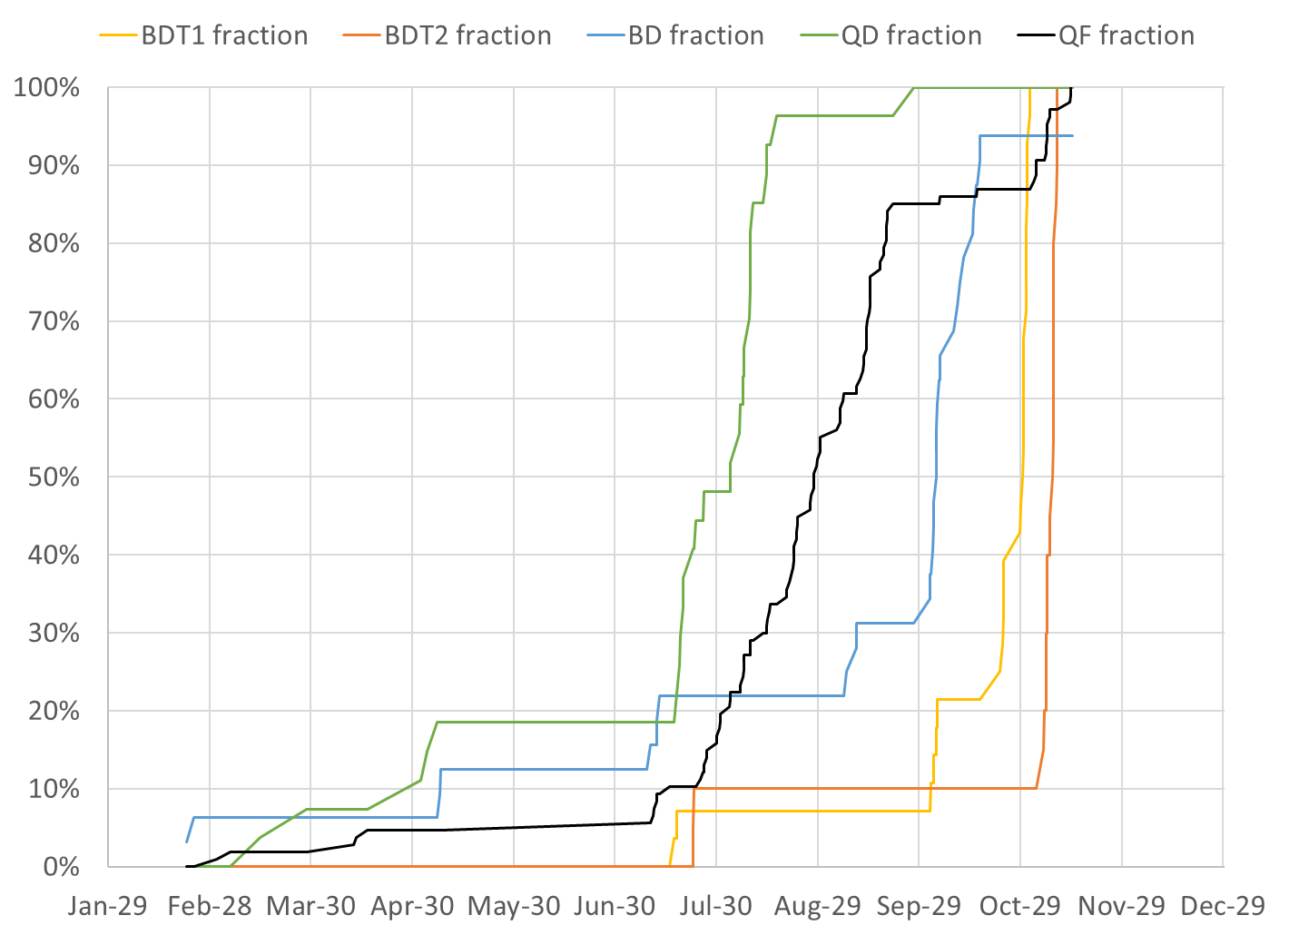
Permanent magnet total: 216
QF: 107
BD: 32
BDT2: 20
BDT1: 28
QD: 27
QFH: 1 (half length)
BDH: 1

Slide 21
Final Measurement Rate
Main Production
Magnets tuned | 200 (excl. early samples)
Rotating coil measurements | 545
Start date | July 9, 2018
End date | November 14, 2018
Total weeks | 18.2
Magnets tuned per week (avg.) | 10.96
Rotating coil meas. per week (avg.) | 29.88
Rotating coil meas. per magnet (avg.) | 2.73

Slide 22
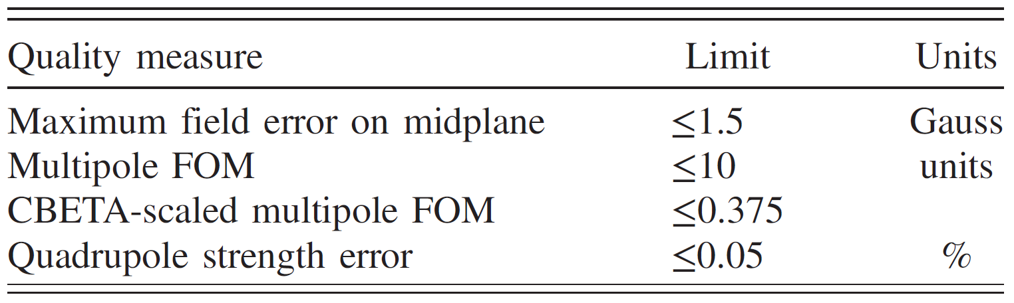
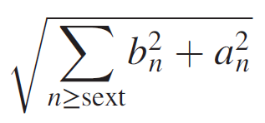
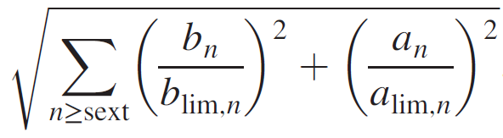
Tuned Field Quality Criteria
Unit = 10⁻⁴ of main pole
FOM is sqrt(sum of all (multipoles in units)²)
  CBETA FOM is weighted version based on tracking
Midplane error generally hardest to achieve
  May go in and out of spec slightly (~0.5G) due to chiller cycle

Slide 23
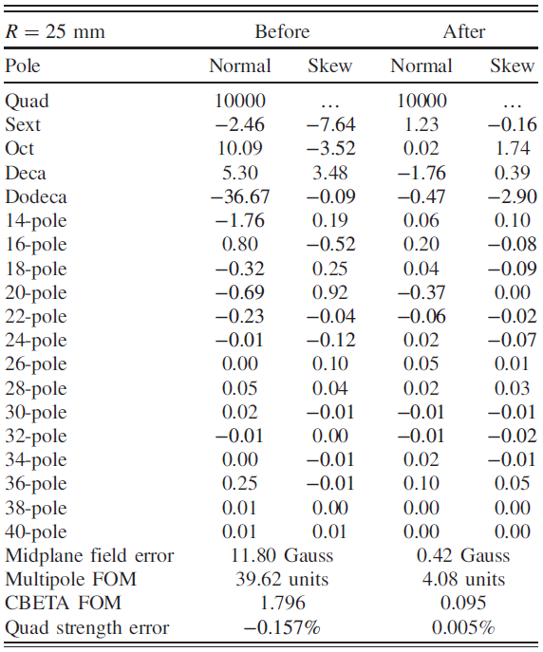
Example Harmonics (QD 2412)

Slide 24
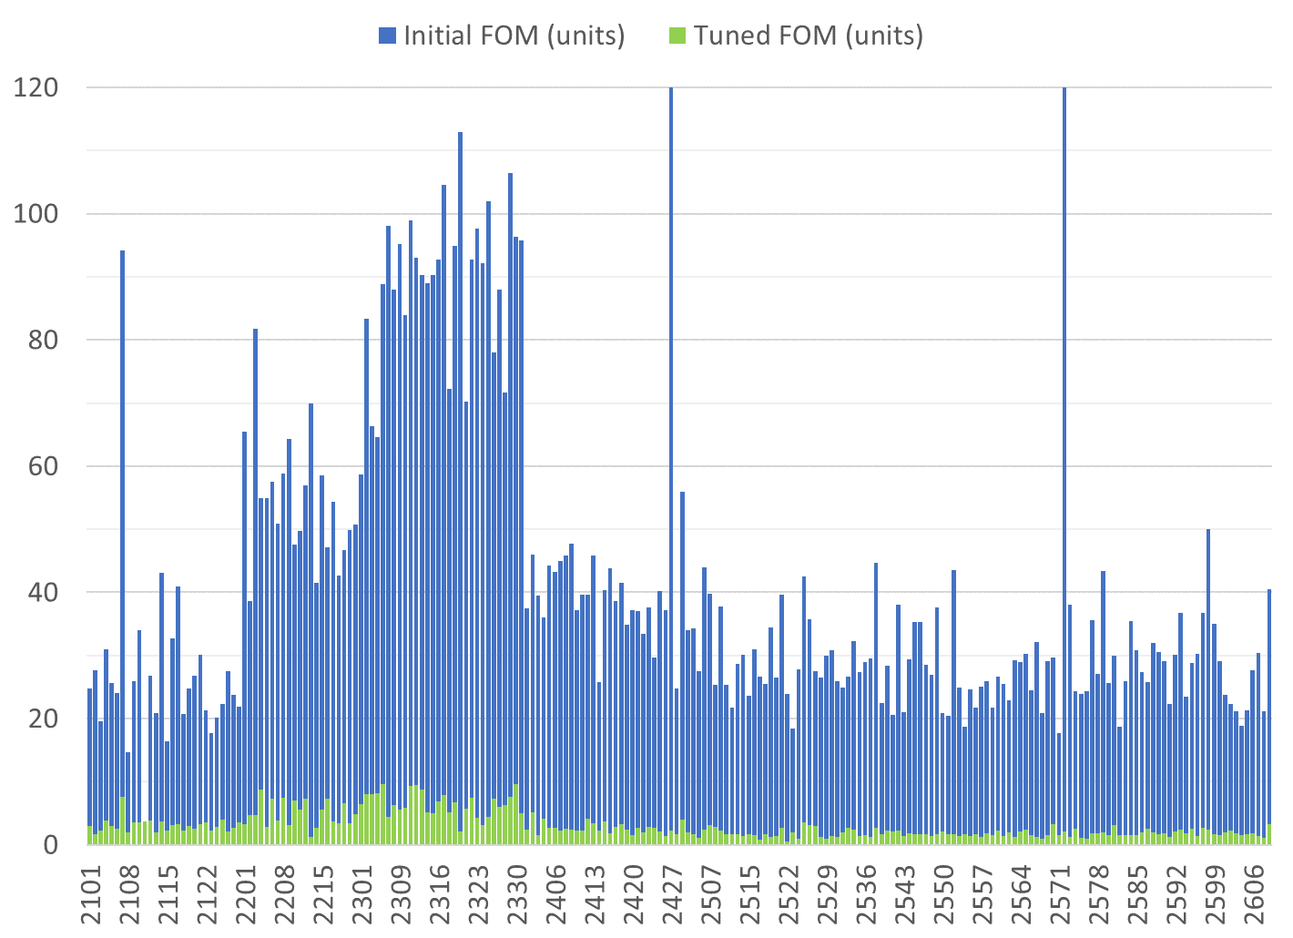
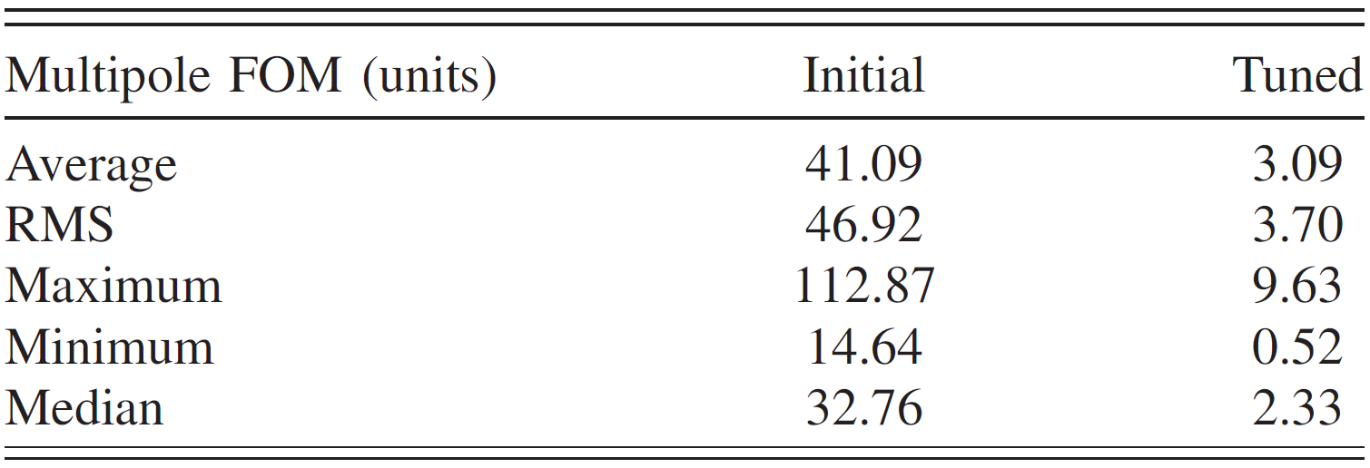
Only tuned magnets shown (2 “rejects” removed)
BDT1
BDT2
BD
QD
QF
Reject matched with good half
Reject matched with good half
80 shims
Tuned with 96 shims
QFH

Slide 25
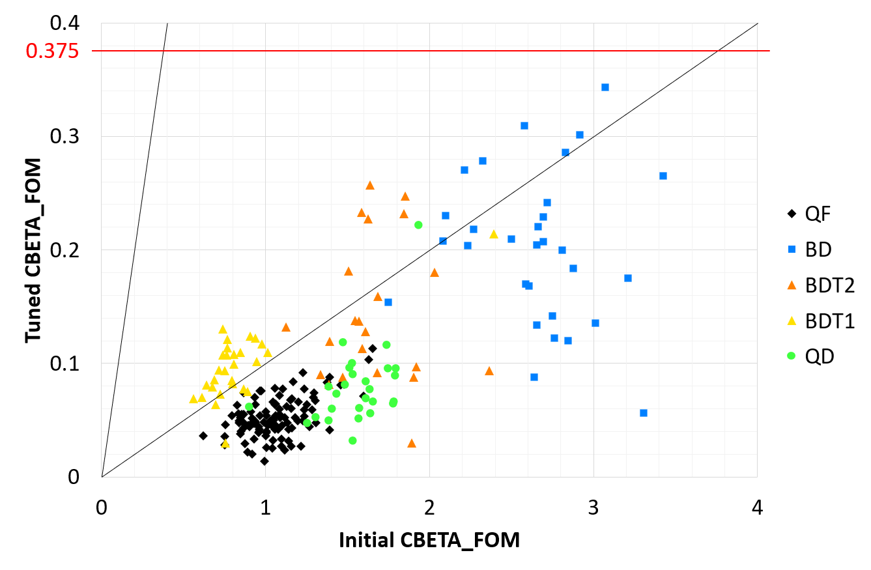
Effect of Tuning (CBETA FOM)
10× improvement

Slide 26
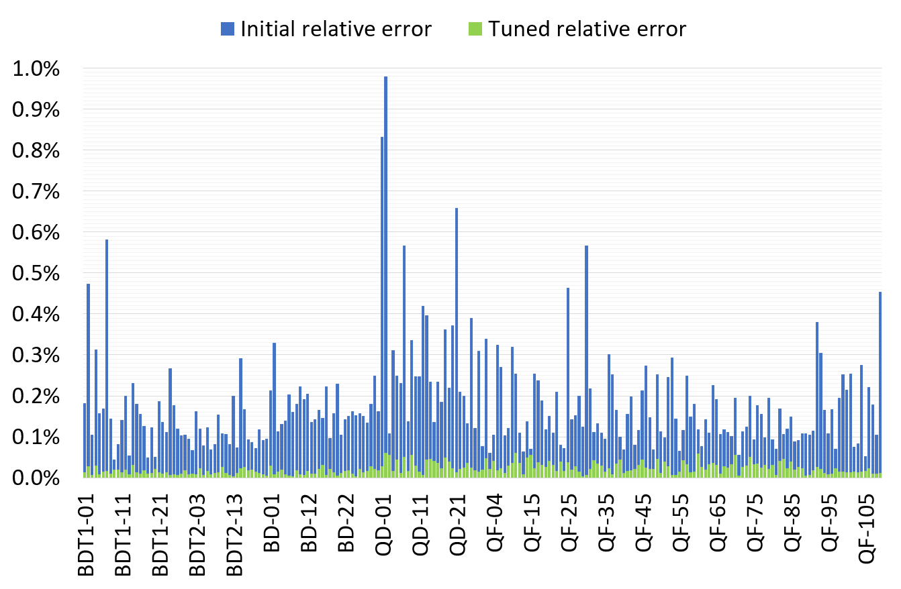
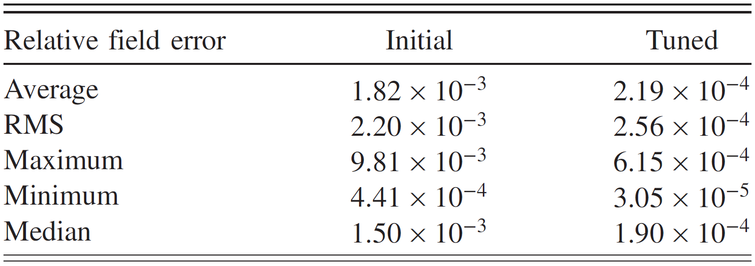
Only tuned magnets shown (2 “rejects” removed)

Slide 27
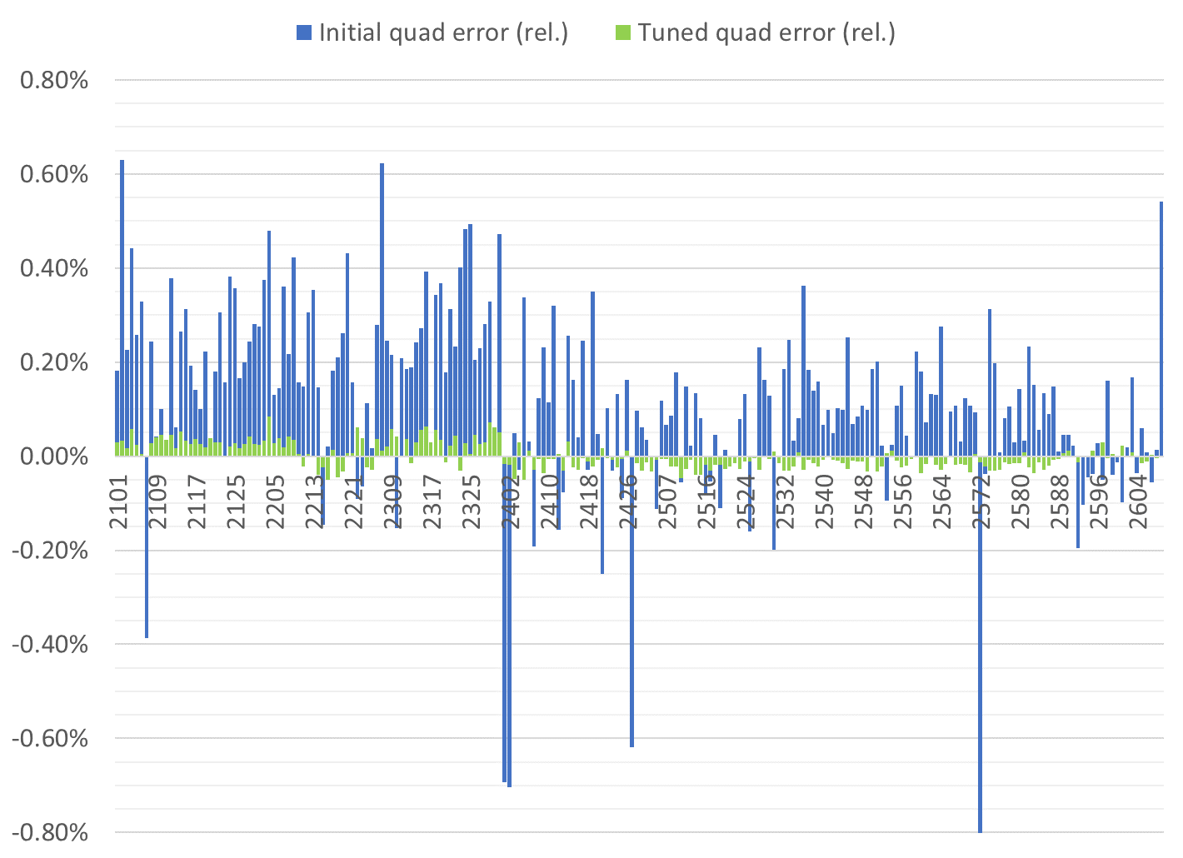
Only tuned magnets shown (2 “rejects” removed)
BDT1
BDT2
BD
QD
QF
QFH

Slide 28
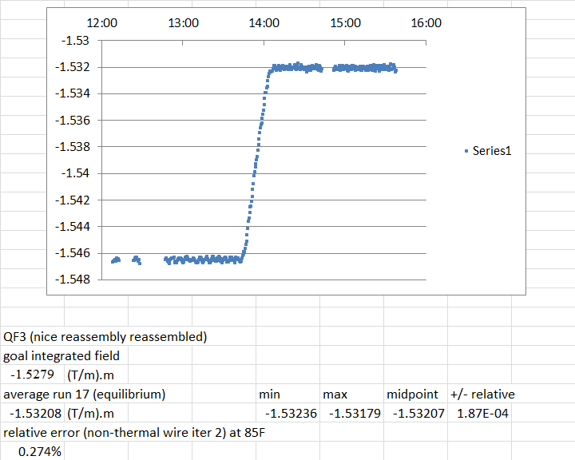
Water Cooling Stability

Slide 29
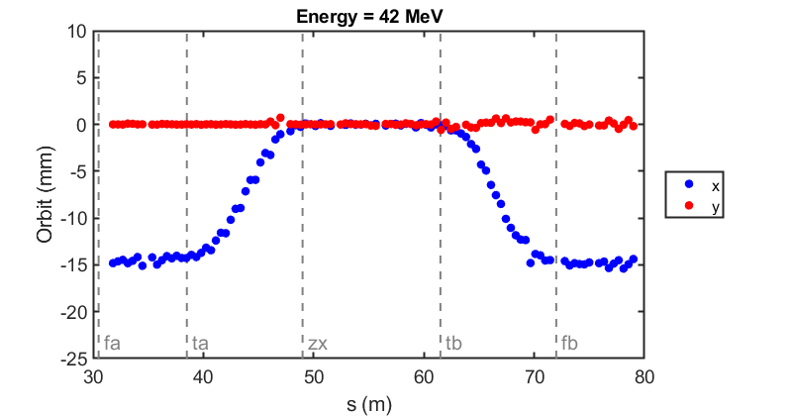
Commissioning results: orbit correction in fixed-field loop
The very first beam through the fixed-field loop on May 7, 2019
Corrected beam using section-by-section local SVD (did not converge for whole FFA)
(June 12, 2019)

Slide 30
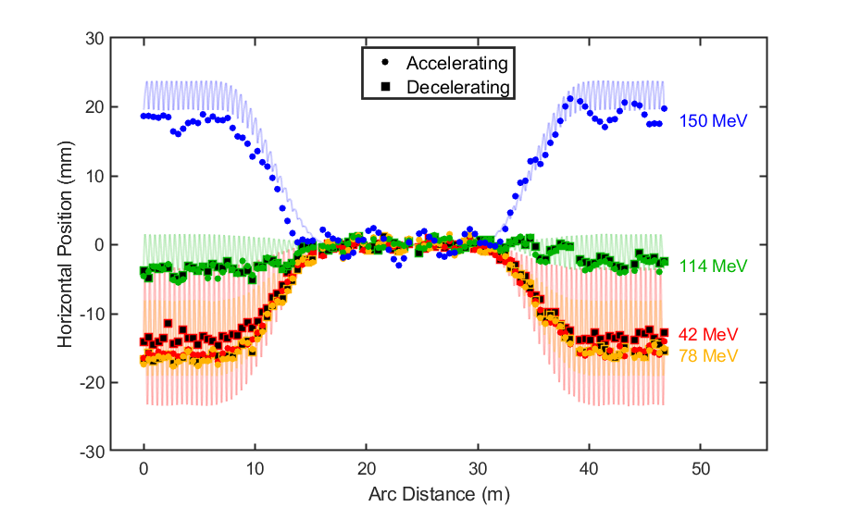
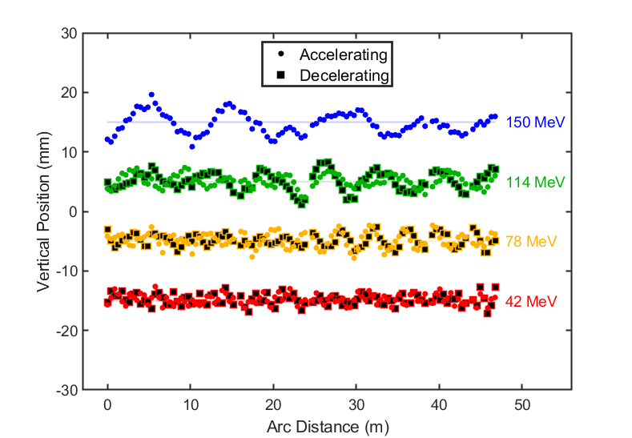
Eventually got 7-turn ERL operation with turns 1,2,3 SVD corrected

Slide 31
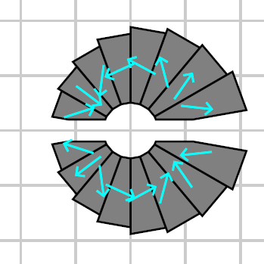
Novel Permanent Magnet Applications Matrix
Demagnetisation?
Radiation resistance?
Assembly precision?
Field quality?
Shimming method?
Project | Higher field | Smaller aperture | Open midplane | Oval aperture
Hadron therapy gantry | Yes | Yes | No | Yes
CEBAF 20GeV upgrade | Yes | Yes | Yes | No?
Next-gen light sources | Yes | Yes | Yes | No?
High-gradient quad for capture of laser/plasma accelerator beams | Yes | Yes | No? | Maybe
ERL LHeC | Yes | Yes? | Yes | No?
ILC damping ring | No | No | Yes | No

Slide 32
High-Gradient Magnet Proposals
Magnet | Dipole at x=0 (T) | Gradient (T/m) | Beam half-excursion (mm) | Aperture radius (mm)
Therapy gantry | 2020 design by Trbojevic
QF | 0 | 155 | 8.8 | 13.8
BD | 1.8 | -97 | 7.5 | 12.5
Light source | 2019 PRAB publication “Complex Bend II: A new optics solution”
CBII-F | 0.26 | 250 | <0.5 | 5
CBII-D | 0.49 | -250 | <0.5 | 5
All magnets are small aperture, >~100T/m
  Also of interest for focussing in plasma accelerators
3 of 4 have nonzero dipole at nominal beam location

Slide 33
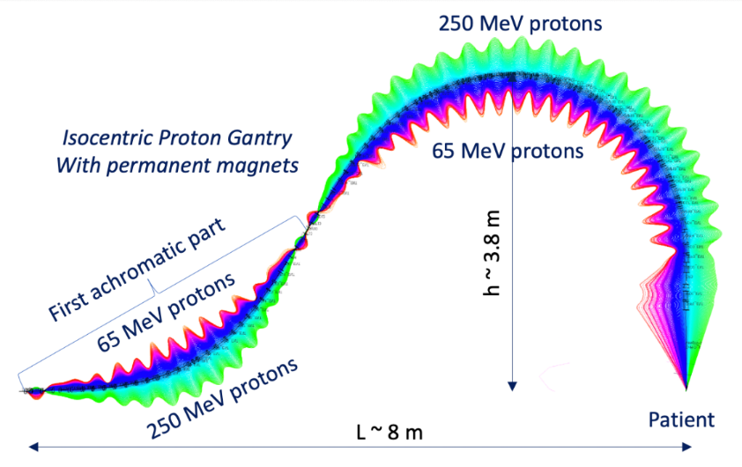
Trbojevic Hadron Therapy Gantry
A fixed-field gantry transports protons over the wide energy range 65-250MeV to the patient
  Faster depth (energy) scanning because no magnet ramp
  Also lighter-weight and less power than electromagnets
Requires a horizontal beam excursion
  Magnified trajectories shown on right
Higher fields give a smaller rotating gantry

Slide 34
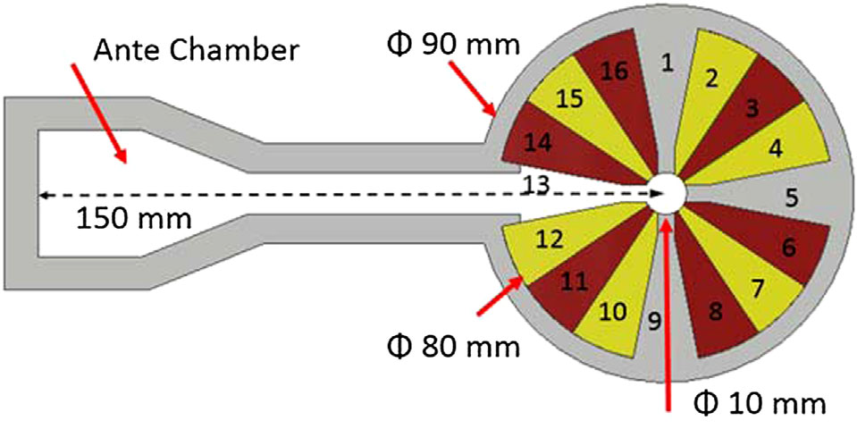
Next Generation Light Source
A section of alternating, high gradient quadrupoles called a “Complex Bend” reduces the electron beam equilibrium emittance
  This is being considered for the NSLS-II upgrade
  Beam is offset to give overall dipole bending field
A slot is required for synchrotron radiation to escape
  Careful cancellation of field error harmonics
  Their design shown below

Slide 35
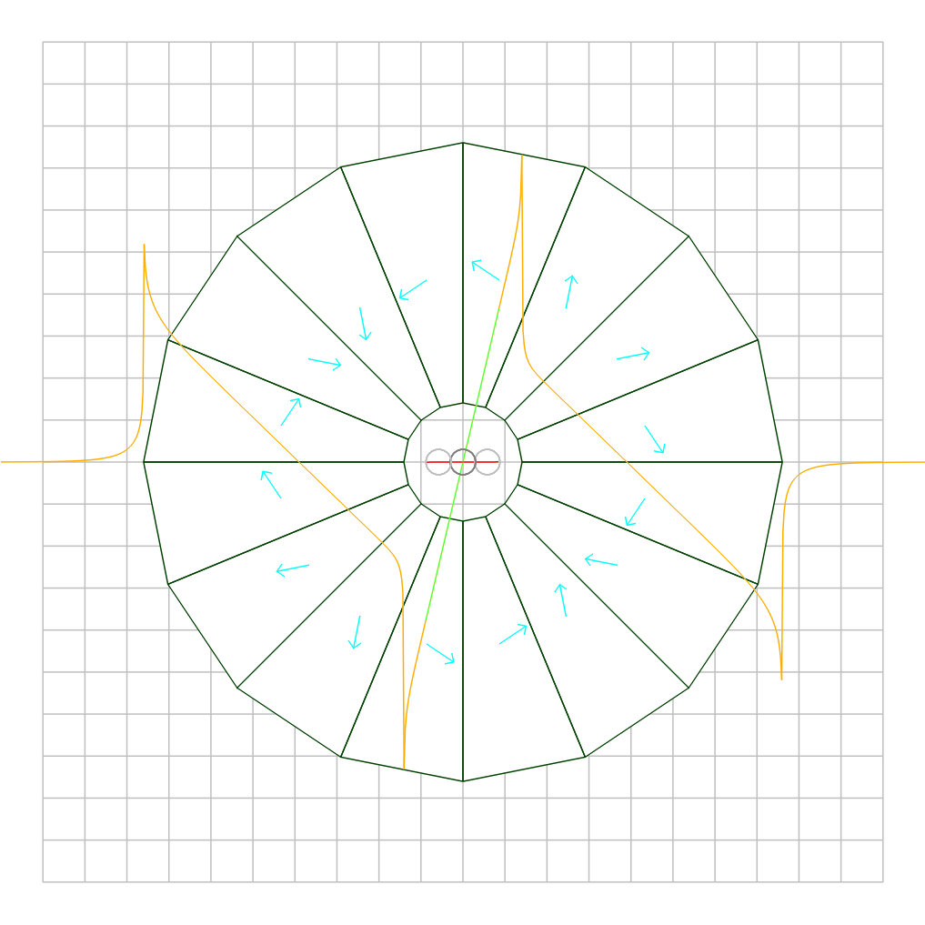
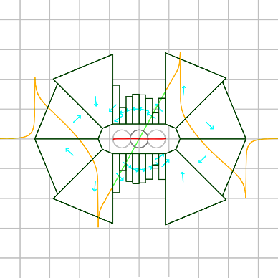
Oval Aperture Comparison
155T/m quadrupole
27.6mm horizontal aperture
B_{r} = 1.4T material
<10⁻⁴ field midplane accuracy
Left: circular aperture
170.9cm² of material
Right: oval aperture
10mm vertical height
24.0cm² of material
Sevenfold reduction in material use by only having aperture in the axis where it is needed
Therapy gantry QF magnet
Same scale!
cm grid

Slide 36
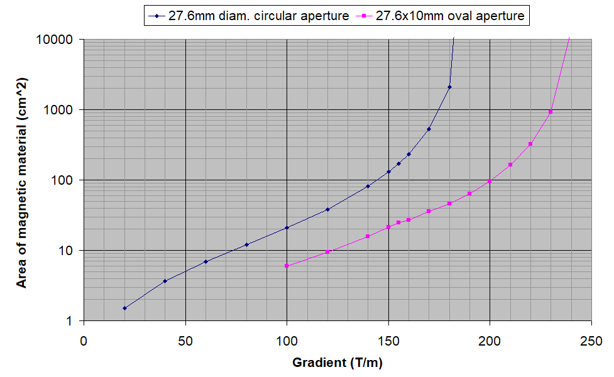
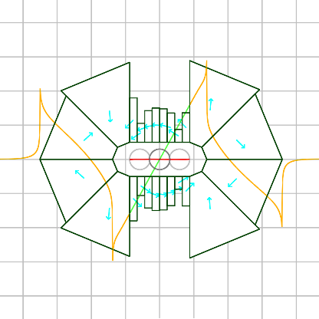
Oval Aperture Magnets
This design technique is beyond what was tested at CBETA
Further design optimisation will be done to make magnet more symmetric and manufacturable
Or 35% more gradient
7x less area

Slide 37
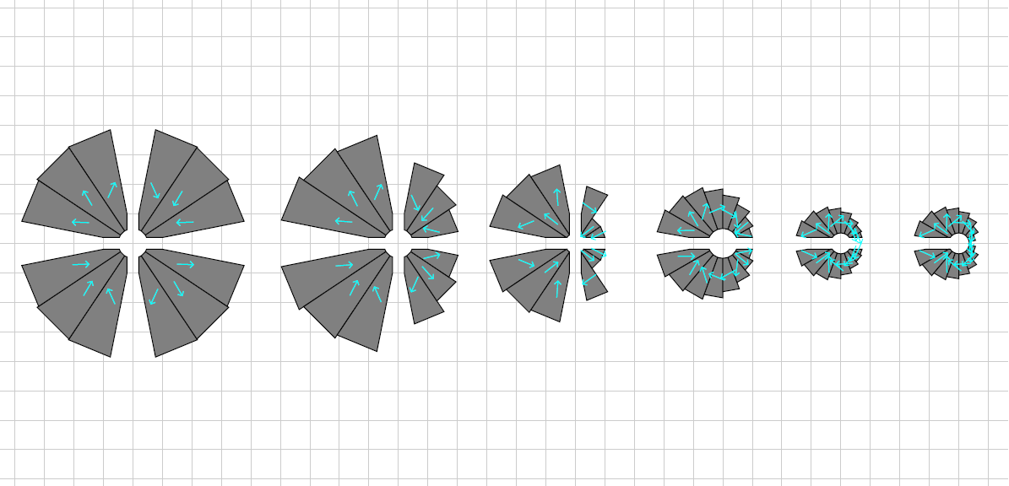
Open-Midplane Magnets Recent Design Improvements in 2020
-250T/m quadrupole combined with 0.49T dipole for NSLS-IIU light source parameter set
5mm Ø aperture, 2mm Ø good field region
  4mm gap open midplane slot
B_{r} = 1.12T material
Combined function offset
Horizontal midplane only
H-only + combined function
Left-only midplane
Quad symmetric
Non-symmetric
Same aperture, same field, same field quality, improvement only by design modifications

Slide 38
Open-Midplane Area vs. Quality
Light source D magnet
20x better field quality, and/or less material used

Slide 39
Open-Midplane Area vs. Quality
Light source F magnet
20x better field quality, and/or less material used

Slide 40
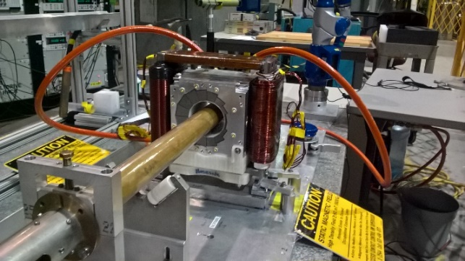
Adaptations for Small Aperture
Iron wires could be adhered to tape rather than plastic cartridge for reduced aperture use
  Or placed in integrated vacuum chamber grooves
SMD rotating coils won’t fit
  Assess capabilities of other existing field measurement systems at SMD and NSLS-II (rotating wire?)
  Could build smaller coil and either rotate coil or magnet
  Horizontal scans with Hall probe or vibrating wire are possible but accuracy is a question, including positional accuracy

Slide 41
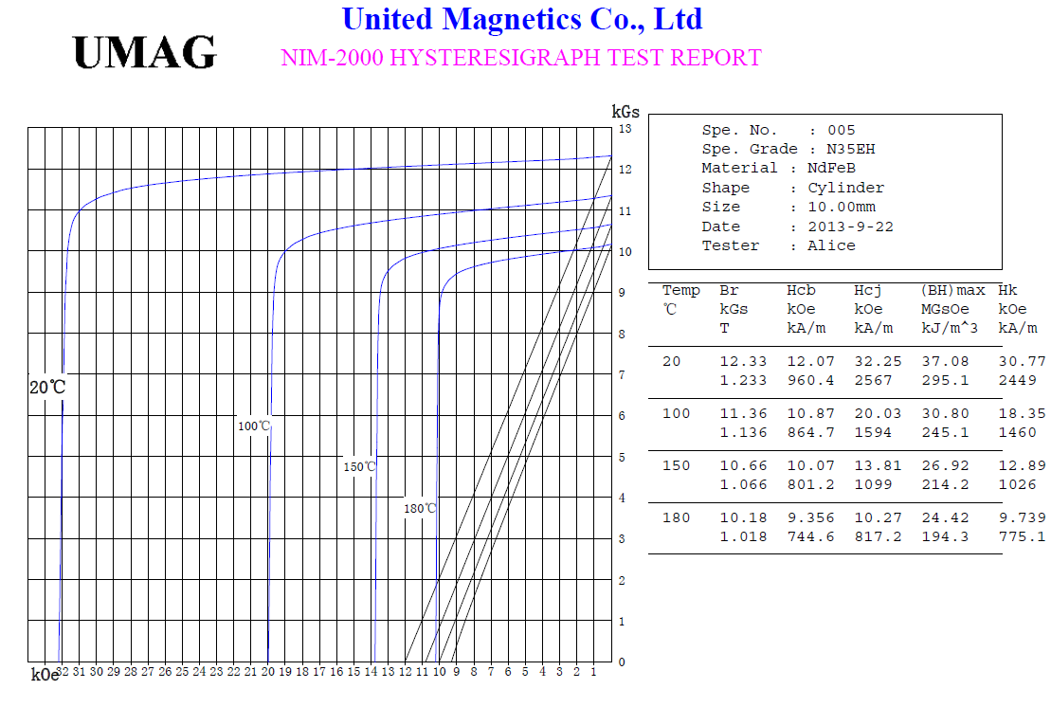
B-H Curve and Demagnetisation
CBETA material grade N35H
H_{cj} value (demagnetisation point,
varies with temperature)
Magnetisation provided by material (μ₀M = B − μ₀H)
Net field (B)
Large opposing fields (negative H in the direction of M) can potentially demagnetise parts of the material in higher field magnets. Not observed or expected in CBETA (-H<1.3T). Depends on material grade H_{cj} value.
External applied field (μ₀H)
opposing magnetisation direction

Slide 42
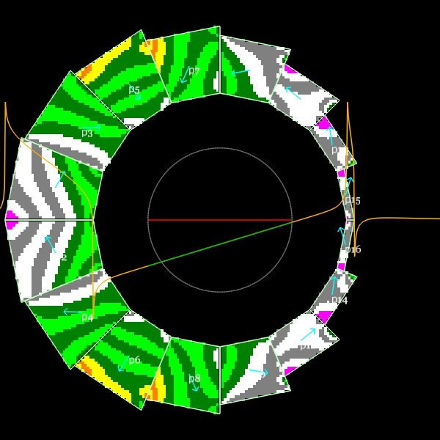
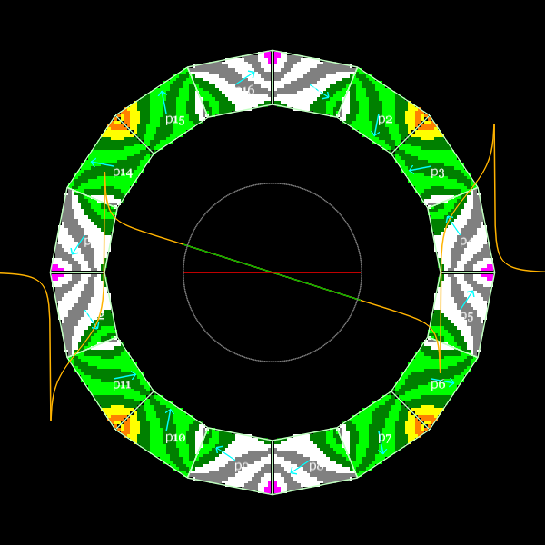
Reverse H field in magnets
BD
QF
mu0(H.M/|M|) = mu0*‘scalar H’ colour scale
White: 0 to -0.5T; green -0.5 to -1T; yellow/orange -1T to -1.5T (0.1T stripes)

Slide 43
Radiation Resistance
A.B. Temnykh, NIM A 587 (2008) 13–19
  Experiment: irradiate PMs → measure field loss
  Data fits empirical law where field loss rate varies exponentially with temperature margin to demagnetisation (Curie) temperature
Dose for 1% field loss in CBETA magnets (cautiously) estimated to be 74kGy
  Set a 1kGy lifetime dose limit for <2e-4 field errors
CBETA note 036
https://www.classe.cornell.edu/CBETA_PM/index_notes.html

Slide 44
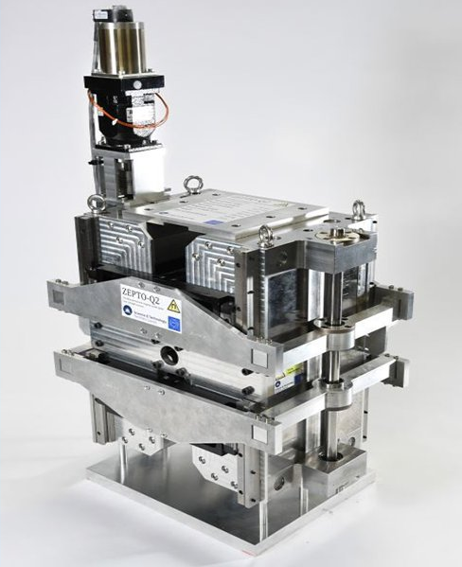
Adjustable Permanent Magnets
The CBETA method of main PM plus corrector coil is generally good for <10% adjustability
For full adjustability, could use mechanically-moving parts such as the ZEPTO quadrupole →
  Ben Shepherd, Daresbury Lab, UK
Or could use lattice with two different PM sections that roll mechanically and produce effective variable fields via their vector sum
  Or installing/removing slices for one-time adjustment

Slide 45
PETRA-IV Magnet Parameters
Name | Type | Strength | Aperture diameter
PSD1A | Sextupole | 3300 T/m² | 30mm
PSD1D | Sextupole | 4150 T/m² | 25mm
PSF2A | Sextupole | 4200 T/m² | 25mm
PQF1 | Quadrupole | 60 T/m | 25mm
PQD2 | Quadrupole | 70 T/m | 25mm
PQD3 | Quadrupole | 50 T/m | 25mm
PQF6 | Quadrupole | 95 T/m | 25mm
PQF8 | Quadrupole | 92 T/m | 25mm
PDQ1 | Dipole+quad | 0.2861 T + 38.94 T/m | 25mm
PDQ2 | Dipole+quad | 0.1976 T + 25.83 T/m | 25mm
PDL1,2(min) | Dipole | 0.2 T | 25mm
PDL1,2(max) | Dipole | 0.4 T | 25mm
POF | Octupole | 300000 T/m³ | 25mm

Slide 46
Common Parameters
Good field region R=7.9mm
All except PSD1A want ~5 units error
  PSD1A is OK with ~100 units
CBETA N35EH material with B_{r}=1.15791 T
Try 10mm midplane full gap on all magnets
Add 3mm to aperture radius for shims

Slide 47
Script
HalbachArea tool available at https://stephenbrooks.org/ap/halbacharea/
halbacharea name=PSD1A R=18e-3 sext=3300 gfr=7.9e-3 ymidplane=5e-3 Br=1.15791 halfoff=0 removeadjacent=0 wedges=24
halbacharea name=PSD1D R=15.5e-3 sext=4150 gfr=7.9e-3 ymidplane=5e-3 Br=1.15791 halfoff=0 removeadjacent=0 wedges=24
halbacharea name=PSF2A R=15.5e-3 sext=4200 gfr=7.9e-3 ymidplane=5e-3 Br=1.15791 halfoff=0 removeadjacent=0 wedges=24
halbacharea name=PQF1 R=15.5e-3 quad=60 gfr=7.9e-3 ymidplane=5e-3 Br=1.15791
halbacharea name=PQD2 R=15.5e-3 quad=70 gfr=7.9e-3 ymidplane=5e-3 Br=1.15791
halbacharea name=PQD3 R=15.5e-3 quad=50 gfr=7.9e-3 ymidplane=5e-3 Br=1.15791
halbacharea name=PQF6 R=15.5e-3 quad=95 gfr=7.9e-3 ymidplane=5e-3 Br=1.15791 halfoff=0 removeadjacent=0
halbacharea name=PQF8 R=15.5e-3 quad=92 gfr=7.9e-3 ymidplane=5e-3 Br=1.15791 halfoff=0 removeadjacent=0
halbacharea name=PDQ1 R=15.5e-3 dipole=0.2861 quad=38.94 gfr=7.9e-3 ymidplane=5e-3 Br=1.15791
halbacharea name=PDQ2 R=15.5e-3 dipole=0.1976 quad=25.83 gfr=7.9e-3 ymidplane=5e-3 Br=1.15791
halbacharea name=PDLmin R=15.5e-3 dipole=0.2 gfr=7.9e-3 ymidplane=5e-3 Br=1.15791
halbacharea name=PDLmax R=15.5e-3 dipole=0.4 gfr=7.9e-3 ymidplane=5e-3 Br=1.15791
halbacharea name=POF R=15.5e-3 oct=300000 gfr=7.9e-3 ymidplane=5e-3 Br=1.15791 halfoff=0 removeadjacent=0 wedges=32

Slide 48
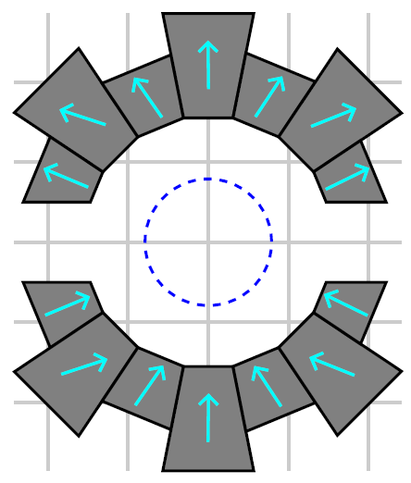
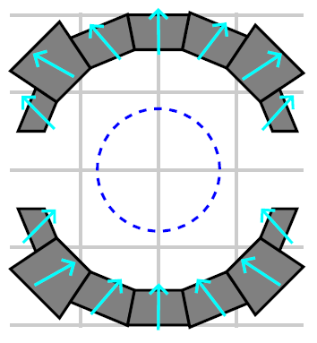
Dipoles
cm grid
PDL1,2(min)
0.2 T
2.9 units FOM
PDL1,2(max)
0.4 T
4.9 units FOM
Everything is good here
  Probably could use simpler design with rectangular blocks

Slide 49
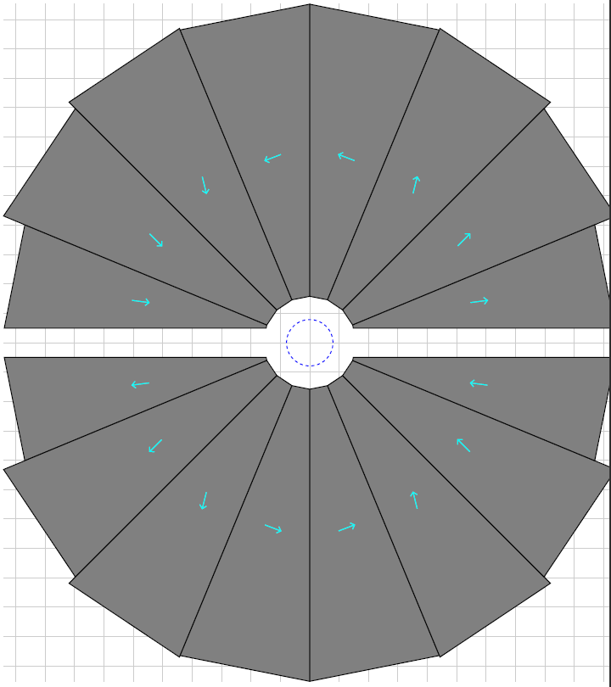
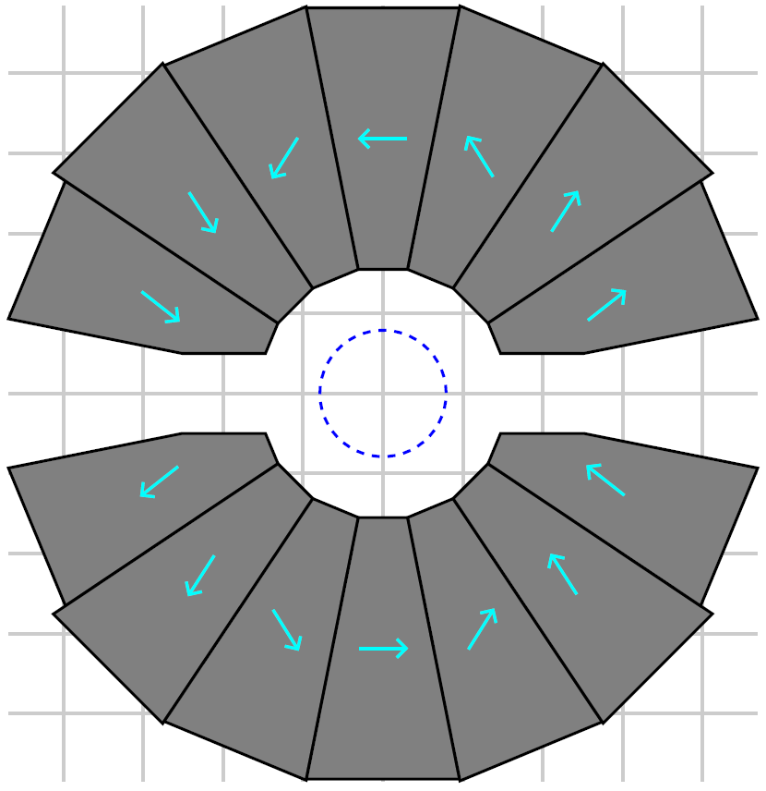
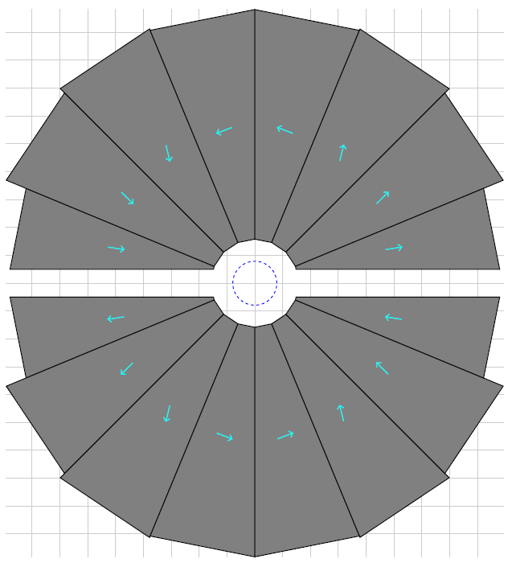


Quadrupoles
PQF1
60 T/m
3.0 units FOM
PQD2
70 T/m
2.6 units FOM
PQD3
50 T/m
3.6 units FOM
Weak quads OK, stronger quads are giant!
  Will try some tweaks later
PQF6
95 T/m
4.5 units FOM
PQF8
92 T/m
4.5 units FOM

Slide 50


Combined Function Dipole+Quads
PDQ1
0.2861 T + 38.94 T/m
3.4 units FOM
PDQ2
0.1976 T + 25.83 T/m
5.1 units FOM
These look good, like CBETA but smaller!
  PDQ2 can probably be made to be in spec with a small amount of optimisation

Slide 51



Sextupoles
PSD1A
3300 T/m²
(“30mm” Ø)
9.3 units FOM
(<100)
PSD1D
4150 T/m²
13.7 units FOM
PSF2A
4200 T/m²
16.0 units FOM
Although the harmonics could be tidied up, these magnets are clearly suffering from the open midplane location
  Sext, oct have high fields at +/-X extremes, exactly where material has been removed
  Will investigate effect of smaller midplane gaps later

Slide 52

Octupole
POF
300000 T/m³
250.4 units FOM
This hasn’t really converged, with 2.5% field error
  The open midplane is even more difficult for octupole
  Will investigate effect of smaller midplane gaps later

Slide 53




Try Smaller Aperture on Quads
R=15.5mm
R=14.5mm
R=12.5mm
Area gets a bit smaller
Harmonics get worse due to proximity of pieces to good field region
Could probably do better with more wedges
Might try reducing midplane instead
Or maybe stronger material grade
Or longer quad in lattice with lower gradient
PQF6
95 T/m
4.5 units FOM
7.1 units FOM
22.1 units FOM
PQF8
92 T/m
4.5 units FOM
6.8 units FOM
21.8 units FOM

Slide 54






Smaller Midplane on Quads
10mm gap
8mm gap
6mm gap
4mm gap
Design responds well to smaller midplane gap
Area gets considerably smaller
Harmonics get better
This has to be weighed against any practical issues of having such a small midplane gap
PQF6
95 T/m
4.5 units FOM
2.4 units FOM
0.8 units
0.3 units
PQF8
92 T/m
4.5 units FOM
2.3 units FOM
0.7 units
0.3 units

Slide 55









Smaller Midplane on Sextupoles
10mm gap
8mm gap
6mm gap
4mm gap
Maybe not allowed due to 10mm pole gap required in spec?
Magnets respond well to smaller midplane gap, improving field quality and greatly reducing area.
PSD1A
3300 T/m²
(“30mm” Ø)
9.3 units FOM
(<100)
2.3 units FOM
1.0 units
0.5 units
PSD1D
4150 T/m²
13.7 units FOM
6.2 units FOM
1.5 units
0.5 units
PSF2A
4200 T/m²
13.7 units FOM
6.5 units FOM
1.6 units
0.5 units

Slide 56



Try Smaller Midplane on Octupole
POF
300000 T/m³
Rapid improvement of accuracy and area with smaller midplane gap
Seems to be a threshold for it to become “good”
A different magnet block geometry (i.e. not radial wedges) might give better results in marginal cases
10mm gap
250.4 units FOM
8mm gap
59.2 units FOM
(weird convergence?)
6mm gap
5.8 units FOM
4mm gap
0.8 units

Slide 57
PETRA-IV Magnets Conclusions
Many of these magnets can be implemented as permanent magnets with open midplanes
  Some look quite compact and/or similar to CBETA
In the more difficult cases, field quality and size depend on the midplane gap required
These designs assume fixed field strength
  Adjustable fields (particularly over a wide range) require different design approaches

Slide 58
Overall Conclusions, Future Work
Successful implementation of permanent magnets with new features in CBETA
  “Accelerator quality” field in Halbach-style magnet
  Flexible: combined function magnets possible
  Compact and relatively cheap, no power supply
Currently applying for BNL lab funding to investigate smaller, higher-gradient, open-midplane and/or oval PMs
  Further extends PM accelerator applications

Slide 59
References
A. Bartnik et al., "CBETA: First Multipass Superconducting Linear Accelerator with Energy Recovery", Phys. Rev. Lett. 125, 044803 (July 2020)
Stephen Brooks et al., "Permanent magnets for the return loop of the Cornell-Brookhaven energy recovery linac test accelerator", Phys. Rev. Accel. Beams 23, 112401 (2020); doi:10.1103/PhysRevAccelBeams.23.112401
Dejan Trbojevic et al., "Permanent Halbach Magnet Proton and Superconducting Carbon Cancer Therapy Gantries" Proc. IPAC2017; doi:10.18429/JACoW-IPAC2017-THPVA094 available from http://jacow.org/ipac2017/papers/thpva094.pdf
Amin Ghaith et al., "Permanent Magnet-Based Quadrupoles for Plasma Acceleration Sources", Instruments 2019, 3, 27; doi:10.3390/instruments3020027
Stephen Brooks, CBETA note 035 "CBETA Halbach Magnet Production Run", available from https://www.classe.cornell.edu/CBETA_PM/index_notes.html
Stephen Brooks et al., "Production of Low Cost, High Field Quality Halbach Magnets", Proc. IPAC2017, pp. 4118-4120; doi:10.18429/JACoW-IPAC2017-THPIK007 available from http://jacow.org/ipac2017/papers/thpik007.pdf

Slide 60
BACKUP

Slide 61




Rejects/Repaired
BD 2305
Harmonics simulation w/swap
QF 2572
Harmonics sim. w/type change
QF 2509
Harmonics simulation w/swap
QD 2427
Harmonics sim. w/type change

Slide 62

Reversed Block in QF 2509

Slide 63

CBETA windowframe correctors at BNL

Slide 64

CBETA girder production at BNL

Slide 65

CBETA first FFA girder at BNL
Half-length magnet for matching

Slide 66

CBETA first FFA girder under construction at BNL

Slide 67
Other Problems/Lessons Learned
@BNL
  Warehouse roof leaks, hence tent in photo
  Gaps when reassembling magnets from halves
@AllStar
  Some blocks went rusty (not passivated?), had them re-made
  One type magnetisation angle was out-of-spec, had them re-made
@KYMA
  Couple of blocks inserted backwards
  One glue failure, exploding magnet, repaired
Team effort
  Block width with chamfer was not communicated clearly to AllStar, meaning blocks slightly larger than needed, had trouble fitting
  Chinese sign convention for magnetisation was opposite, had to invert blocks

Slide 68


Helmholtz Measurements
Example: AllStar data for wedge types P1 through P16 (BD magnet)
Angle errors Strength variation

Slide 69

Magnetisation Angle Distributions
Requested that factory re-make types P15 and P16 to reduce systematic error.
These are the smallest blocks, so not critical, but re-make will improve quality of untuned magnets.
General request was for 1 degree RMS error, but can cope with some above and some below as we have here (see next slide)

Slide 70

Magnet Error Model
Both the strength and angle error distribution can be put back into the field simulation
Example: BD magnet using AllStar’s data set.
1000 magnets were generated, some with position errors. Histogram is binned by the “units FOM”.
Green = easy to tune
Red = possible problems
Based on first girder experience.

Slide 71

One-turn Whole-FFA SVD Correction
This used an FFA response matrix generated semi-empirically from the phase advances of the first two corrector orbit bumps in each plane
(October 24, 2019)

Slide 72

Two Turns Uncorrected
(October 23, 2019)

Slide 73


Two Turns Corrected with SVD
(November 8, 2019)

Slide 74



All Four Tunes Compared to Model

Slide 75

Closed Orbit Bumps (1-turn)
(November 6, 2019)

