Slide 1
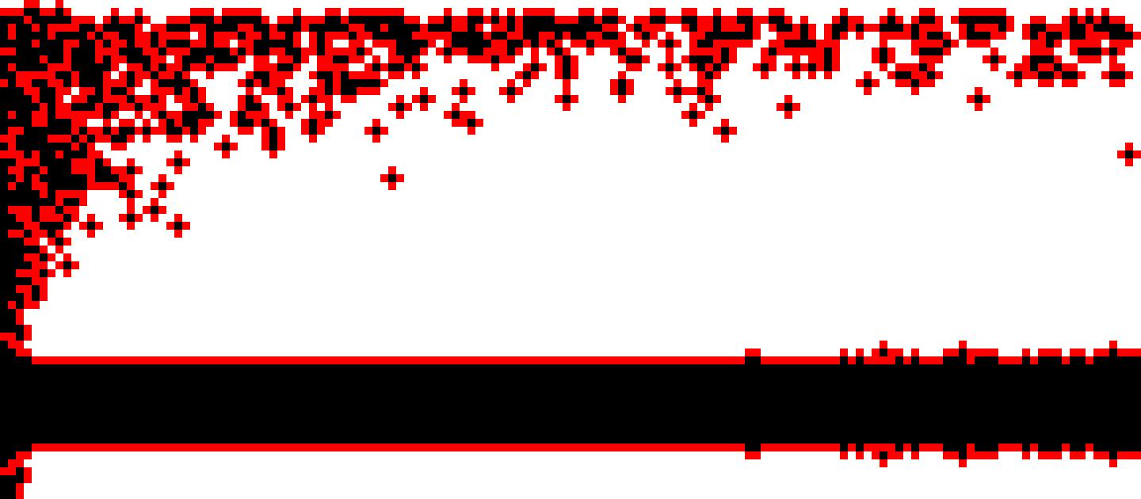
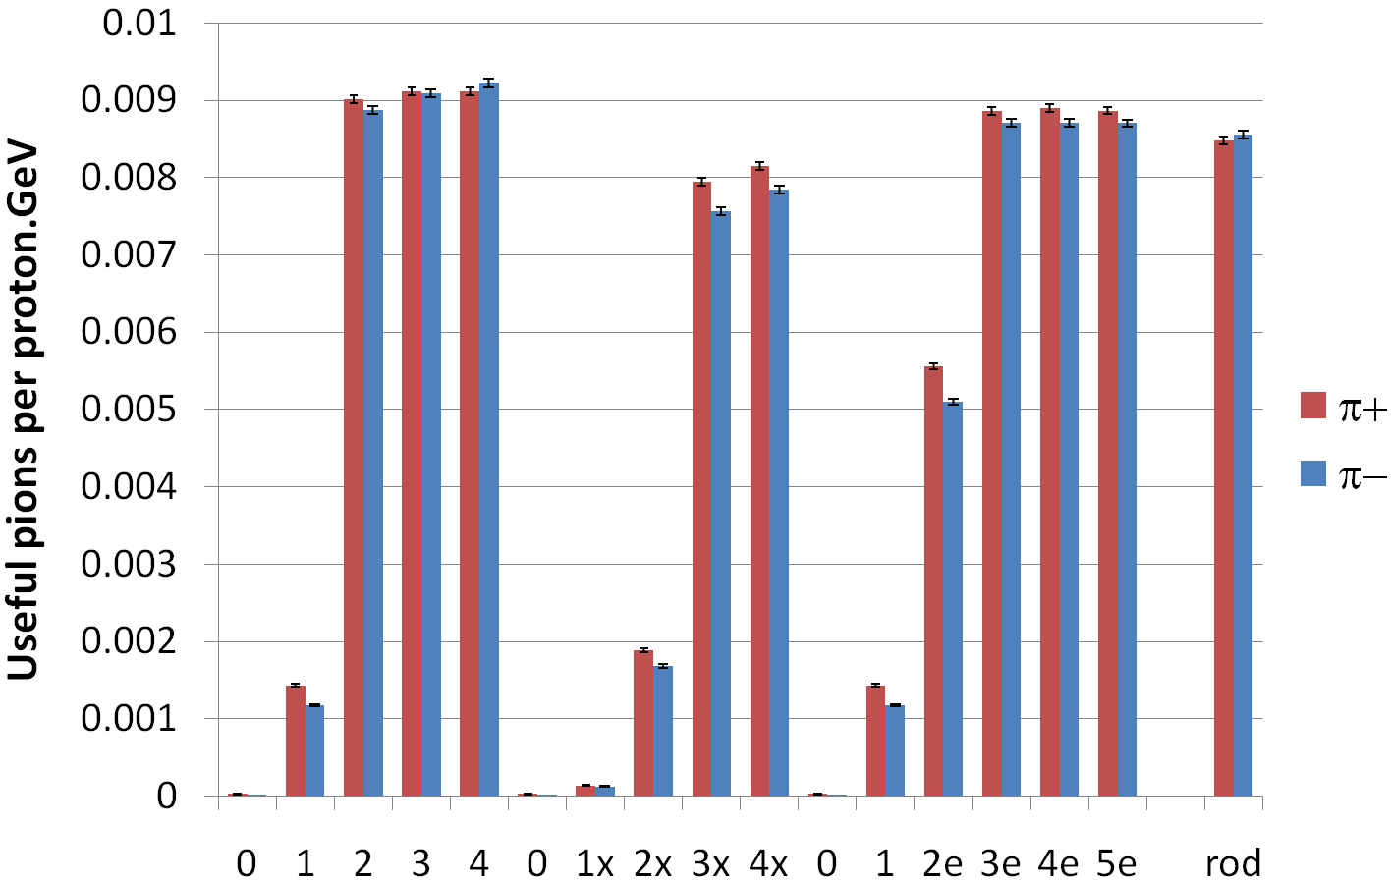
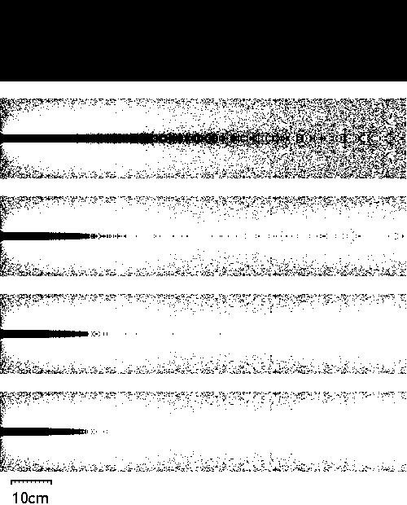
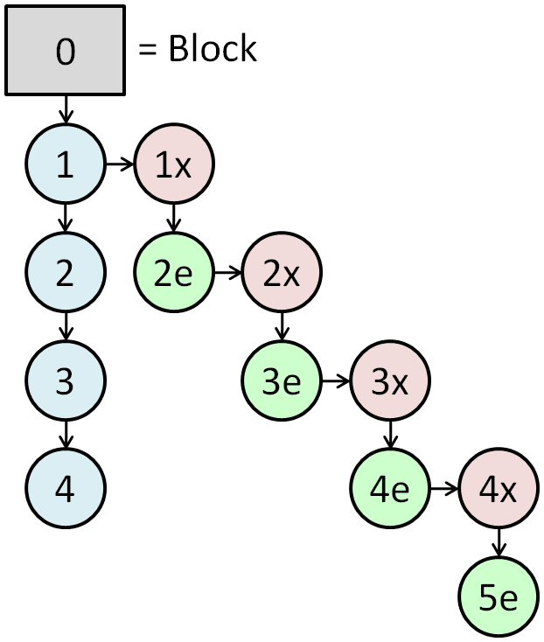
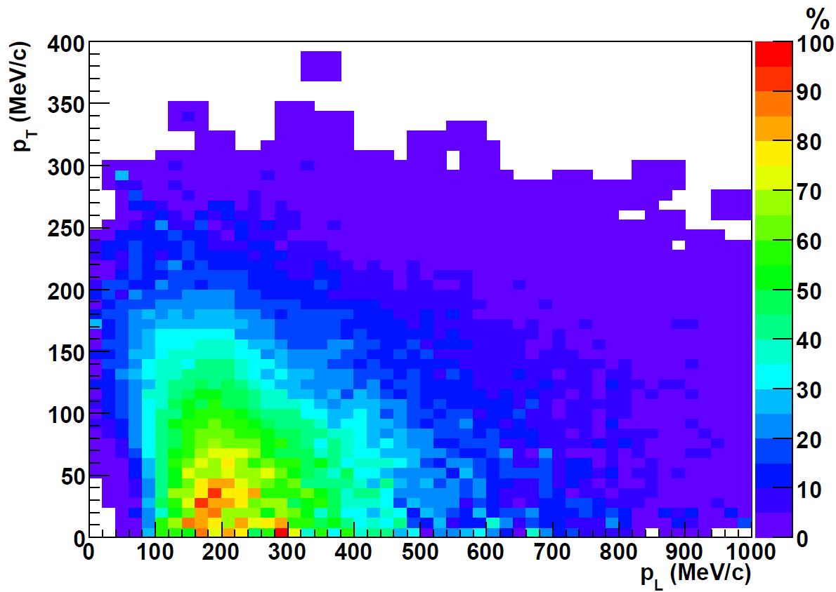
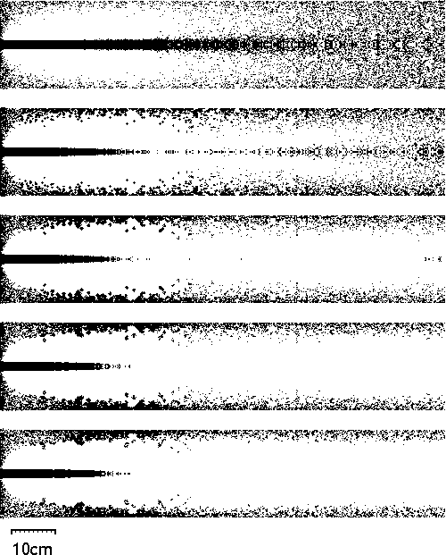
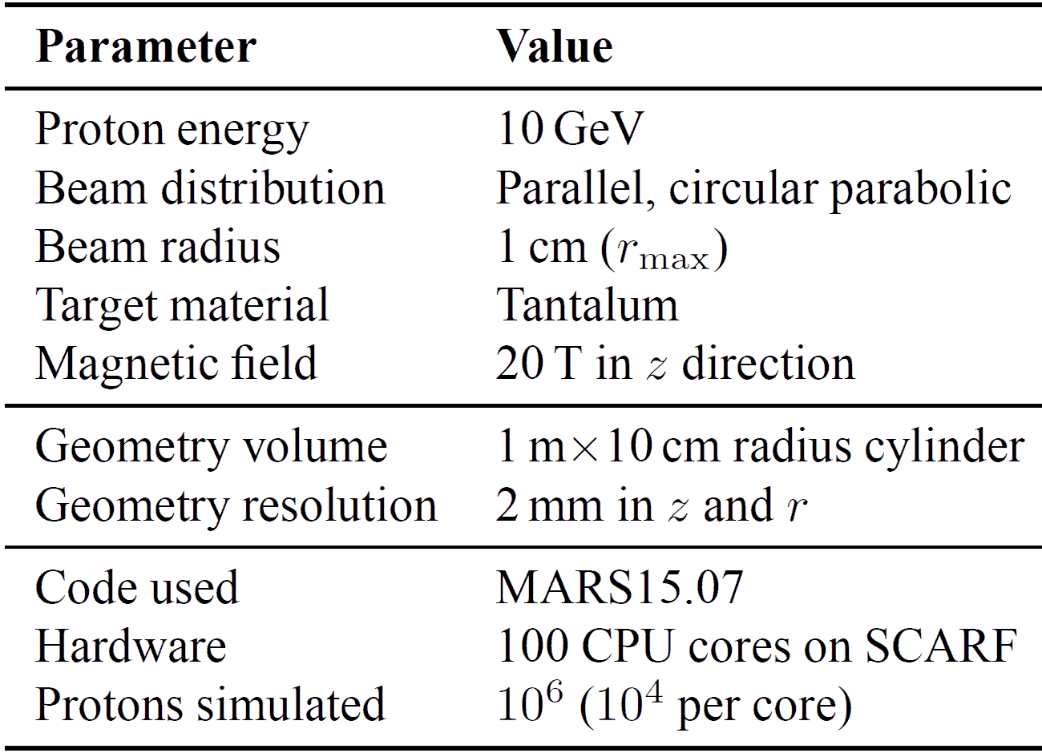
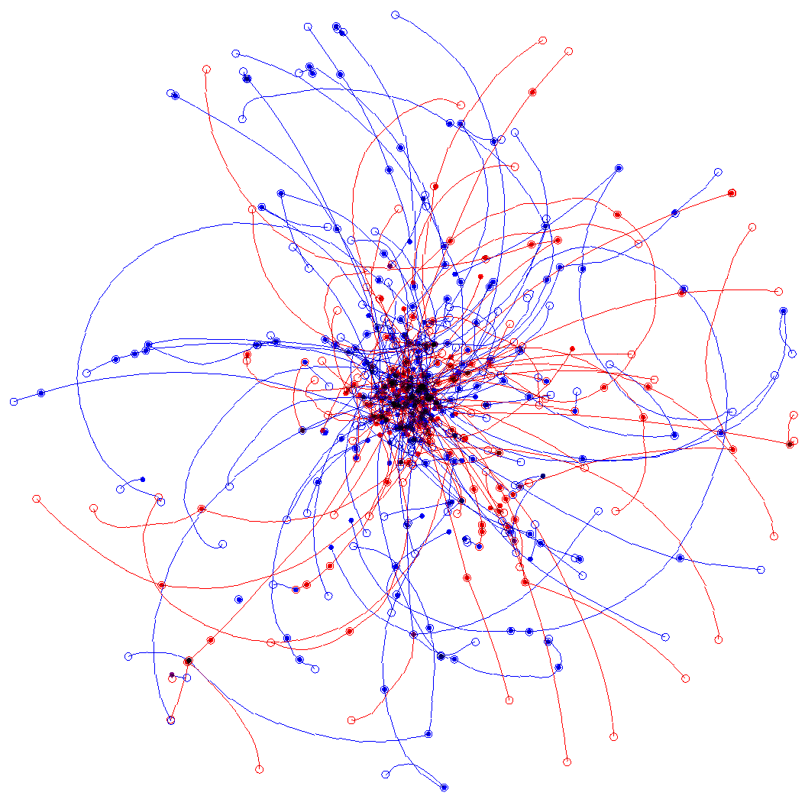
Optimising Pion Production Target Shapes for the Neutrino Factory
S.J. Brooks {stephen.brooks@stfc.ac.uk}, RAL, Chilton, OX11 0QX, UK
 | First Sequence – only removing material Starting with a solid cylinder of tantalum 1m long and 10cm in radius, successive MARS simulations identify the parts that are net producers and absorbers of useful pions. On each iteration, the parts that are net absorbers are removed. The first picture shows the pion balance in the original solid cylinderical block, the rest, from top to bottom show geometries 1 through 4. Formula Fit to Core Part of Geometry 4 (best yield) | Second Sequence – adding and removing material Material is allowed to expand into adjacent bins after each removal step in the manner shown below (for geometry 1 in black becoming geometry 1x in red). | Resulting Pion Yields – compared to a 20×1cm radius cylindrical reference target (‘rod’)
Abstract
The neutrino factory requires a source of pions within a momentum window determined by the ‘muon front end’ accelerator structure downstream. The technique of finding which parts of a large target block are net absorbers or emitters of particles may be adapted with this momentum window in mind. Therefore, analysis of a hadronic production simulation run using MARS15 can provide a candidate target shape in a single pass. However, changing the shape of the material also affects the absorption/emission balance, so this paper investigates iterative schemes to find a self-consistent optimal, or near-optimal, target geometry.
+7.6±0.6%
+3.1±0.6%
0
1
1x
The probability of a pion producing a useful muon was determined as a function of the pion's original longitudinal and transverse momenta in a particle tracking study by John Back (Warwick). This distribution of probabilities is shown to the right. It is used as weightings to evaluate ‘useful’ pion yield.
1
(right) Relation of iteration geometries to the original block. Downward steps remove regions that are net absorbers of pions; rightward steps expand the geometry.
(below) Individual pion tracks in the block target, seen in side and end views. Red denotes π⁺ and blue π⁻. Filled circles indicate pion emission and hollow circles absorption.
rod
2
1
3
2e
4
3e
4e
5e
Poster reference: WEPE098

