Slide 1

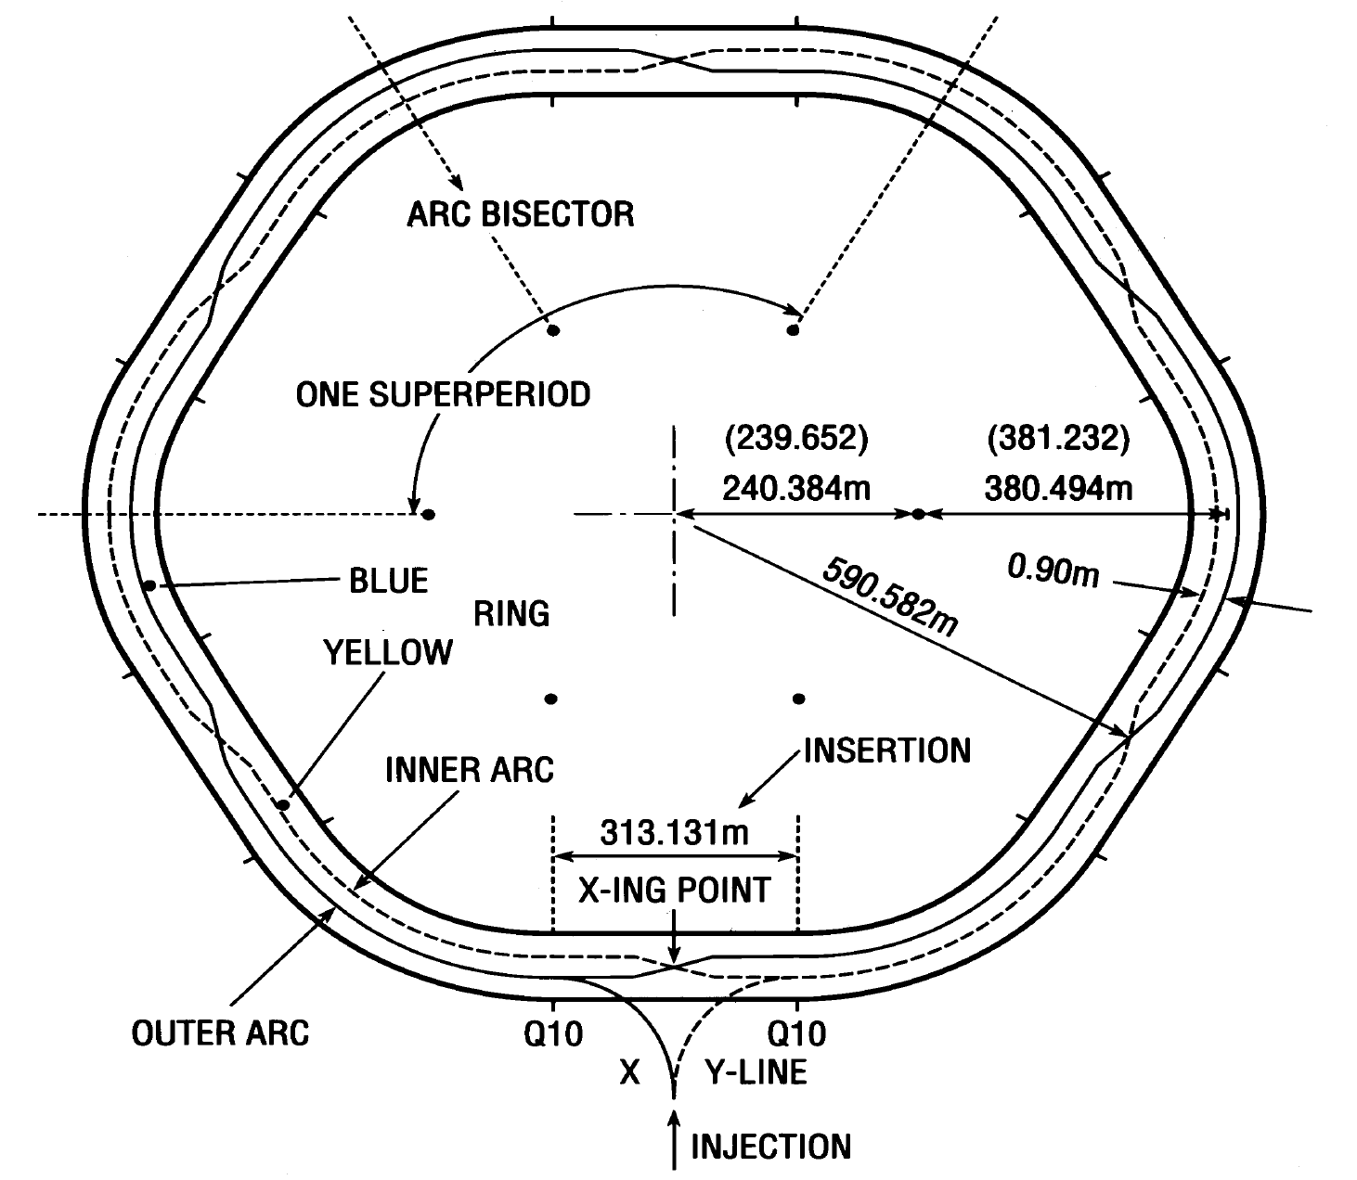
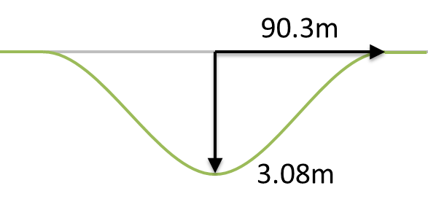
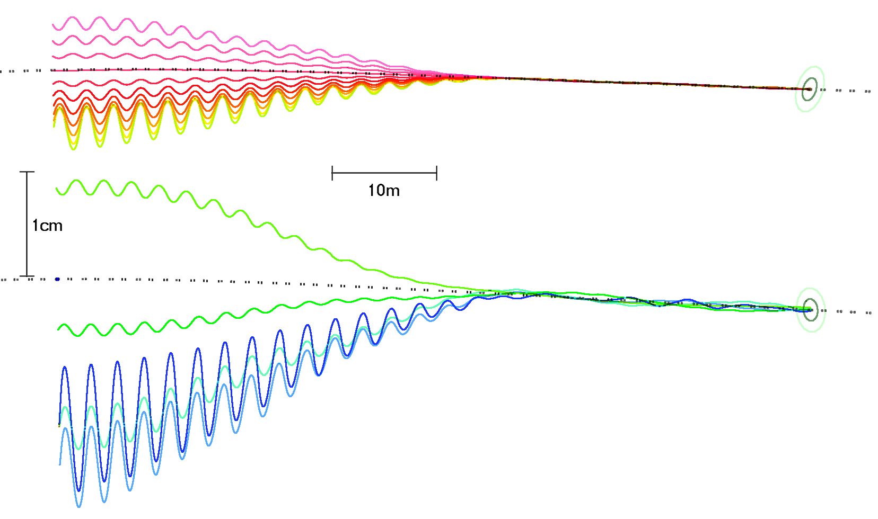
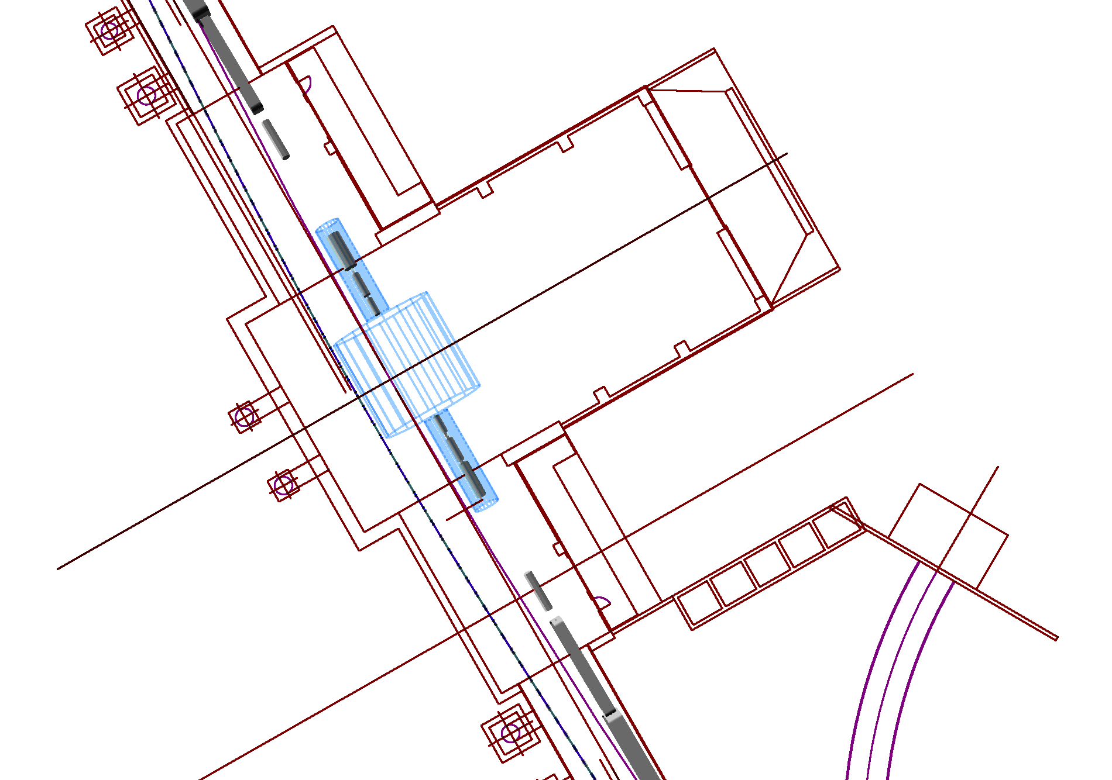
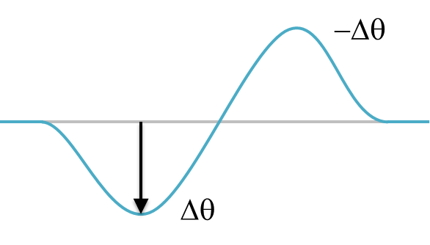
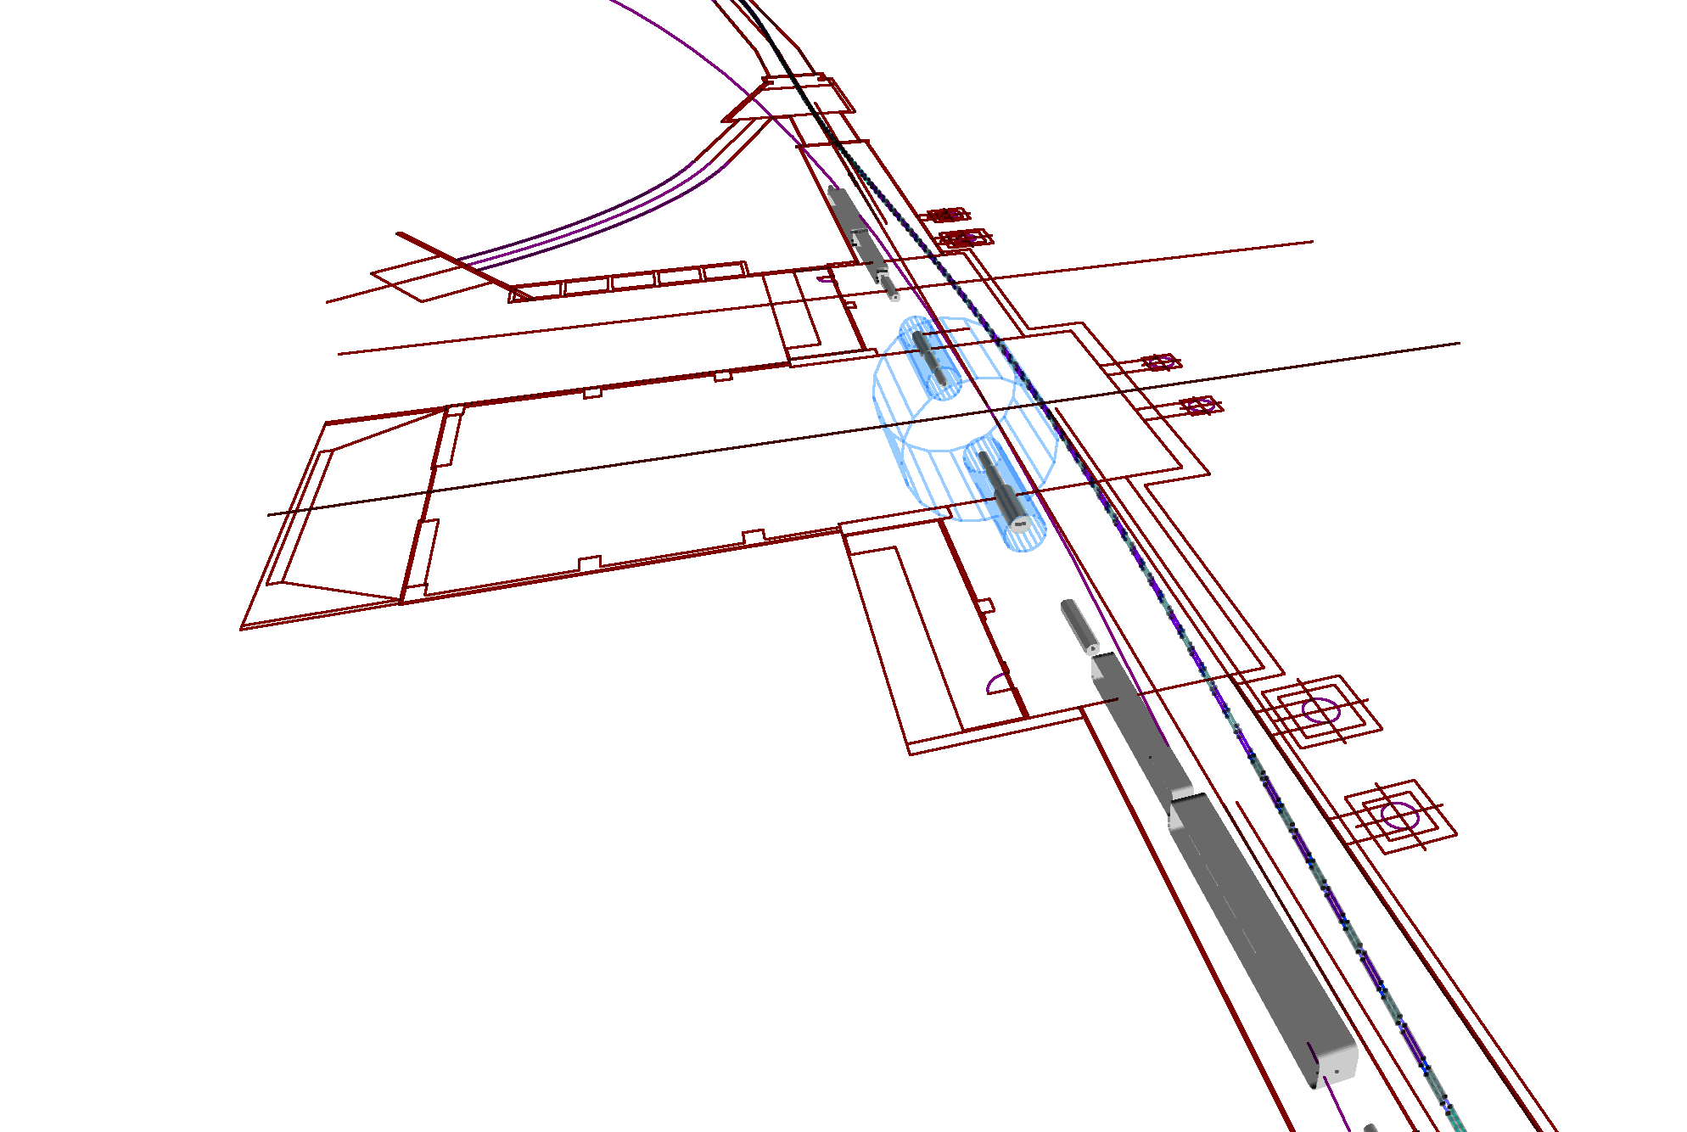
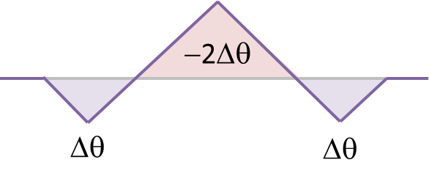
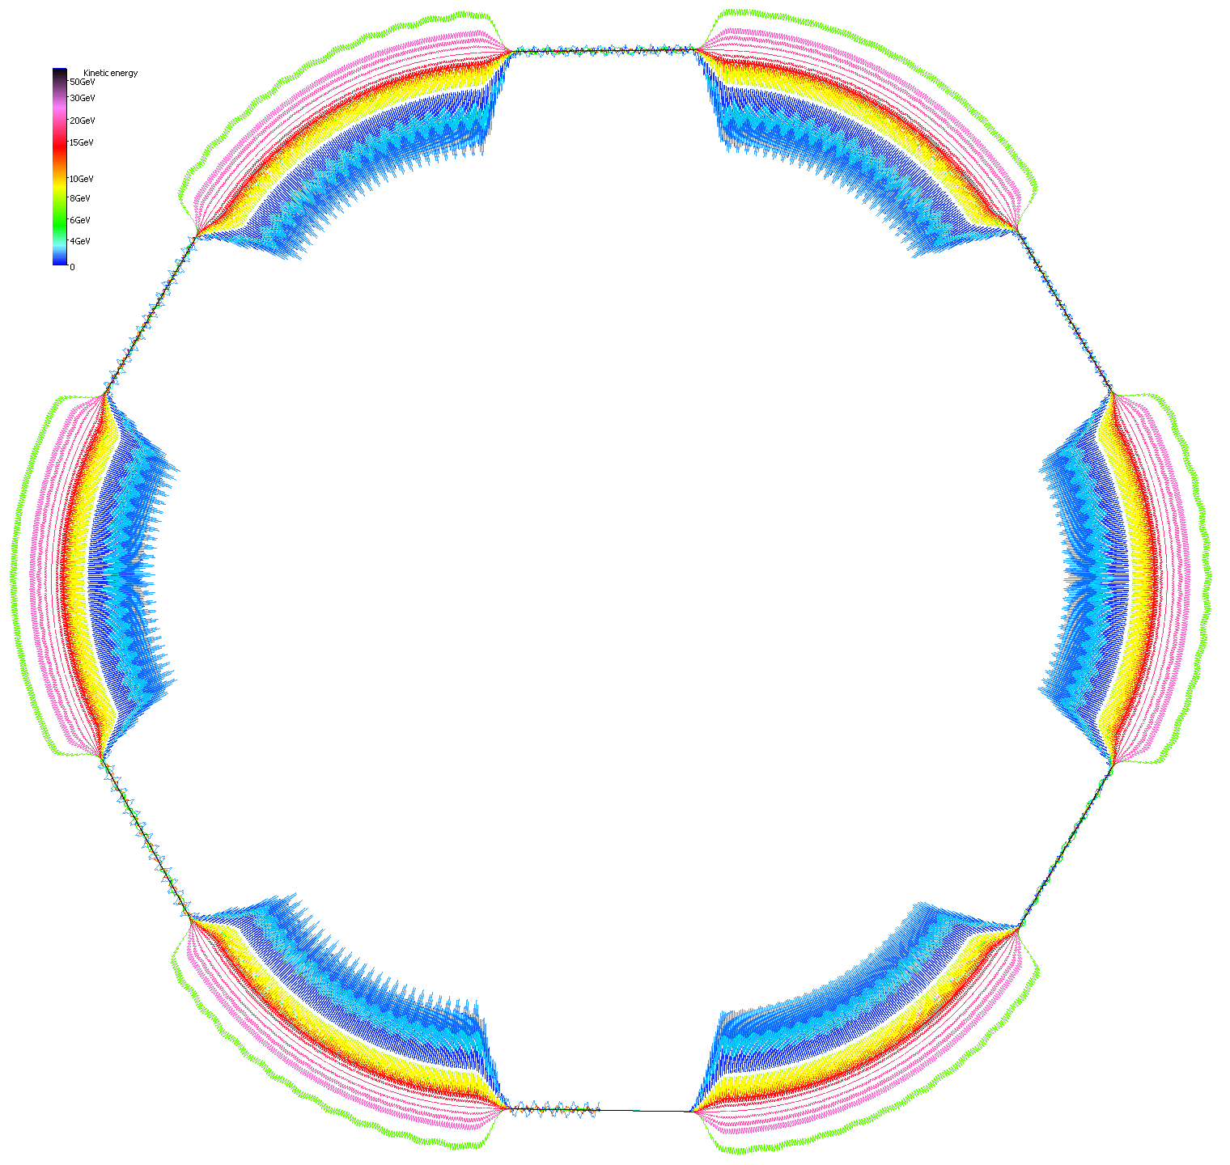


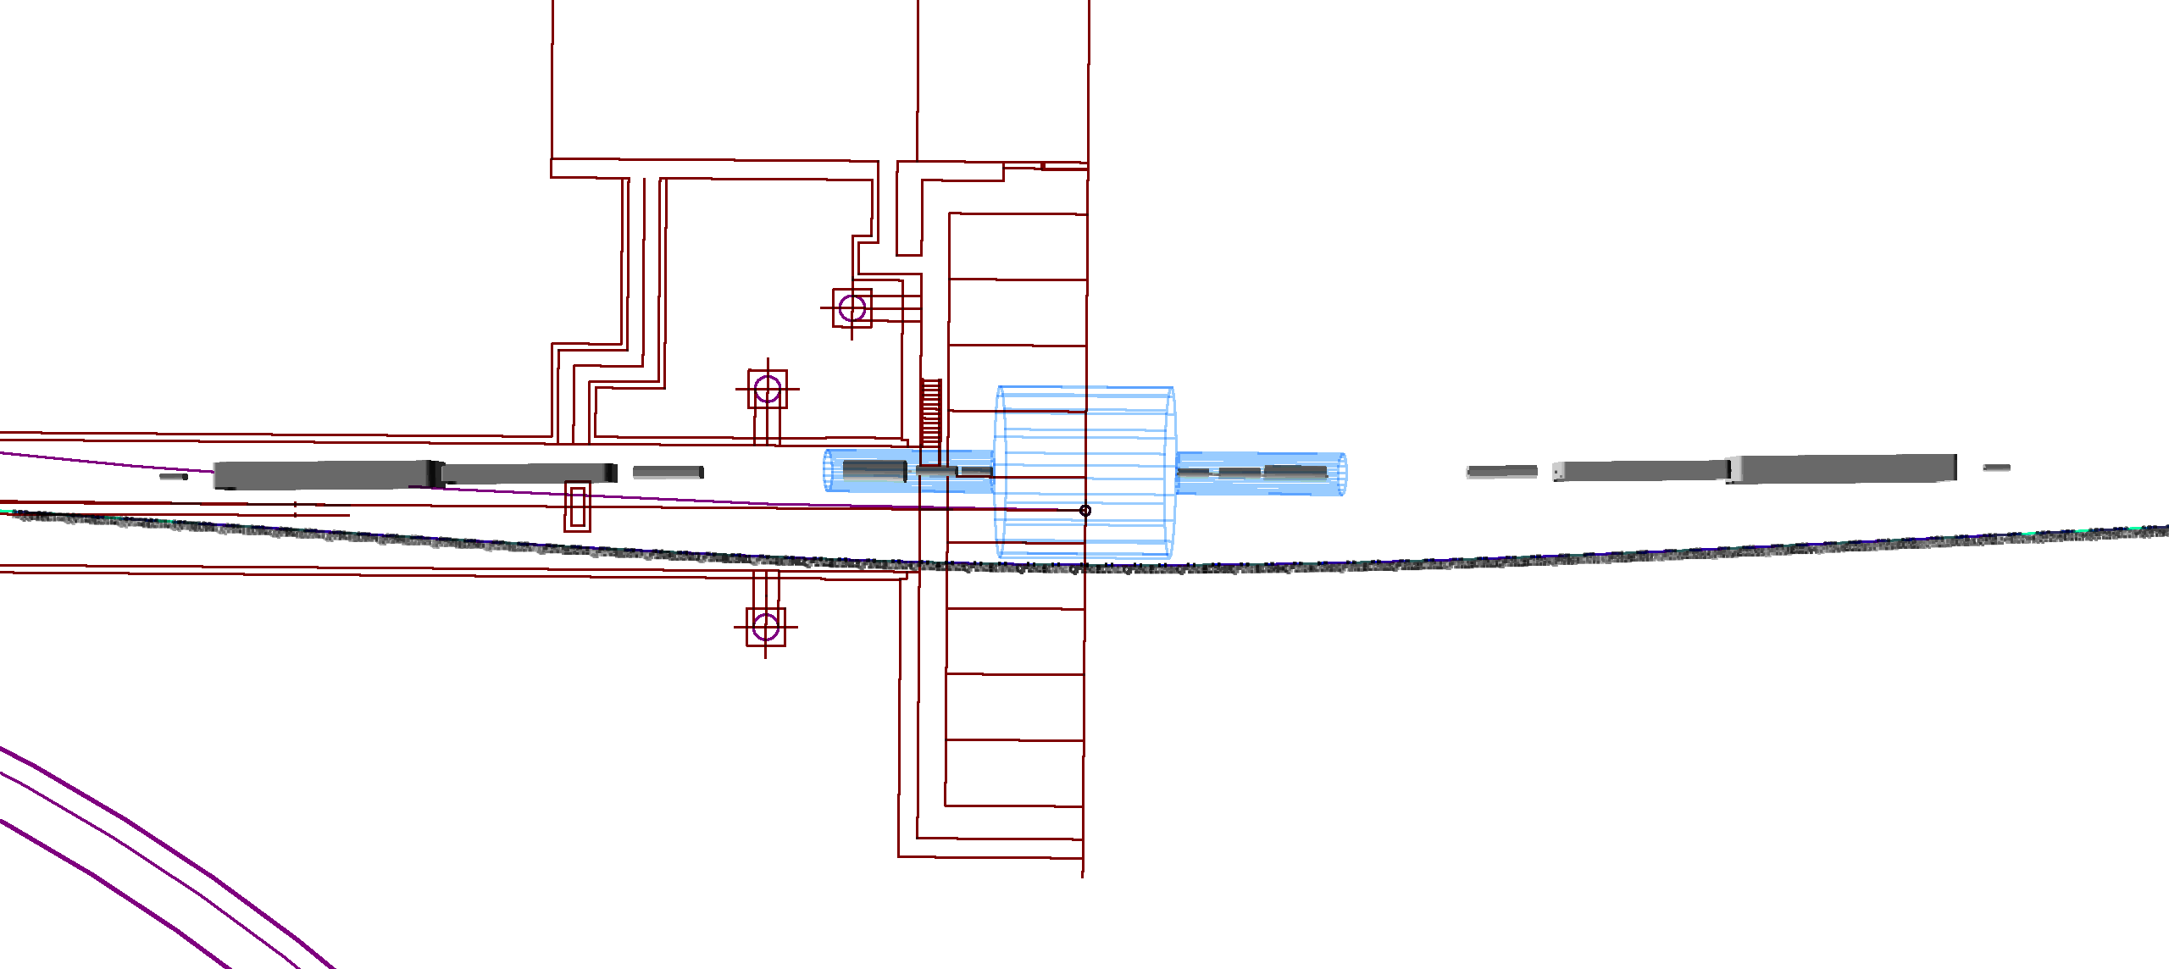
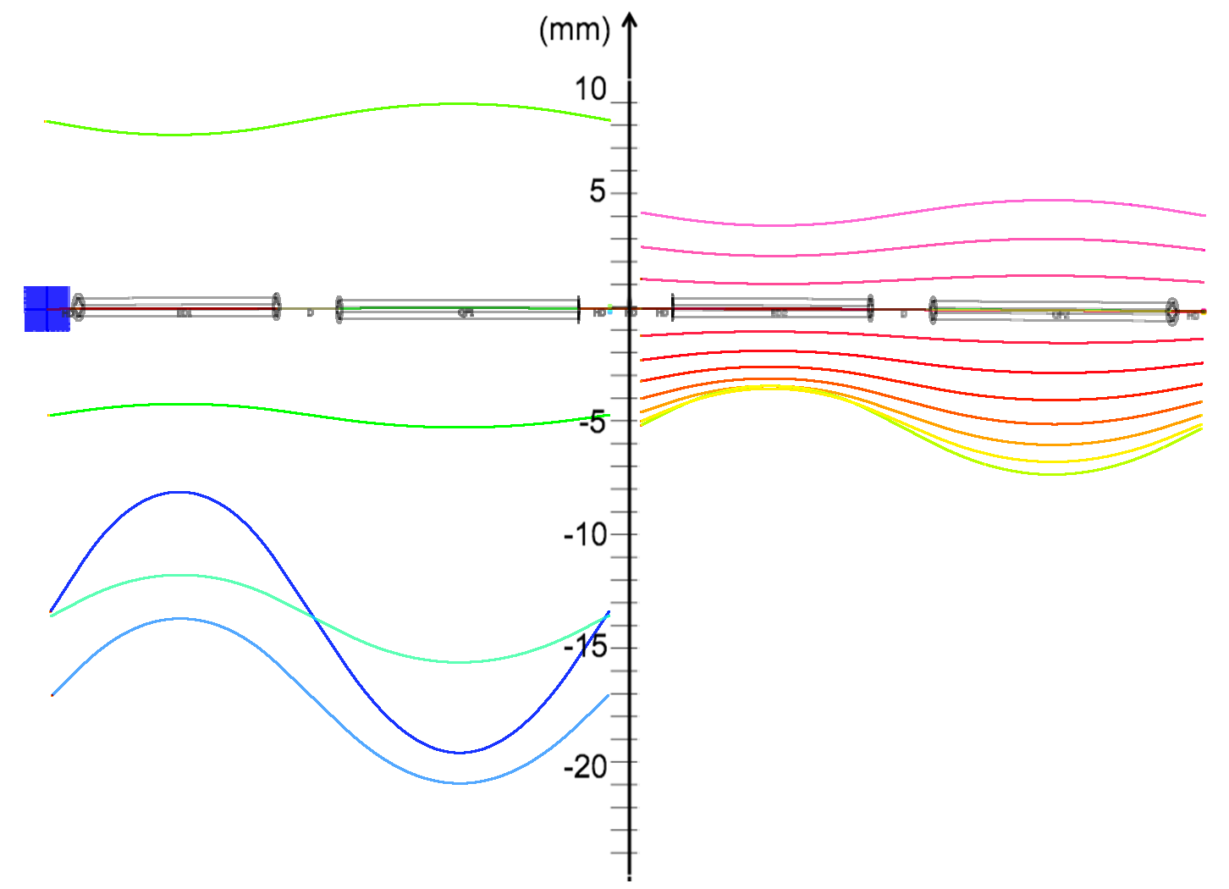
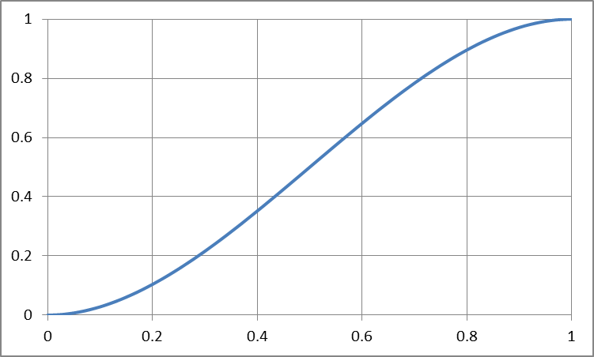
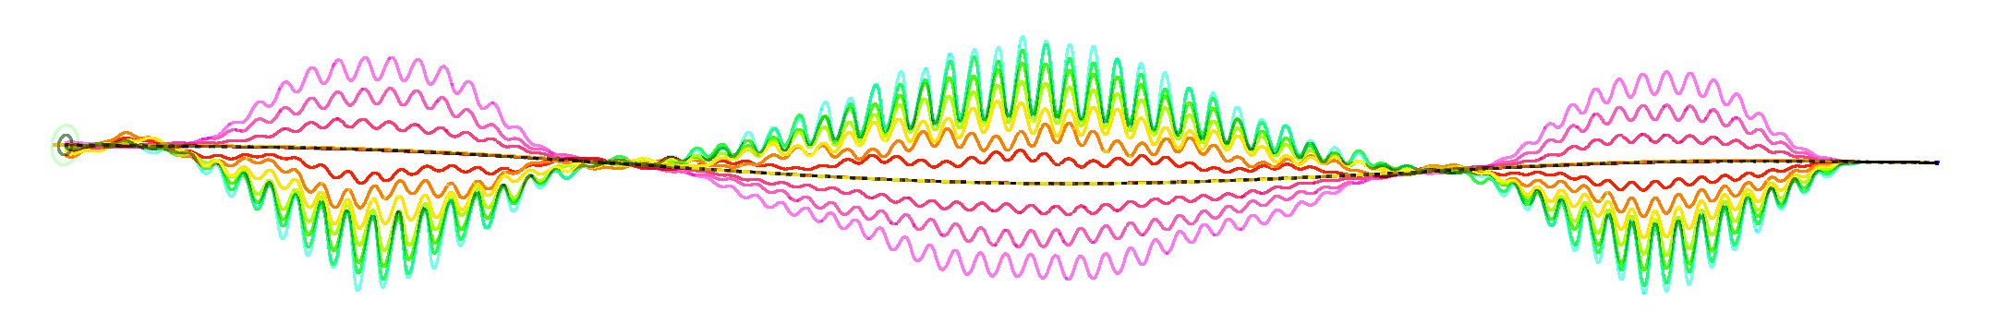
FFAG Straight Sections and Bypasses in eRHIC
Stephen Brooks {sbrooks@bnl.gov}
Problem The basic cells of eRHIC’s two stacked FFAG accelerators are designed for the ~380m radius of curvature of the RHIC tunnel arcs. However, RHIC’s tunnel is a rounded hexagon that also contains straight sections as shown below. Arc-to-Straight Transitions The two magnets in each FFAG cell are offset quadrupoles. If the offsets were reduced to zero, closed orbits for beams of all energies would stay on the x=y=0 centre line but the cell tunes and beta functions would stay the same since the focussing structure hasn’t changed. This suggests one way to match between the arcs and straights is to adiabatically reduce the quadrupole offsets while also reducing the curvature of the reference line proportionately. In eRHIC’s case the cubic ramp polynomial 3x²-2x³ for 0<x<1 was found to be a good schedule for how to reduce the angles and offsets over 17 cells. Left: basic eRHIC cells. Right: graph of 3x²-2x³. | Arc-to-Straight Tracking A transition from the arcs to the straights was tracked using the Muon1 code and the resulting trajectories are shown below, transversely exaggerated by 1000x. The upper plot is the high-energy FFAG (11 energies, 7.944–21.164GeV) and the lower plot is the low-energy FFAG (5 energies, 1.334–6.622GeV). The orbits move smoothly towards the centre line as expected. As the transition is not infinitely long (and therefore only approximately adiabatic), there is some residual orbit oscillation left over in the straight sections, which amounts to ±0.436mm in the low-energy FFAG and ±0.066mm in the high-energy FFAG. With the correct geometry, the entire superperiod 6 ring can be assembled, with FFAGs fitting in the RHIC tunnel. The tracking of this is shown below, with orbits exaggerated transversely by 5000x because the ring is ~3840m in circumference. | Detector Bypass Principle The method of gradually changing the curvature of an FFAG cell, while remaining matched because the beta functions do not change, can be generalised to more difficult problems. One of these is the bypass required to route the eRHIC FFAGs around the large detectors. The transverse displacements above require the beamline angle to change as shown below. This, in turn, requires beamline curvature that changes as the derivative of angle, shown below. 70 of the 76 cells of the eRHIC straight section may be divided up into ramps of increasing and decreasing curvature to give this variation in the required space. Tracking shows that the orbits return to the centre line as required, with a small error. This is shown below with a transverse exaggeration of 2000x. | Detector Bypass 3D Layout The shape of the FFAG bypass can be checked against a plan view of the RHIC tunnel walls, imported from an AutoCAD file into Muon1. Space can be reserved for an R=4.16m, 8.23m length cylinder (the same size as the STAR detector), assuming it can be rolled inwards 1.76m from its current position using the existing rails. The bypass centre is 4.5m from the detector centre. Above: plan and perspective views of the 8 o’clock position (PHENIX). Below: plan view of one half of the STAR hall with the eRHIC FFAG and hadron IR.

