Slide 1
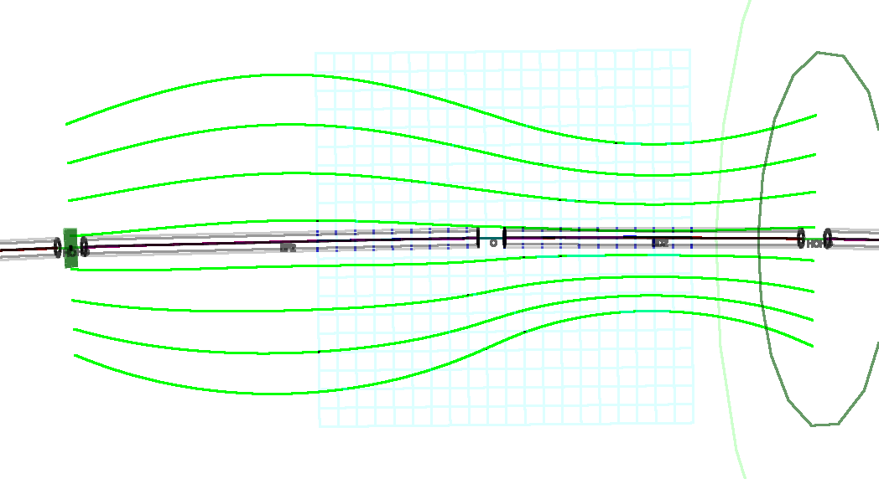
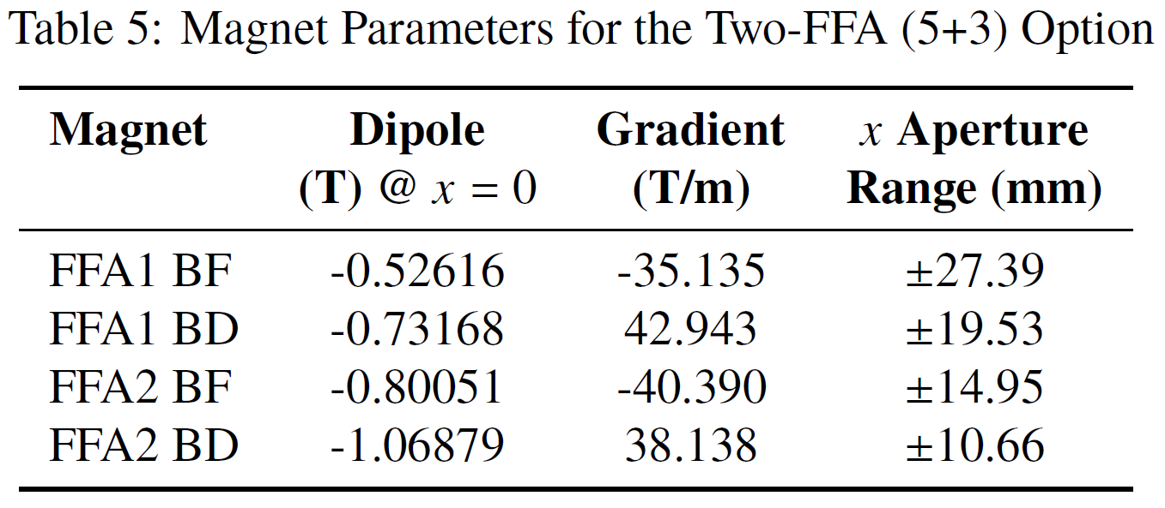
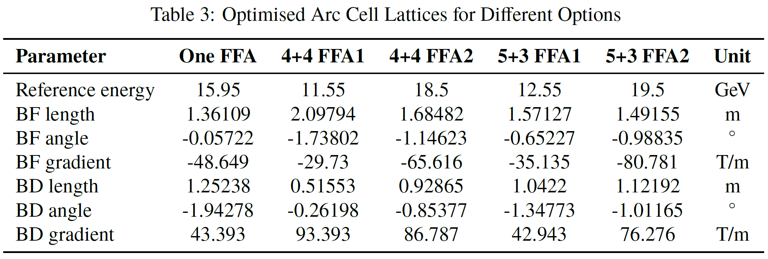
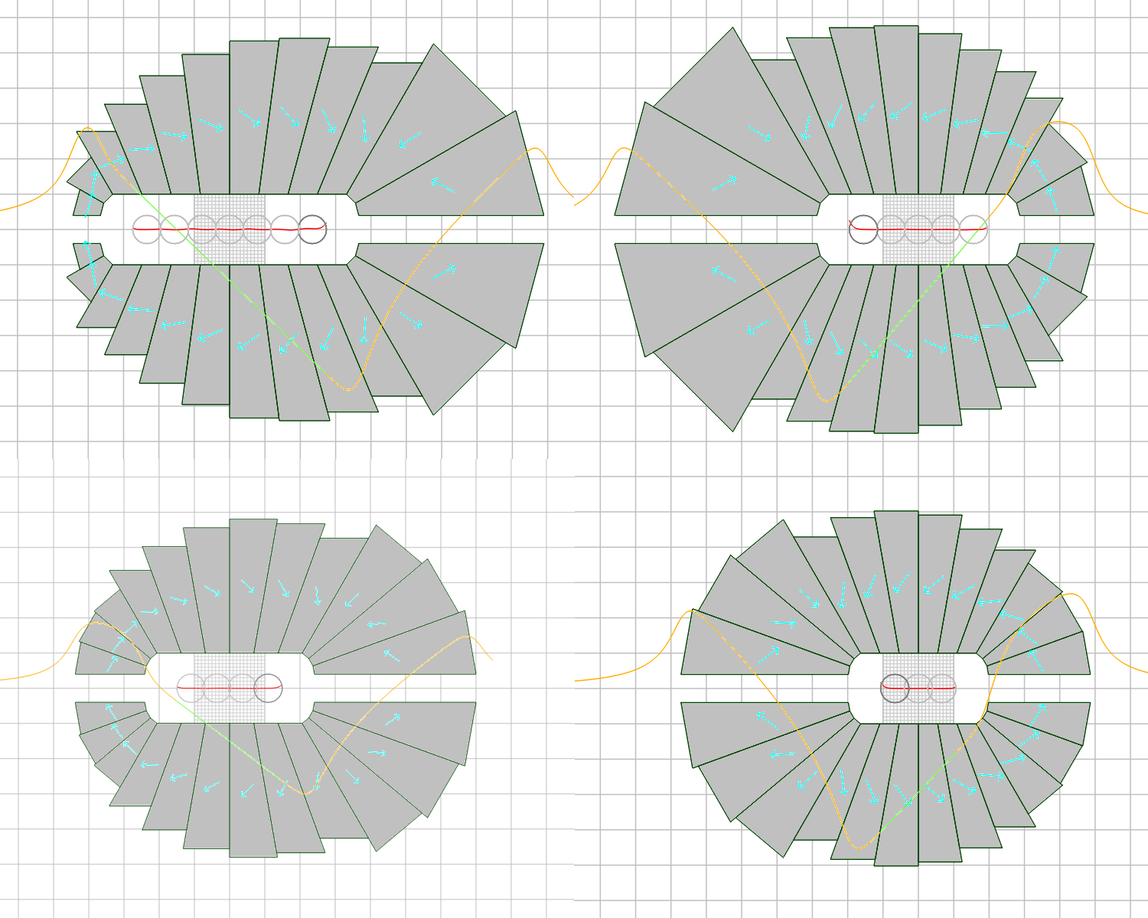
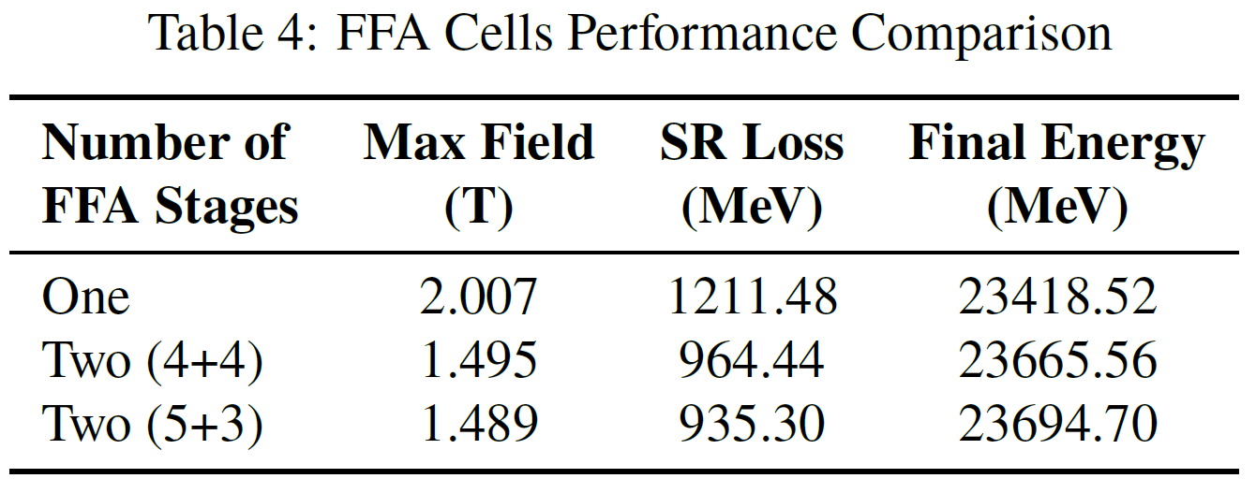
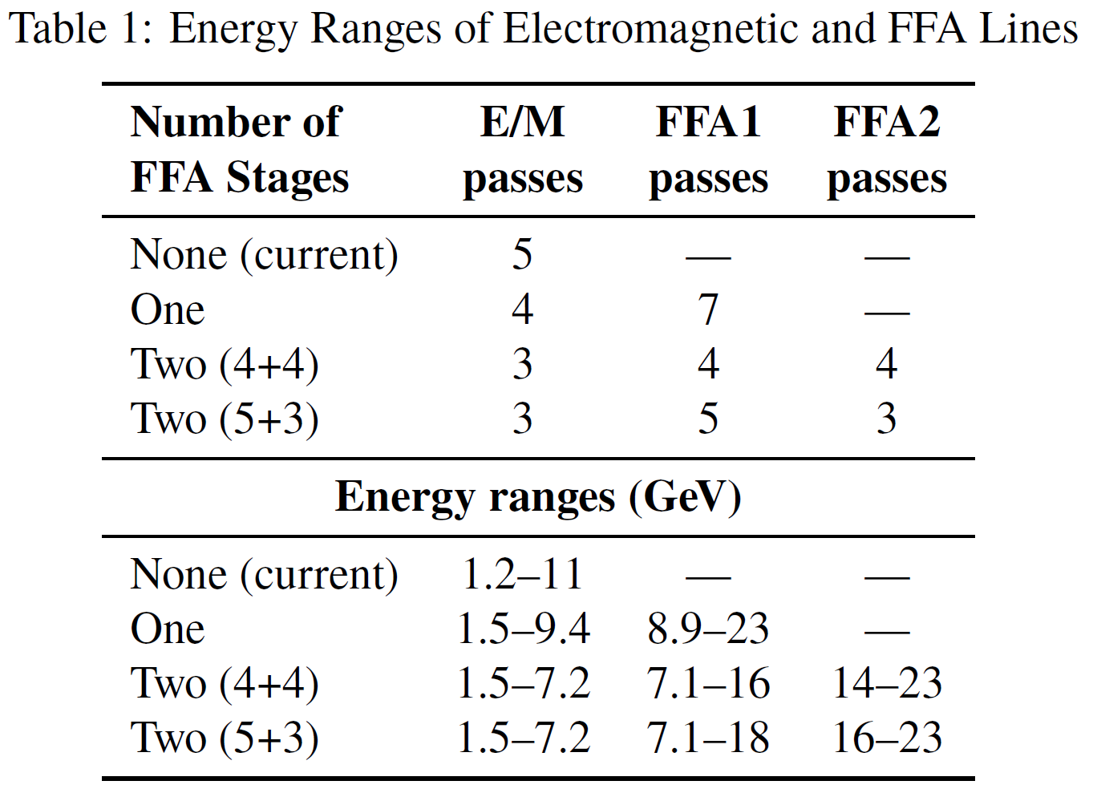
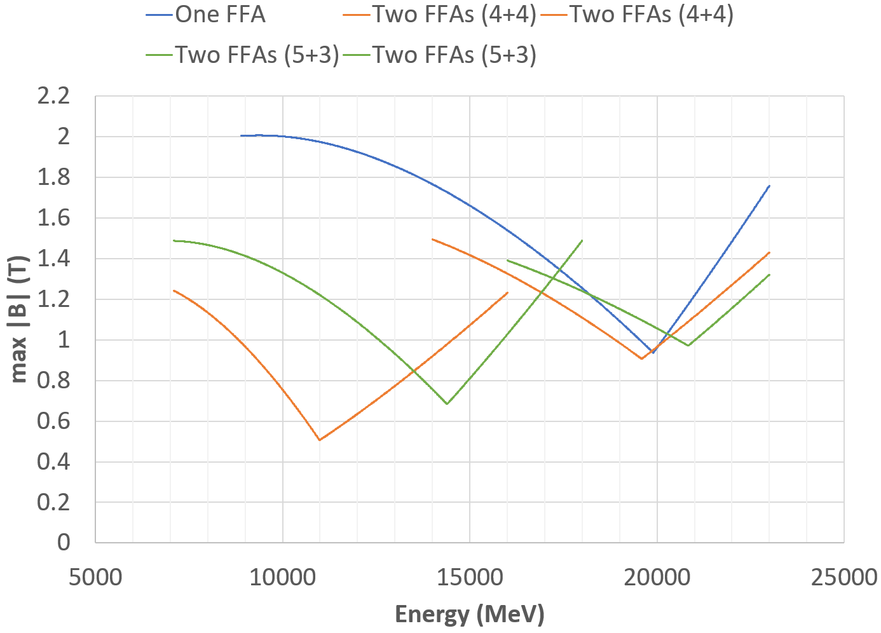
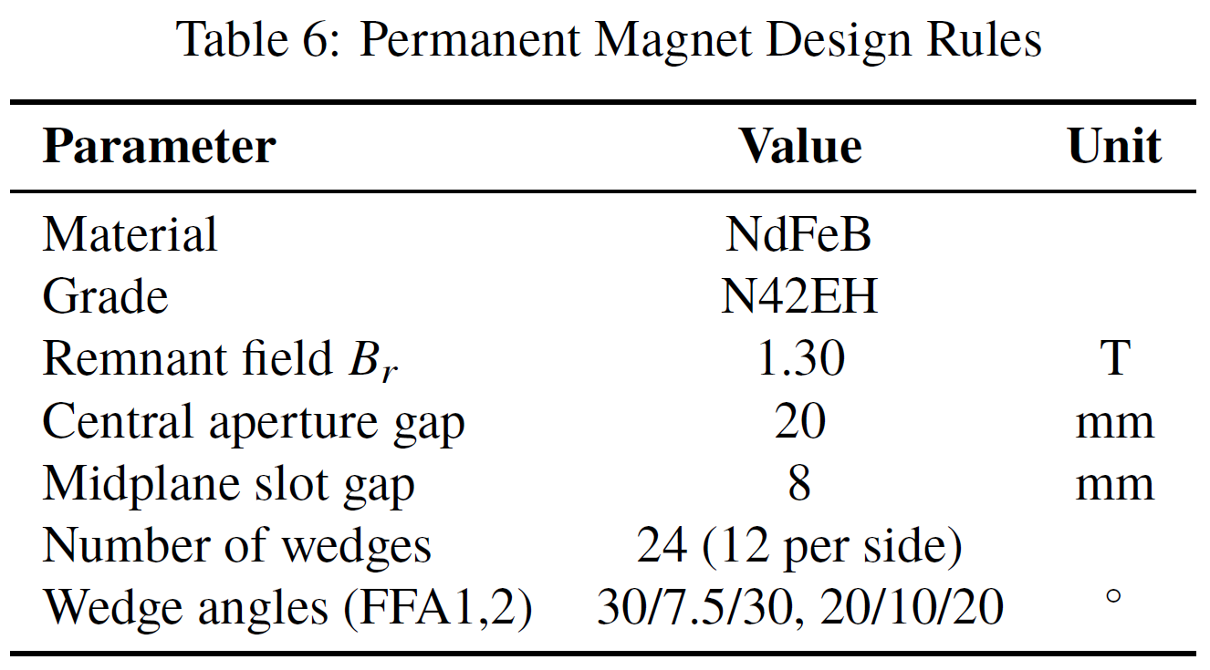
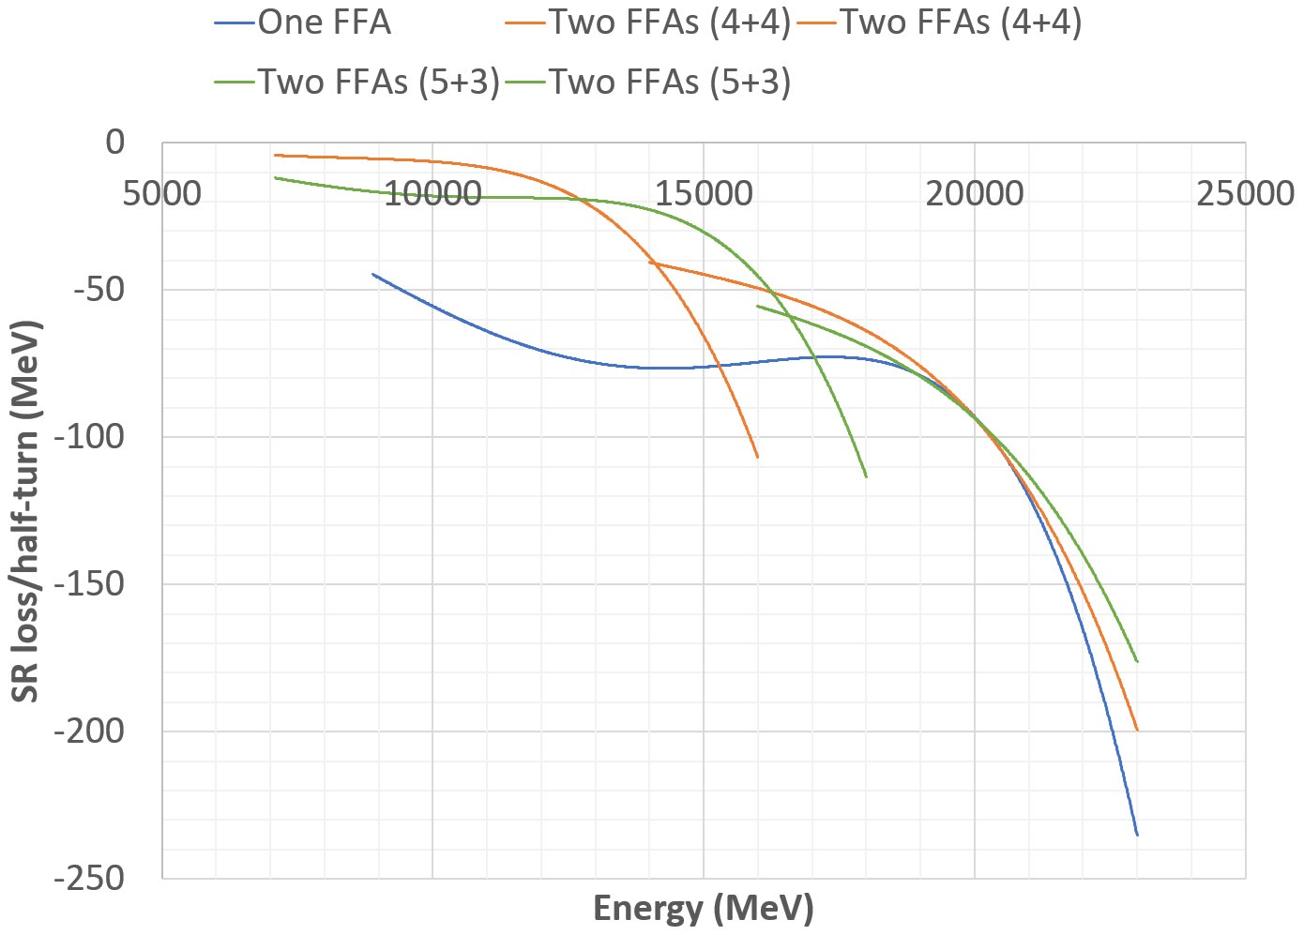
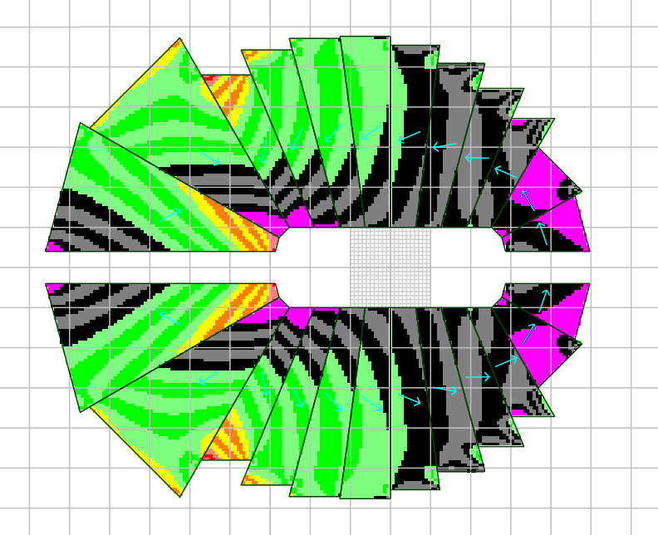
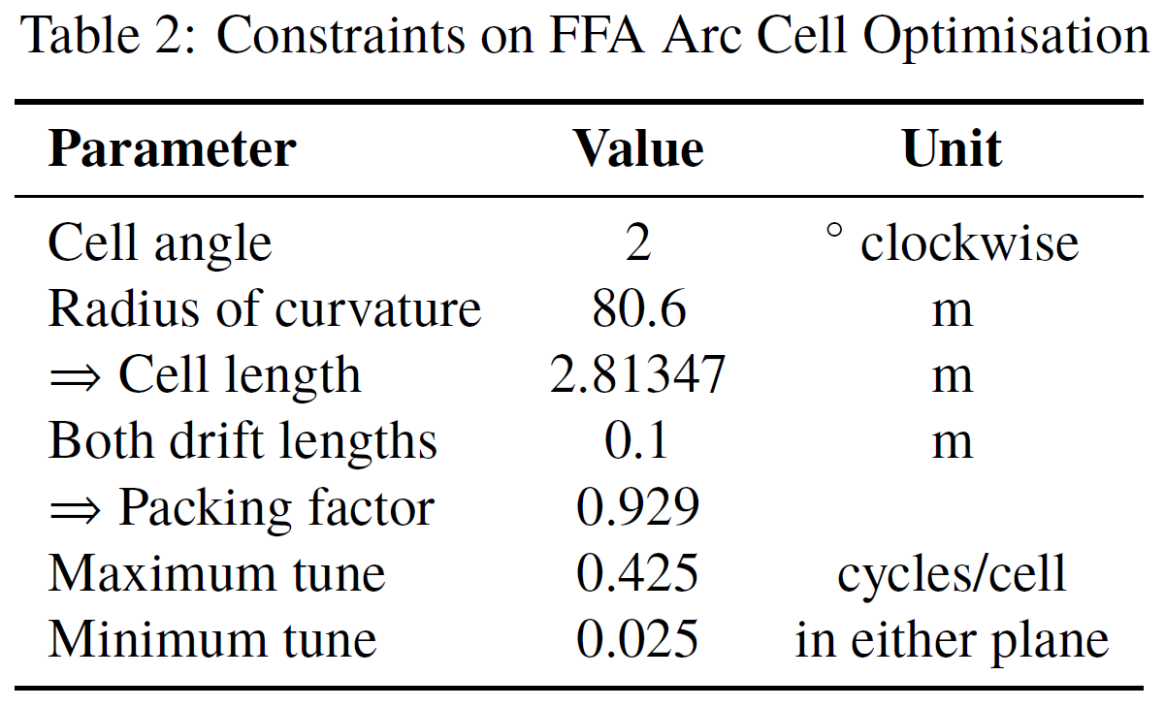
Permanent Magnets for the CEBAF 24GeV Upgrade
S.J. Brooks {sbrooks@bnl.gov}, Brookhaven National Laboratory, Upton, NY, USA
S.A. Bogacz, Thomas Jefferson National Accelerator Facility, Newport News, VA, USA
Abstract
An upgrade of the CEBAF facility to double its present energy of 12GeV has been proposed. To provide double the number of linac passes using the existing five stacked arc beamlines, some beamlines are replaced by fixed-field accelerator (FFA) arcs, allowing multiple energies to pass through the same magnets. A solution is presented in which two of the existing electromagnetic beamlines are replaced with permanent magnet non-scaling FFA arcs, as demonstrated at CBETA. The two-stage design reduces peak magnetic field and synchrotron radiation loss compared to using a single stage. FFAs do not pulse their magnets, making permanent magnets a promising and power-efficient technology option. However, the magnetic field requirements are still at the high end of accelerator permanent magnets produced thus far (1.6T peak on beam), while the magnets must also be combined-function, having a gradient with a dipole offset. Designs using a novel oval aperture and open midplane within an adapted Halbach magnet are presented.
Energy Ranges
The CEBAF linac energy will be varied from 925 to 1090MeV to give a continuous energy range with different numbers of FFA turns. The injector will be upgraded from 123MeV to 650MeV. The total arc passes on each side of the machine is increased from 5 to 11.
Arc Cell Constraints
An optimisation was performed to try and find arc cells with minimal maximum field on any energy's closed orbit centroid.
Arc Cell Lattices
The cell lattice is BF-O-BD-O using combined function magnets. Below is the cell for FFA2 in the two-FFA, 5+3 turn option, with the orbits exaggerated transversely by 64×.
Arc Cell Performance
Maximum field on beam centroid, as a function of energy in the various FFA options.
Energy lost to synchrotron radiation in different FFA options.
Permanent Magnets
Permanent magnets were designed for the two-FFA, 5+3 turn option with the highest performance. The magnet designs include open midplanes to allow synchrotron radiation to escape and use an oval-shaped modified Halbach design for greater efficiency with a horizontal orbit span.
Magnet cross-sections with 1cm grid. Blue arrows denote magnetisation direction.
Sensitivity to demagnetisation in the FFA1 BD magnet, given by field antiparallel to the magnetisation direction, -µ₀H·M/|M|. Black is 0 to 0.5T, green ≤1T, yellow ≤1.5T and red >1.5T. Magneta indicates parallel field.
BF
23GeV
BD
16GeV
FFA1 BF
FFA1 BD
FFA2 BF
FFA2 BD

