Slide 1
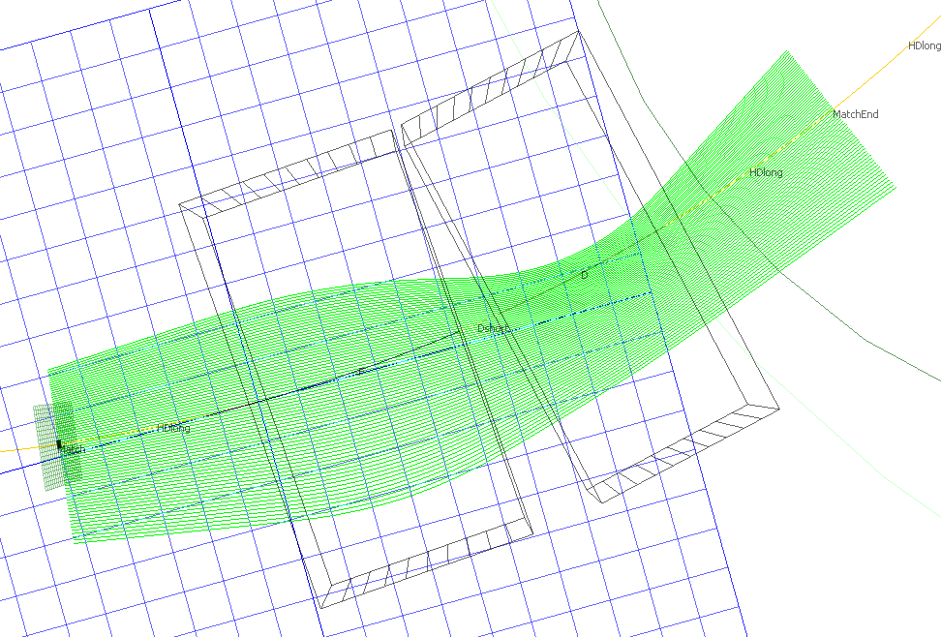
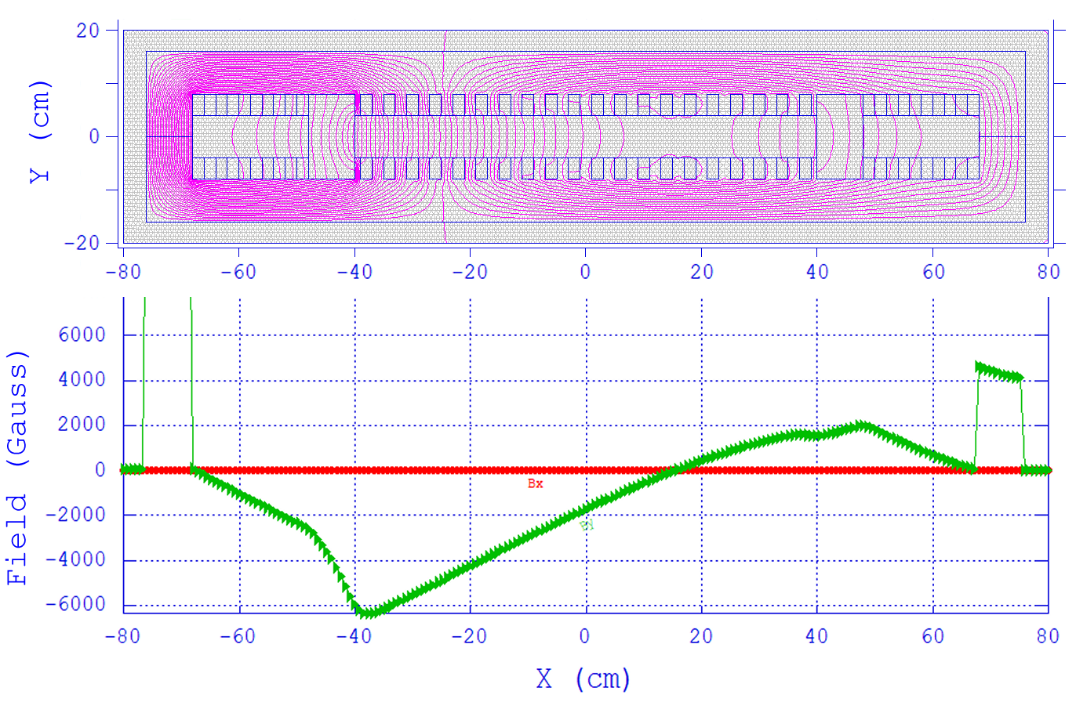
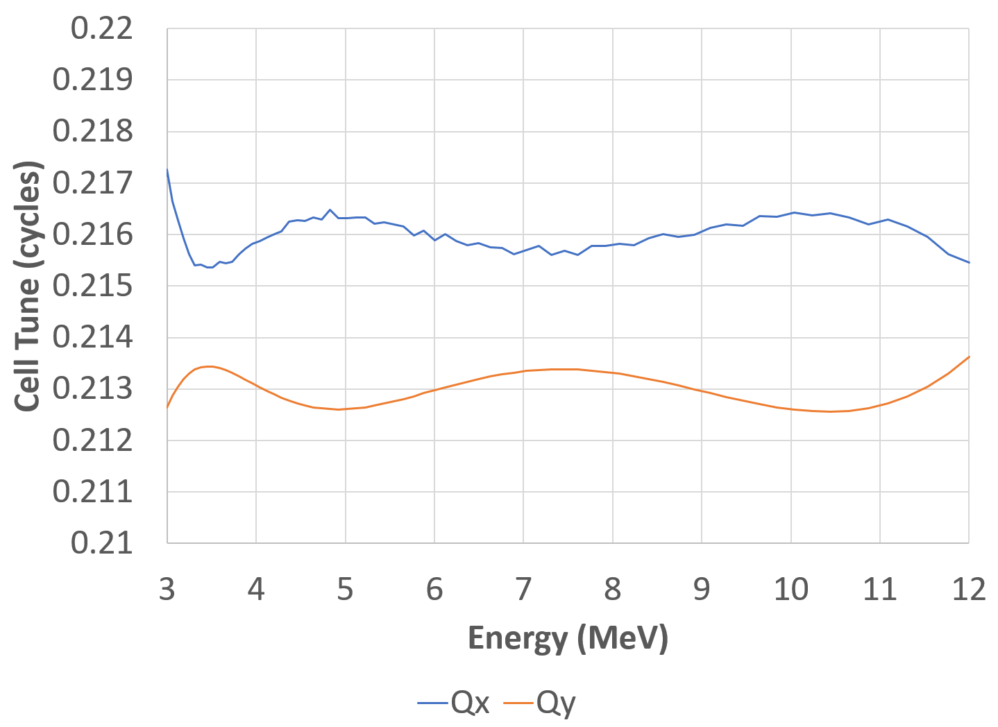
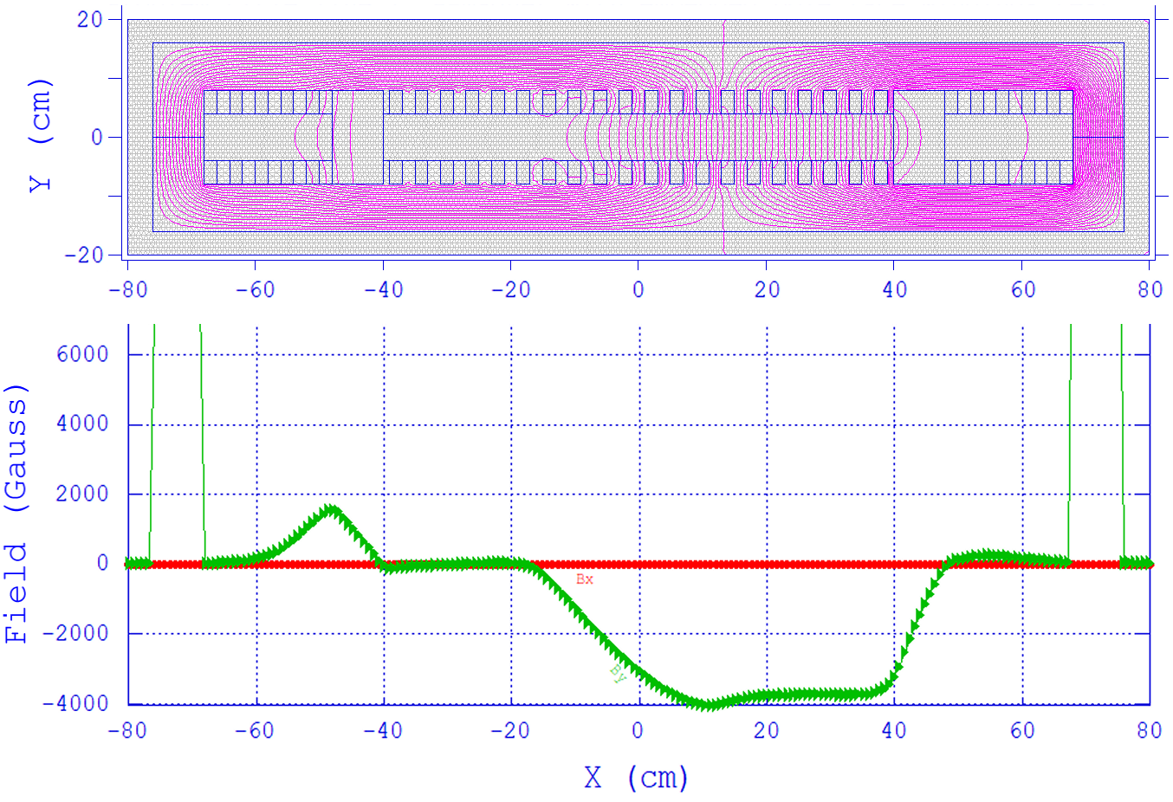
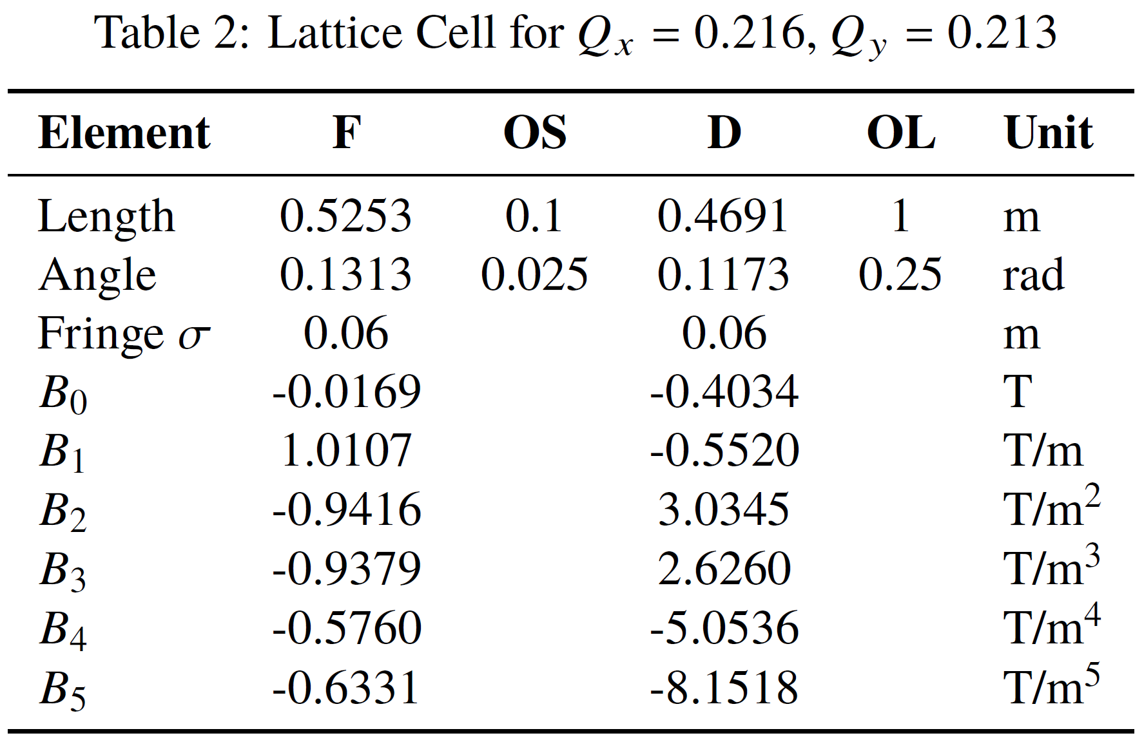
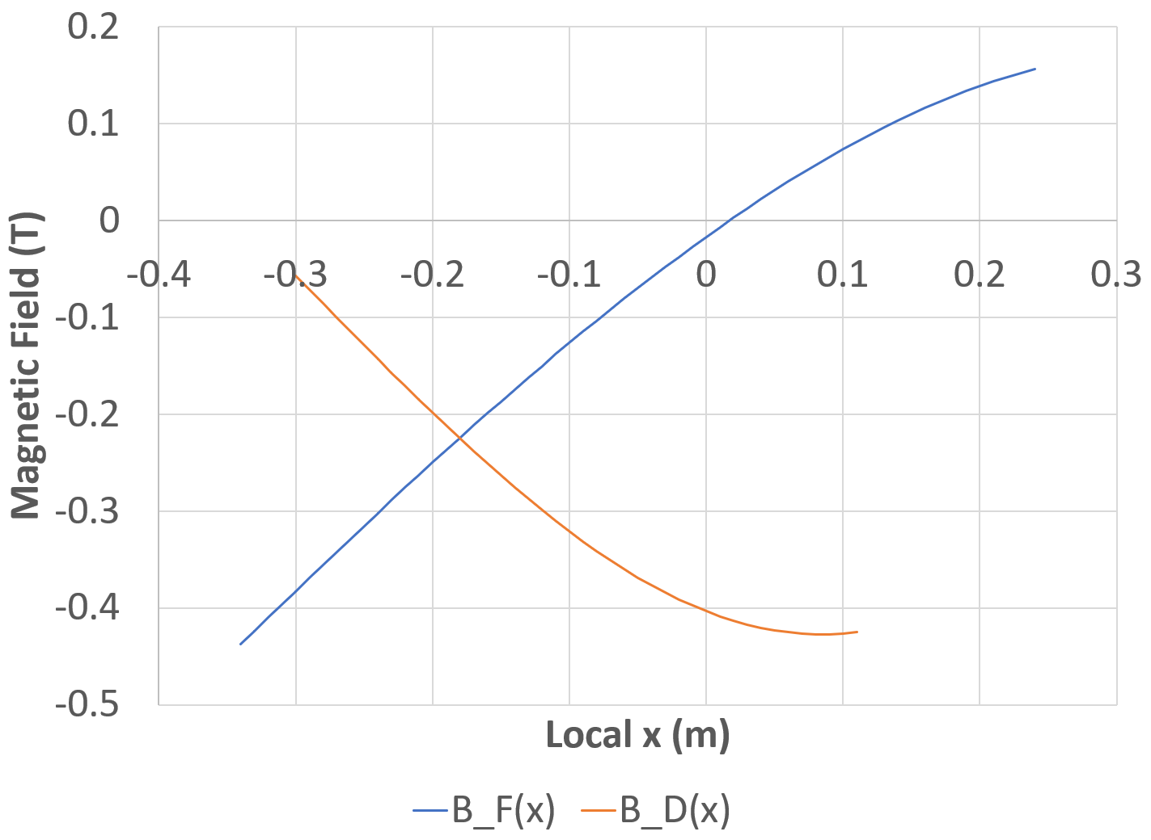
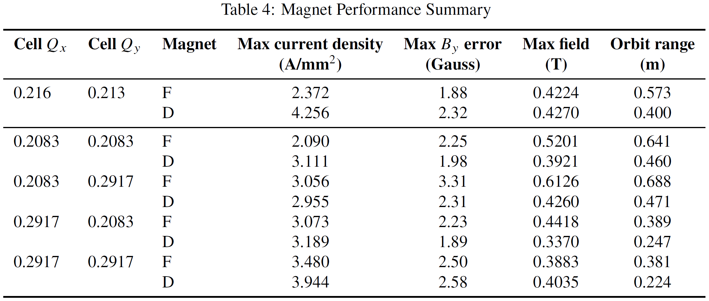
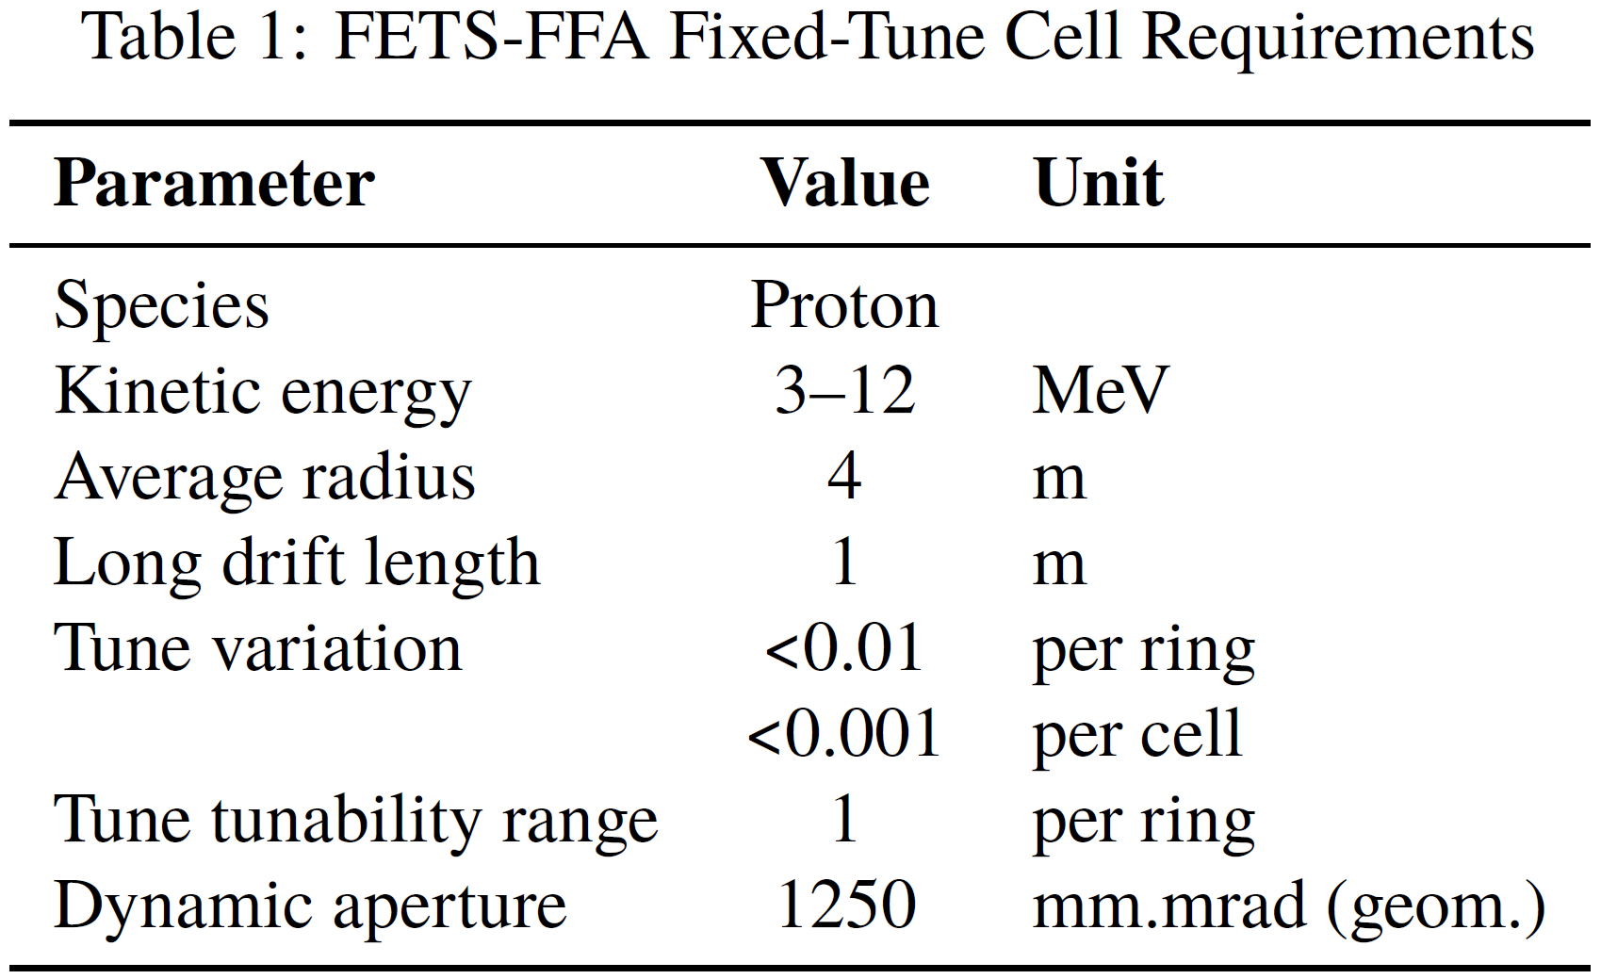
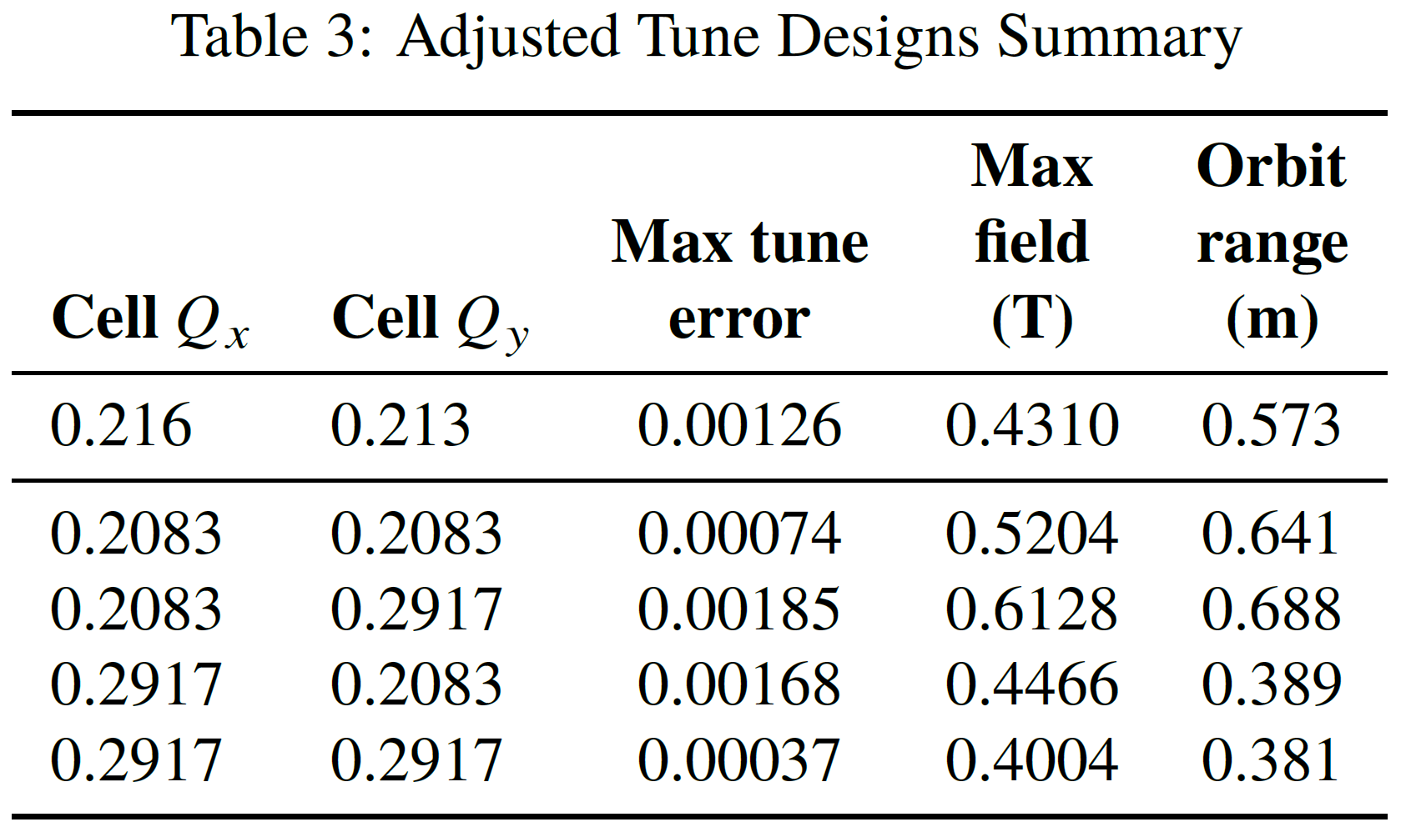
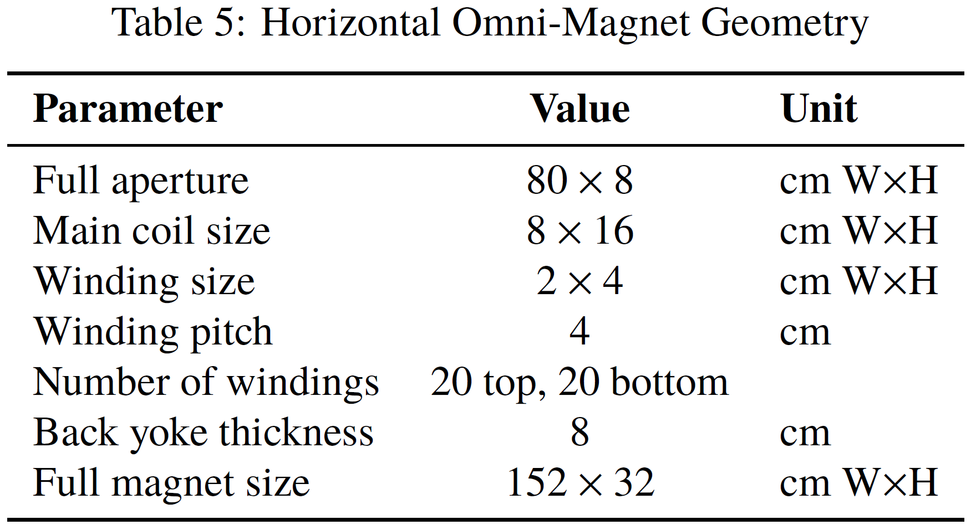
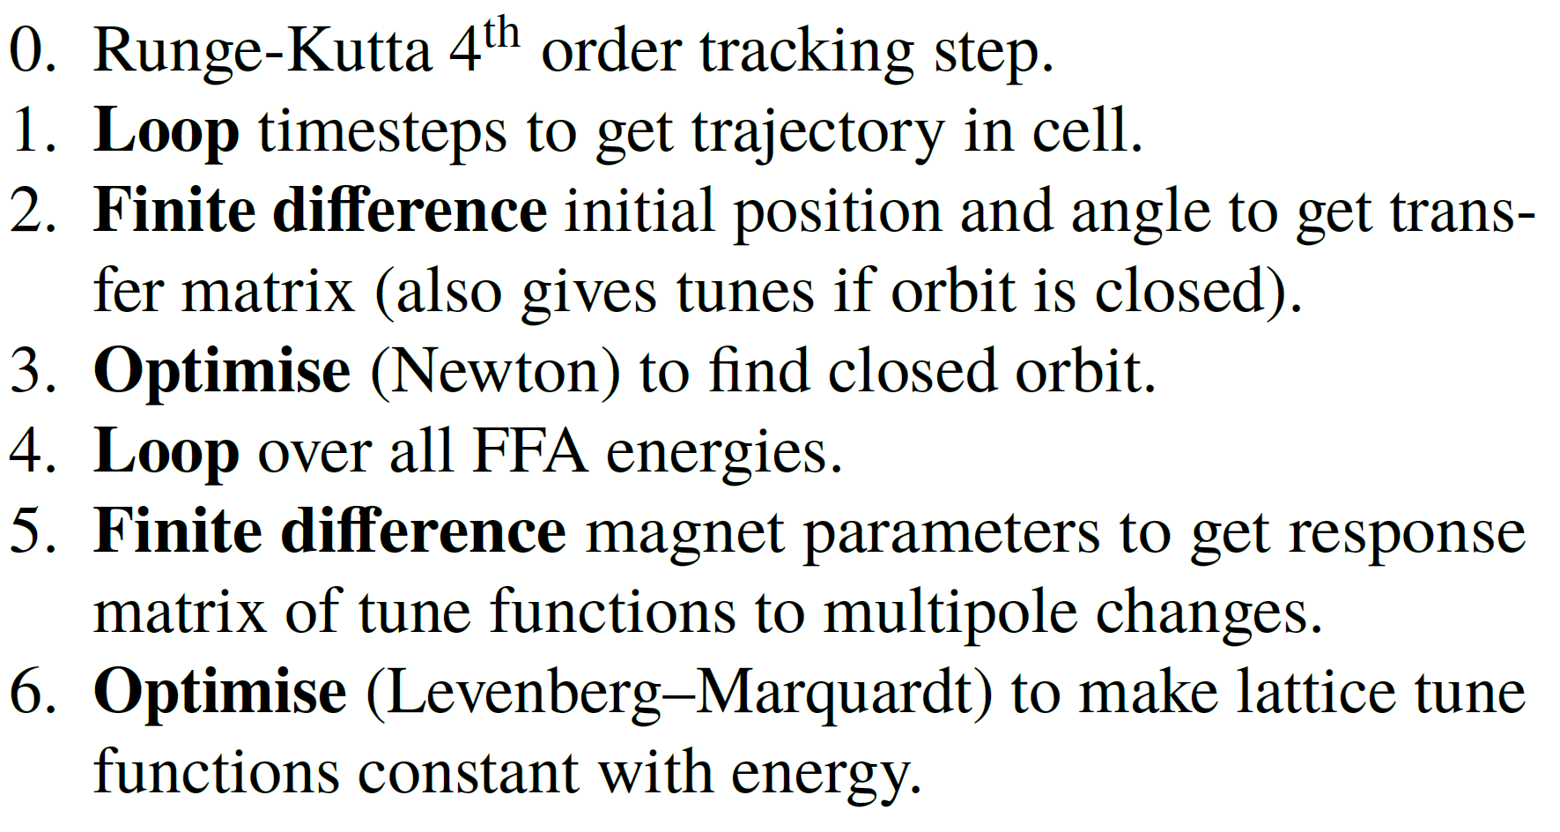
Non-Scaling Fixed-Field Proton Accelerator with Constant Tunes
S.J. Brooks {sbrooks@bnl.gov}, Brookhaven National Laboratory, Upton, NY, USA
Abstract
Recent studies by Dejan Trbojevic have confirmed that Non-Scaling Fixed Field Accelerators (NS-FFAs) can have their tune dependence on momentum flattened by adding nonlinear components to the magnet fields, although not necessarily for an unlimited momentum range. This paper presents such a cell suitable for the proposed 3−12 MeV FETS-FFA proton R&D ring at RAL.
The nonlinear magnetic field components are found automatically using an optimiser and settings covering a ring tune range of one unit in both planes independently are attainable. A fully configurable magnet with multiple windings across its horizontal aperture has been designed in 2D using Poisson, which can produce the required nonlinear fields without exceeding 5 A/mm² current density.
Introduction
The ISIS-II project plans to use a fixed-field accelerator (FFA) to increase the proton beam power driving the neutron source at RAL to ≥1.25 MW from its present ∼200 kW.
A prototype FFA using the 3 MeV proton beam from the Front End Test Stand (FETS) at RAL is being designed to test beam dynamics under realistic space charge levels and machine errors. This R&D ring is called FETS-FFA.
Near-constant ring tunes are desirable for accelerating beams with high space charge levels to avoid resonances. Scaling FFAs guarantee this via a scaling law, but are less magnetically efficient because they always include a reverse bend. In this paper, an efficient non-scaling FFA solution with a fixed tune is found for FETS-FFA.
By adding higher-order multipoles to a linear non-scaling FFA cell, the sextupoles can cancel the first tune derivative dQ/dE, the octupoles can cancel d²Q/dE² and so on. This eventually leads to a very flat tune dependence, at least over a finite energy range.
Requirements
Algorithm Nested Loops
Fixed-Tune Cell
(Above) Closed orbit range in the Q_{x}=0.216, Q_{y}=0.213 cell, from 3–12 MeV (top to bottom).
(Below) Tune variation with energy in the cell.
The cell lattice including multipole components for each magnet is shown below (left), with the fields plotted as a function of transverse position (right).
Adjustment of 1 in ring tune (0.0833 in cell tune) is required for R&D purposes. The table below shows fixed-tune cells from the algorithm for all four “corners” of the adjustment range.
Mid-Plane Field Model
The field at y=0 in the magnets is defined by:
Horizontal Omni-Magnets
Tune adjustment in FETS-FFA requires independently adjusting all multipoles of each magnet: an unusual requirement. A magnet with many embedded pole-face coils was designed to provide universal field adjustment capability.
Field lines (top) and mid-plane field (bottom) for the F magnet of the Q_{x}=0.2083, Q_{y}=0.2917 cell, which has the largest peak field and orbit excursion.
Field lines and mid-plane field for the D magnet of the Q_{x}=0.2917, Q_{y}=0.2917 cell, which has the smallest orbit excursion. Field is only produced in a fraction of the aperture.
Conclusion
Non-scaling FFA cells with tunes fixed to ∼10⁻³ level have been found for the FETS-FFA project.
Found by an automated algorithm.
Dynamic aperture of 400 mm.mrad (geom.)
Magnetic fields below 0.62 T on the beams, compared to >1 T in the scaling FFA.
Very promising machine type for applications with many turns and high space charge levels where resonances must be avoided.
10cm grid

