Slide 1
Ultra-low Emittance Bunches from Laser Cooled Ion Traps for Intense Focal Points

Slide 2
Ion Traps & Laser Doppler Cooling
Paul trap configuration has four AC transverse electrodes (like alternating gradient focussing) and DC longitudinal end caps
Temperature limit T_{D} = ℏΓ/2k_{B} = 0.552mK
Longitudinal trap electrodes with injection / extraction hole
Emitted in random direction
Transverse trap electrodes
⁴⁰Ca⁺
397nm photon
Ions
Linewidth Γ = 2π*23MHz, frequency f = c/397e-9 = 755THz
Active over velocity range ~ c(23MHz/755THz) = 9.1m/s
Tune so that force pushes more on ions moving towards laser
Laser

Slide 3
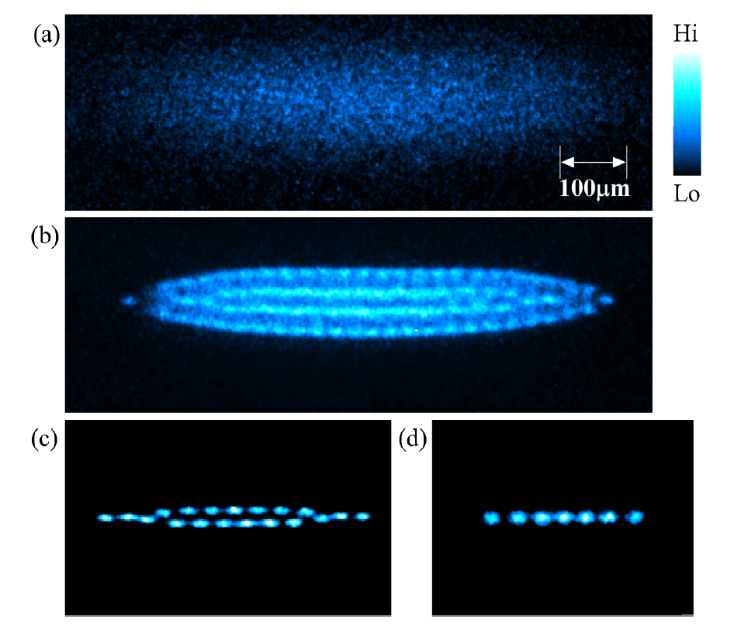
S-POD, IBEX experiments
Fluorescence of Coulomb crystal in S-POD trap, from K. Izawa et al., J. Phys. Soc. Jpn., Vol. 79, No. 12 (U.Hiroshima)
The IBEX Paul trap (RAL) with vacuum chamber opened. The four rods in the center of the image are the transverse trap electrodes.

Slide 4
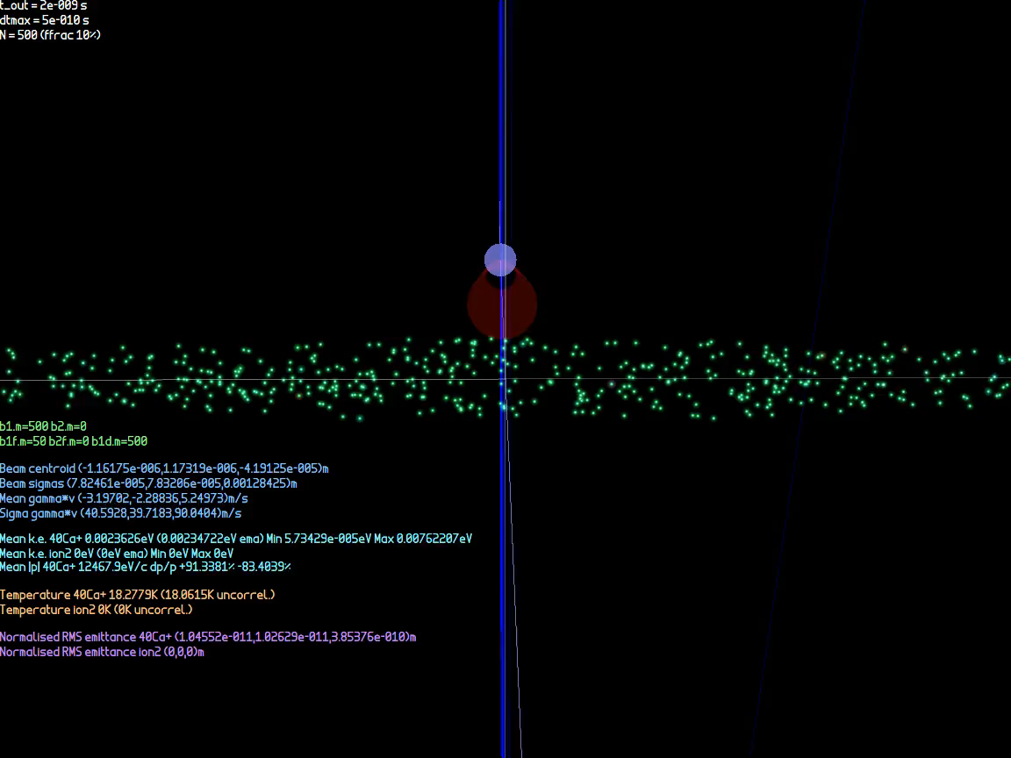
Laser Doppler Cooling Simulation

Slide 5
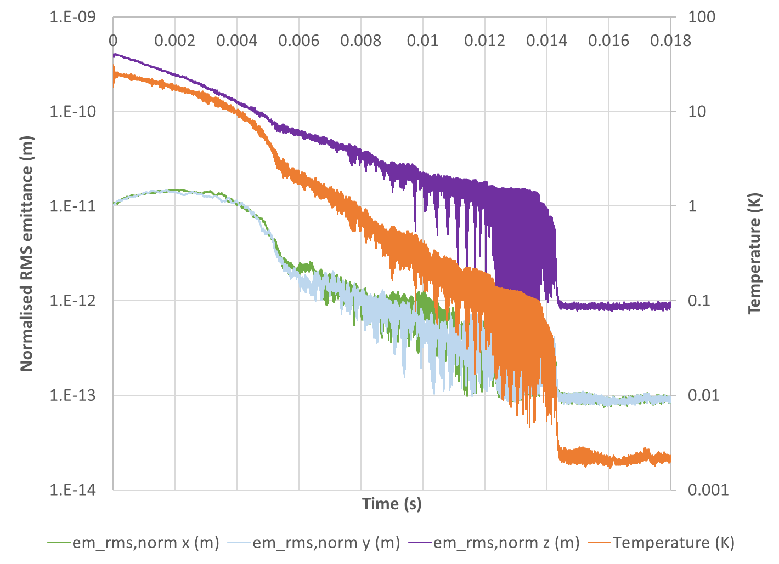
Laser Doppler Cooling Simulation
N = 500 ions

Slide 6
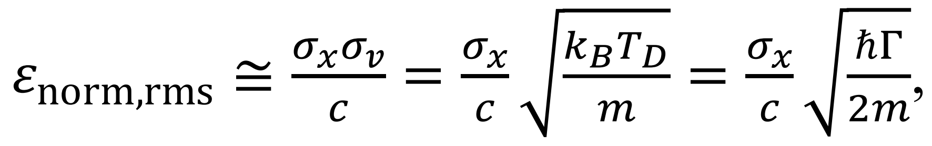
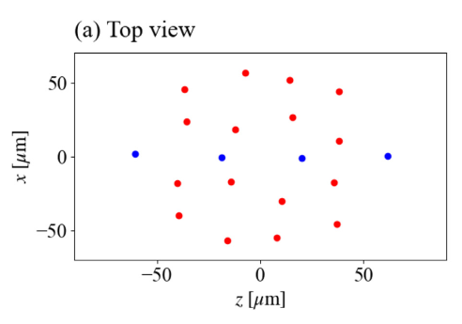
Ion Trap Flexibility
Flexible source with variable parameters over wide range:
Bunch charge (1 to 10⁷ ions)
Via gas pressure, trap voltage
Bunch size, aspect ratio, shape
Via trap voltages, trap geometry, collimation
Emittance/temperature
Stop cooling part way, or tighten trap (→ quantum limit!)
Ion species
Use sympathetic cooling - mix coolable ion e.g. ⁴⁰Ca⁺ ion in contact with desired species
Easily exchangeable electrode configurations
Martin et al., New J. Phys. 21 (2019) 053023
IBEX 10⁶-10⁷
Takai et al., Japan. J. Appl. Phys. 45, No. 6A (2006) 5332-5343
S-POD 1-10⁷
ε_{norm,rms} ≥ ℏ/2mc
Muroo et al., PTEP2023 063G01

Slide 7
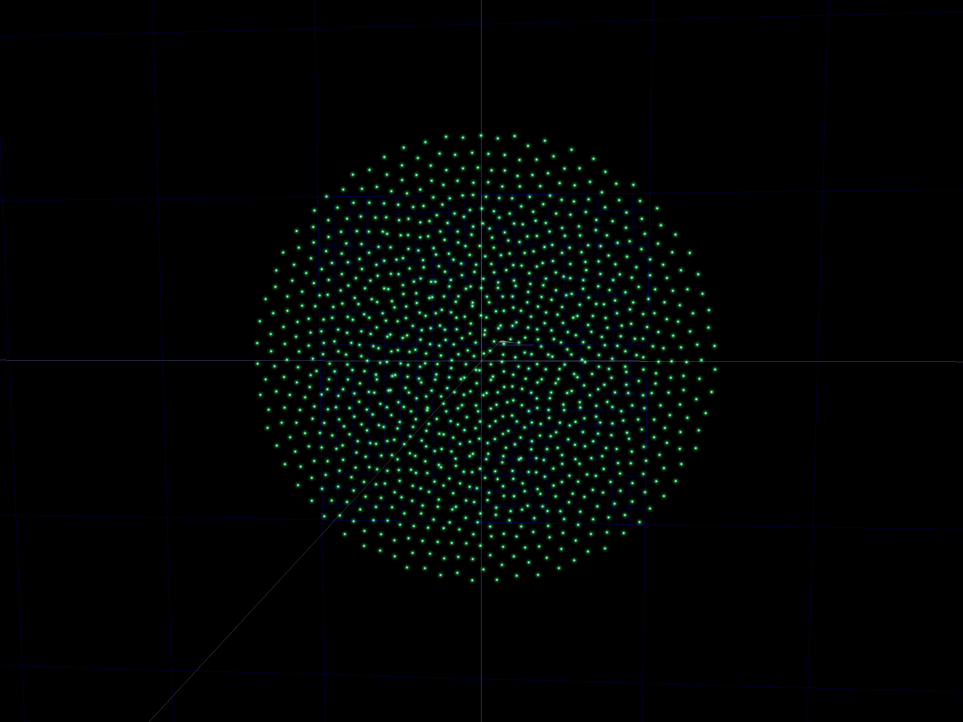
Flexibility e.g.: 2D Coulomb Crystal
Made the transverse trapping voltages much smaller than the longitudinal

Slide 8
What do we do with this beam?
p or γv
p or γv
Accelerate to
1000GeV/u
Focus with
σ_{p}/p = σ*_{θ} = 0.01
x
x
Ion trap beam
Typical ion source beam
Parameter | Ion source | Ion trap
N | 10⁹ | 500
ε_{norm,rms} | 10⁻⁷m | 2×10⁻¹³m
σ_{x} | 1mm | 90μm
σ_{v} | 30km/s | 0.65m/s
T | 4.3MK | 2mK
Parameter | Ion source | Ion trap
N | 10⁹ | 500
ε_{norm,rms} | 10⁻⁷m | 2×10⁻¹³m
σ*_{x} | 9.4nm | 18fm
σ*_{θ} | 10mrad | 10mrad
L/bunch | 9×10²⁸cm⁻² | 6×10²⁷cm⁻²

Slide 9
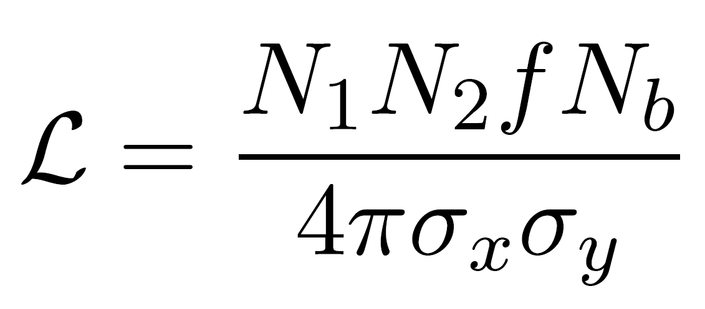
High Specific Luminosity Scaling
Luminosity is held constant if N ∝ σ∗
If σ*_{θ} is also held constant, that’s N ∝ σ∗ ∝ ε
But luminosity per ion increases at smaller N
6×10²⁷cm⁻² from 2×500 ions is 130,000 times more efficient than 9×10²⁸cm⁻² from 2×10⁹ ions
In fact the ion trap saturated the cross section
If σ_{tot} > 84mbarn, then >500 collisions expected
One pass and it’s gone!

Slide 10
What’s going on in the longitudinal plane? and Other Questions
Need short bunch length for good collisions
The ion trap’s emittance is small in all three planes
The bunch seems pretty “opaque”, does it self-interact?
Space charge repulsion prior to the focus?
Why don’t collider interaction points create a sharp focus all three space planes?
Is that even possible?
Yes, but relativity reduces longitudinal Δv_{bunch rest frame}

Slide 11
Bunch Implosion Radius Limits
Model: imploding uniform sphere of charge in the bunch’s rest frame
Space charge dictates r ≥ 1/(4πε₀) Nq²/E_{k,in}
E_{k,in} is inward kinetic energy at sphere surface
Density ρ ∝ N/r³ ∝ E_{k,in}³/N²
Emittance dictates σ_{x} ≥ ε_{norm,rms}/σ_{βγ}
σ_{x} = r/sqrt(5), σ_{βγ} = (βγ)_{in}/sqrt(5)
σ_{βγ,Transv.} = (βγ)_{beam}σ*_{θ}, σ_{βγ,Long.} = β_{beam}σ_{p}/p

Slide 12
Minor Complexities
Ca⁺ will behave as Ca²⁰⁺ once nuclei are within each others’ electron clouds (no shielding)
Space charge forces for a non-spherical uniform charge density ellipsoid are actually coupled between the planes (but still linear)
Just like the 2D KV envelope space charge force
Integrated backwards from focal point and fitted focal ellipsoid size to match incoming σ*_{θ} and σ_{p}/p

Slide 13
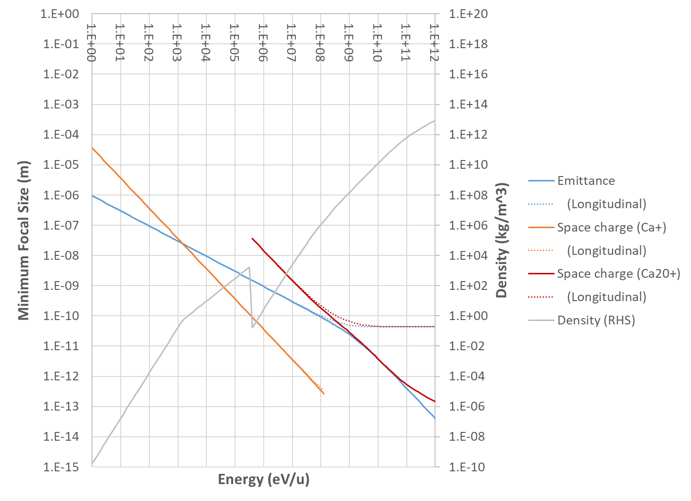
Energy Scaling Graph
Nuclear density 2.5e17
For N = 500 ions
σ_{p}/p = σ*_{θ} = 0.01
Water 1e3
Doesn’t quite get there, mainly because of longitudinal plane
Switch to using fully-stripped ion charge when orbitals touch

Slide 14
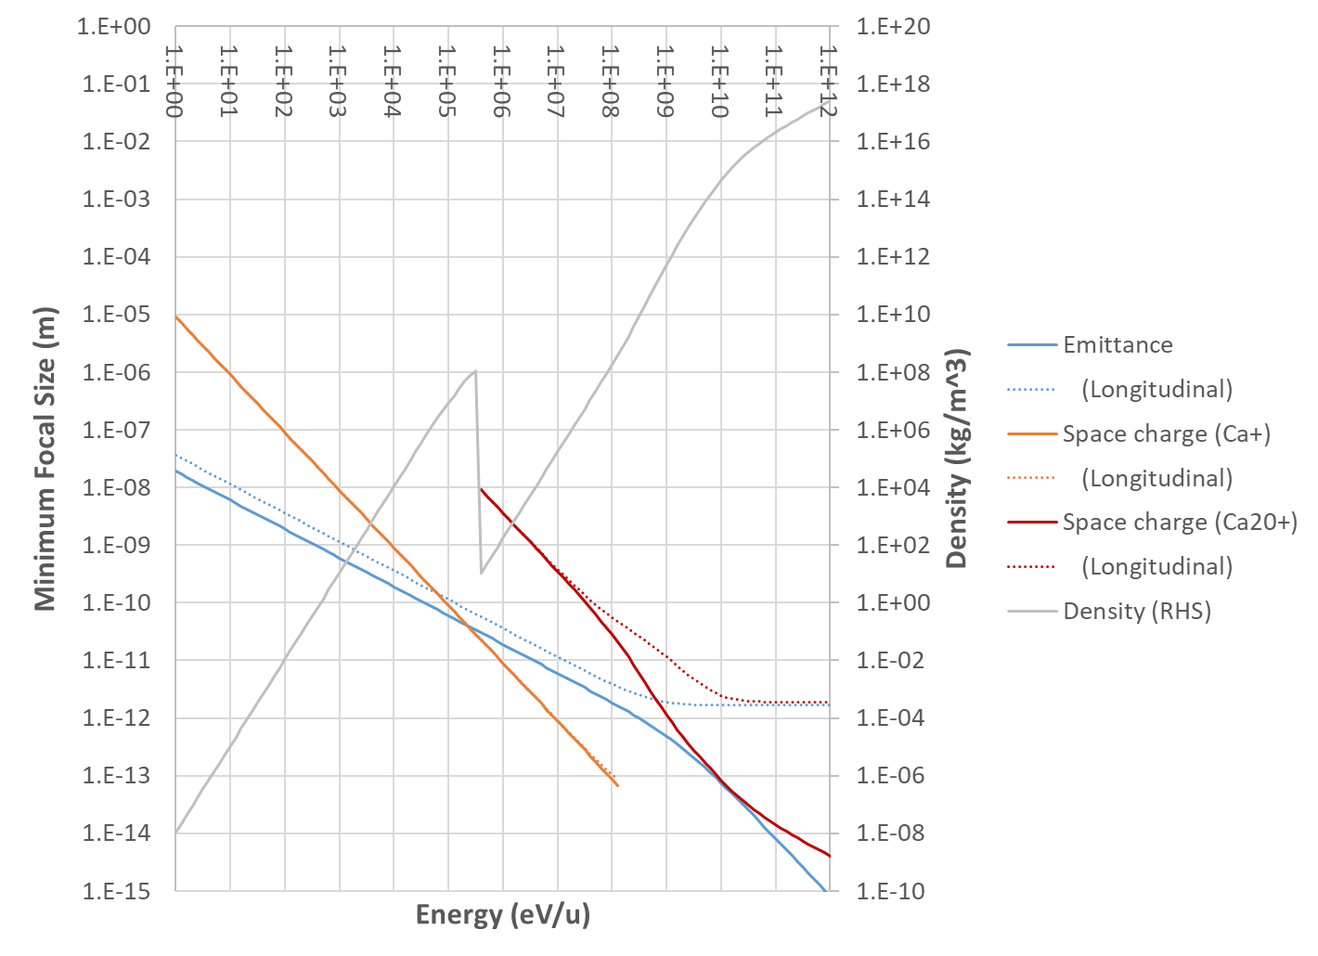
Energy Scaling Graph
Nuclear density 2.5e17
For N = 500 ions
σ_{p}/p = σ*_{θ} = 0.02
ε_{L} = 1.9ε_{T}
Water 1e3
Can fix by using a tighter ion trap with ~20× smaller emittance (not too hard) and 2× larger dp/p (helps a lot).
Colliding bunches could also work, as might an FFA channel supporting a wider dp/p.

Slide 15
Potential Future Applications
We can already accurately position objects close to the nuclear size (e.g. LIGO mirrors)
The low emittance (entropy) of the ion trap initial state allows nuclei to be placed in particular locations deliberately, e.g.:
Make white dwarf, neutron star matter
3-way and multi-way particle collisions
Synthesise custom shapes of nuclear matter
Possible neutron-rich superheavy elements

Slide 16
What can stop us?
Space charge, emittance and energy spread considerations as mentioned previously
Optical aberrations!
Lenses are not linear, spherical aberration, chromaticity etc.
Can focussing in all three planes be done?
Experimental noise, jitter etc.
Ideas for feedback using scattered pattern from interaction point
Coulomb scattering has very good resolution

Slide 17
Focussing Beamline Simulation
Test of three-plane focusing and optical aberration correction (at lower energy)
Input N=20000, T=2mK ion trap bunch parameters
Given energy chirp
Curved electrostatic beamline
Point-source ‘electrodes’
Arranged in rings of 12
Generalised multipole lenses
Goal: minimise 3D focal size

Slide 18
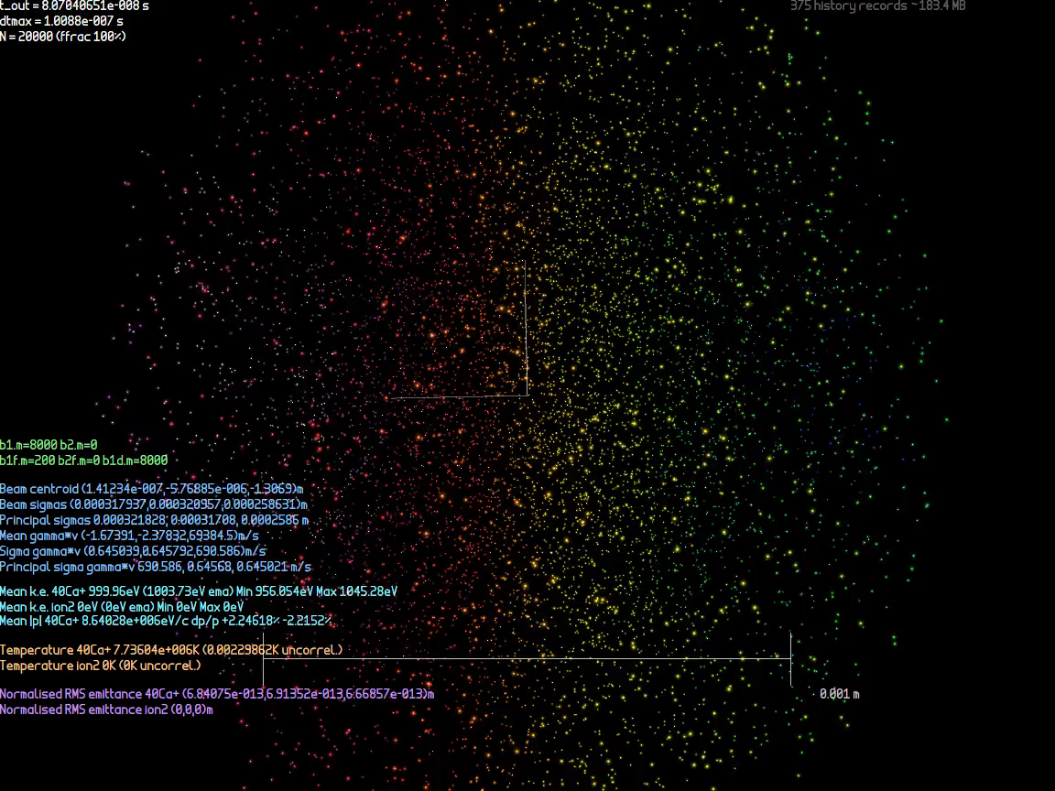
Focussing Beamline Simulation

Slide 19
Optimisation of Electrode Voltages
11 electrode charges were optimised per electrode ring (12 minus one monopole)
The bunch initial chirp was also optimised
So 15 electrode rings → 166 parameters
Used modified Levenburg-Marquardt method with nonlinearity correction
See https://arxiv.org/abs/2307.03820
Response matrix → SVD → try various damped inverses
Sample additional points to infer nonlinear behaviour

Slide 20
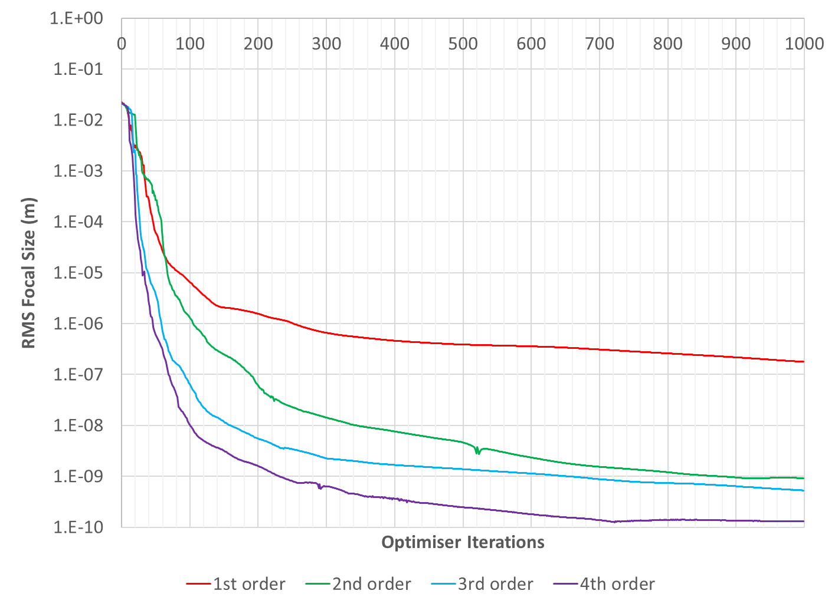
Improved L-M Optimiser

Slide 21
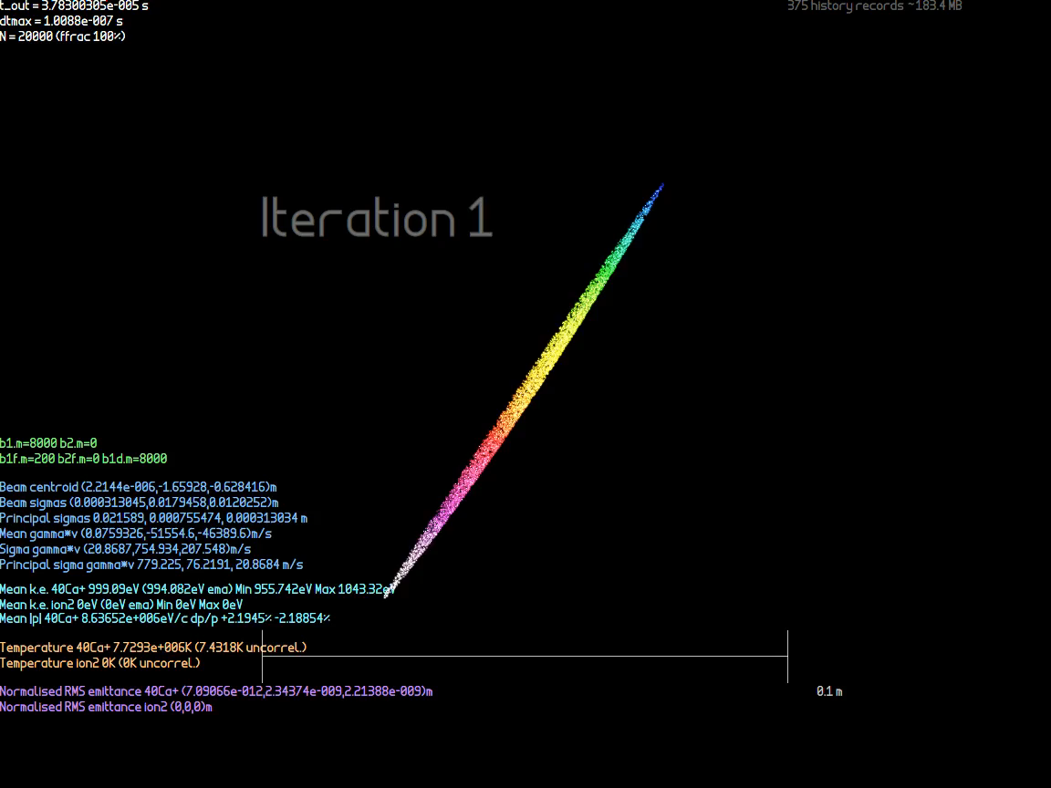
Focal Point Optimisation (T=2mK)

Slide 22

Focal Point Optimisation (T=0)

Slide 23
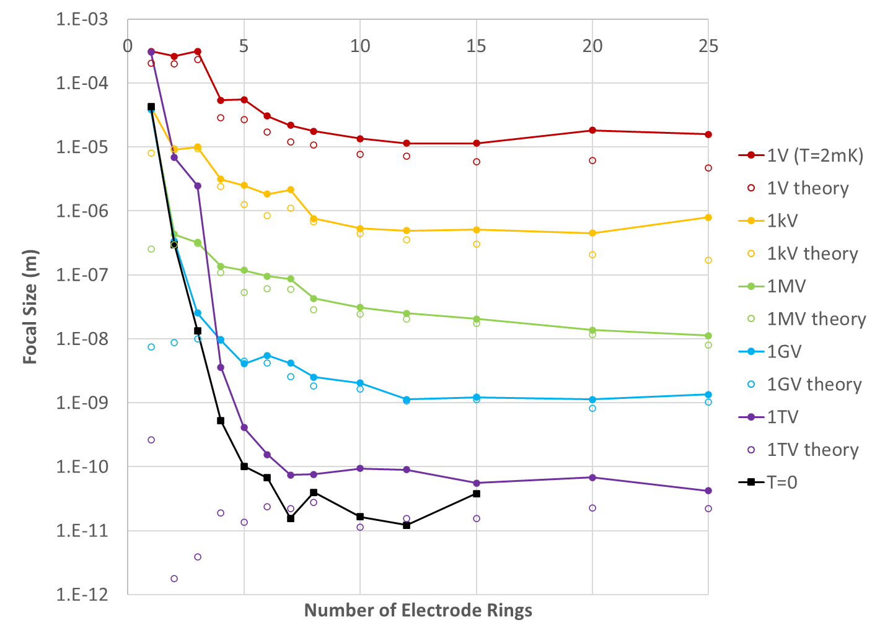
Focal Size vs. Electrodes Used
Lines are limited by normalised emittance (const.) and chosen dp/p chirp (generally increasing)
T=0 line shows limit from pure aberrations
“Theory” is the minimum allowed size taking account the emittance and chirp
Numerical accuracy floor?

Slide 24
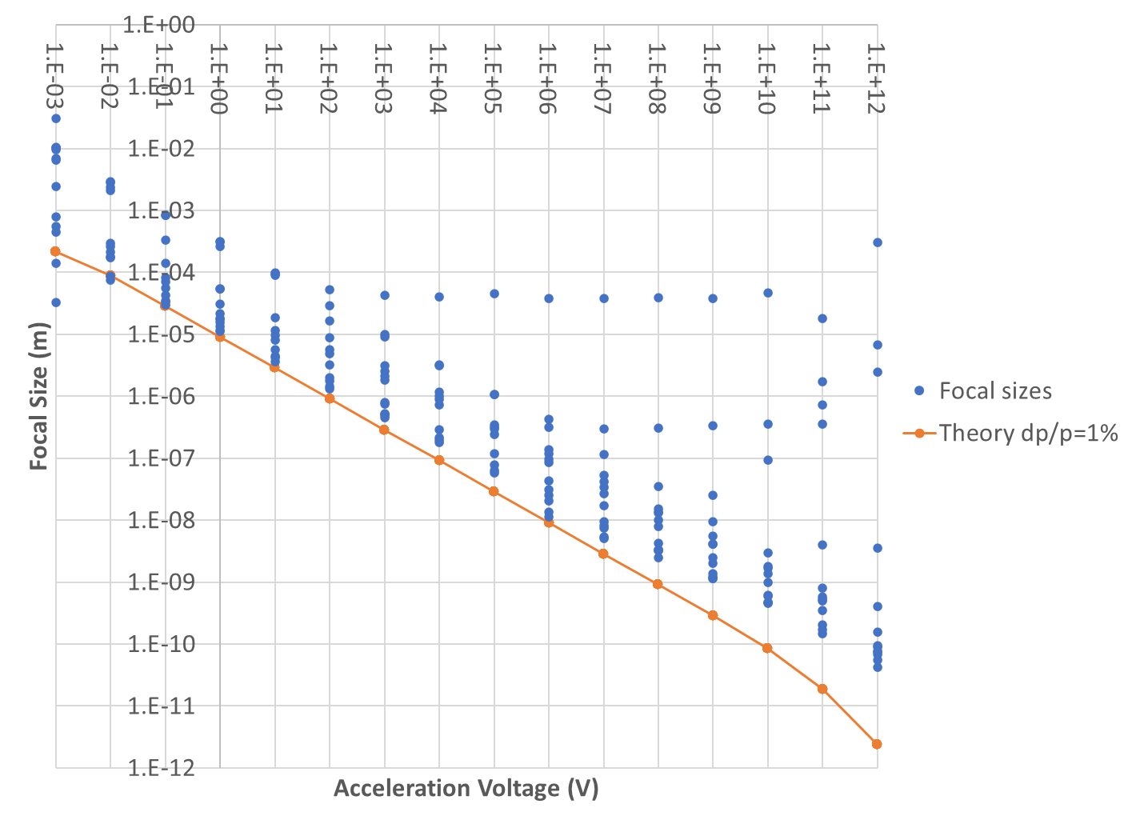
Focal Size vs. Energy
Focal sizes plotted for all numbers of electrode rings
Beamlines with only one electrode ring stop here
Two rings here
Higher energies don’t use 1% dp/p, could need more electrode rings or just be hitting numerical noise

Slide 25
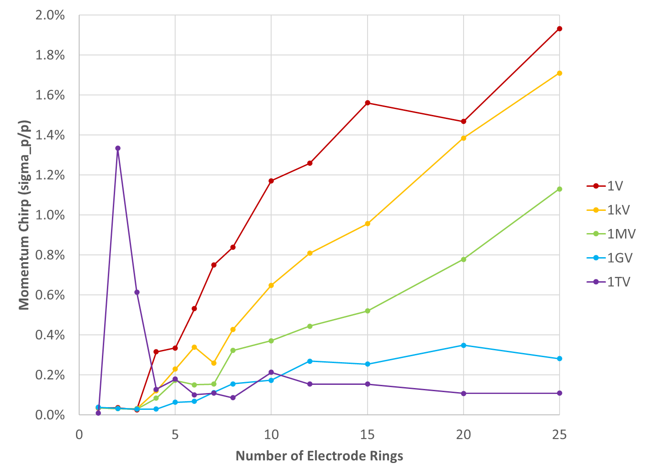
Optimal Chirp vs. Electrodes Used
As more beamline elements are allowed, optimiser can cancel aberrations for a larger momentum range
Higher energies have smaller geometrical emittance already, less incentive to increase dp/p

Slide 26
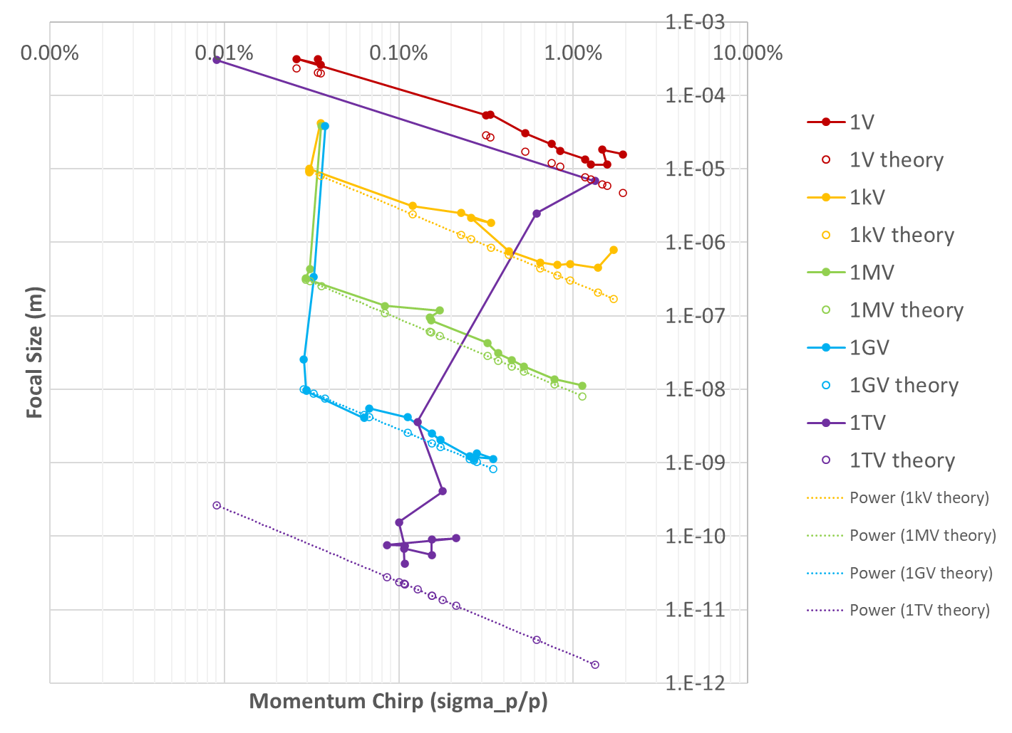
Focal Size vs. Initial Chirp
Scalings as expected, ignoring 1TV that has a bit of trouble

Slide 27
Cooling at High Energy?
Doppler cooling also works in a boosted frame
Pros:
Can create cold beams at or near final energy
Bypass jitter from RF and acceleration process
Use blue-shift to cool using harder transitions(?)
Cons:
Needs a low-intra-beam-scattering (IBS) ring lattice
Very low phase advance per cell
Bunch velocity distribution near-Maxwellian
Too much energy or field could strip ions
Ring is more expensive than an at-rest ion trap
PALLAS ring did this, but beam velocity only 2.8km/s
Schramm et al., Plasma Phys. Control. Fusion 44 (2002) B375–B387
Improves cooling rate, but increases limiting temperature

Slide 28
Increasing Current Throughput
Throughput of basic trap isn’t great
10⁷ ions every 16ms (62.5Hz) is 100pA average
But trap is small enough and 10ms is short enough that could make a CW cooling channel at a PALLAS-like speed of 50km/s
Bunches every 100ns (10MHz), spaced by 5mm
Average current could go as high as 16uA
Length of channel 16ms*50km/s = 800m
Could coil it up, trap can be narrow, rods few mm apart

Slide 29
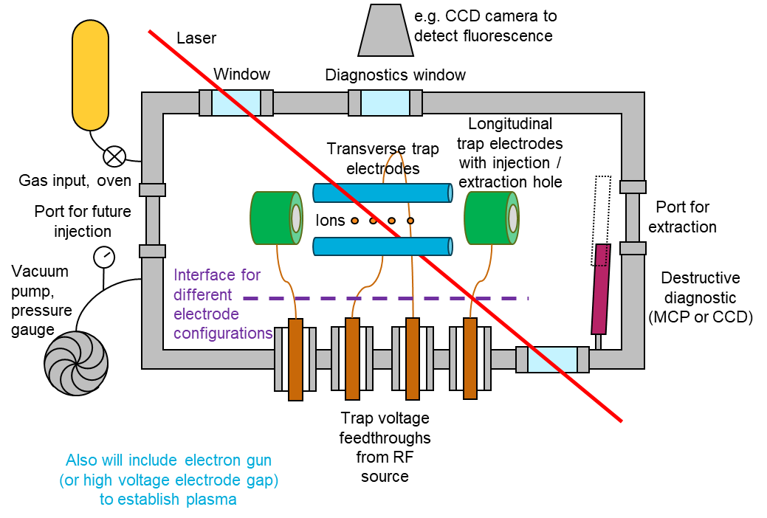
Recent Funding at BNL
Received Lab-Directed R&D (LDRD) funding at BNL, total $400k over 2 years, Oct ‘23-Sep ’25
Proposed to “construct a basic foundational system”
Probably without laser cooling to start with

Slide 30
Conclusion
Ultra-low emittance bunches provide some interesting unexplored regimes
10⁶ times smaller emittance vs. conventional bunches
Extraction into an accelerator would be new
Lower entropy initial states are going to be the long term trend as experiments improve
Can even achieve the quantum ground state
Produce e.g. entangled spin states in a beam!
Ultimately, appears capable of custom synthesis of nuclear density matter

Slide 31
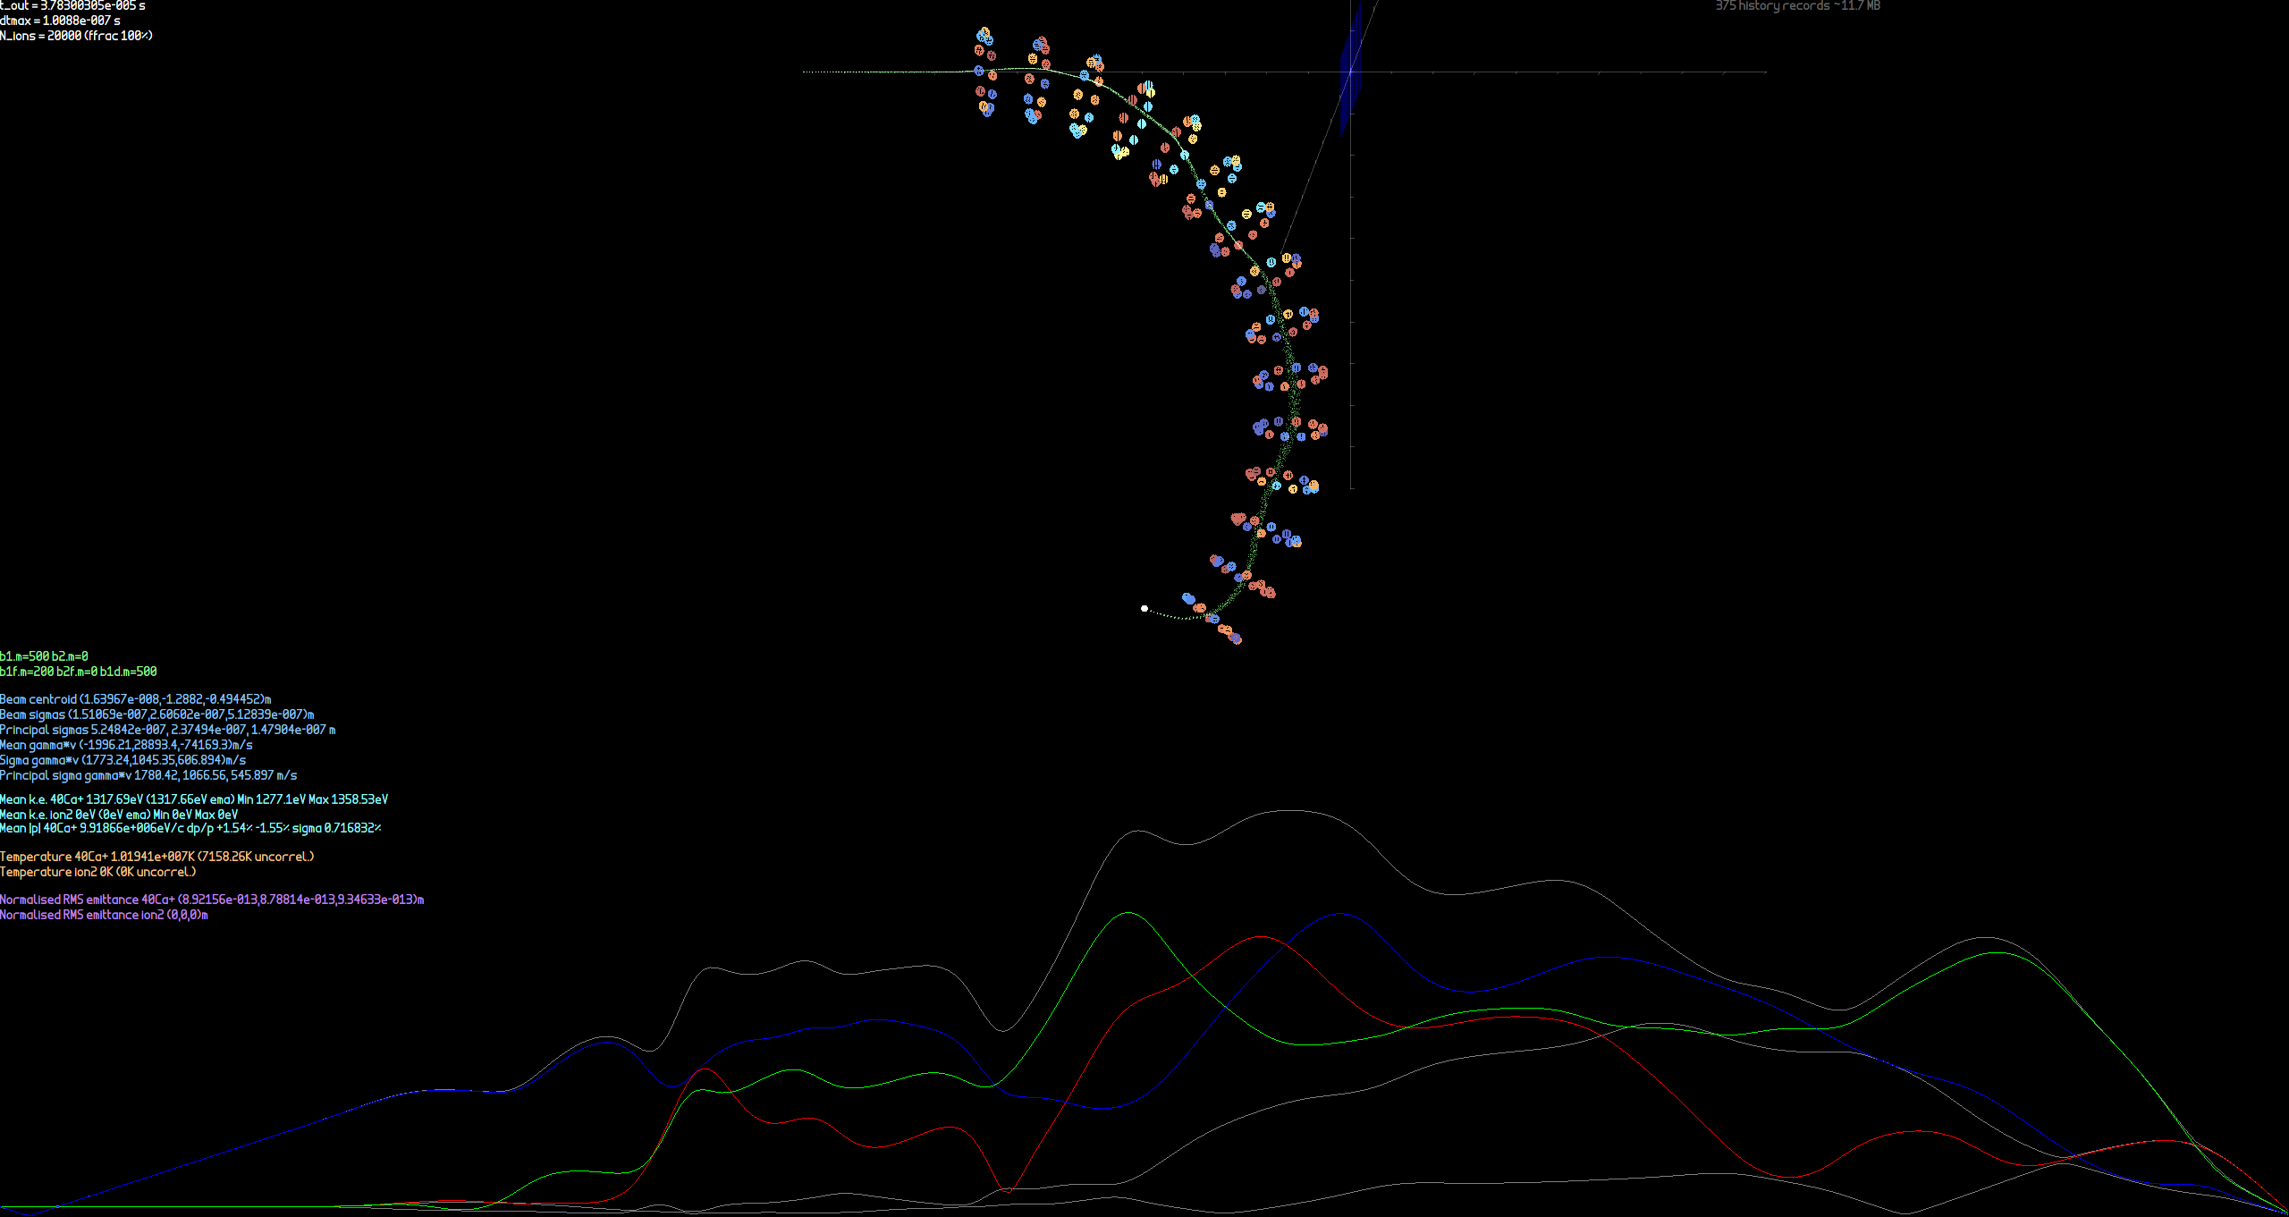
Beam sizes in focussing channel

Slide 32
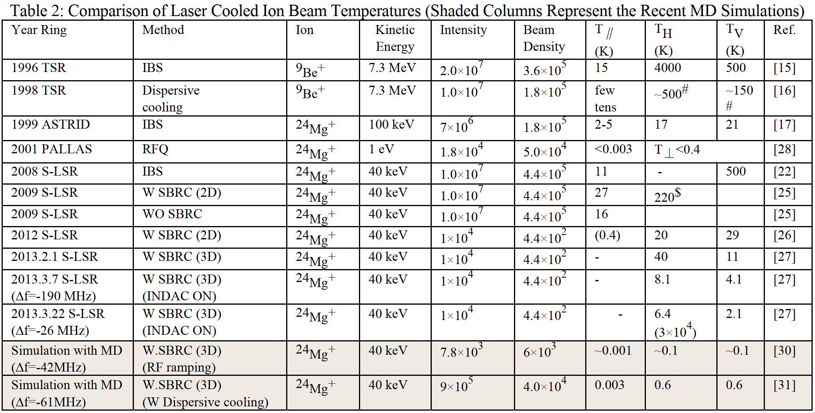
Doppler-cooled rings as of 2014
Noda et al., IPAC2014

