Slide 1
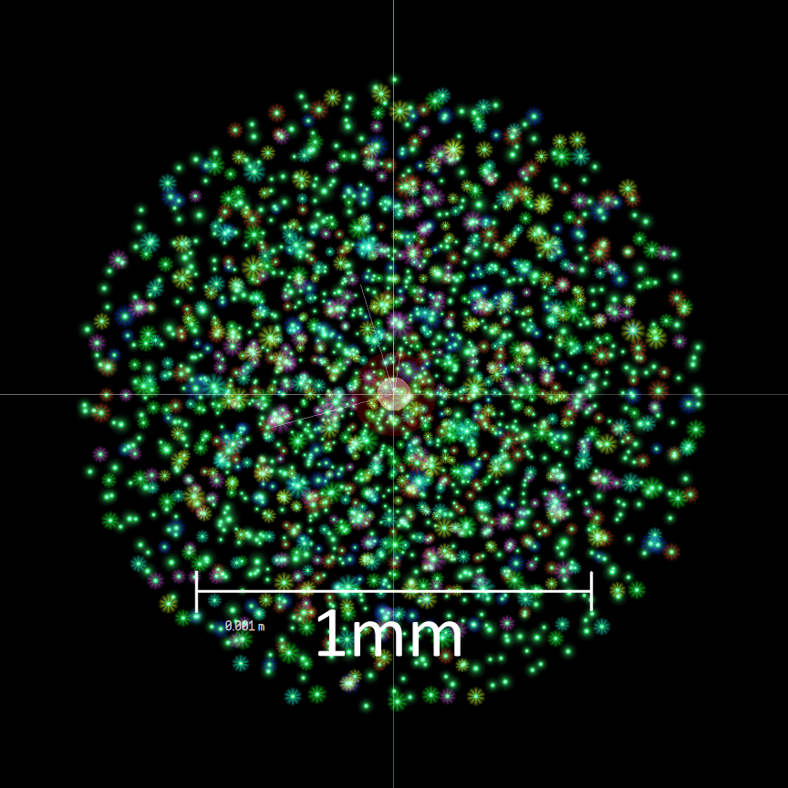
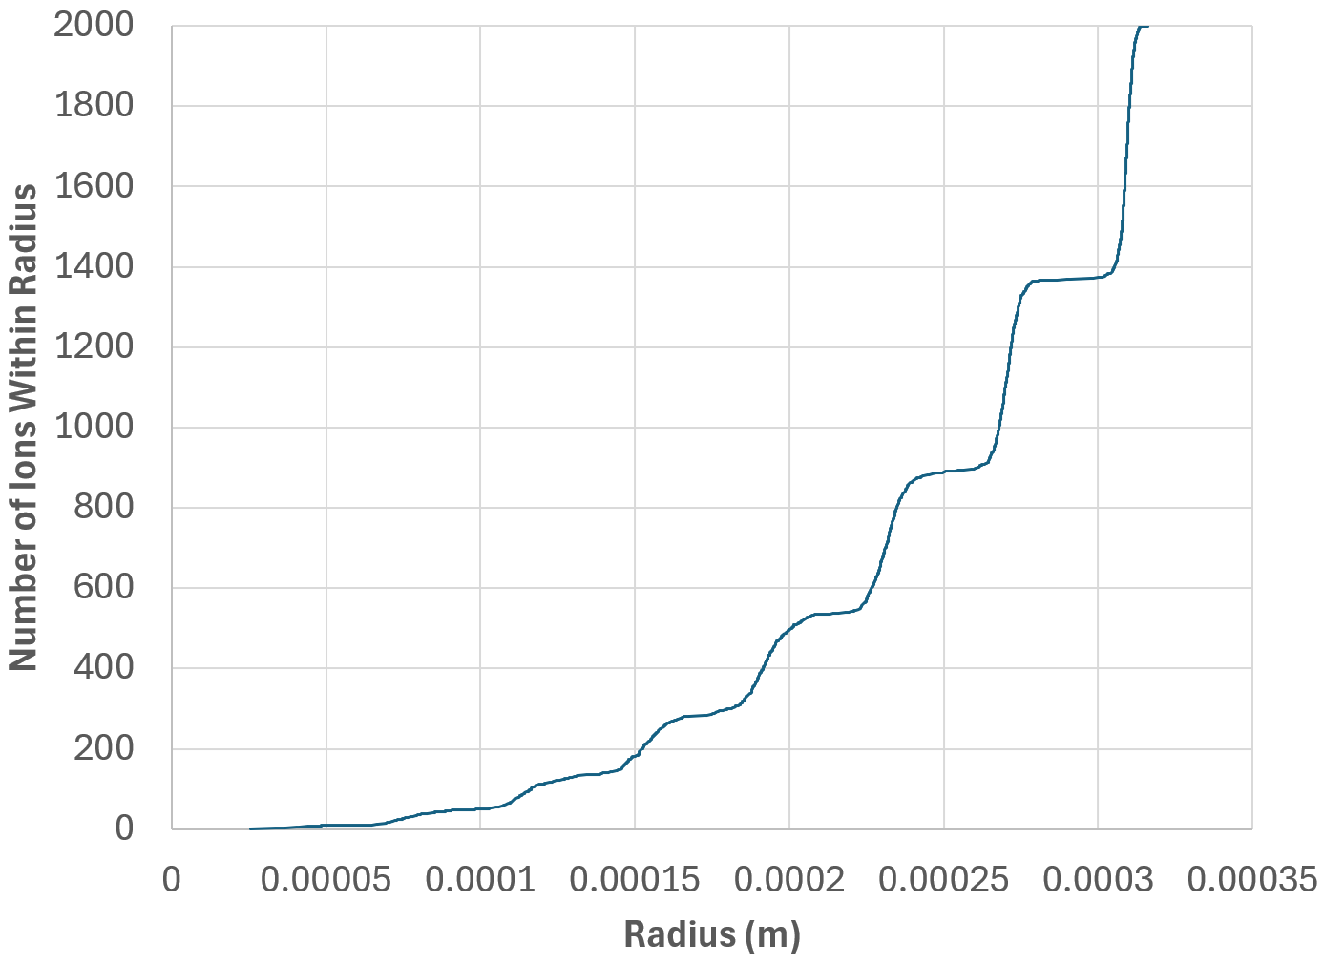
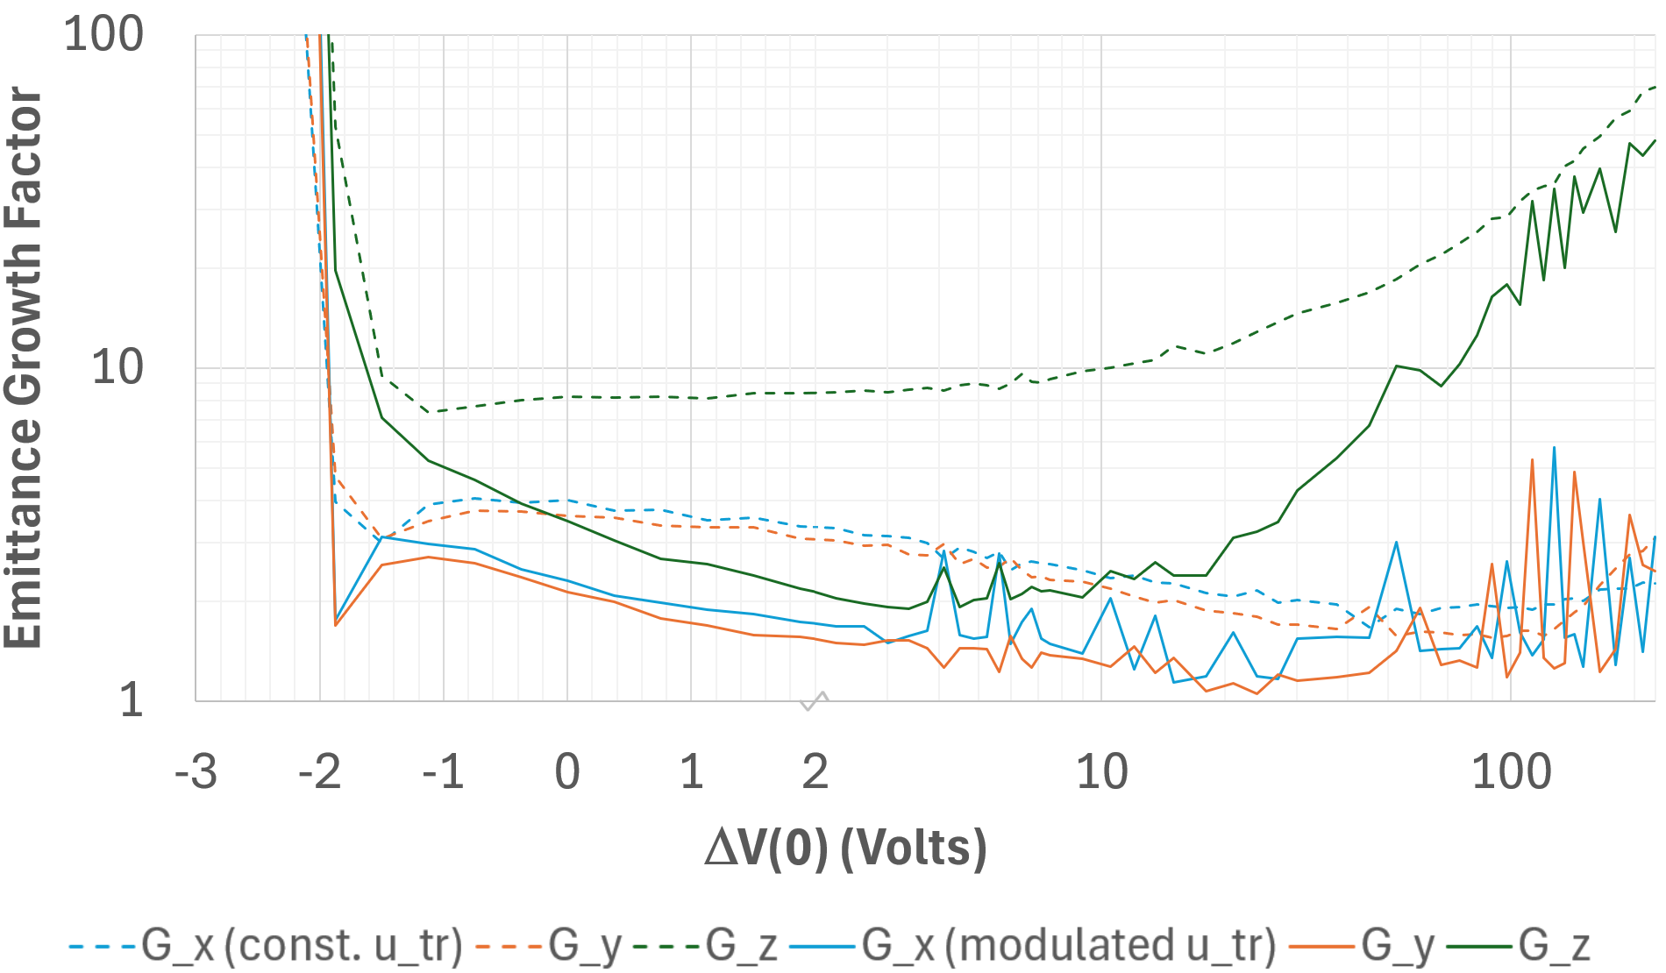

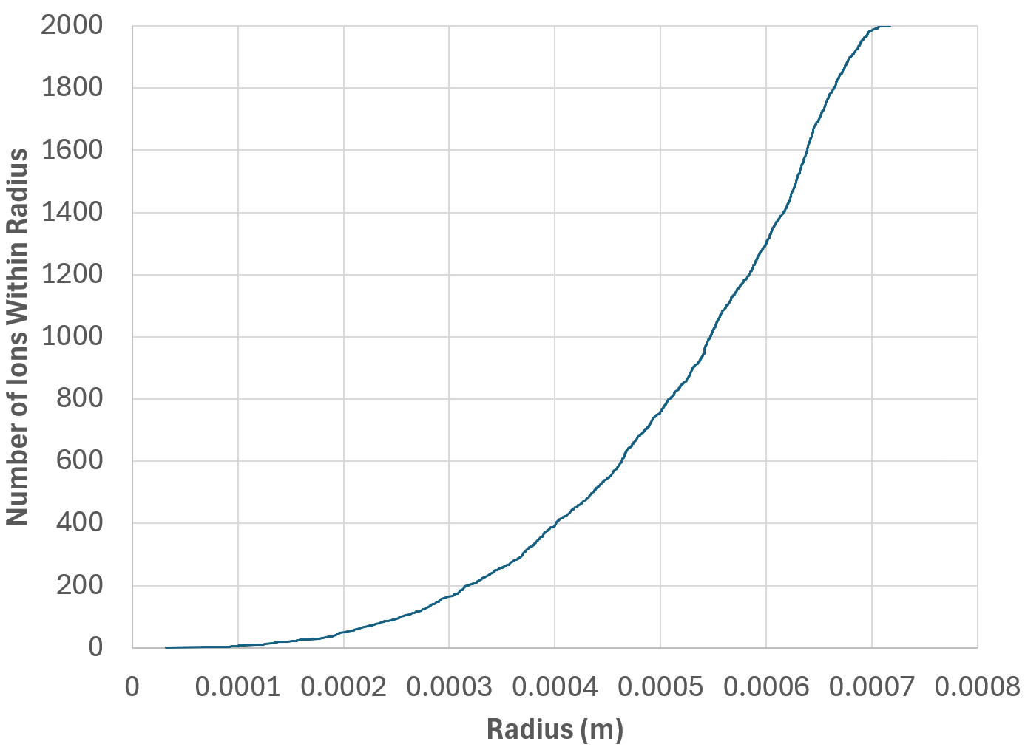
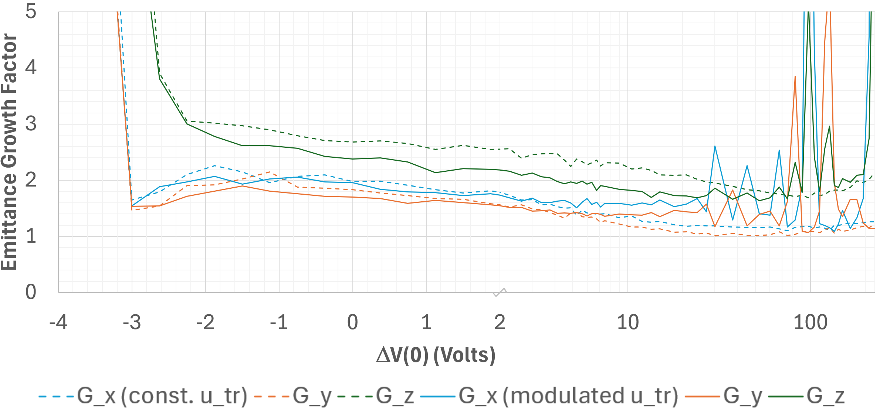
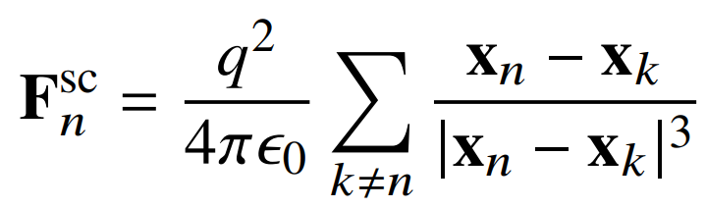
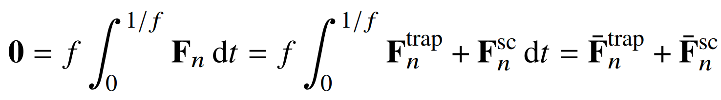
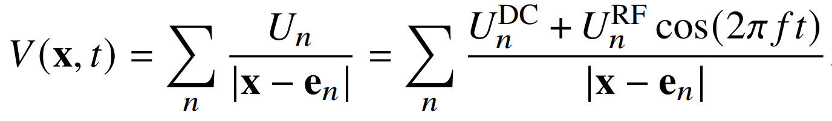
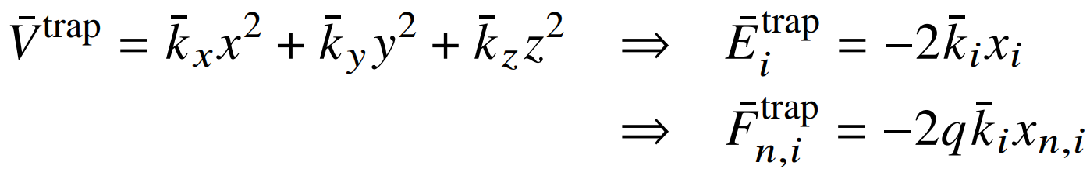
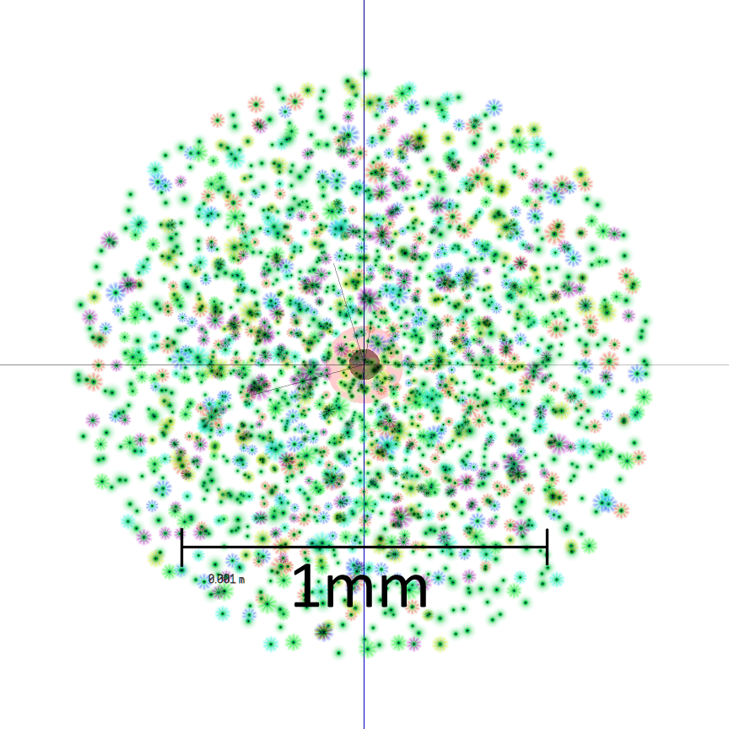
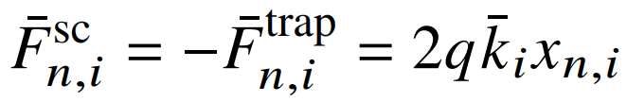
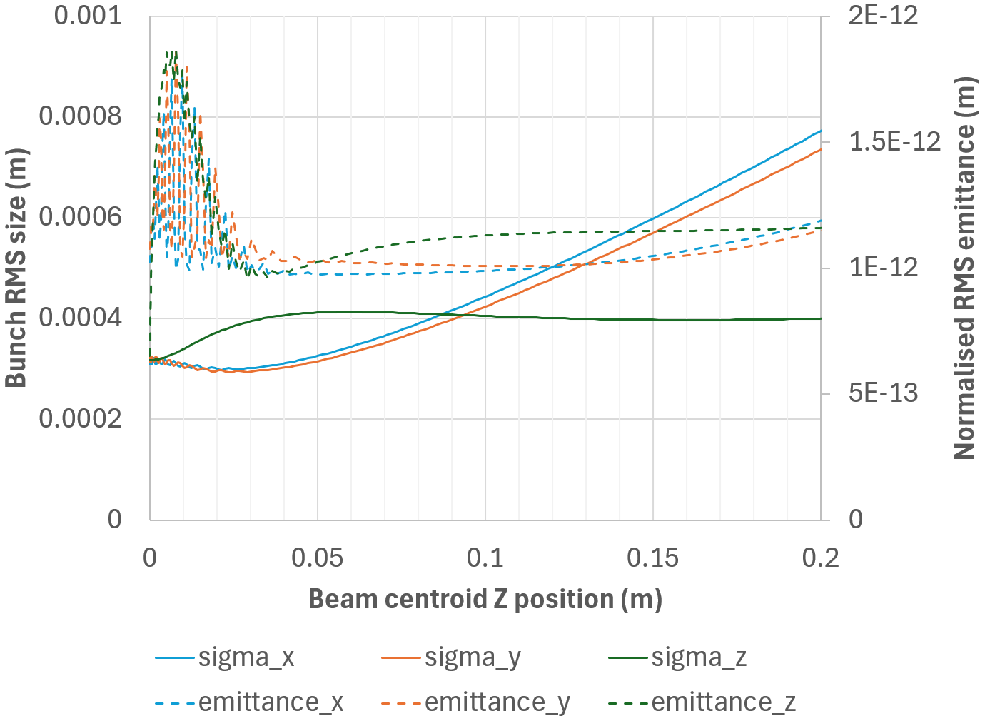


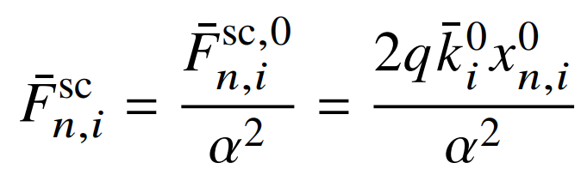
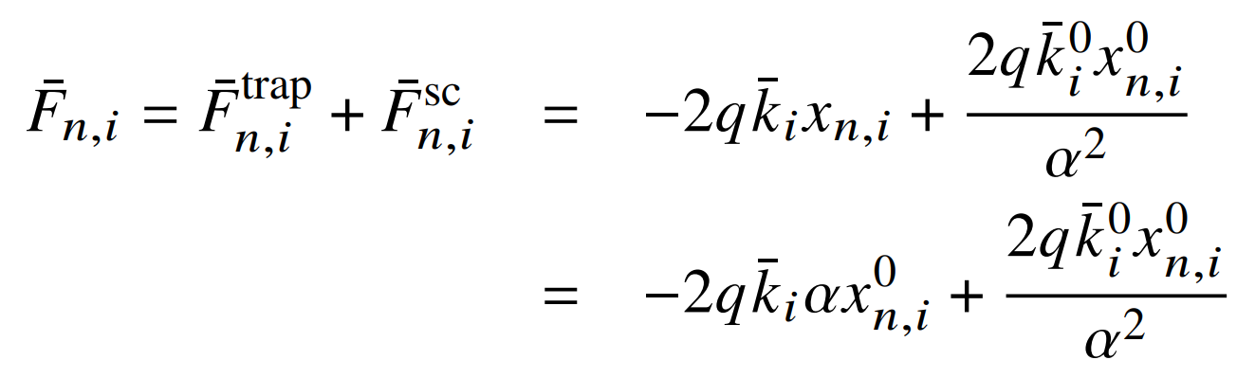
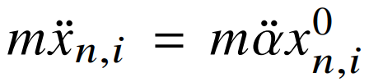
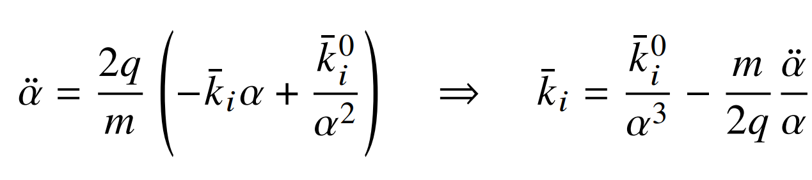
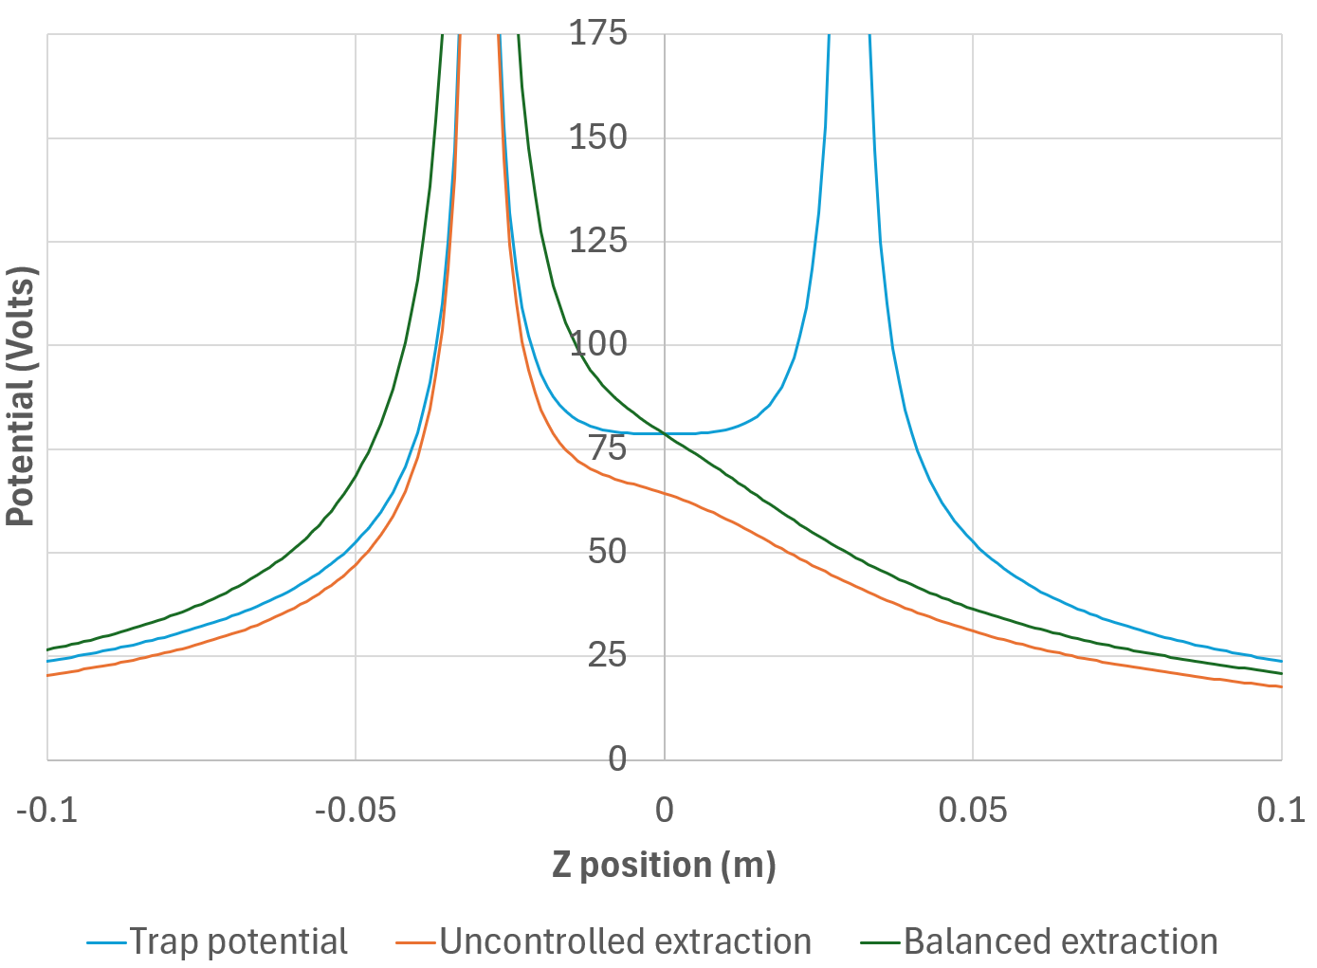
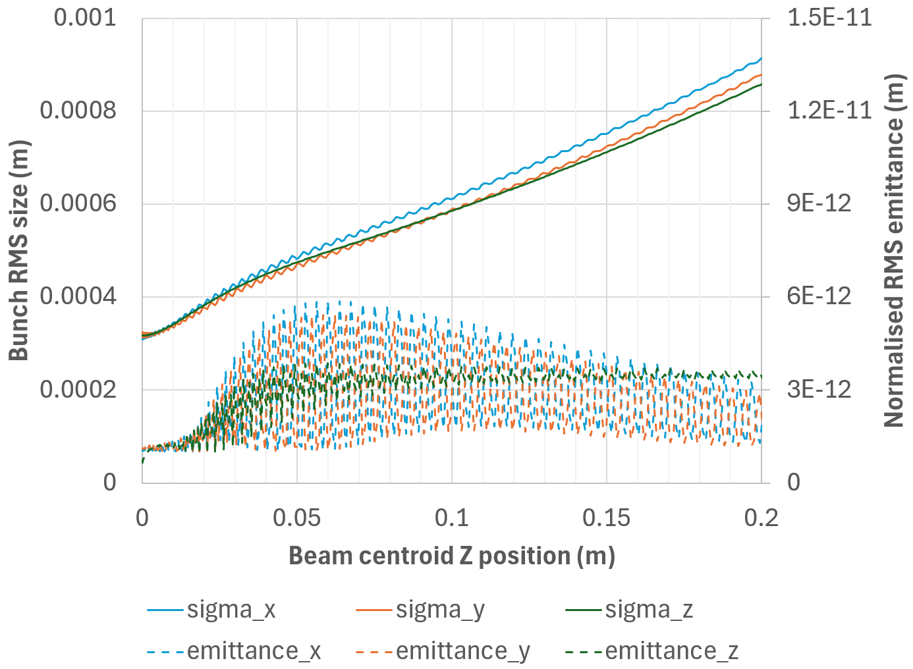
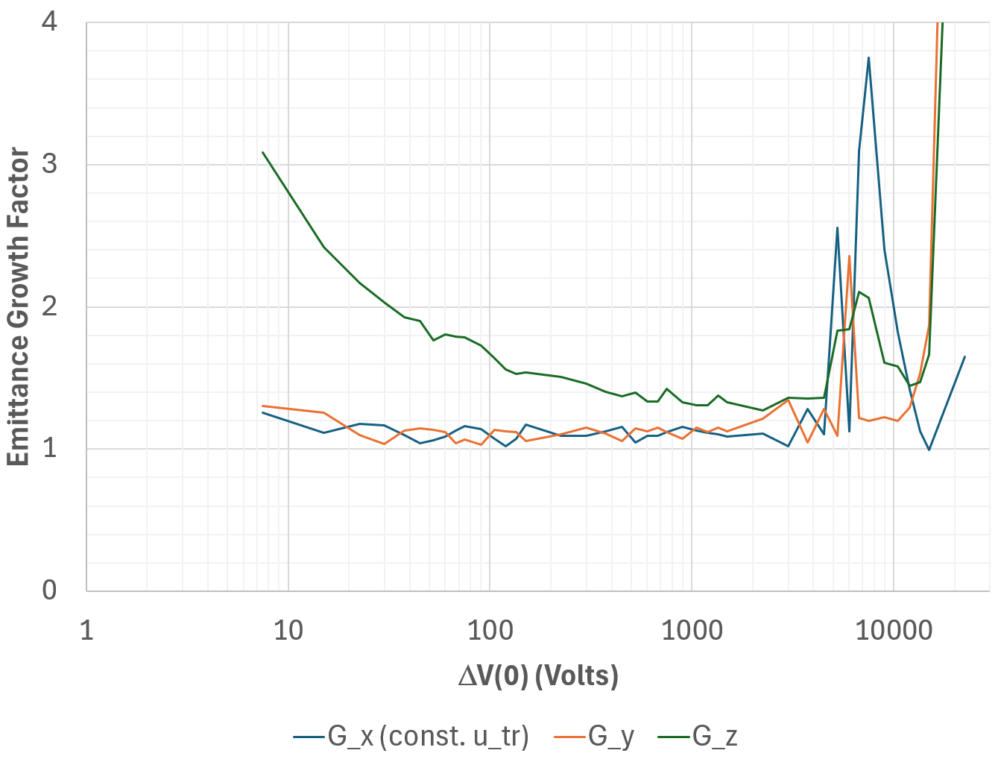
Extraction of Coulomb Crystals with Limited Emittance Growth
S.J. Brooks {sbrooks@bnl.gov}, Brookhaven National Laboratory, Upton, NY, USA
Abstract
Laser Doppler cooled ion traps can produce stationary bunches of ions with extremely low velocity spread (0.6m/s RMS) and emittance (10⁻¹³m normalised). This corresponds to temperatures of a few milli-Kelvin and allows the ions to settle into a fixed lattice analogous to a solid crystal, but with the Coulomb repulsion balanced by the trapping force, rather than a chemical bond. Extraction of such a bunch into a beamline could provide a new regime of ultra-low emittance beams if the emittance is preserved through the extraction operation. This paper shows that extraction from the ion trap and initial acceleration does not cause drastic growth, thus preserving the ultra-low emittance nature of the bunch. Techniques for compensating coherent `emittance growth' effects such as nonlinear bunch distortion are also investigated.
Paul Trap Field Model
Simple six point electrode model, f=2MHz.
Extraction Methods
The simplest method is uncontrolled extraction where U_{+z} is set to zero for t ≥ t_{extract}. The beam will pass through e_{+z} but not encounter a field singularity.
Balanced extraction is also considered, which sets U_{+z} to zero while simultaneously doubling U_{-z}. This has the advantage of keeping d²V/dz² the same before and after t_{extract}.
Trap potential along the z axis before and after extraction, for two different methods.
Coulomb Crystal
Coulomb crystal of 2000 ⁴⁰Ca⁺ ions in the simulation before extraction.
Analytic Formula for Zero Emittance Growth
Bunch size and emittance during balanced extraction with unlimited u_{tr} AM modulation and ΔV(0)=15V.
Uncontrolled Extraction
Emittance growth factors, with and without AM modulation of transverse RF focussing.
Balanced Extraction
Improved emittance growth factors, with and without AM modulation.
Bunch size and emittance during balanced extraction with optimal DC bias and no AM.
Increasing Voltage
Varying bias voltage with balanced extraction, u_{lg} set to 0.00072ΔV(0) and u_{tr} set to maintain a spherical Coulomb crystal (no modulation).
Shell structure seen in
f = 10MHz, T = 1.6mK crystal (above), but washed out in f = 2MHz, T = 4.7mK crystal used here (below).
Best result: ΔV(0) = 75V, no modulation, G_{x,y,z} = (1.10,1.02,1.74)
Crystal at equilibrium with its own space charge over an RF cycle
U^{DC}
U^{RF}
r_{trap} = 3cm
+y
Effective linear external focussing force
-z
+x
+z
DC bias ΔV(0) = 6u_{dc}/r_{trap}
→ Space charge force is also linear
-x
Assume extracted bunch scales equally in all axes
-y
Inverse square law
x⁰ was original crystal, linear force
F=ma
Choose external focussing force to maintain uniform scaling
Can be done with amplitude modulation (AM) of RF for the transverse trap electrode strength u_{tr}
Best result: ΔV(0) = 1500V, G_{x,y,z} = (1.09,1.12,1.33)

