Slide 1
CBETA Magnet 1301, Survey etc.
First girder BD1

Slide 2
Last Weeks
Christmas week: found top and bottom pairs of tuning wires were touching
Caused high harmonic noise
Redesigned 105mil shim holder to fix problem
Last week only 1 day of measurement
Found sometimes the shim holder was rolled in the magnet by 1-2mm
Now being more careful about checking placement

Slide 3
BD1 History, some R&D

Slide 4
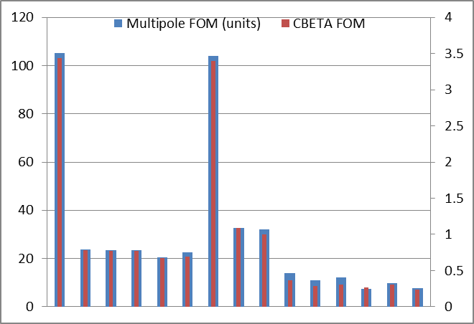
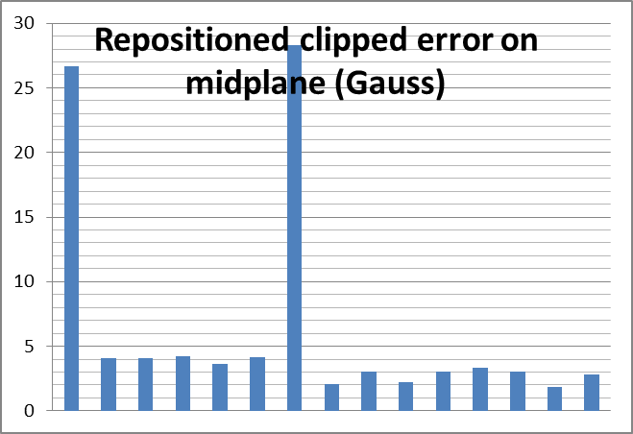
BD1 FOMs Evolution

Slide 5
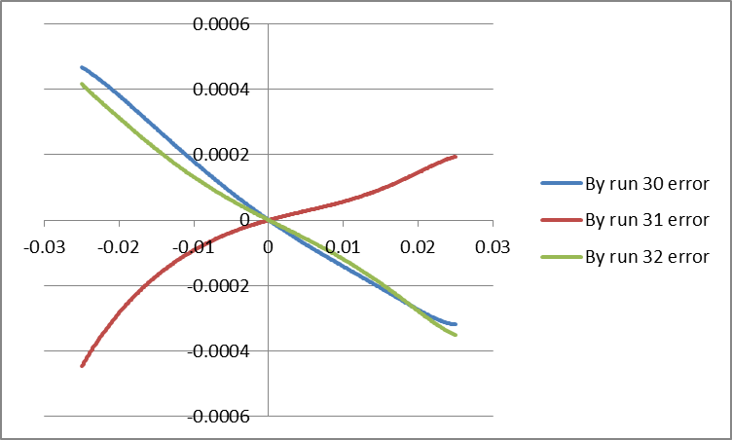
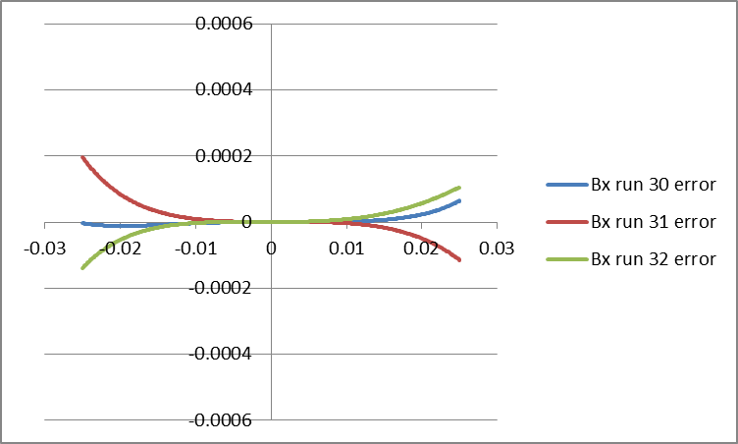
BD1 Error Fields Run 30, 31, 32
Strength keeps flip-flopping around by ~0.1%
Iteration isn’t improving it any further

Slide 6
All FG Magnets Status
Magnet name | Max error on midplane* (Gauss) | Quad strength error | Multipole sqrt(sumsq) (units) | CBETA FOM | Notes | Run #
BD1 (rb) | 2.84 | -0.103% | 7.64 | 0.239 | After R&D | 32
BD2 | 2.63 | -0.196% | 19.28 | 0.539 | 105mil wire | 8
BD3 (rb) | 0.98 | +0.030% | 9.05 | 0.265 | New iter 2 | 15
BD4 | 1.03 | +0.045% | 11.62 | 0.167 | New iter 3 | 9
QF1 | 1.82 | -0.036% | 6.18 | 0.118 | New iter 2 | 6
QF2 | 1.06 | -0.047% | 7.22 | 0.110 | New iter 1 | 34
QF3 (ra) | 0.94 | -0.006% | 10.26 | 0.226 | New iter 2 | 20
QF4 (ra) | 1.35 | +0.068% | 6.48 | 0.200 | New iter 1 | 5
BDH** | 0.32 | +0.005% | 5.50 | 0.158 | Iter 3 | 5
* New definition with retuned position ** Upside-down, needs resurvey
(rb) = rebuilt, (ra) = reassembled from halves

Slide 7
Survey Data and Software
A sample run of survey data in BMAD/L0E frame was sent to Cornell
Generally happy with the format
David Burke will check the fiducials look OK on CAD model
Still need a couple more features
Optimised magnet positioning
Compensate for Earth’s magnetic field on BNL coil

Slide 8
Next Week
Tue: BD1 E4E survey if accepted?
Wed: BD2 tuning
Thu: BD2 survey
Fri: BDH remeasure and resurvey, final E4E
I’ll continue to develop survey software

